Slide 1
AP Lit Pechakucha
Annie Cunningham

Slide 2
The Beginning

Slide 3
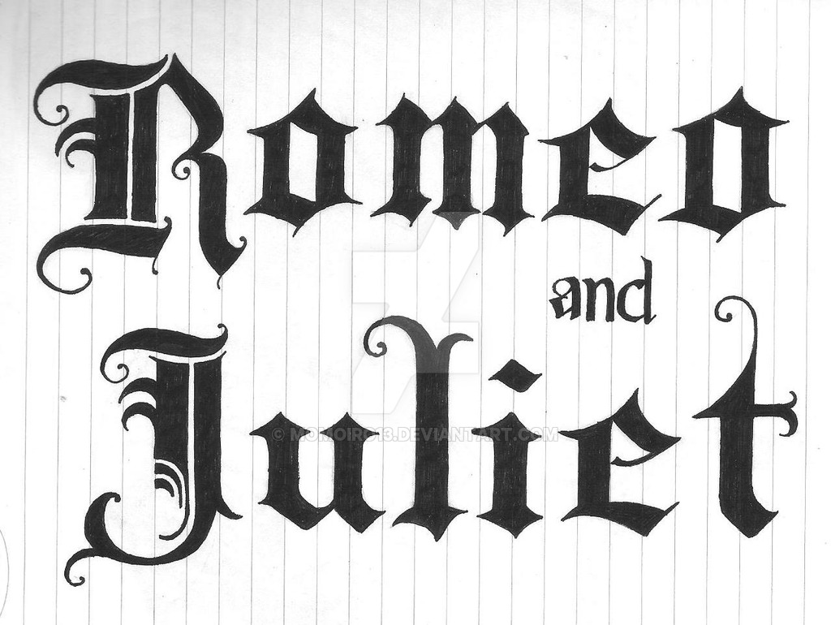
Literal Comprehension
Text details

Slide 4
Figurative Author’s Craft
ATR

Slide 5
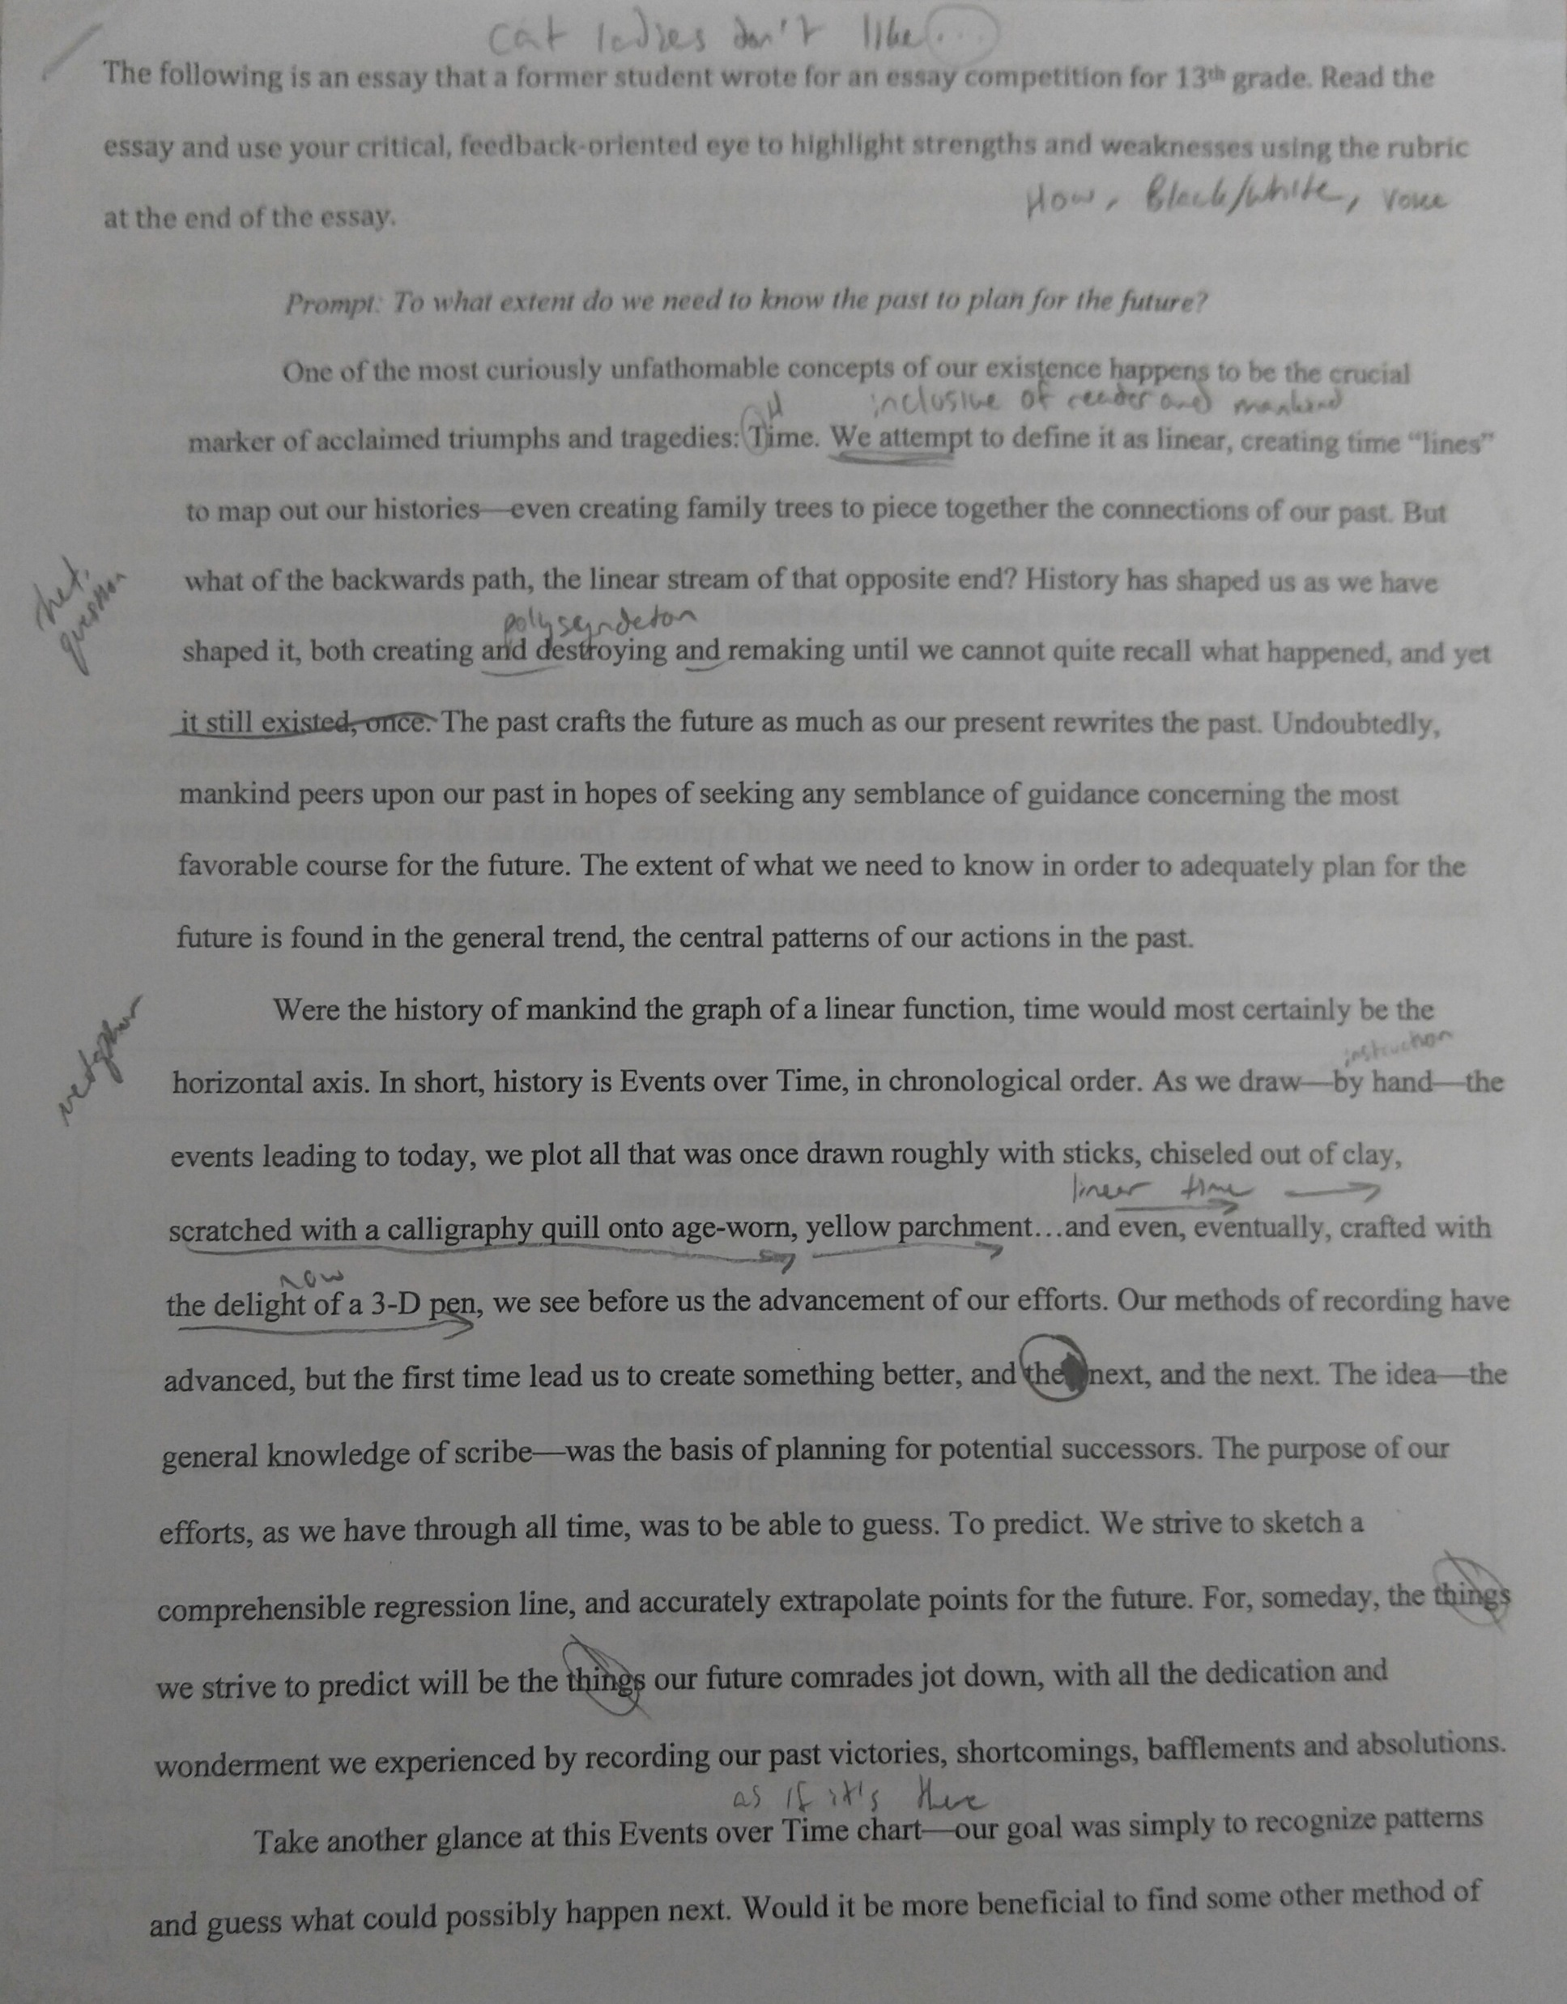
Black and White Conventions
Essay competition

Slide 6
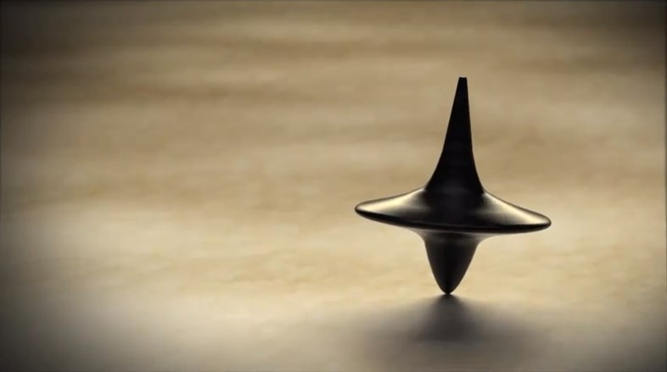
Colorful Authorship
Lit device-ception

Slide 7
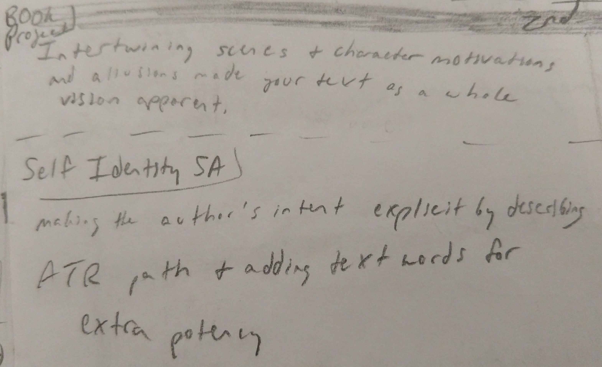
Text as a Whole
Theme

Slide 8
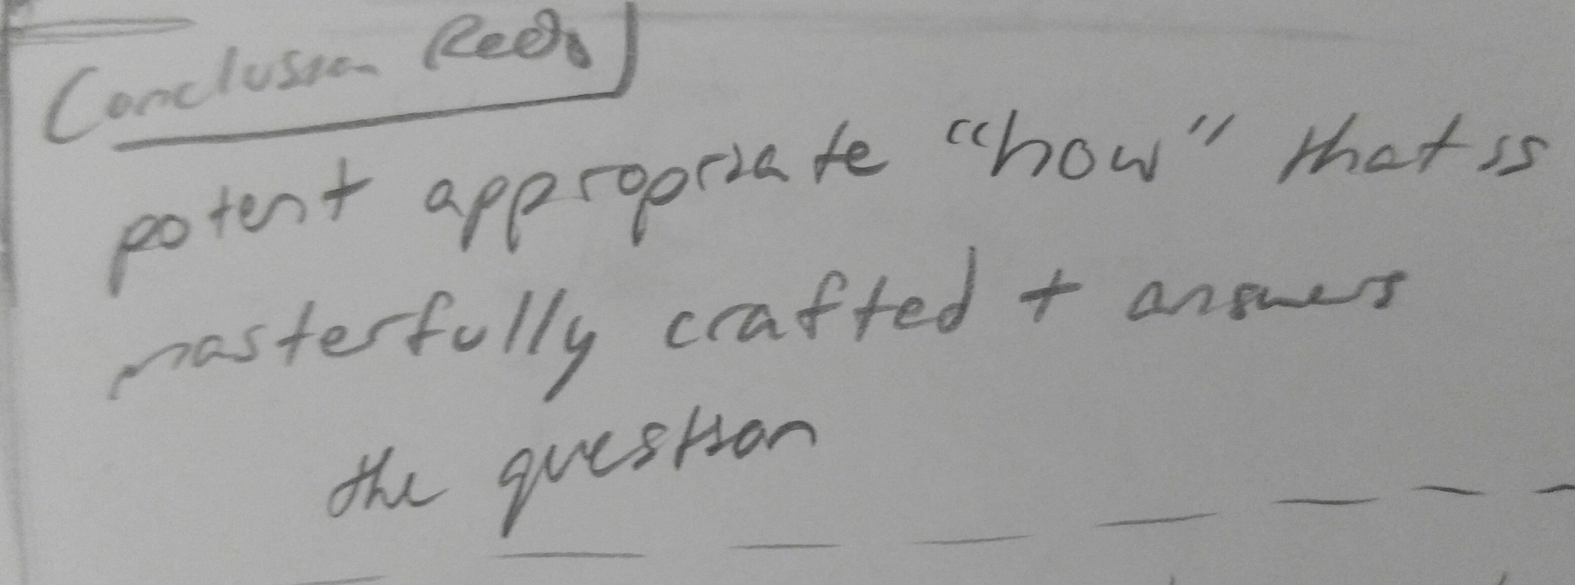
HOW
Feedback

Slide 9
Accomplishments
Author Papers

Slide 10
Accomplishments
Our Town Summative
HOW

Slide 11
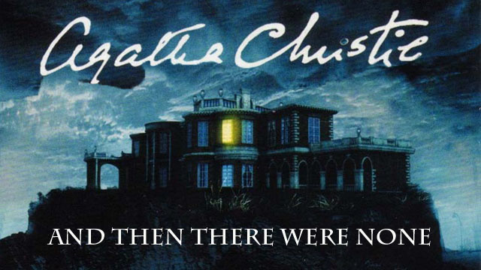
Accomplishments

Slide 12
Overall accomplishment : A

