Slide 1
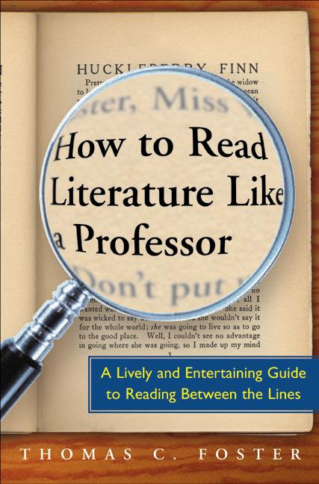
Chapter 8: Hanseldee and Greteldum
By: Stephen Kline

Slide 2
Main Points
All literature grows from previous literature
Making references that everyone understands is hard
Fairytales are most widely known

Slide 3
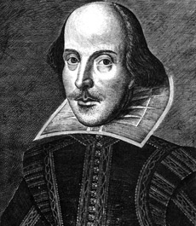
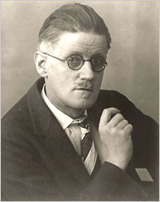
Common References
Homer- not as popular
Shakespeare- overused
“… quotes are like eligible persons of the other sex: all the good ones are taken.”
James Joyce- too complex
T.S. Elliot- secondhand quotes

Slide 4
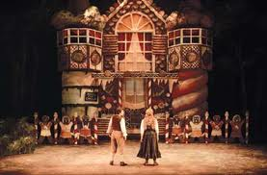
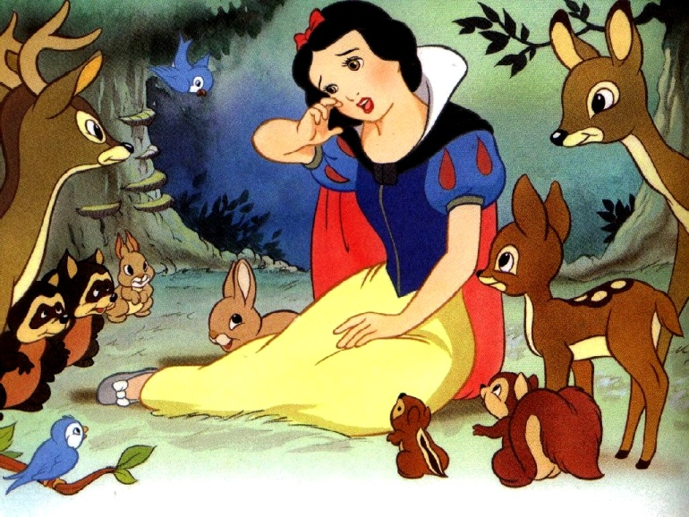
Children’s Stories
Easy to build off of
More basic than other literature
Widely known

Slide 5
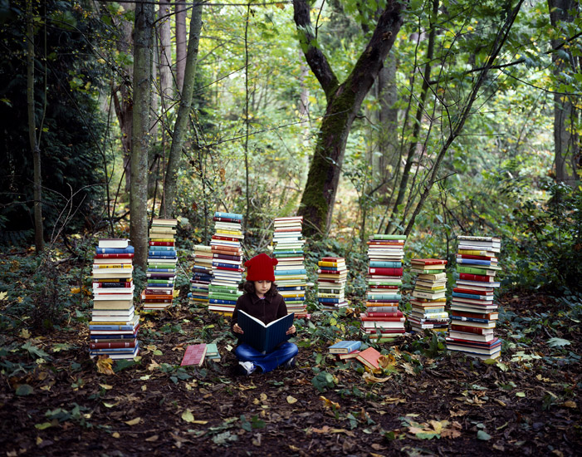
What This Means to You
Keep track of the pieces referenced
Ask why the author would use that comparison

