Slide 1
Oedipus’s Different Locations
By: Carol Fons
1st Hr.

Slide 2
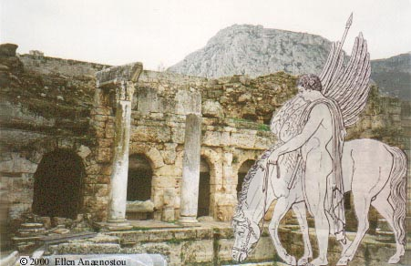
Corinth
Corinth was positioned on the Isthmos which was a canal and because of this, was controlling the communication of Peloponnese with the mainland Greece. It was this position that made this city the richest commercial city of ancient Greece.

Slide 3
Corinth Today
Corinth is 48 miles from Athens. There are a lot of ruins to go look at like the Temple of Aphrodite and Apollo as well as a sacred spring, and fountains, but that doesn’t sound all that much fun to me, but what ever floats your boat.

Slide 4
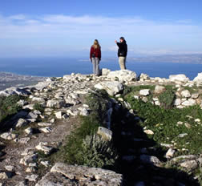
Temple of Aphrodite
This is what is left of the temple. Supposedly this is a real hot spot not sure why it is a bunch of rocks.

Slide 5
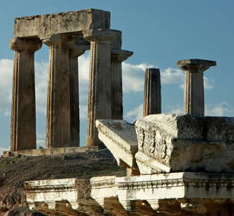
Temple of Apollo
At least this one is still standing. Nice craftsmanship on this one.

Slide 6
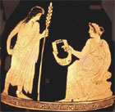
Apollo and a Muse
Apollo and a Muse and this is on some kind of pot they didn’t say what kind, but they did say that the muse it playing a lyre probably because Apollo is the God of sun and music.

Slide 7
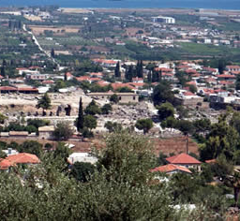
Modern Day Corinth
This is what Corinth looks like today. As we can see it is still populated.

Slide 8
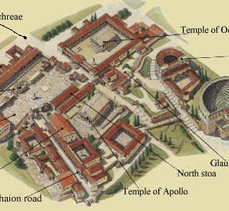
A Somewhat Picture of Ancient Corinth
This is a picture of what ancient Corinth. Sorry for the bad picture.

Slide 9
Was Corinth in anyother Greek Literature?
Yes Corinth was mentioned in a poem called The Cranes of Ibykos also Homer mentions Corinth a few times.

Slide 10
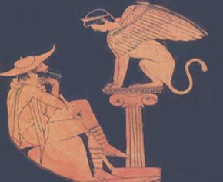
Thebes
The birth place of legendary hero Hercules and men of importance like Pindar and Epameinondas, played a major role in the affairs of Greece, from its early history as the many legends of the city testify.

Slide 11
Thebes Today
Thebes today is a modern day city just outside Athens which makes it very hard to find any pictures because they are all from Athens or Egypt.

Slide 12
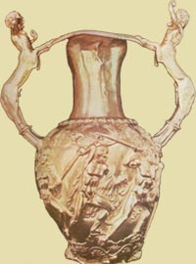
Was Thebes in anyother Greek Literture?
Well yes it was Homer mentions it in the Odyssey, it is also mentioned by the people who wrote about all the Kings and the battles that went through Thebes.

Slide 13
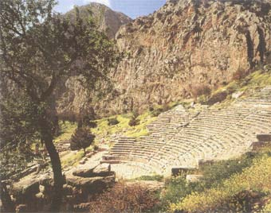
Delphi
Above the Gulf of Corinth, in the holy Mountain, surrounded by a forest of pines, lay the shrine of the God Apollo, Delphi. For many centuries the voice of Delphi, the most important sanctuary, was the absolute guiding power to the Greeks. People as well cities visited it in order to get answers and guidance for their future and destiny. Delphi also influenced education and literature.

Slide 14
Delphi Today
Delphi is 2.5 hours drive away from Athens. While there you can stay in a hotel close to the ruins right in the modern town of Delphi. The museum has a lot of art work and statues in it, but you can also go and see the ruins and temples also the theater.

Slide 15
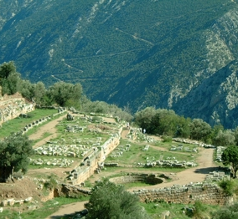
View of the Sanctuary of Athena
What a great view isn’t it? All I see is rocks. No not really I think this looks really cool.

Slide 16
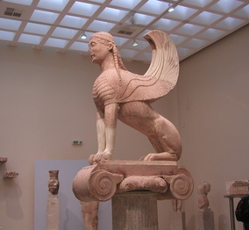
Museum
This is a picture in side of the museum of a winged sphinx.

Slide 17
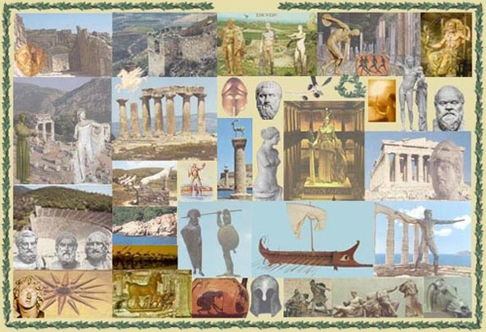
Was Delphi in anyother Greek literatre?
Yes because there is so much known about Delphi. Someone wrote about the oracles and when the Persians attacked the temples.

Slide 18
Work Cited
Papakyriakou/Anagnostou, Ellen (1997). Ancient Greek Cities. Retrieved February 23, 2008, from Corinth Web site: http://www.sikyon.com/Korinth/korinth_eg.html
Papakyriakou/Anagnostou, Ellen (1997). Ancient Greek Cities. Retrieved February 23, 2008, from Thebes Web site: http://www.sikyon.com/Thebes/thebes_eg.html
Papakyriakou/Anagnostou, Ellen (1997). Ancient Greek Cities. Retrieved February 23, 2008, from Delphi Web site: http://www.sikyon.com/Delphi/delphi_eg.html
(2005-08). Sacred Destinations. Retrieved February 23, 2008, from Delphi Web site: http://www.sacred-destinations.com/greece/delphi.htm
(2005-08). Sacred Destinations. Retrieved February 23, 2008, from Corinth Web site: http://www.sacred-destinations.com/greece/corinth.htm

