Slide 1
Annaliess Kielman
AP Lit & Comp
Final Grade
Determination

Slide 2
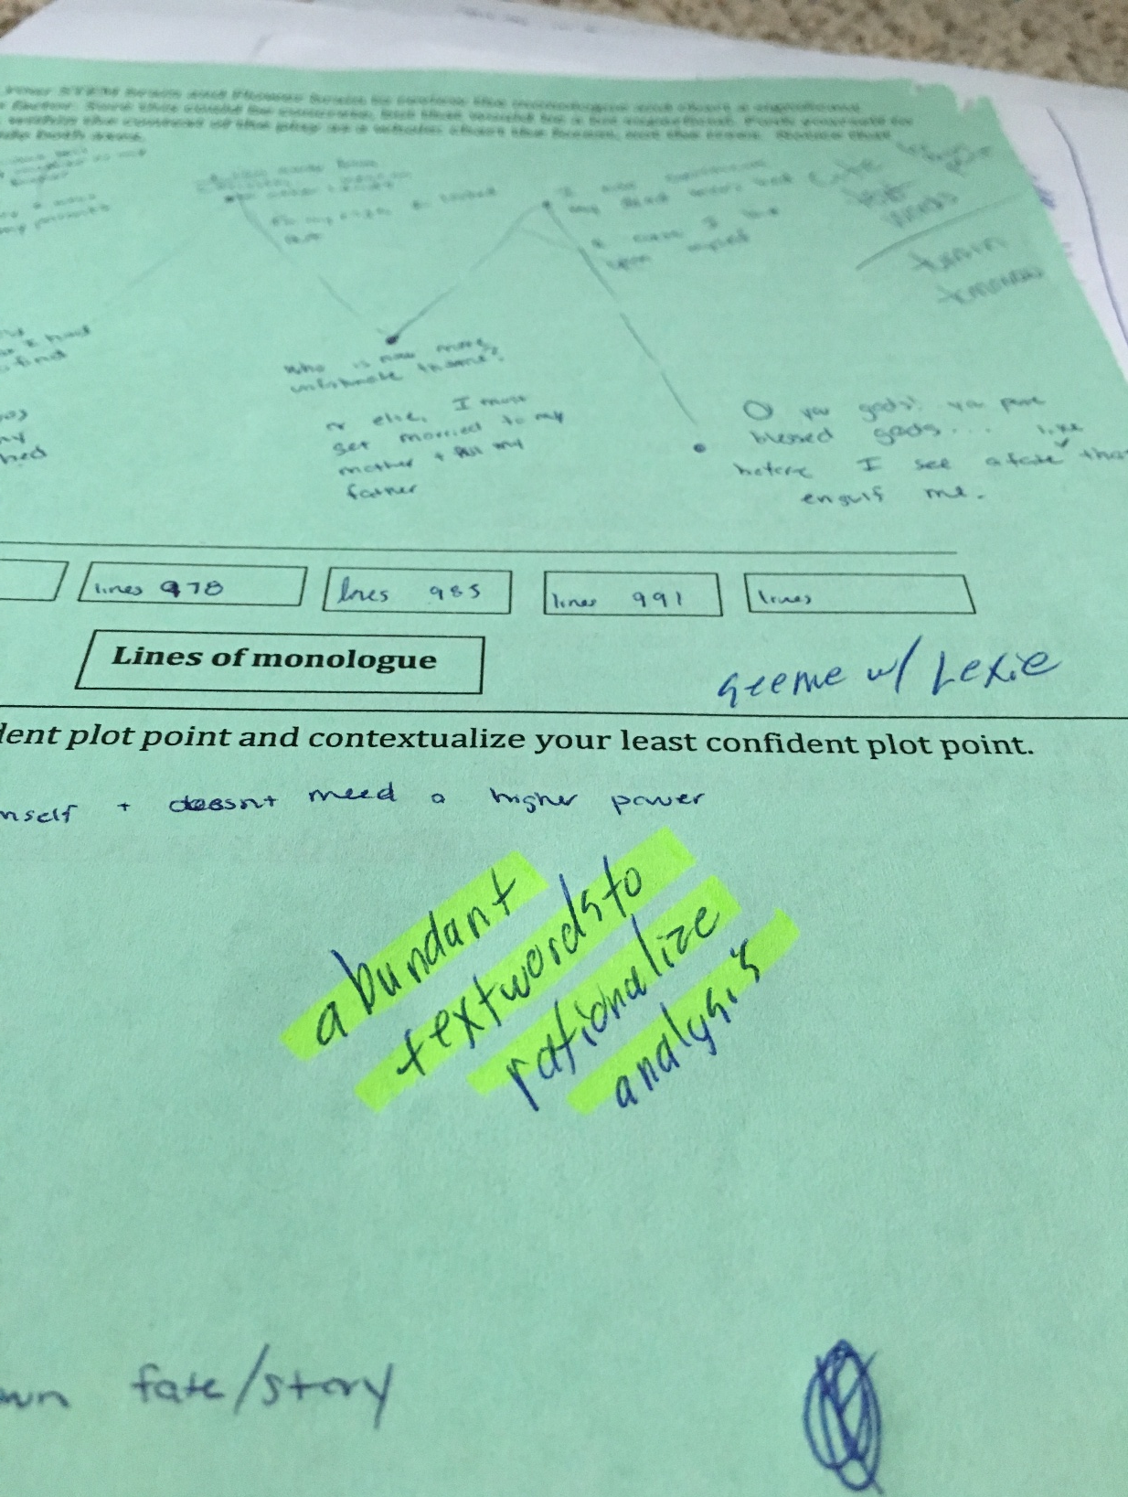
Past Work
Literal, Figurative, TAW

Slide 3
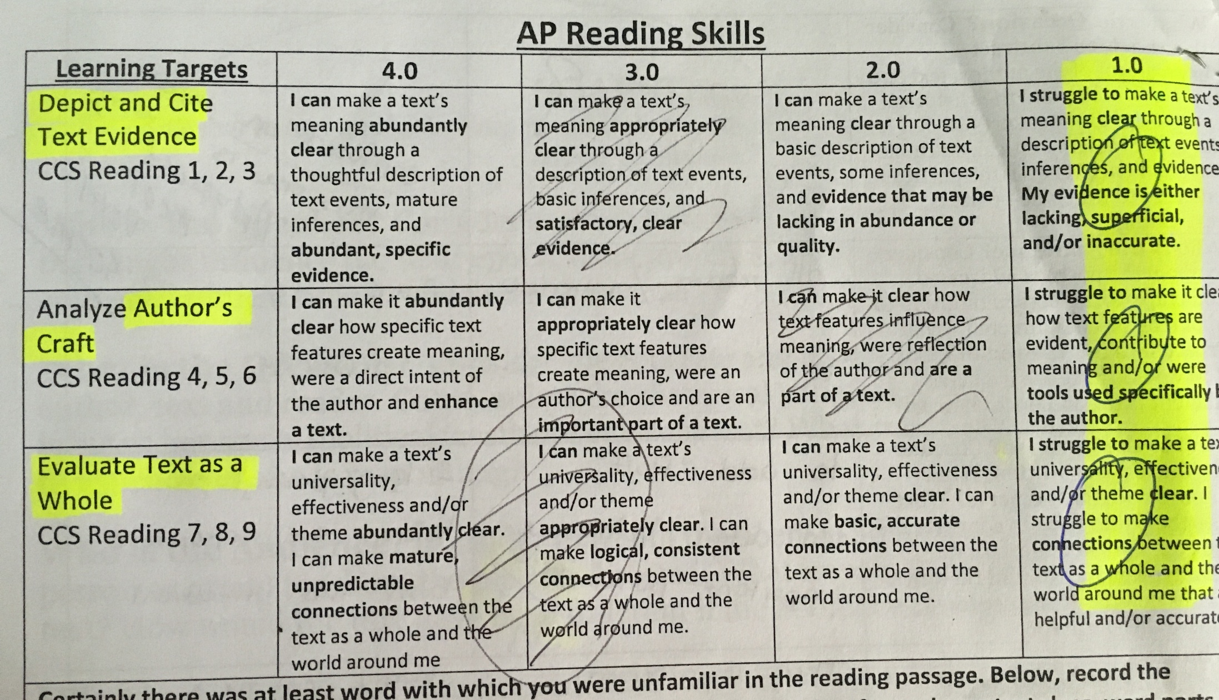
Literal
Figurative
Past Work
Text as a Whole

Slide 4
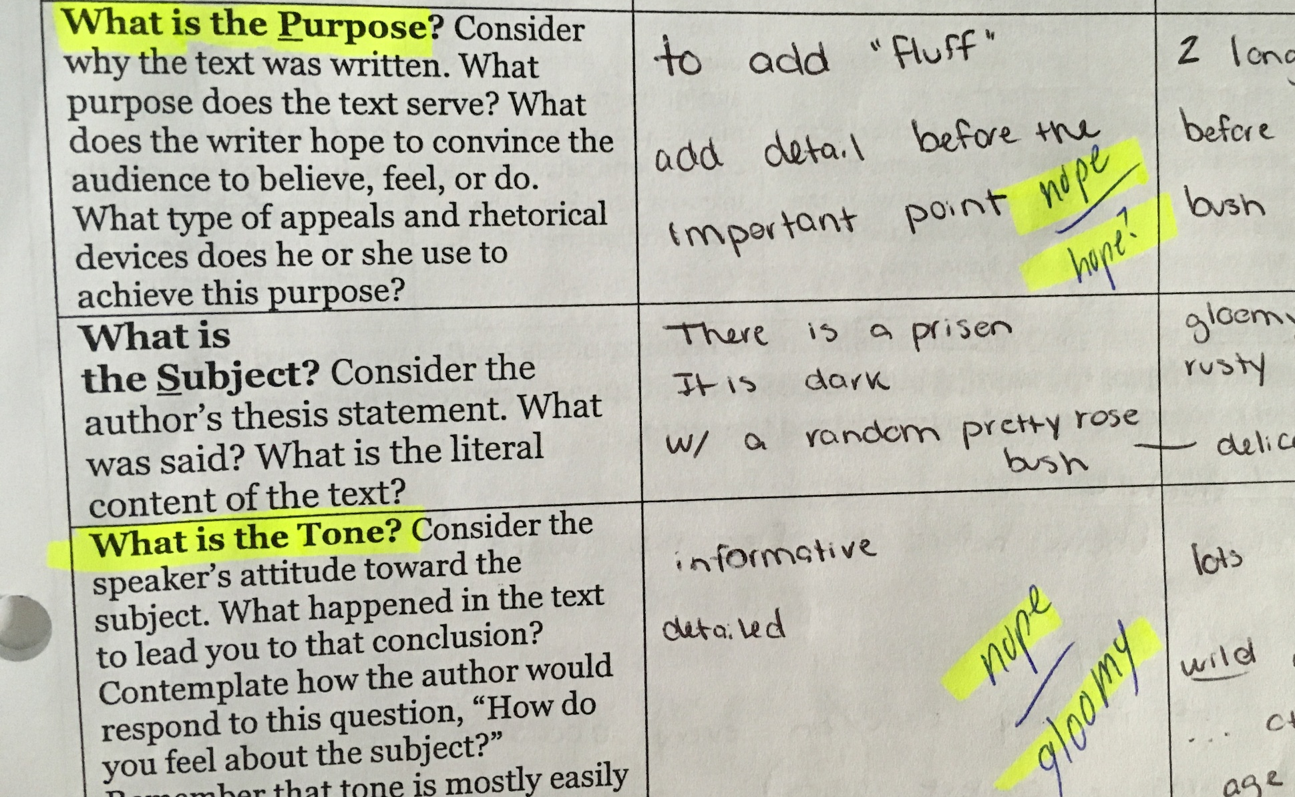
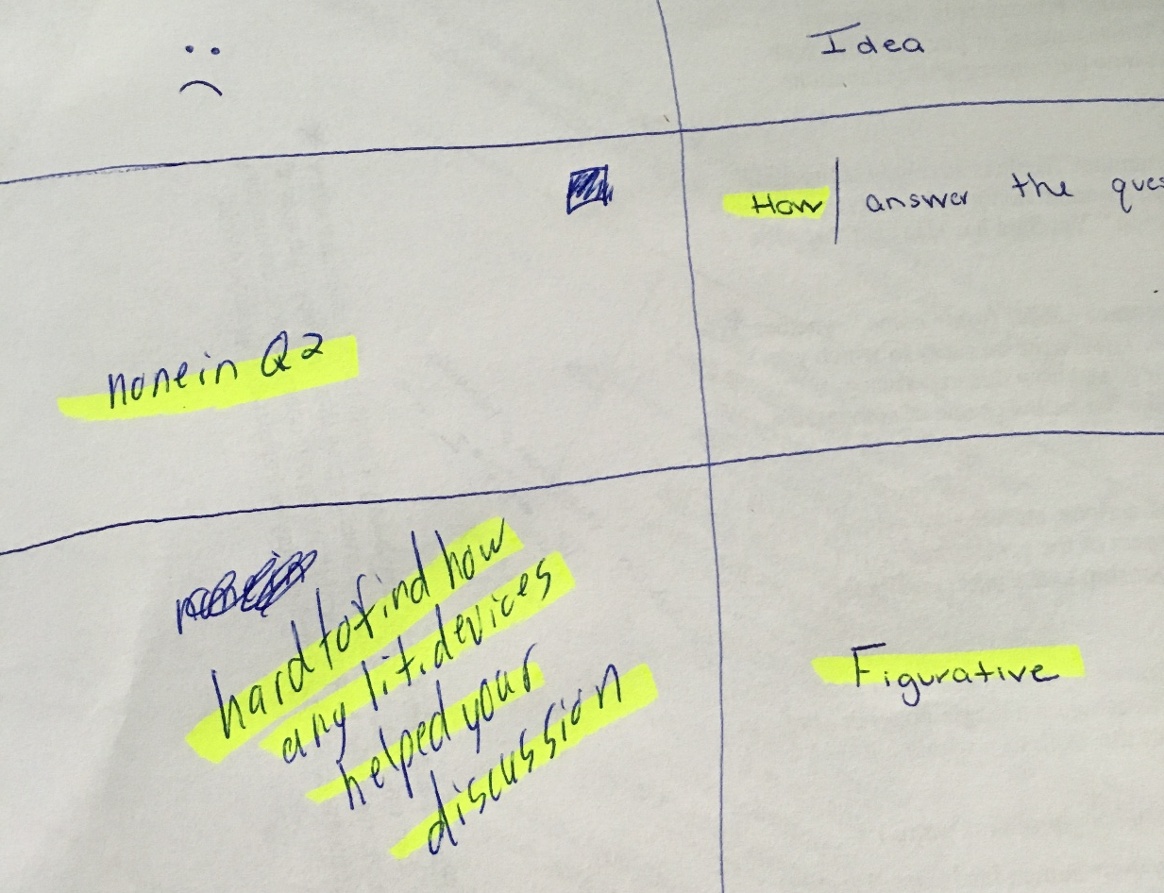

Slide 5
Current Work
Literal, TAW, Figurative

Slide 6
Current Work
Literal, TAW, Figurative

Slide 7
Past Work
B&W, Color, HOW

Slide 8
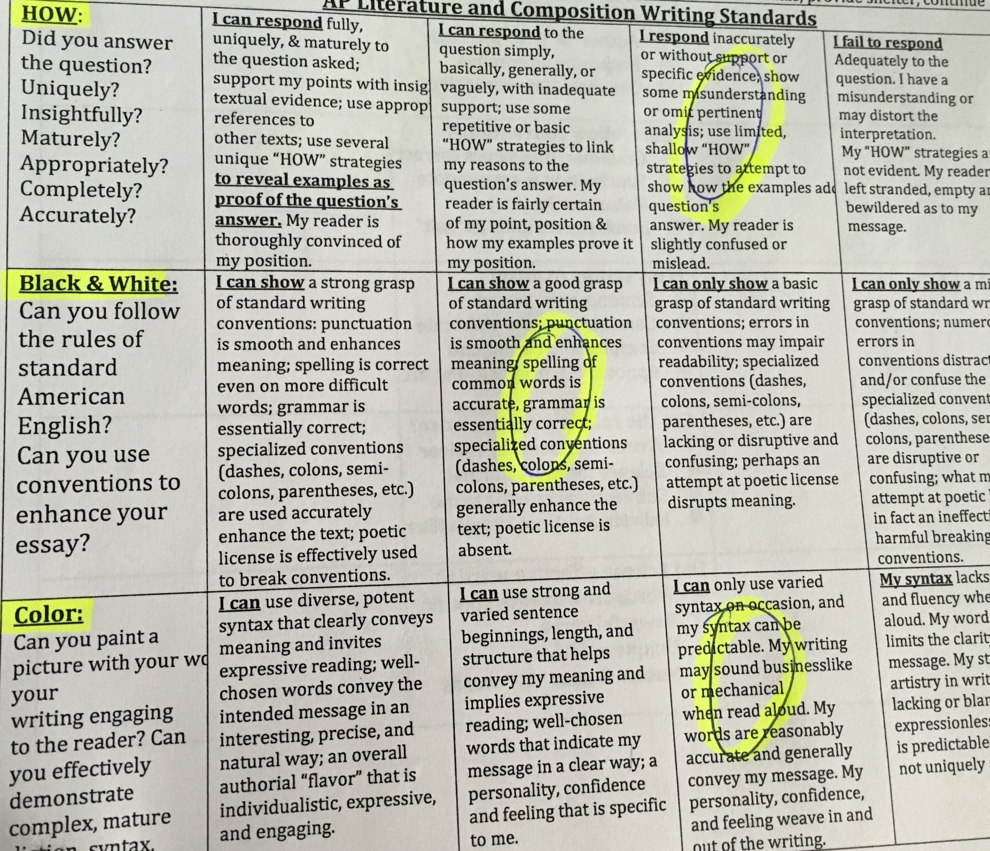
HOW
B&W
Color

Slide 9
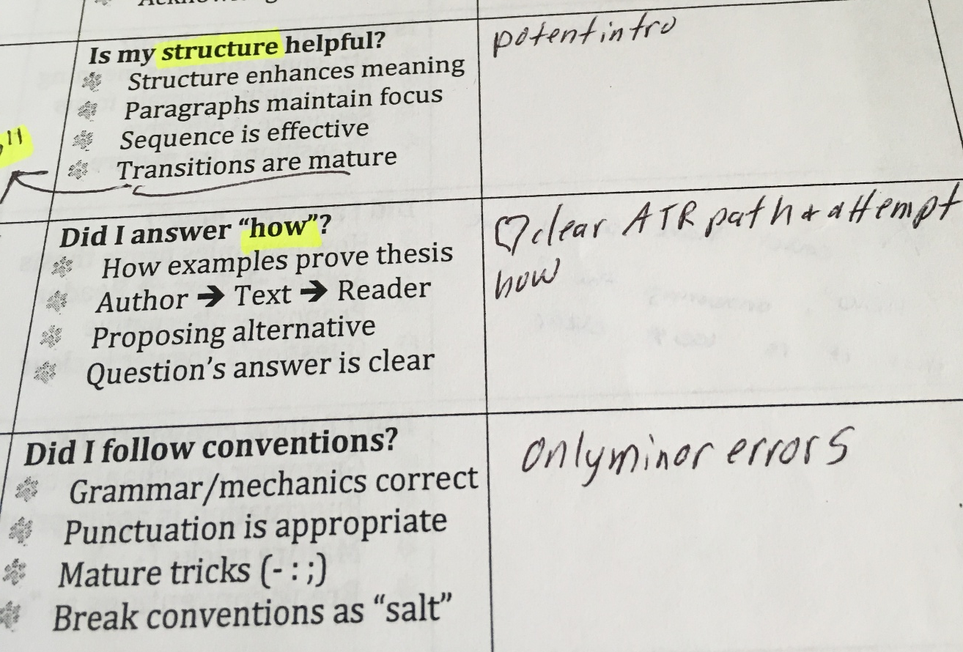
B&W, HOW, Color: Past

Slide 10
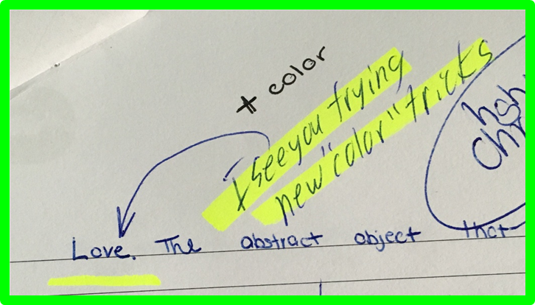
Current Work
B&W, Color, HOW

Slide 11
Final Feedback

Slide 12
Final Letter Grade:
“A”
because….

