Slide 1
Welcome to your favorite part of the day
Aric Foster
Stemandflowerlearning.com
stemflowerlc@gmail.com
armadafoster.weebly.com
@aricfoster2
The Right Side of History
One teacher’s ELA journey through the SBL

Slide 2
Question #1:
How many years have I been teaching?

Slide 3
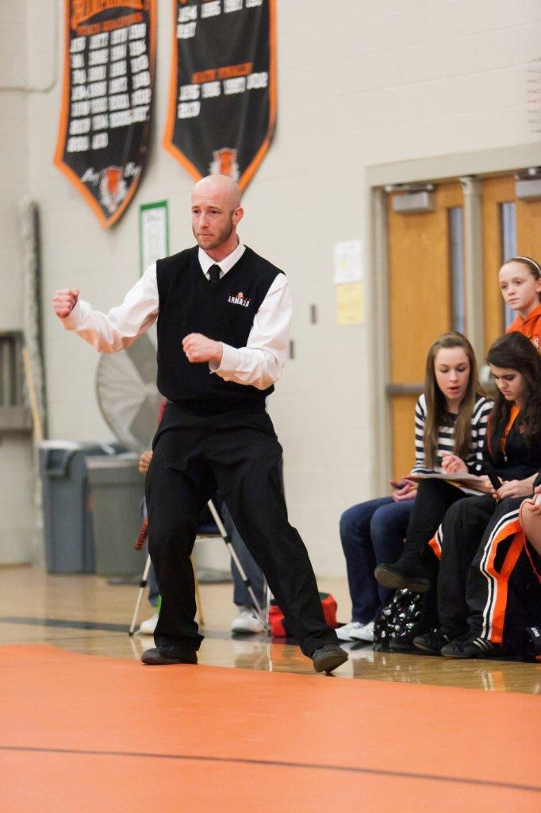
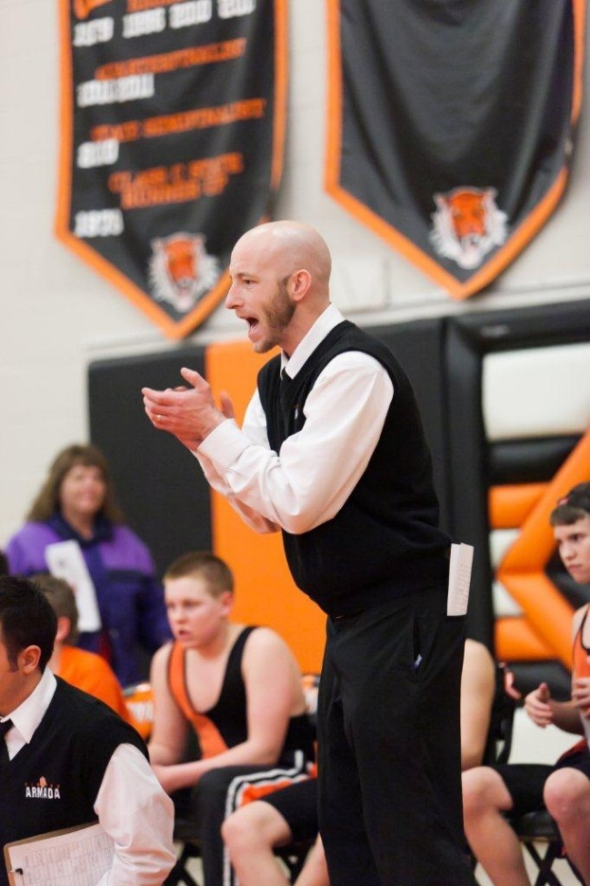
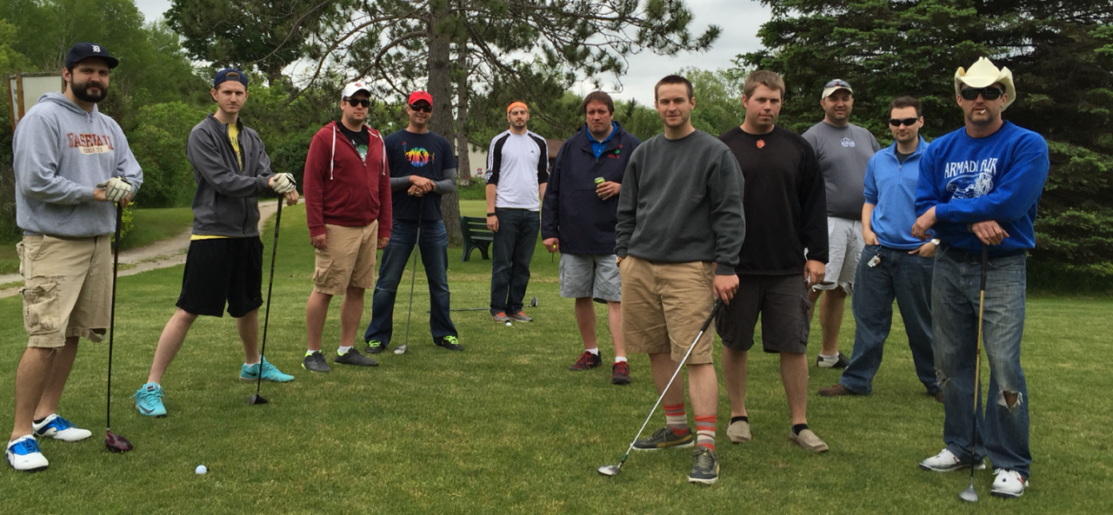
Currently year 15
in Armada
English 11,
AP Lit/Comp,
Coaching:
wrestling, track

Slide 4
Question #2:
How many times have I consulted about Standard Based Learning?

Slide 5
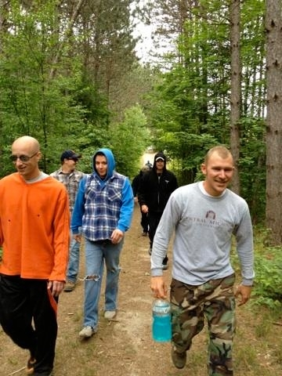
Answer #2:
10, SBL 6 years, TTOG
2 years, “normal” teacher

Slide 6
Question #3:
How many children do I have?

Slide 7
Answer #3:
One perfect child:
Aric Victor
3 years old

Slide 8
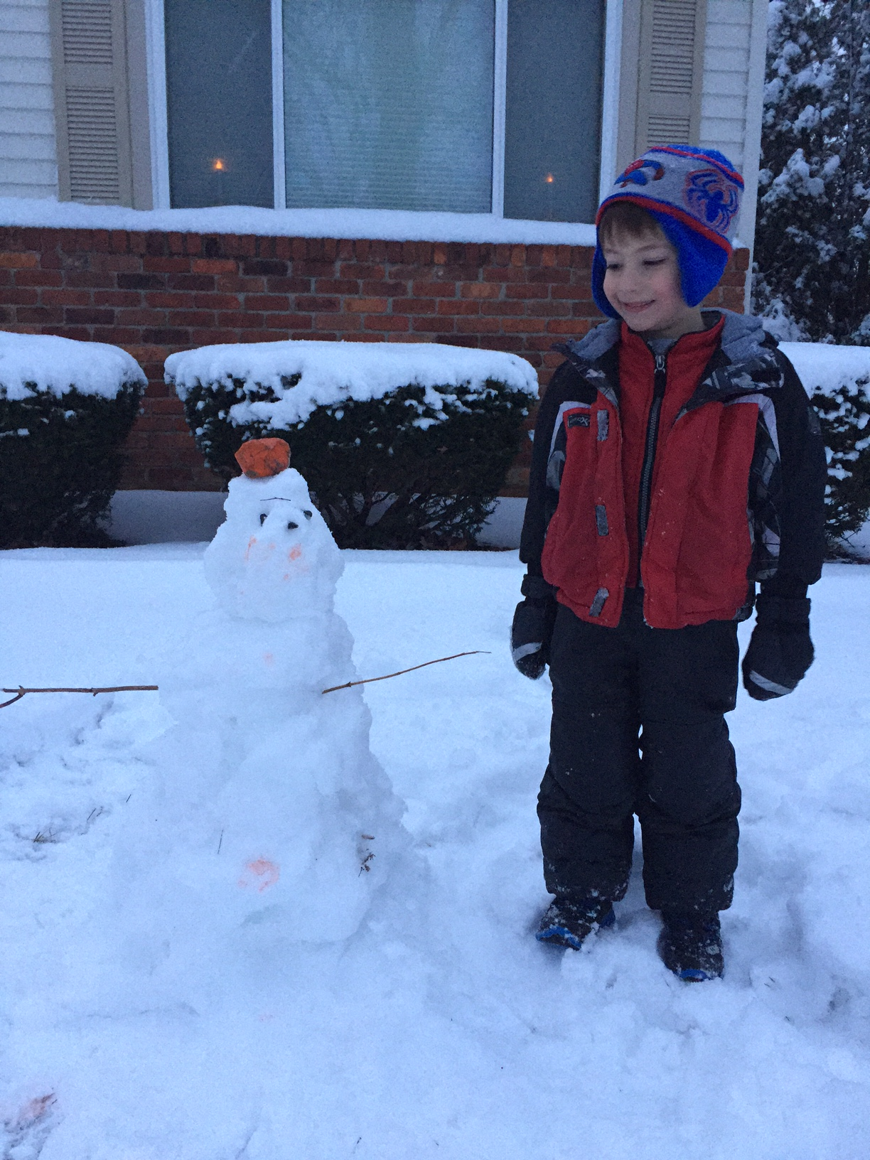
Why did I do this?
“Missy O.” &
“Jake D.”
“Students” vs. “Learners”

Slide 9
Standards Based Learning Key Components
Separate proficiency from behavior
Standards are synthesized from Common Core & tests
Redo/retakes for full credit
100% summative and 0% formative to calculate final grade; formatives are just practice & don’t need scores.
Tons of timely, narrative, descriptive, standard-referenced feedback.
Group work is not graded for individual’s proficiency mark
Late work accepted to mimic the “Real World”
Culture eats strategy for breakfast

Slide 10
How do we really know what our kids know?
Teaching 101 Path:
Standards ➔ Activities ➔ Assessment
Teaching 2.0 Path:
Standards ➔ Assessment ➔ Activities

Slide 11
Teaching 2.0 Path: Standards ➔
What Aric did:
Highlighted CCSS for Endurance (job), Leverage (other classes) and Readiness (next level)

Slide 12
Teaching 2.0 Path: Standards ➔
What Aric did:
Highlighted CCSS for Endurance (job), Leverage (other classes) and Readiness (next level)
Synthesized 10ish standards per trimester

Slide 13
Teaching 2.0 Path: Standards ➔
What Aric did:
Highlighted CCSS for Endurance (job), Leverage (other classes) and Readiness (next level)
Synthesized 10ish standards per trimester
Revised each grading period based on proficiency
Main ideas + details = Comprehension
No infer third trimester
Put diction in first trimester
10 is too many, ideally closer to 6

Slide 14
How do we really know what our kids know?
Teaching 2.0 Path:
Standards ➔ Assessment ➔ Activities
Look at pages 1-4 (Learning Targets Matrix) and compare/contrast it to your work.

Slide 15
How do we really know what our kids know?
Teaching 101 Path:
Standards ➔ Activities ➔ Assessment
Teaching 2.0 Path:
Standards ➔ Assessment ➔ Activities

Slide 17
Teaching 2.0 Path: Standards ➔ Assessment
What Aric did:
Made standards in June & summative in July

Slide 18
Teaching 2.0 Path: Standards ➔ Assessment
What Aric did:
Made standards in June & summative in July
Summative performance task measuring all standards. See pages 5-11

Slide 19
Teaching 2.0 Path: Standards ➔ Assessment
What Aric did:
Made standards in June & summative in July
Summative performance task measuring all standards. See pages 5-11
Two days in library and a weekend

Slide 20
Teaching 2.0 Path: Standards ➔ Assessment
What Aric did:
Made standards in June & summative in July
Summative performance task measuring all standards. See pages 5-11
Two days in library and a weekend
“Repeat offenders” and Special Education learners = show me all standards

Slide 21
Teaching 2.0 Path: Standards ➔ Assessment
What Aric did:
Made standards in June & summative in July
Summative performance task measuring all standards. See pages 5-11
Two days in library and a weekend
“Repeat offenders” and Special education learners = show me all standards
Revisions = alternative text and writing task. See pages 12-15

Slide 22
How do we really know what our kids know?
Teaching 2.0 Path:
Standards ➔ Assessment ➔ Activities
How clearly do your assessments assess standards?

Slide 23
How do we really know what our kids know?
Teaching 101 Path:
Standards ➔ Activities ➔ Assessment
Teaching 2.0 Path:
Standards ➔ Assessment ➔ Activities

Slide 25
Teaching 2.0 Path: Standards ➔ Assessment ➔ Activities
Formative: “back-filling” learning
If it doesn’t practice what and how kids need to perform on “game day,” don’t do it.
But this activity is really fun…
Teach the standards, not the content
What if I don’t “cover” everything?

Slide 26
Teaching 2.0 Path: Standards ➔ Assessment ➔ Activities
What Aric did:
Reviewed old tasks and modified them to address standards

Slide 27
Teaching 2.0 Path: Standards ➔ Assessment ➔ Activities
What Aric did:
Reviewed old tasks and modified them to address standards
Graphed which standards got addressed in a unit

Slide 28
Teaching 2.0 Path: Standards ➔ Assessment ➔ Activities
What Aric did:
Reviewed old tasks and modified them to address standards
Graphed which standards got addressed in a unit
Amended tasks for equal practice of all standards

Slide 29
Teaching 2.0 Path: Standards ➔ Assessment ➔ Activities
What Aric did:
Reviewed old tasks and modified them to address standards
Graphed which standards got addressed in a unit
Amended tasks for equal practice of all standards
Deleted “Beowulf monomyth” task ☹

Slide 30
How do we really know what our kids know?
Teaching 2.0 Path:
Standards ➔ Assessment ➔ Activities
Look at pages 16-22. How clearly do your formatives “practice” the summative?

Slide 31
Deerfield Exclusive!
How do we assess speaking and listening without “forcing” it or sitting through multiple class days of monotonous, ineffective presentations? How do we encourage our learners to be “producers” and not just “consumers”? See pages 23-24

Slide 32
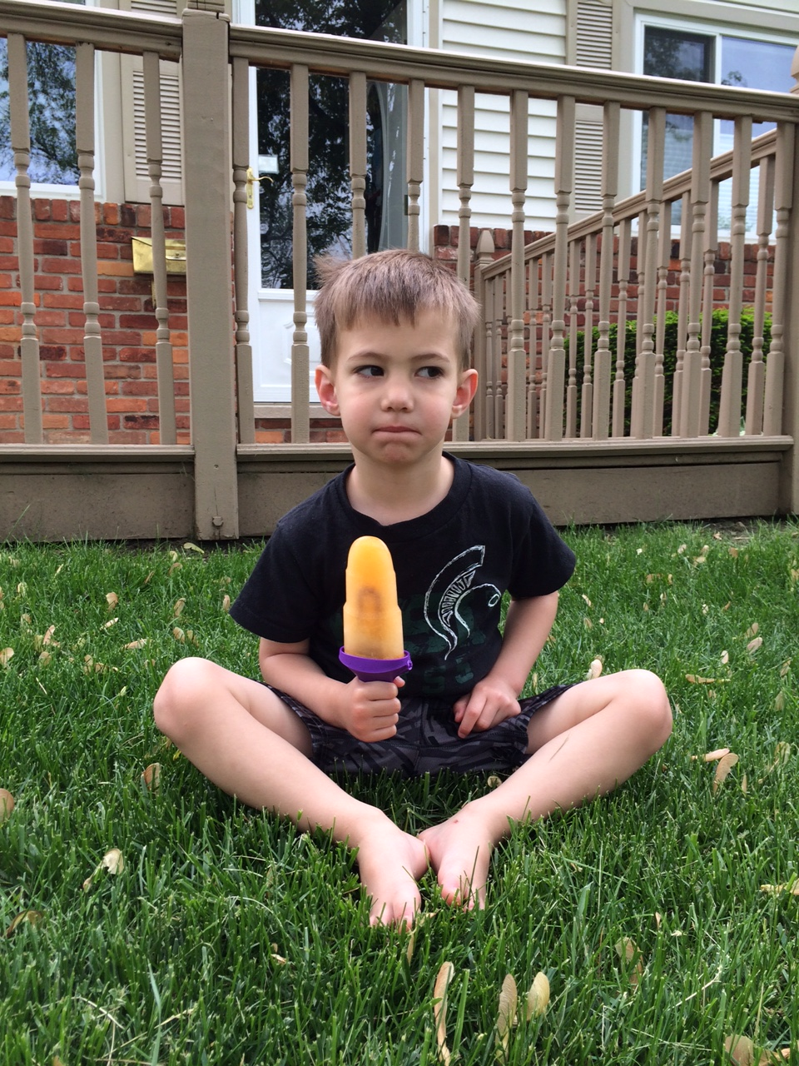
That’s nice, but how do you calculate a student’s final grade?

Slide 33
That’s nice, but how do you calculate a student’s final grade?
Average of a learner’s performance in all standards on summative

Slide 35
Final Grade Principles
100% Summative = Final Grade
Late work, missing work, work habits, employability, participation, citizenship, etc. ARE important and deserve feedback and need to be reported…separately.

Slide 36
“Employability” district-wide should have consistency and “teeth”
“Cardinal Code” in Davison
“Creek Code” in Swartz Creek
Similar code in Grosse Ile
Armada: no code and two poor scores per marking period = ineligible (kinda)

Slide 37
Final Grade Specifics
Formatives earn students scores and feedback, but don’t count towards final grade.

Slide 38
Final Grade Specifics
Formatives earn students scores and feedback, but don’t count towards final grade.
Formative scores & feedback logged in PowerSchool, Seesaw, and on paper. See pages 5-6

Slide 39
Final Grade Specifics
Formatives earn students scores and feedback, but don’t count towards final grade.
Formative scores & feedback logged in PowerSchool, Seesaw and on paper.
Average of all summative scores used to calculate final grade; no percentages.

Slide 40
Armada 4.0 Conversion Scale
Average of all Learning Target scores on summative assessments | Letter Grade
4.0-3.6 | A
3.59-3.3 | A-
3.29-3.0 | B+
2.99-2.7 | B
2.69-2.4 | B-
2.39-2.1 | C+
2.09-1.8 | C
1.79-1.5 | C-
1.49-0 | E
Not completing all parts of summative | I (Incomplete)

Slide 41
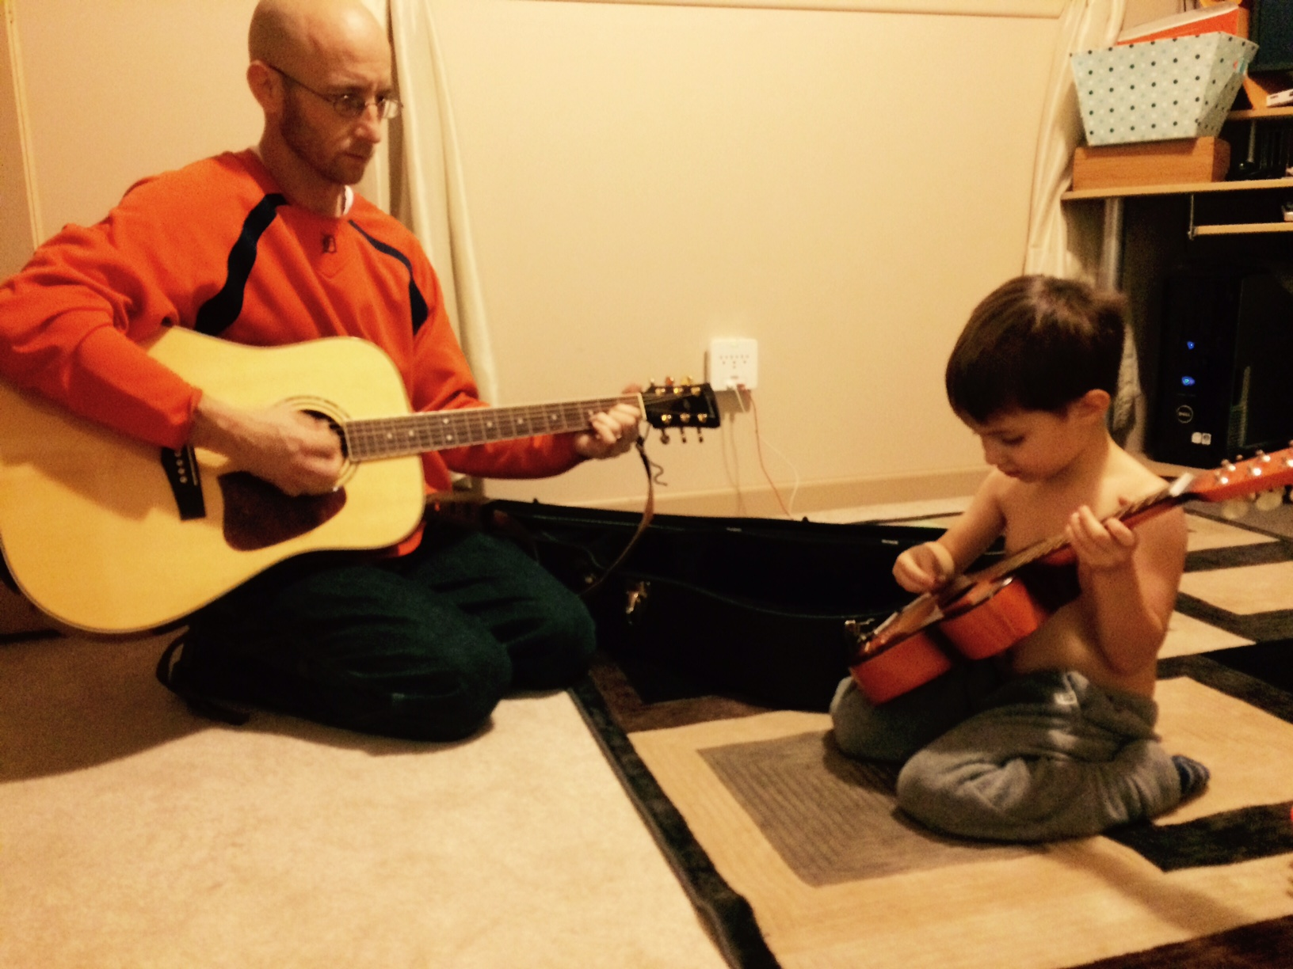
Missy O. earned
2, 3, 3, 4 in “Grammar”
Averaging over time: 3
Final performance on summative: 4

Slide 42
Final Grade Specifics
Formatives earn students scores and feedback, but don’t count towards final grade.
Formative scores & feedback logged in LMS (Skyward), Seesaw and on paper.
Average of all summative scores used to calculate final grade; no percentages.
Can revise summative if not on the ICU list. ICU Formatives = “Retake Ticket”

Slide 43
Deerfield Exclusive!
What would best meet your needs at this point?
Sharing your examples and Aric gives feedback
Seeing how Aric builds a culture of learning

Slide 44
Wait…Students get zero extrinsic final grade motivation to do “homework”? They won’t do it if it’s not for points!
Oh really?
BUILD A CULTURE

Slide 45
Intensive Care Unit List = Magical Excel Spreadsheet

Slide 46
Intensive Care Unit List
Intensive Care and “Aggressive Compassion”

Slide 47
Intensive Care Unit List
Intensive Care and “Aggressive Compassion”
If I am convinced a task will help a student learn and grow, why would I “give up” on insisting they do it?

Slide 48
Intensive Care Unit List
Intensive Care and “Aggressive Compassion”
Never give up!
Feedback/scores are TIMELY

Slide 49
Intensive Care Unit List
Intensive Care and “Aggressive Compassion”
Never give up!
Feedback/scores are TIMELY
Proficient in all standards on a given task = off list

Slide 50
Intensive Care Unit List
Intensive Care and “Aggressive Compassion”
Never give up!
Feedback/scores are TIMELY
Proficient in all standards = off list
Stand at the door and increase consequences:
Guilt and Remind 101 EVERY DAY

Slide 51
Intensive Care Unit List
Intensive Care and “Aggressive Compassion”
Never give up!
Feedback/scores are TIMELY
Proficient in all standards = off list
Stand at the door and increase consequences:
Guilt & Remind 101 Everyday!
Work in hall until you address feedback and revise to proficiency.
(I usually bring them back in after 10 minutes-ish)

Slide 52
Intensive Care Unit List
Intensive Care and “Aggressive Compassion”
Never give up!
Feedback/scores are TIMELY
Proficient in all standards = off list
Stand at the door and increase consequences:
Guilt & Remind 101 & Work in hall
Donate your time: before school, after, or lunch. If you don’t show, you write snail mail letter home.

Slide 53
Intensive Care Unit List
Intensive Care and “Aggressive Compassion”
Never give up!
Feedback/scores are TIMELY
Proficient in all standards = off list
Stand at the door and increase consequences:
Guilt & Remind 101 & Work in hall & Donate your time
Home contact: phone call, email,
paper letter that student writes

Slide 54
Intensive Care Unit List
Intensive Care and “Aggressive Compassion”
Never give up!
Feedback/scores are TIMELY
Proficient in all standards = off list
Stand at the door and increase consequences:
Guilt & Remind 101 & Hall & Time & Home contact
Explain how and why you are
on the ICU list to the principal

Slide 55
Intensive Care Unit List
Intensive Care and “Aggressive Compassion”
Never give up!
Feedback/scores are TIMELY
Proficient in all standards = off list
Stand at the door and increase consequences:
Guilt & Remind 101 & Hall & Time & Home & Principal
No “recess” = Song analysis, auditorium, outside

Slide 56
Intensive Care Unit List
Intensive Care and “Aggressive Compassion”
Never give up!
Feedback/scores are TIMELY
Proficient in all standards = off list
Stand at the door and increase consequences:
Guilt & Remind 101 & Hall & Time & Home & Principal & Recess
“Helping Hands”

Slide 57
Intensive Care Unit List
Intensive Care and “Aggressive Compassion”
Never give up!
Feedback/scores are TIMELY
Proficient in all standards = off list
Stand at the door and increase consequences:
Guilt & Remind 101 & Hall & Time &
Home & Principal & Recess & Helping Hands
www.poweroficu.com
Danny Hill & Jason Nave
Brickhouse Culture: Defeat Student Apathy @PowerofICU

Slide 58
Intensive Care Unit List
Does it work?
For the past three years that I have been doing SBL, I have taught about 80% of all Armada Juniors.
During this time, Armada’s ACT scores in English have been the highest in the history of the school, breaking its own record each year. In 2015, the AHS ACT composite score was the highest in school history.

Slide 59
Intensive Care Unit List
Does it work?
100 Armada Juniors in 2014-2015
300 English 11 junior final grades and
FIVE final trimester grades were E’s.
Two for lack of proficiency and
three didn’t complete summative.

Slide 60
Intensive Care Unit List
Does it work?
100 Armada Juniors = record breaking ACT scores
300 English 11 junior final grades and only 2 learners failed.
1st trimester: 1,449 total student tasks proficient/1,550 total = 93.5%
2nd trimester: 1,460 total student tasks proficient/1,536 total = 95%
3rd trimester: 984 total student tasks proficient/1,057 total = 93.1%
Total all year
4,143 total student tasks on the ICU list.
3,893 student tasks completed proficiently with timely, narrative, descriptive, standards-based feedback,
which is 94% completion proficiently with zero numerical contribution to their final grade. ☺

Slide 61
Deerfield Exclusive!
What would best meet your needs at this point?
Sharing your examples and Aric gives feedback
Seeing how Aric “throws out grades”

Slide 62
Want more information?
STEM & Flower Learning Consultants
Stemandflowerlearning.com
stemflowerlc@gmail.com
@stemflowerlc
Aric Foster Megan Moran
@Aricfoster2 @MeganCMoMo

Slide 63
What if there were NO GRADES? No numbers, percentages, or indicators?
Discuss with neighbors and pick one “pro” and one “con” group member to share out in three minutes.

Slide 64
I realized that eventually, if kids understand growth mindset, culture of learning, and are “in,” then they don’t need numbers.

Slide 65
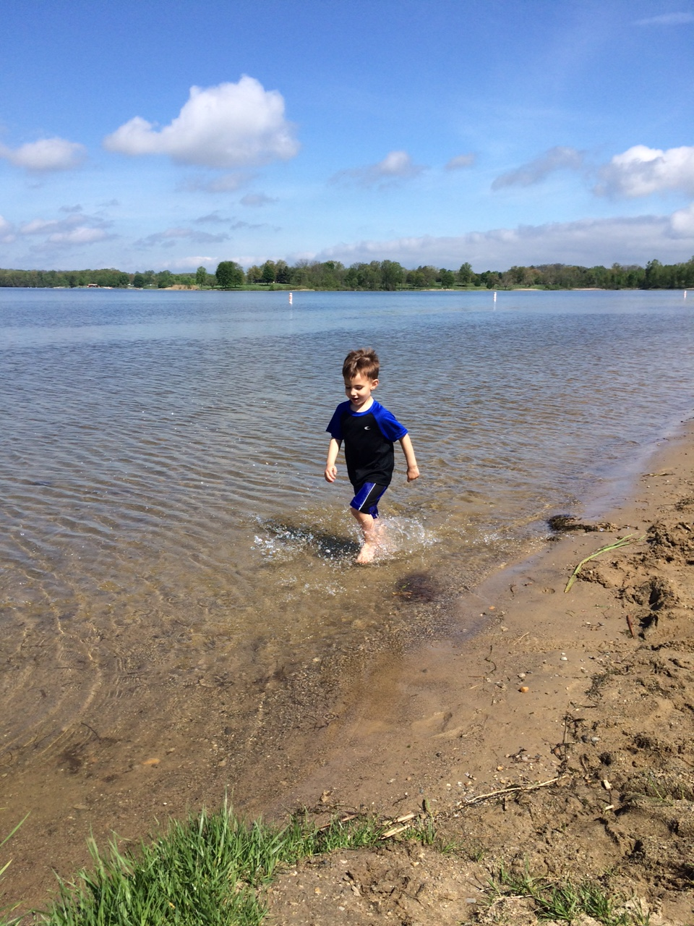
Which is the most effective feedback for mi hijito?
“Good job”
2.0 in focus
1.5 in speed
3.0 in aesthetics
2.0 in splashing
“Too slow; try again”

Slide 66
Which is the most effective feedback for mi hijito?
“I see you running. Is it challenging to run in the water? Why? What are you doing with your feet? What do you notice? I notice that the faster you run, the more you splash. Show me again. I can’t wait to see you run in the water again.”

Slide 67
#TTOG = Teachers Throwing Out Grades
Star Sackstein @mssackstein
Hacking Assessment
Mark Barnes
@markbarnes19
Assessment 3.0: Throw out your gradebook and inspire learning

Slide 69
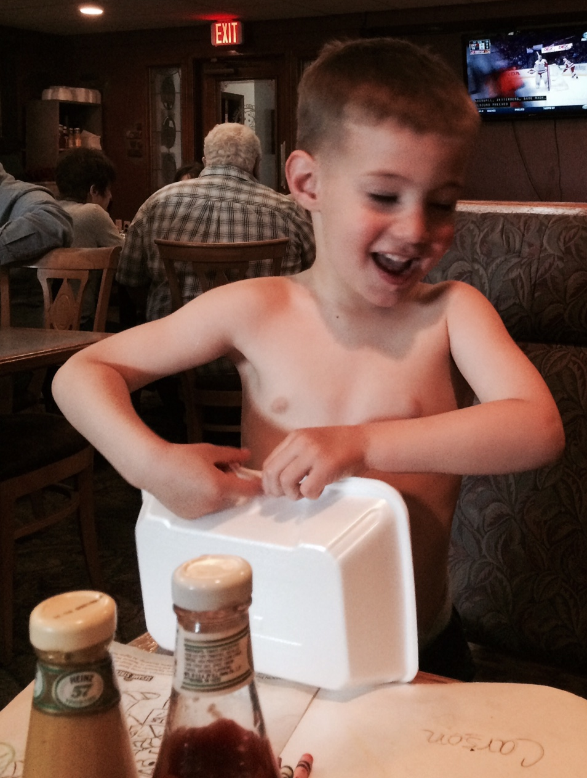
SBL ➔ TTOG
AP Lit. Seniors

Slide 70
SBL ➔ TTOG
AP Lit. Seniors
6 Standards

Slide 71
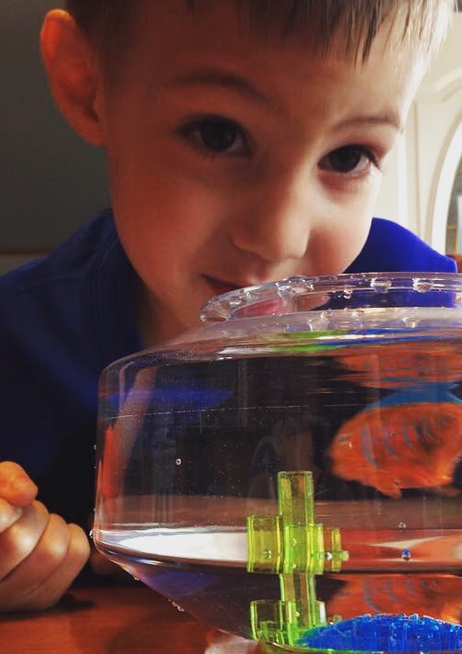
SBL ➔ TTOG
AP Lit. Seniors
6 Standards
SE2R: Summarize, Explain, Redirect, Resubmit

Slide 72
SBL ➔ TTOG
AP Lit. Seniors
6 Standards
SE2R
“Saw, didn’t see, how addresses specific standard, extra practice, resubmission”

Slide 73
Feedback Only Rubric
Concerns | Standard | Points of Pride
 | Do I literally comprehend the text? Main ideas are accurate Details main ideas Text words are helpful Inferences add comprehension “What was said?” is clear
 | Can I analyze author’s craft? Abundant literary devices Accurate analysis Device connections abound “How was it said?” is clear
 | Can I see author’s intent? Theme is universal sentence Author ➔ Text ➔ Reader Other text connections “Why was it said?” is clear

Slide 74
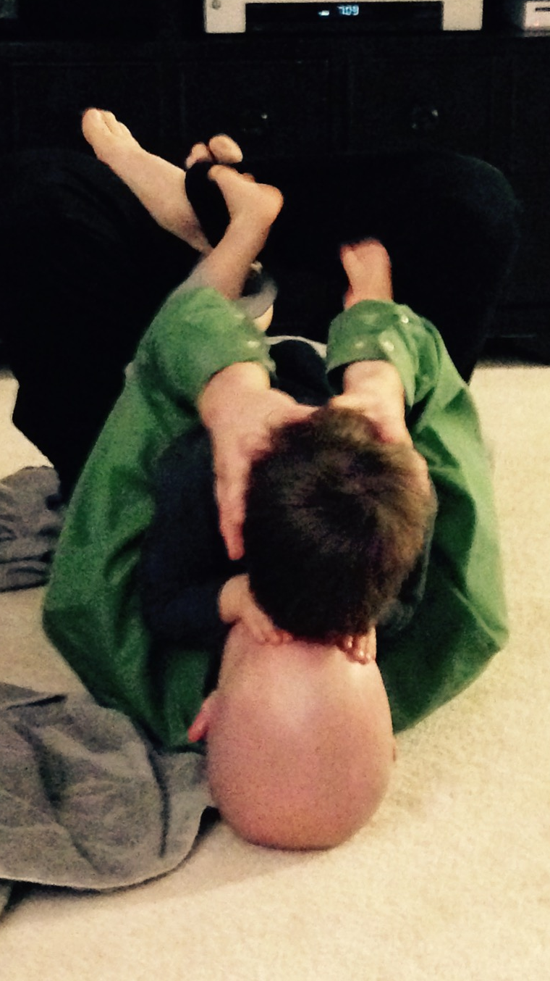
SBL ➔ TTOG
AP Lit. Seniors
6 Standards
SE2R
“Saw, standards, practice, resubmit”
Abundance, not format, for evidence
Excel and graphs (5 students)

Slide 76
SBL ➔ TTOG
AP Lit. Seniors
6 Standards
SE2R
“Saw, standards, practice, resubmit”
Abundance, not format, for evidence
Excel and graphs (5)
Physical Binder with dividers (11)

Slide 86
SBL ➔ TTOG
AP Lit. Seniors
6 Standards
“Saw, standards, practice, resubmit”
Abundance, not format
Excel and graphs (5)
Physical Binder (11)
Blog (6)
Apfoster.wordpress.com

Slide 87
SBL ➔ TTOG
AP Lit. Seniors
6 Standards
“Saw, standards, practice, resubmit”
Abundance, not format
Excel and graphs (5)
Physical Binder (11)
Blog (6)
Websites (8)
Rachelsfeedback.weebly.com

Slide 88
SBL ➔ TTOG
AP Lit. Seniors
6 Standards
“Saw, standards, practice, resubmit”
Abundance, not format
Excel and graphs (5)
Physical Binder (11)
Blog (6)
Websites (8)
Class wide feedback & Voxer

Slide 89
Whole Class Feedback

Slide 90
SBL ➔ TTOG
AP Lit. Seniors
6 Standards
“Saw, standards, practice, resubmit”
Abundance, not format
Excel and graphs (5)
Physical Binder (11)
Blog (6)
Websites (8)
Class wide feedback & Voxer
2 mini-conferences & final

Slide 91
SBL ➔ TTOG
6 Standards
“Saw, standards, practice, resubmit”
Abundance, not format
Excel and graphs (5)
Physical Binder (11)
Blog (6)
Websites (8)
Class wide feedback & Voxer
2 mini-conferences & final
2 down, 5 up

Slide 92
Does it work?

Slide 93
Does it work?
Zero parent, student or admin complaints

Slide 94
Does it work?
Zero parent, student or admin complaints
Kids’ positive feedback

Slide 95
Does it work?
Zero parent, student or admin complaints
Kids’ positive feedback
Seniors felt respected, honored, & heard.

Slide 96
Does it work?
Zero parent, student or admin complaints
Kids’ positive feedback
Seniors felt respected, honored, & heard.
Same amount (if not less) work

Slide 97
Does it work?
Zero parent, student or admin complaints
Kids’ positive feedback
Seniors felt respected, honored, & heard.
Same amount (if not less) work
Strong rapport, “felt” like learning, authentic assessment

Slide 98
Want more information?
STEM & Flower Learning Consultants
Stemandflowerlearning.com
stemflowerlc@gmail.com
@stemflowerlc
Aric Foster Megan Moran
@Aricfoster2 @MeganCMoMo

Slide 99
I hope this was the favorite part of your day
Aric Foster
Stemandflowerlearning.com
stemflowerlc@gmail.com
armadafoster.weebly.com
@aricfoster2
The Right Side of History
One teacher’s ELA journey through the SBL process and into #ttog.

