Slide 1
Welcome to your favorite part of the day
Aric Foster
afoster@armadaschools.org
armadafoster.weebly.com
@aricfoster2
The Right Side of History
One teacher’s ELA journey through the SBL process and into #ttog.

Slide 2
Question #1:
How many years have I been teaching?

Slide 3
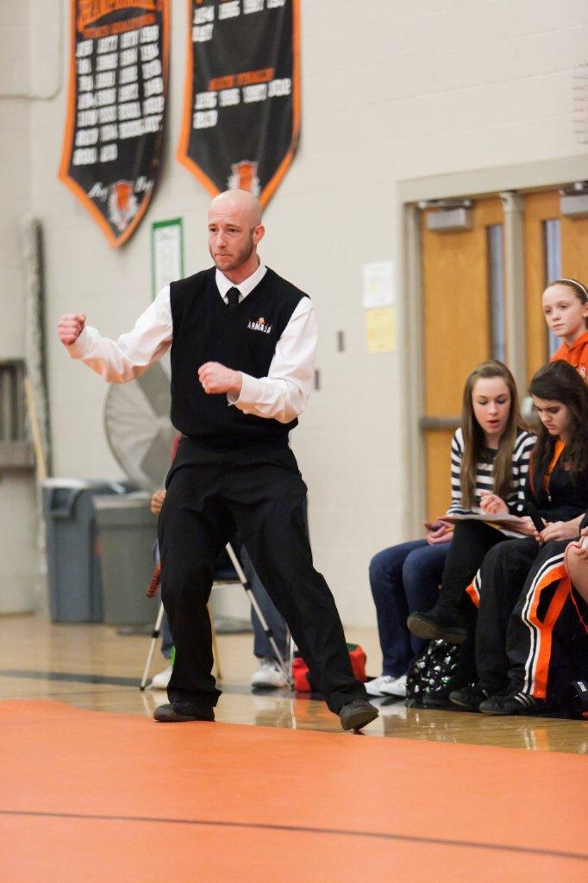
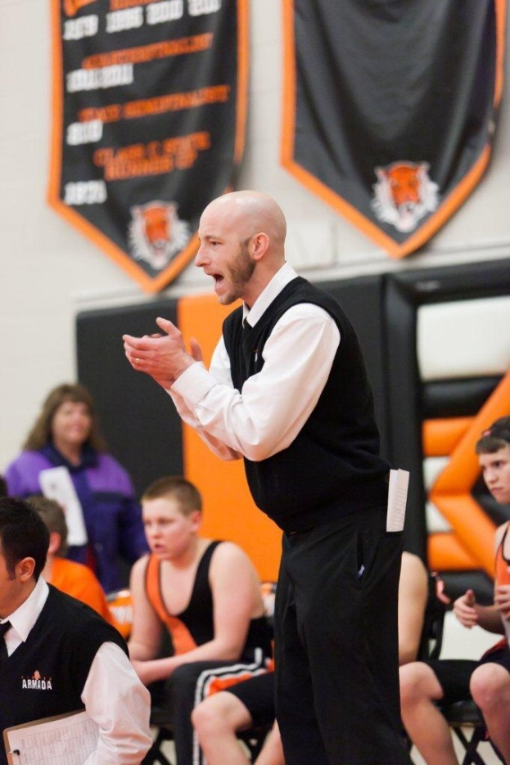
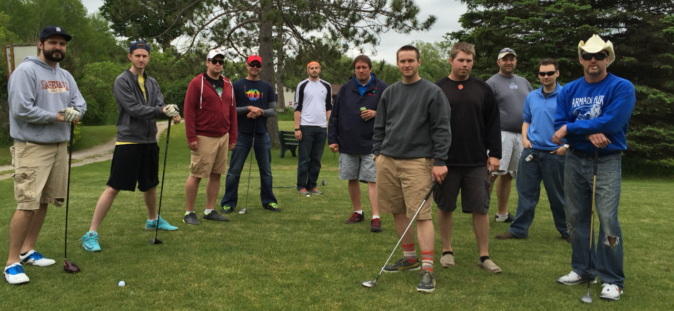
Currently year 15
in Armada
English 11,
AP Lit/Comp,
Coaching:
wrestling, track

Slide 4
Question #2:
How many times have I made this presentation?

Slide 5
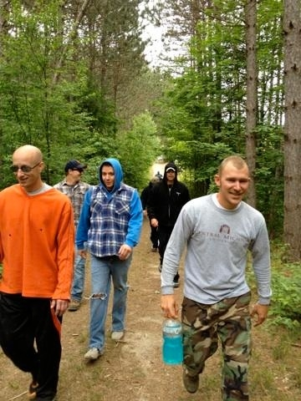
Answer #2:
10, SBL 6 years, TTOG
2 years, “normal” teacher

Slide 6
Question #3:
How many children do I have?

Slide 7
Answer #3:
One perfect child:
Aric Victor
3 years old

Slide 8
How much do we know?
Elevated SBL Experience
Standing on chair: Wormeli/O’Connor/Hillman
Standing on floor: SBL teacher/admin for 3 or more years
Sitting in chair: SBL rookie, got the gist, not proficient yet
Sitting on floor: Thinks SBL is Spanish Blinking Librarian

Slide 9
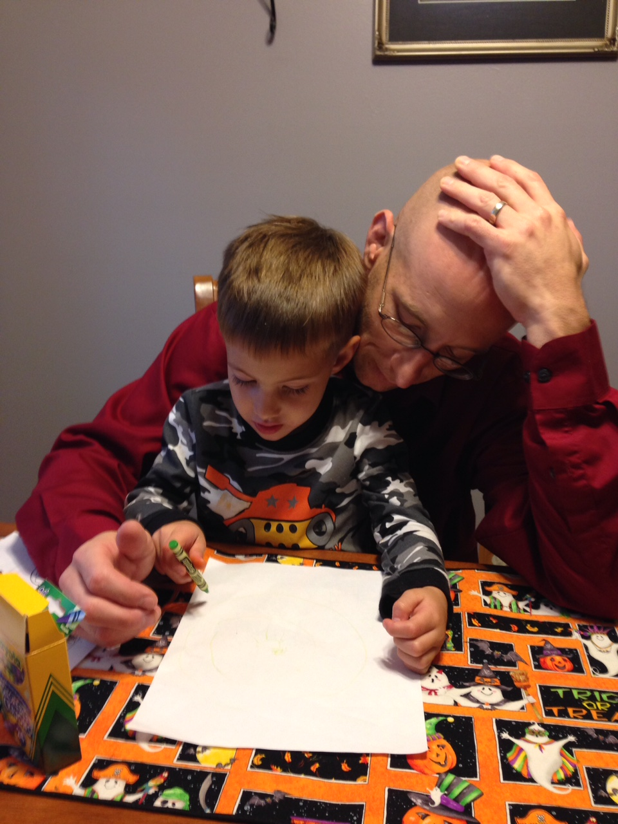
What do we know about a learner that earns an 82%? What does that 82% mean?
You are probably thinking, “It depends”
But should it? What generalities can we make about the 82% learner?

Slide 10
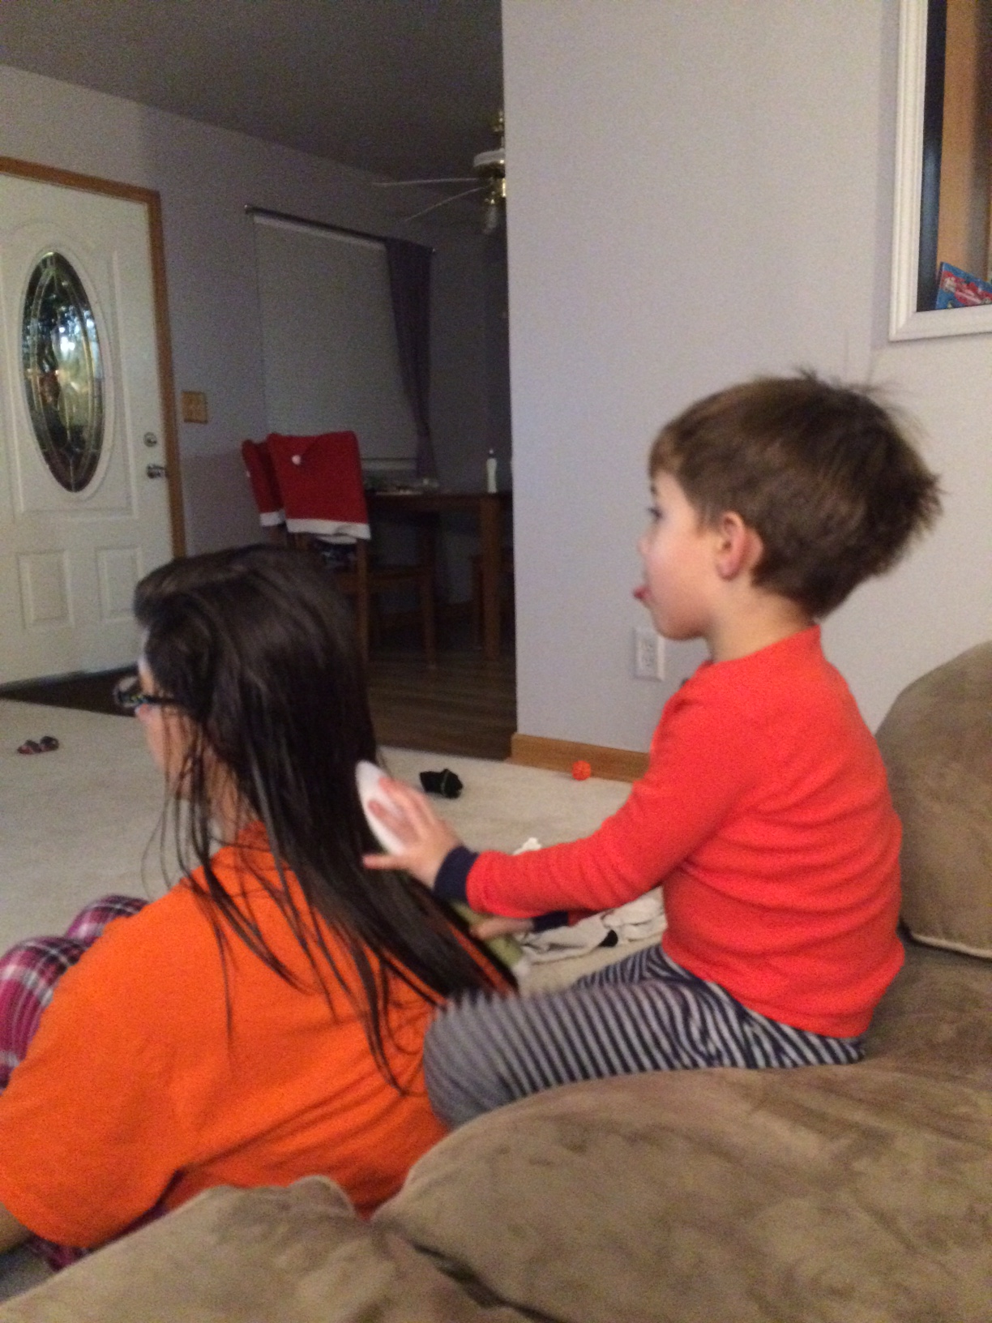
Why did I do this?
“Missy O.” &
“J. Day”
“Students” vs. “Learners”

Slide 11
Standards Based Learning Key Components
Kinesthetic (Dis)Agreement

Slide 12
Standards Based Learning Key Components
Separate proficiency from behavior

Slide 13
Standards Based Learning Key Components
Separate proficiency from behavior
Standards are synthesized from Common Core & standardized tests

Slide 14
Standards Based Learning Key Components
Separate proficiency from behavior
Standards are synthesized from Common Core & tests
Redo/retakes for full credit

Slide 15
Standards Based Learning Key Components
Separate proficiency from behavior
Standards are synthesized from Common Core & tests
Redo/retakes for full credit
100% summative and 0% formative to calculate final grade; formatives are just practice & don’t need scores.

Slide 16
Standards Based Learning Key Components
Separate proficiency from behavior
Standards are synthesized from Common Core & tests
Redo/retakes for full credit
100% summative and 0% formative to calculate final grade; formatives are just practice & don’t need scores.
Tons of timely, narrative, descriptive, standard-referenced feedback.

Slide 17
Standards Based Learning Key Components
Separate proficiency from behavior
Standards are synthesized from Common Core & tests
Redo/retakes for full credit
100% summative and 0% formative to calculate final grade; formatives are just practice & don’t need scores.
Tons of timely, narrative, descriptive, standard-referenced feedback.
Group work is not graded for individual’s proficiency mark

Slide 18
Standards Based Learning Key Components
Separate proficiency from behavior
Standards are synthesized from Common Core & tests
Redo/retakes for full credit
100% summative and 0% formative to calculate final grade; formatives are just practice & don’t need scores.
Tons of timely, narrative, descriptive, standard-referenced feedback.
Group work is not graded for individual’s proficiency mark
Late work accepted to mimic the “Real World”

Slide 19
Standards Based Learning Key Components
Separate proficiency from behavior
Standards are synthesized from Common Core & tests
Redo/retakes for full credit
100% summative and 0% formative to calculate final grade; formatives are just practice & don’t need scores.
Tons of timely, narrative, descriptive, standard-referenced feedback.
Group work is not graded for individual’s proficiency mark
Late work accepted to mimic the “Real World”
Culture eats strategy for breakfast

Slide 22
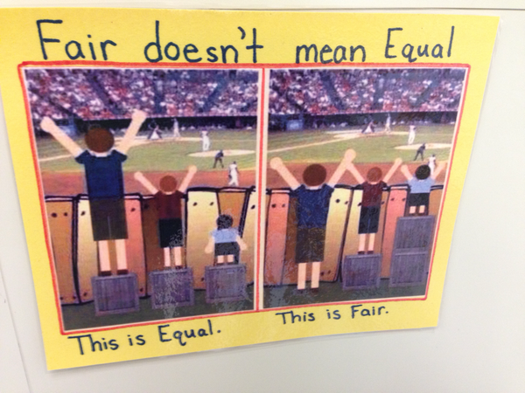
Fair Isn’t Always Equal by Rick Wormeli

Slide 23
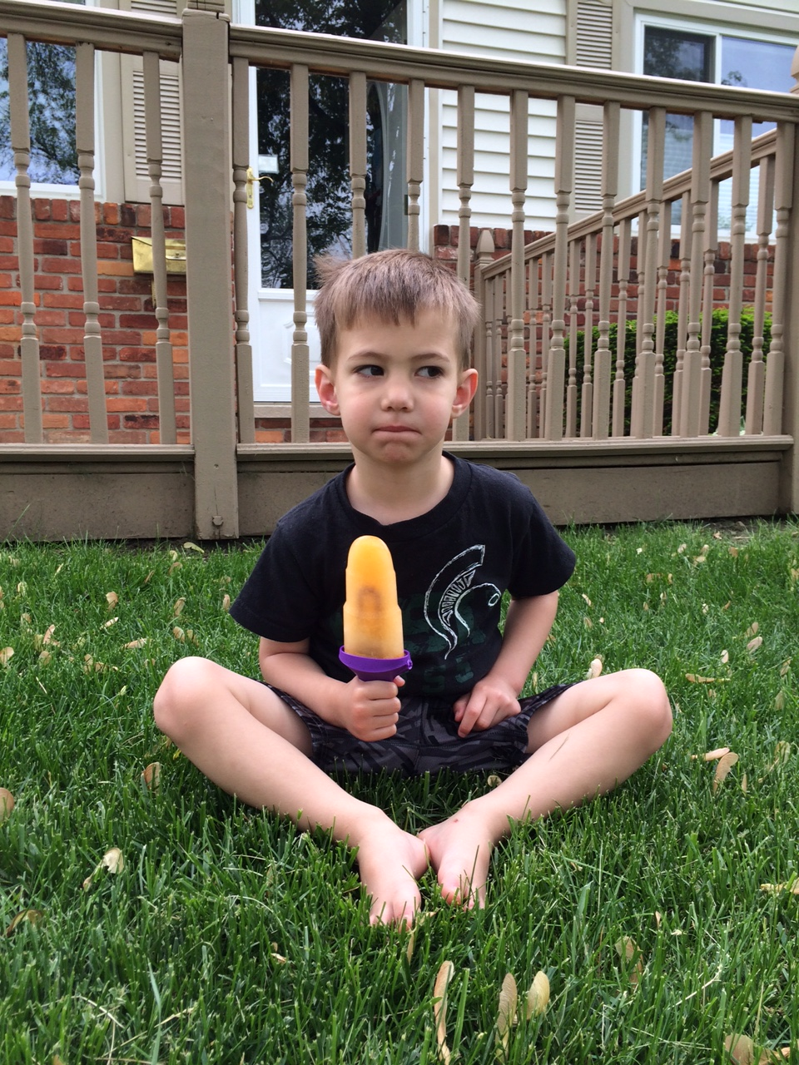
That’s nice, but how do you calculate a student’s final grade?

Slide 24
That’s nice, but how do you calculate a student’s final grade?
Average of a student’s performance in all standards on summative

Slide 25
Learning Target | 4.0 | 3.0 | 2.0 | 1.0
Comprehend and explain the literal main ideas and detail of a text | I can insightfully explain the author’s “big picture” & details accurately beyond teacher’s expectations. | I can plainly explain the author’s “big picture” & details relatively accurately and consistently. | I can just mention the author’s “big picture” & details somewhat accurately and somewhat consistently. | I struggle to identify author’s “big picture” & details I have some inaccuracies and/or need teacher assistance.
Common Core Standards: | Fiction Reading: R1, R2, R3, R10 Informational Reading: R1, R2, R3, R10
Mechanics = Produce writing that follows convention: accurate grammar, punctuation, & mechanics | I can display an advanced use of Standard American English grammar, punctuation & mechanics. | I can display a sufficient control over Standard American English grammar, punctuation & mechanics. | I can only display an inconsistent or partial control over grammar, punctuation & mechanics. | I have multiple miscues in grammar, punctuation & mechanics; my errors distracted from meaning
Common Core Standards: | Writing: W1d, W2e Language: L1a, L1b, L2, L3

Slide 26
Final Grade Principles
100% Summative = Final Grade
Late work, missing work, work habits, employability, participation, citizenship, etc. ARE important and deserve feedback and need to be reported…separately.

Slide 27
Citizenship district-wide should have consistency and “teeth”
“Cardinal Code” in Davison
“Creek Code” in Swartz Creek
Similar code in Grosse Ile
Armada: no code and two poor scores per marking period = ineligible (kinda)

Slide 28
Final Grade Specifics
Formatives earn students scores and feedback, but don’t count towards final grade.

Slide 29
Final Grade Specifics
Formatives earn students scores and feedback, but don’t count towards final grade.
Formative scores & feedback logged in PowerSchool, Seesaw, and on paper.

Slide 30
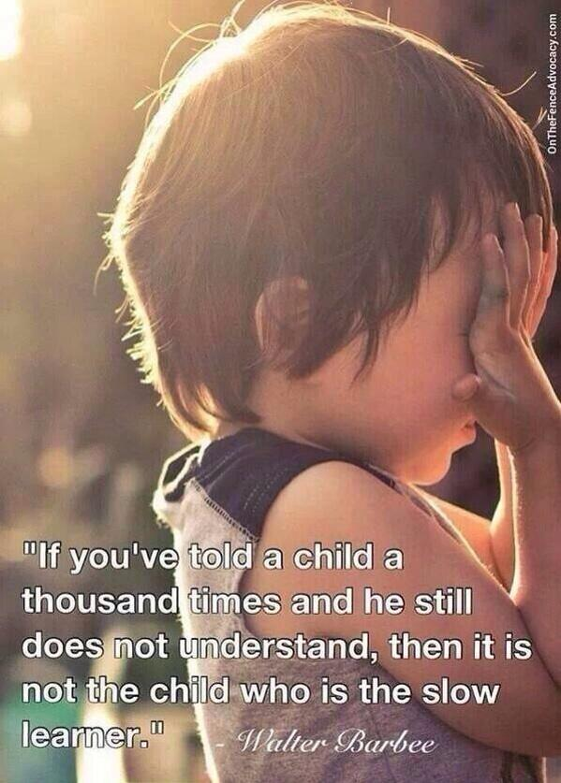

Slide 31
Final Grade Specifics
Formatives earn students scores and feedback, but don’t count towards final grade.
Formative scores & feedback logged in PowerSchool, Seesaw and on paper.
Only performance on summative counts... At the END and NOT averaged over time.

Slide 32
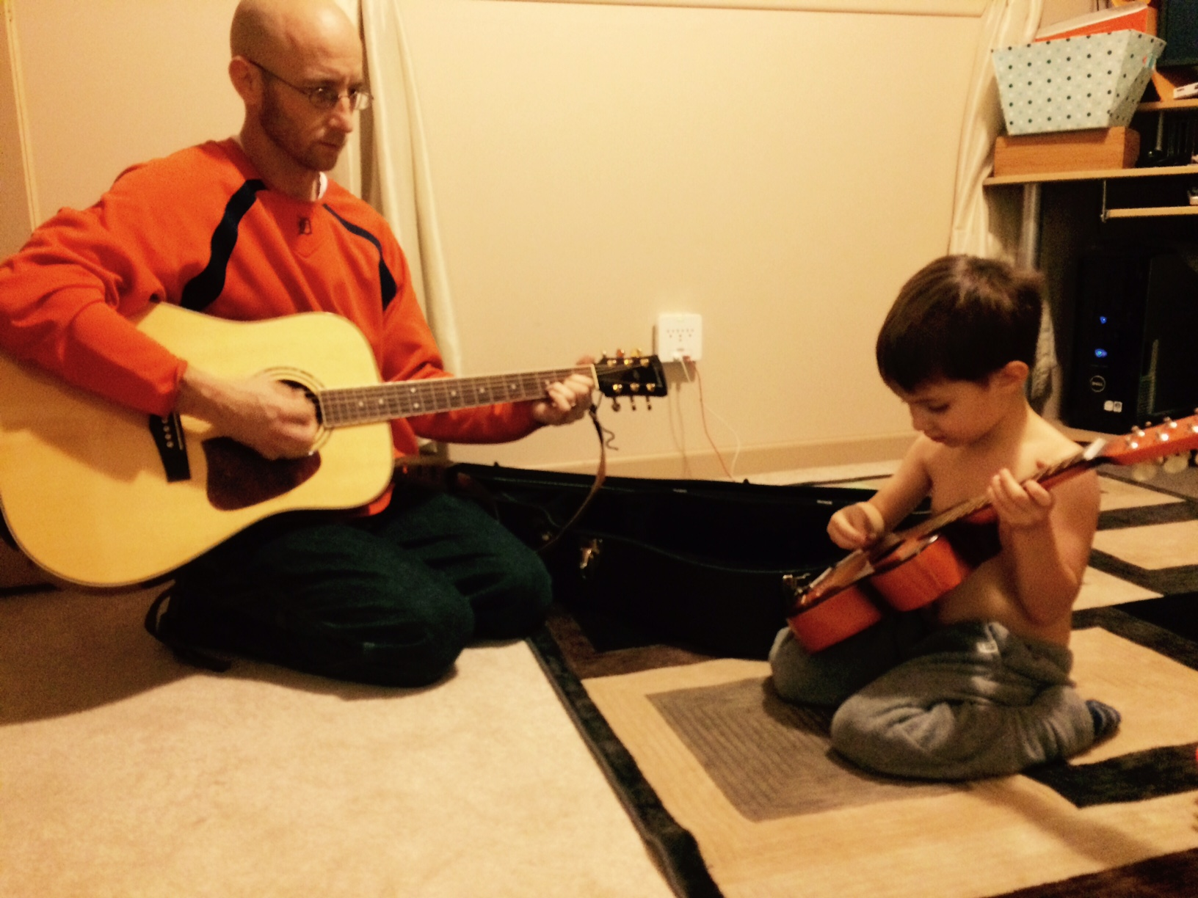
Missy O. earned
2, 3, 3, 4 in “Grammar”
Averaging over time: 3
Final performance on summative: 4

Slide 33
Final Grade Specifics
Formatives earn students scores and feedback, but don’t count towards final grade.
Formative scores & feedback logged in PowerSchool, Seesaw and on paper.
Only performance on summative counts at the end, not averaged over time.
Can revise summative if not on the ICU list. ICU Formatives = “Retake Ticket”

Slide 34
Wait…Students get zero extrinsic final grade motivation to do “homework”? They won’t do it if it’s not for points!
Oh really?
BUILD A CULTURE

Slide 35
Intensive Care Unit List = Magical Excel Spreadsheet

Slide 36
Intensive Care Unit List
Intensive Care and “Aggressive Compassion”

Slide 37
Intensive Care Unit List
Intensive Care and “Aggressive Compassion”
If I am convinced a task will help a student learn and grow, why would I “give up” on insisting they do it?

Slide 38
Intensive Care Unit List
Intensive Care and “Aggressive Compassion”
Never give up!
Feedback/scores are TIMELY

Slide 39
Intensive Care Unit List
Intensive Care and “Aggressive Compassion”
Never give up!
Feedback/scores are TIMELY
Proficient in all standards on a given task = off list

Slide 40
Intensive Care Unit List
Intensive Care and “Aggressive Compassion”
Never give up!
Feedback/scores are TIMELY
Proficient in all standards = off list
Stand at the door and increase consequences:
Guilt and Remind 101 EVERY DAY

Slide 41
Intensive Care Unit List
Intensive Care and “Aggressive Compassion”
Never give up!
Feedback/scores are TIMELY
Proficient in all standards = off list
Stand at the door and increase consequences:
Guilt & Remind 101 Everyday!
Work in hall until you address feedback and revise to proficiency.
(I usually bring them back in after 10 minutes-ish)

Slide 42
Intensive Care Unit List
Intensive Care and “Aggressive Compassion”
Never give up!
Feedback/scores are TIMELY
Proficient in all standards = off list
Stand at the door and increase consequences:
Guilt & Remind 101 & Work in hall
Donate your time: before school, after, or lunch. If you don’t show, you write snail mail letter home.

Slide 43
Intensive Care Unit List
Intensive Care and “Aggressive Compassion”
Never give up!
Feedback/scores are TIMELY
Proficient in all standards = off list
Stand at the door and increase consequences:
Guilt & Remind 101 & Work in hall & Donate your time
Home contact: phone call, email,
paper letter that student writes

Slide 44
Intensive Care Unit List
Intensive Care and “Aggressive Compassion”
Never give up!
Feedback/scores are TIMELY
Proficient in all standards = off list
Stand at the door and increase consequences:
Guilt & Remind 101 & Hall & Time & Home contact
Explain how and why you are
on the ICU list to the principal

Slide 45
Intensive Care Unit List
Intensive Care and “Aggressive Compassion”
Never give up!
Feedback/scores are TIMELY
Proficient in all standards = off list
Stand at the door and increase consequences:
Guilt & Remind 101 & Hall & Time & Home & Principal
No “recess” = Song analysis, auditorium, outside

Slide 46
Intensive Care Unit List
Intensive Care and “Aggressive Compassion”
Never give up!
Feedback/scores are TIMELY
Proficient in all standards = off list
Stand at the door and increase consequences:
Guilt & Remind 101 & Hall & Time & Home & Principal & Recess
www.poweroficu.com
Danny Hill & Jason Nave
Brickhouse Culture: Defeat Student Apathy @PowerofICU

Slide 47
Intensive Care Unit List
Does it work?
For the past three years that I have been doing SBL, I have taught about 80% of all Armada Juniors.
During this time, Armada’s ACT scores in English have been the highest in the history of the school, breaking its own record each year. In 2015, the AHS ACT composite score was the highest in school history.

Slide 48
Intensive Care Unit List
Does it work?
100 Armada Juniors in 2014-2015
300 English 11 junior final grades and
FIVE final trimester grades were E’s.
Two for lack of proficiency and
three didn’t complete summative.

Slide 49
Intensive Care Unit List
Does it work?
100 Armada Juniors = record breaking ACT scores
300 English 11 junior final grades and only 2 learners failed.
1st trimester: 1,449 total student tasks proficient/1,550 total = 93.5%
2nd trimester: 1,460 total student tasks proficient/1,536 total = 95%
3rd trimester: 984 total student tasks proficient/1,057 total = 93.1%

Slide 50
Intensive Care Unit List
Does it work?
100 Armada Juniors = record breaking ACT scores
300 English 11 junior final grades and only 2 learners failed.
1st trimester: 1,449 total student tasks proficient/1,550 total = 93.5%
2nd trimester: 1,460 total student tasks proficient/1,536 total = 95%
3rd trimester: 984 total student tasks proficient/1,057 total = 93.1%
Total all year
4,143 total student tasks on the ICU list.
3,893 student tasks completed proficiently with timely, narrative, descriptive, standards-based feedback,
which is 94% completion proficiently with zero numerical contribution to their final grade. ☺

Slide 51
Want more information?
STEM & Flower Learning Consultants
Stemandflowerlearning.com
stemflowerlc@gmail.com
@stemflowerlc
Aric Foster Megan Moran
@Aricfoster2 @MeganCMoMo

Slide 52
What if there were NO GRADES? No numbers, percentages, or indicators?
Discuss with neighbors and pick one “pro” and one “con” group member to share out in three minutes.

Slide 53
I realized that eventually, if kids understand growth mindset, culture of learning, and are “in,” then they don’t need numbers.

Slide 54
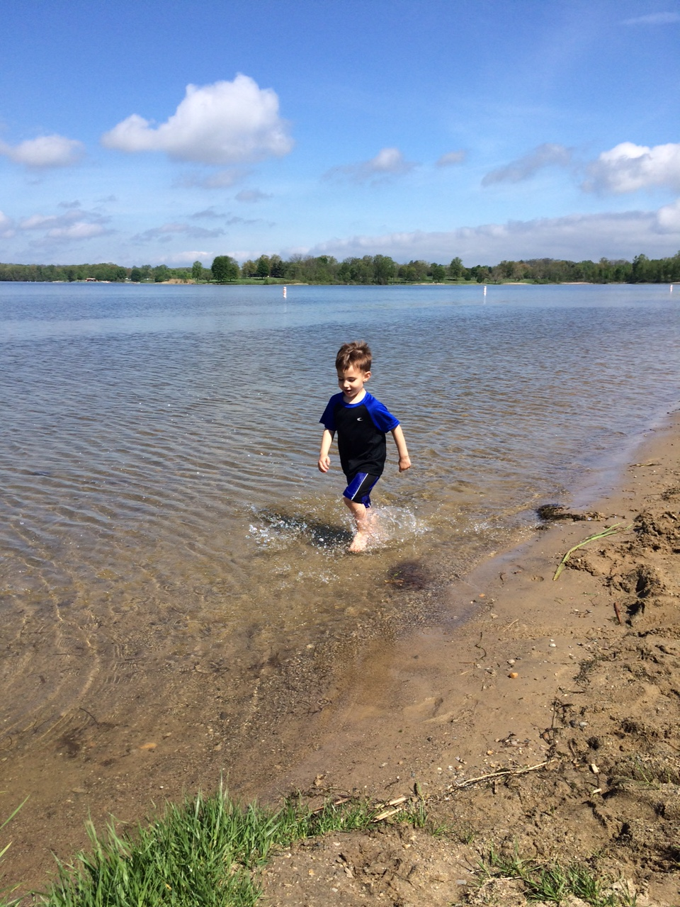
Which is the most effective feedback for mi hijito?
“Good job”
2.0 in focus
1.5 in speed
3.0 in aesthetics
2.0 in splashing
“Too slow; try again”

Slide 55
Which is the most effective feedback for mi hijito?
“I see you running. Is it challenging to run in the water? Why? What are you doing with your feet? What do you notice? I notice that the faster you run, the more you splash. Show me again. I can’t wait to see you run in the water again.”

Slide 56
#TTOG = Teachers Throwing Out Grades
Star Sackstein @mssackstein
Mark Barnes
@markbarnes19
Assessment 3.0: Throw out your gradebook and inspire learning

Slide 58
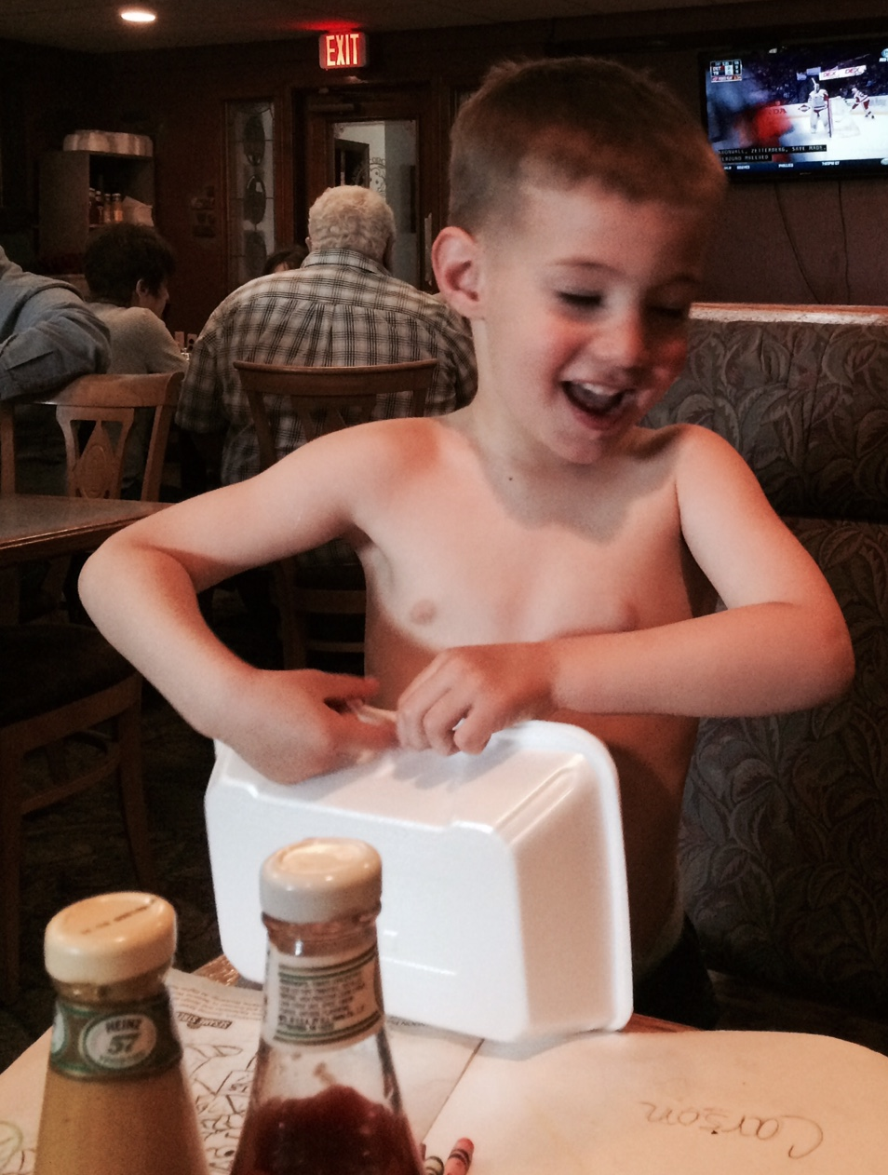
SBL ➔ TTOG
AP Lit. Seniors

Slide 59
SBL ➔ TTOG
AP Lit. Seniors
6 Standards

Slide 60
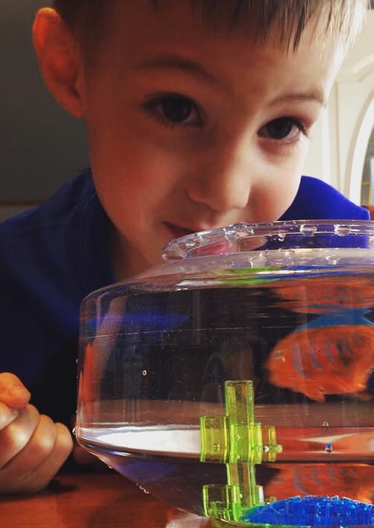
SBL ➔ TTOG
AP Lit. Seniors
6 Standards
SE2R: Summarize, Explain, Redirect, Resubmit

Slide 61
SBL ➔ TTOG
AP Lit. Seniors
6 Standards
SE2R
“Saw, didn’t see, how addresses specific standard, extra practice, resubmission”

Slide 62
Feedback Only Rubric
Concerns | Standard | Points of Pride
 | Do I literally comprehend the text? Main ideas are accurate Details main ideas Text words are helpful Inferences add comprehension “What was said?” is clear
 | Can I analyze author’s craft? Abundant literary devices Accurate analysis Device connections abound “How was it said?” is clear
 | Can I see author’s intent? Theme is universal sentence Author ➔ Text ➔ Reader Other text connections “Why was it said?” is clear

Slide 63
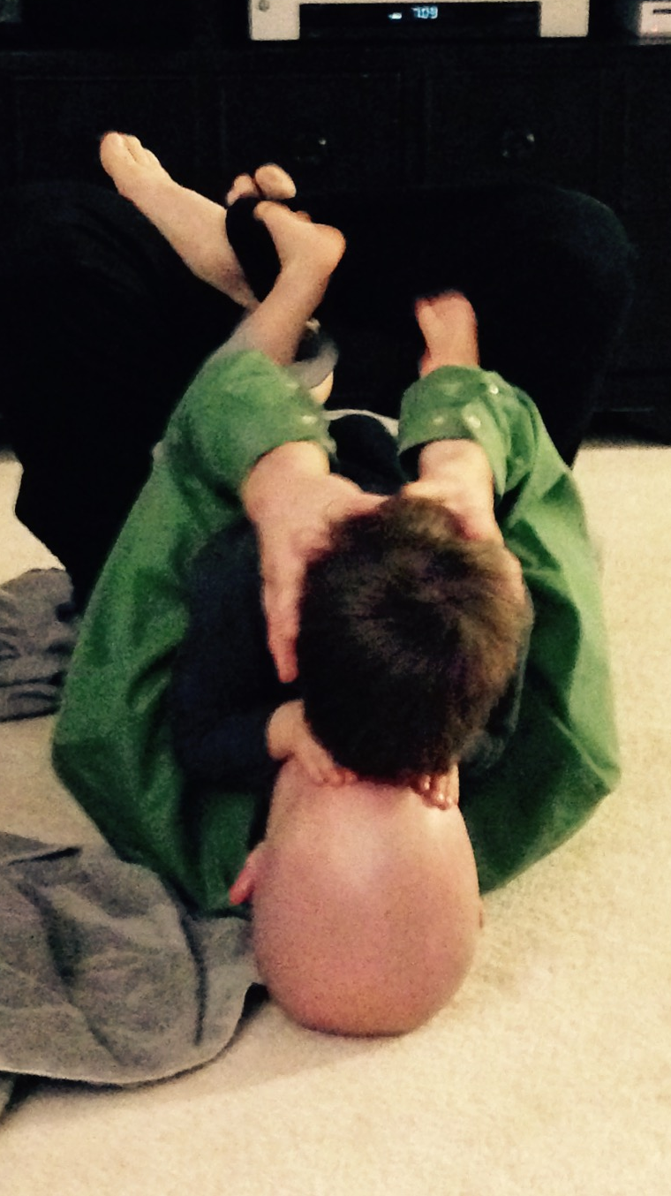
SBL ➔ TTOG
AP Lit. Seniors
6 Standards
SE2R
“Saw, standards, practice, resubmit”
Abundance, not format, for evidence
Excel and graphs (5 students)

Slide 65
SBL ➔ TTOG
AP Lit. Seniors
6 Standards
SE2R
“Saw, standards, practice, resubmit”
Abundance, not format, for evidence
Excel and graphs (5)
Physical Binder with dividers (11)

Slide 75
SBL ➔ TTOG
AP Lit. Seniors
6 Standards
“Saw, standards, practice, resubmit”
Abundance, not format
Excel and graphs (5)
Physical Binder (11)
Blog (6)
Apfoster.wordpress.com

Slide 76
SBL ➔ TTOG
AP Lit. Seniors
6 Standards
“Saw, standards, practice, resubmit”
Abundance, not format
Excel and graphs (5)
Physical Binder (11)
Blog (6)
Websites (8)
Rachelsfeedback.weebly.com

Slide 77
SBL ➔ TTOG
AP Lit. Seniors
6 Standards
“Saw, standards, practice, resubmit”
Abundance, not format
Excel and graphs (5)
Physical Binder (11)
Blog (6)
Websites (8)
Class wide feedback & Voxer

Slide 78
Whole Class Feedback

Slide 79
SBL ➔ TTOG
AP Lit. Seniors
6 Standards
“Saw, standards, practice, resubmit”
Abundance, not format
Excel and graphs (5)
Physical Binder (11)
Blog (6)
Websites (8)
Class wide feedback & Voxer
2 mini-conferences & final

Slide 80
SBL ➔ TTOG
6 Standards
“Saw, standards, practice, resubmit”
Abundance, not format
Excel and graphs (5)
Physical Binder (11)
Blog (6)
Websites (8)
Class wide feedback & Voxer
2 mini-conferences & final
2 down, 5 up

Slide 81
Does it work?

Slide 82
Does it work?
Zero parent, student or admin complaints

Slide 83
Does it work?
Zero parent, student or admin complaints
Kids’ positive feedback

Slide 84
Does it work?
Zero parent, student or admin complaints
Kids’ positive feedback
Seniors felt respected, honored, & heard.

Slide 85
Does it work?
Zero parent, student or admin complaints
Kids’ positive feedback
Seniors felt respected, honored, & heard.
Same amount (if not less) work

Slide 86
Does it work?
Zero parent, student or admin complaints
Kids’ positive feedback
Seniors felt respected, honored, & heard.
Same amount (if not less) work
Strong rapport, “felt” like learning, authentic assessment

Slide 87
Want more information?
STEM & Flower Learning Consultants
Stemandflowerlearning.com
stemflowerlc@gmail.com
@stemflowerlc
Aric Foster Megan Moran
@Aricfoster2 @MeganCMoMo

Slide 88
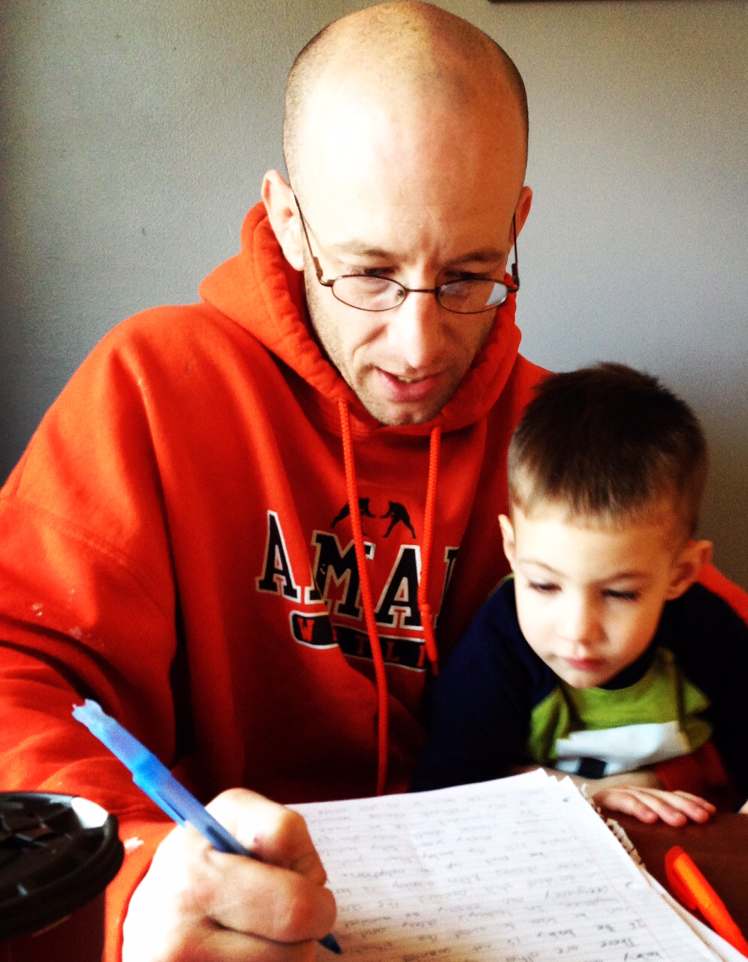
Questions?
Ask right now please
Comments?
@aricfoster2
afoster@armadaschools.org
Armadafoster.weebly.com
Complaints?
Sorry@ECET2MI.org

Slide 89
I hope this was your favorite part of the day
Aric Foster
afoster@armadaschools.org
armadafoster.weebly.com
@aricfoster2
The Right Side of History
One teacher’s ELA journey through the SBL process and into #ttog.

