Slide 1
Welcome to your favorite part of the day
Aric Foster
afoster@armadaschools.org
armadafoster.weebly.org
@aricfoster2
The Right Side of History
One teacher’s ELA journey through the SBL process and into #ttog.

Slide 2
Question #1:
How many years have I been teaching?

Slide 3
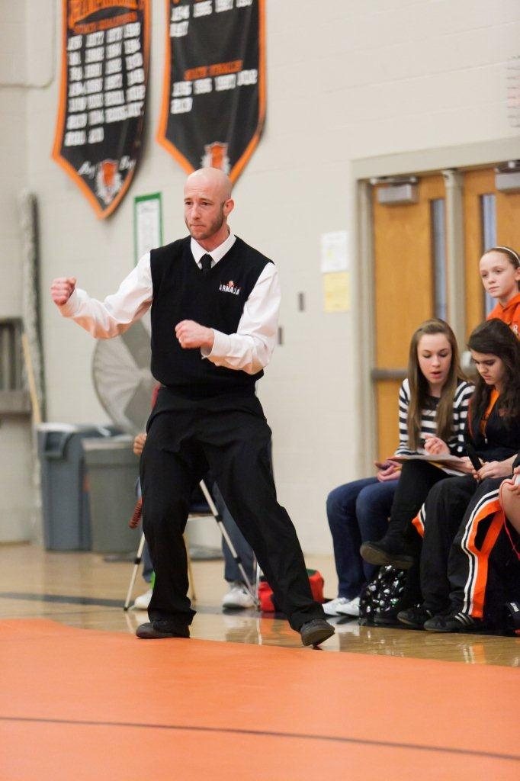
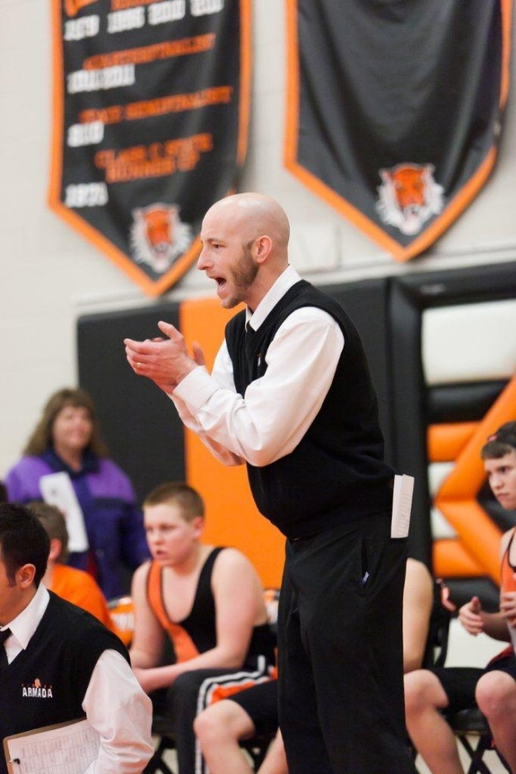
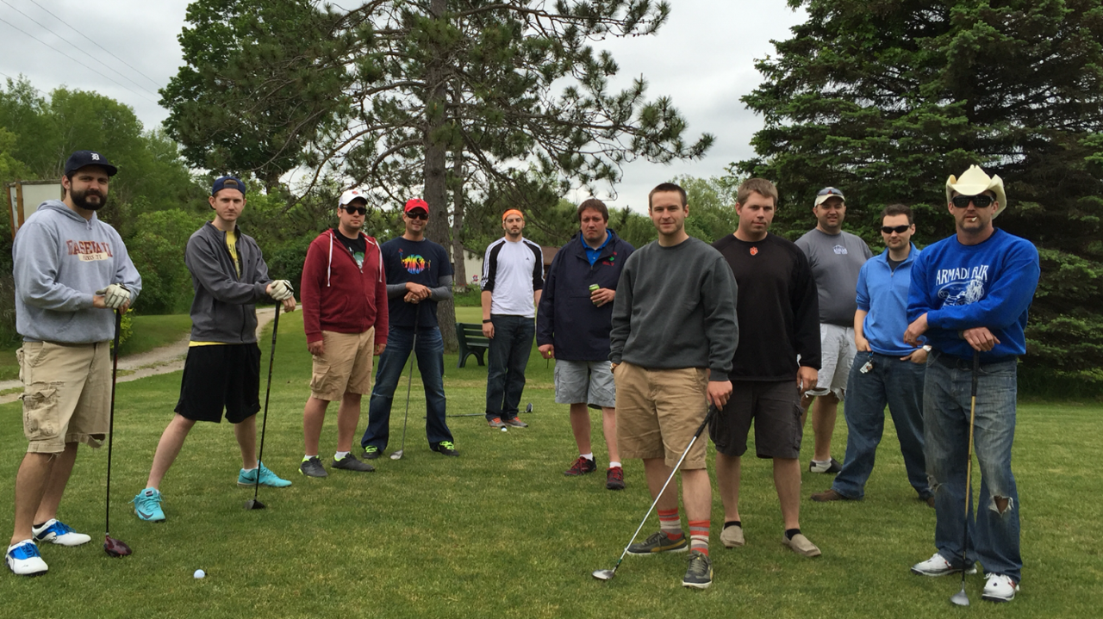
Just finished
year 14 in Armada
English 11,
AP Lit/Comp,
Coaching:
wrestling, track

Slide 4
Question #2:
How many times have I made this presentation?

Slide 5
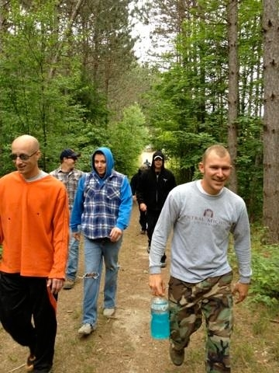
Answer #2:
Zero, but SBL 4 years;
just a “normal” teacher

Slide 6
Question #3:
How many children do I have?

Slide 7
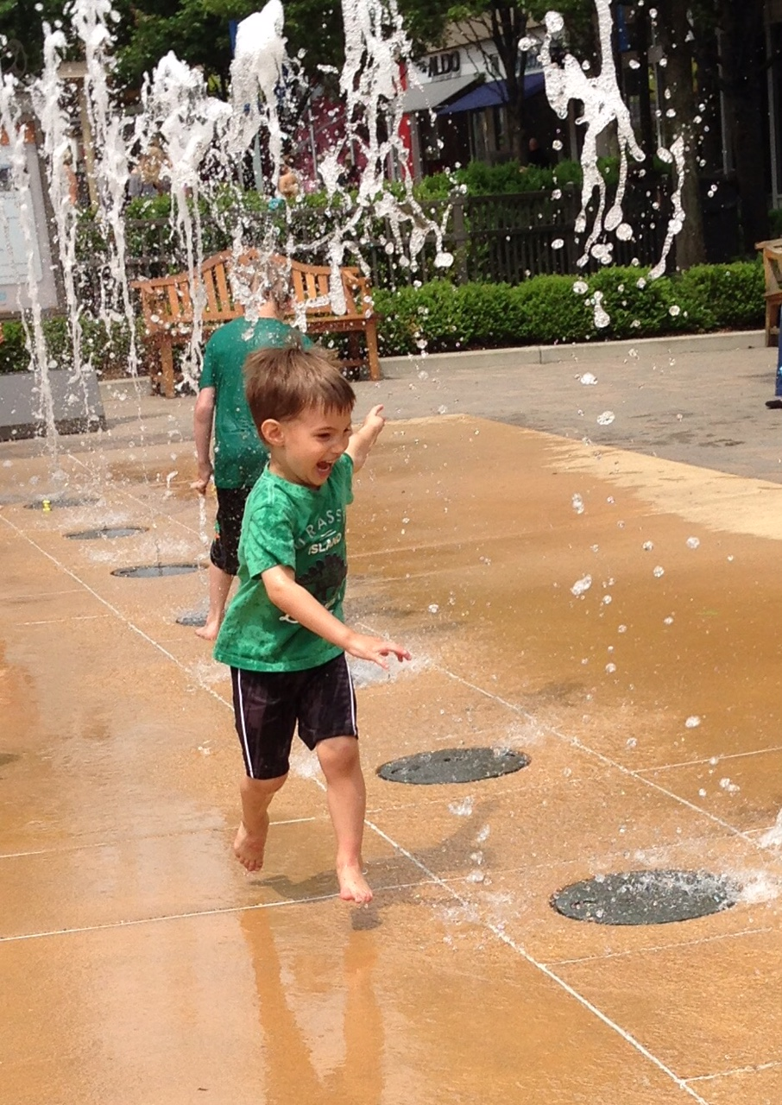
Answer #3:
One perfect child:
Aric Victor
3 years old

Slide 8
How much do we know?
Elevated SBL Experience
Standing on chair: Wormeli/O’Connor/Hillman
Standing on floor: SBL teacher/admin for 3 or more years
Sitting in chair: SBL rookie, got the gist, not proficient yet
Sitting on floor: Thinks SBL is Spanish Blinking Librarian

Slide 9
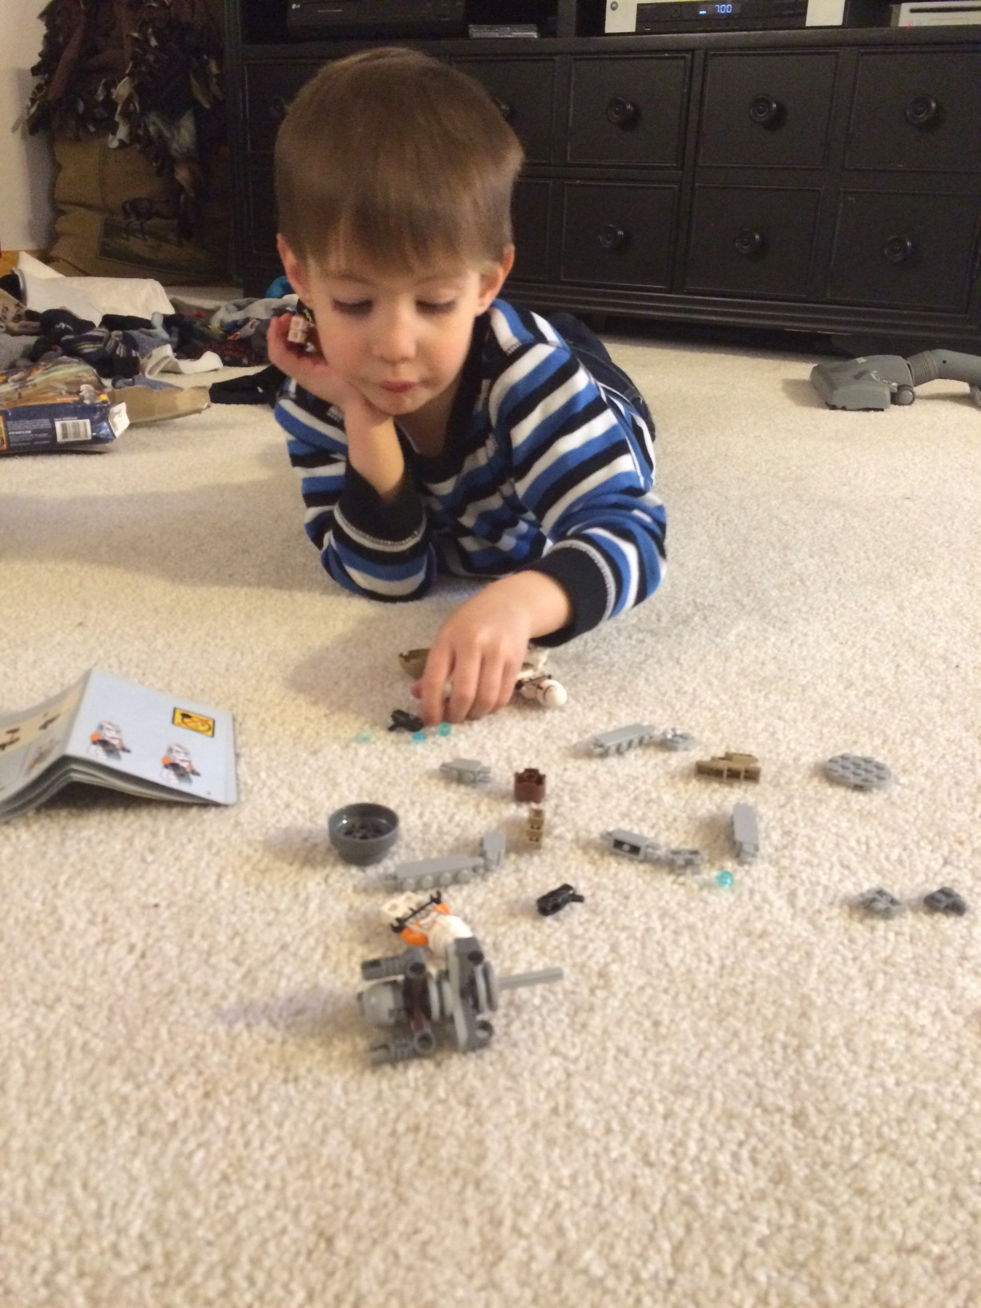
Why did I do this?
“Missy O.” & “J. Day”
“Students” vs. “Learners”
What does an 82%
mean in my class?

Slide 10
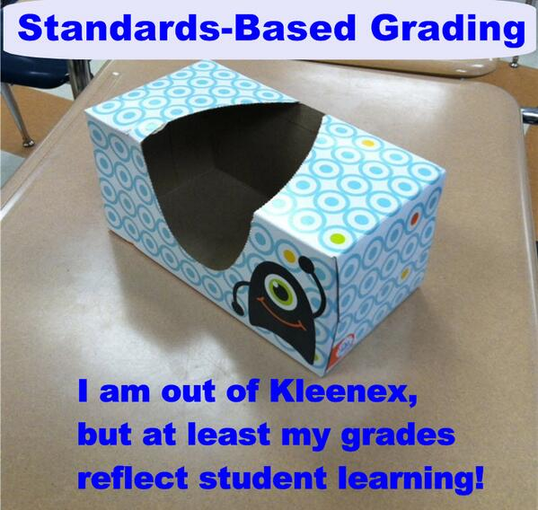

Slide 11
Creating SBL Classroom
Step #1: Create Power Standards
Lakeshore Model
Endurance: relevant in profession
Leverage: relevant in other classes
Readiness: relevant in next class
First 3 years = 15 standards = too many
E11: 10 per 12 week trimester
AP: 12, 6, 0

Slide 12

Creating SBL Classroom
Step #1: Create Power Standards
Step #2: Create Matrix
Standards Matrix
All standards with 4.0 descriptors
  4.0 = Beyond expectations in quantity and complexity and maturity
  3.0 = Proficient, “I got this”
  2.0 = Inconsistent, “Kinda got this” “I get the basic parts and struggle with the tough parts”
  1.0 = Emerging, “I need teacher help to do this”

Slide 13
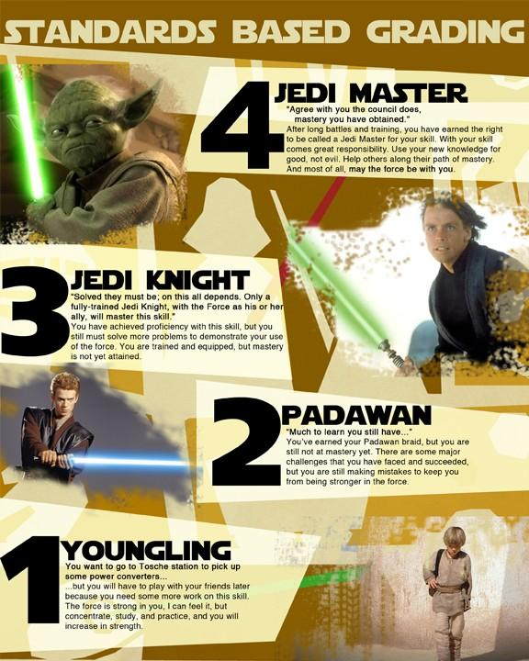

Slide 14
Creating SBL Classroom
Step #1: Create Power Standards
Step #2: Create Matrix
Standards Matrix
All standards with 4.0 descriptors
“Final exam” on first day (page 2)

Slide 15
Creating SBL Classroom
Step #1: Create Power Standards
Step #2: Create Matrix
Standards Matrix
All standards with 4.0 descriptors
“Final exam” on first day
Altered per marking period based on FA and SA performances.

Slide 16
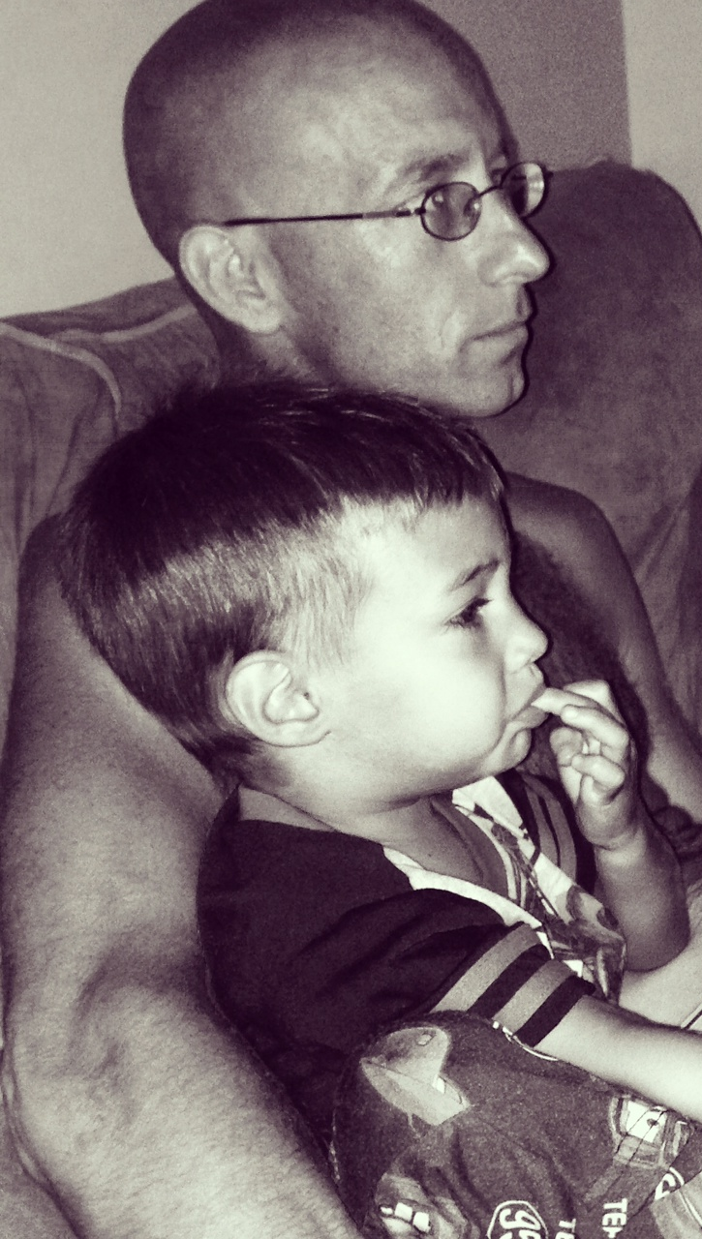
Standards Matrix Evolution
Reading & Writing…
Do I need to add Speaking
and Listening?

Slide 17
Standards Matrix Evolution
Reading & Writing
Reading:
What was said? = Literal
How was it said? = Author’s Craft
Why was it said? = Theme
So What? = Connections (old)

Slide 18
Standards Matrix Evolution
Reading & Writing
Reading: Literal, Craft, Theme
Vocab in reading
  Skills not words
  Context Clues
  Word Parts (Affixes & Greek/Latin)
  Parts of Speech
  Assessment: our words, affix variations, new words in context

Slide 19
Standards Matrix Evolution
Reading & Writing
Reading: Literal, Craft, Theme
Vocab skills not words
Infer poor, switch to 1st & 2nd

Slide 20
Standards Matrix Evolution
Reading & Writing
Reading: Literal, Craft, Theme
Vocab skills not words
Infer poor, switch to 1st & 2nd
Writing
  Purpose: Persuade, Inform, Nar.
  Organization: Structure & Trans
  Support: Evidence for purpose
  Mechanics: Grammar & Punct.
  Style: Diction & Syntax

Slide 21
Standards Matrix Evolution
Reading & Writing
Reading: Literal, Craft, Theme
Vocab skills not words
Infer poor, switch to 1st & 2nd
Writing: Purpose, Org, Support, Mechanics, Style
Old Standards: Research, Use Technology, Follow Directions, Group Work, Present Information, Publish.

Slide 22
Creating SBL Classroom
Step #1: Create Power Standards
Step #2: Create Matrix
Standards Matrix
All standards with 4.0 descriptors
“Final exam” on first day
Altered per marking period based on FA and SA performances.
Copy/paste master document for FA’s

Slide 23
Learning Target | 4.0 | 3.0 | 2.0 | 1.0
Comprehend and explain the literal main ideas and detail of a text | I can insightfully explain the author’s “big picture” & details accurately beyond teacher’s expectations. | I can plainly explain the author’s “big picture” & details relatively accurately and consistently. | I can just mention the author’s “big picture” & details somewhat accurately and somewhat consistently. | I struggle to identify author’s “big picture” & details I have some inaccuracies and/or need teacher assistance.
Common Core Standards: | Fiction Reading: R1, R2, R3, R10 Informational Reading: R1, R2, R3, R10
Mechanics = Produce writing that follows convention: accurate grammar, punctuation, & mechanics | I can display an advanced use of Standard American English grammar, punctuation & mechanics. | I can display a sufficient control over Standard American English grammar, punctuation & mechanics. | I can only display an inconsistent or partial control over grammar, punctuation & mechanics. | I have multiple miscues in grammar, punctuation & mechanics; my errors distracted from meaning
Common Core Standards: | Writing: W1d, W2e Language: L1a, L1b, L2, L3

Slide 24
Formal Formative Assessment:
Writing choices
Three learning targets (1 reading & 2 writing), Exemplar WITH FEEDBACK
Lord of the Flies Chapter 3 Response
(pages 3-4)

Slide 25
Creating SBL Classroom
Step #1: Create Power Standards
Step #2: Create Matrix
Step #3: Create Formative Assessments
Formative Assessments
Exemplars with feedback
Kept tally so all are “covered”

Slide 26
Creating SBL Classroom
Step #1: Create Power Standards
Step #2: Create Matrix
Step #3: Create Formative Assessments
Formative Assessments
Exemplars with feedback
Kept tally so all are “covered”
All online: armadafoster.weebly.com

Slide 27
Creating SBL Classroom
Step #1: Create Power Standards
Step #2: Create Matrix
Step #3: Create Formative Assessments
Step #4: Create Summative Assessment
Summative Assessment
Covers all standards (best in chunks)

Slide 28
Creating SBL Classroom
Step #1: Create Power Standards
Step #2: Create Matrix
Step #3: Create Formative Assessments
Step #4: Create Summative Assessment
Summative Assessment
Covers all standards
Stand alone assessment with new text

Slide 29
Creating SBL Classroom
Step #1: Create Power Standards
Step #2: Create Matrix
Step #3: Create Formative Assessments
Step #4: Create Summative Assessment
Summative Assessment
Covers all standards
Stand alone assessment with new text
Differentiated instruction “show me you know it” (pages 5-6)

Slide 30
2015-16 Amendments
New SAT: revisit standards, if we do SAT literary analysis, I have to change all of my first and second trimester summatives from solely persuasive

Slide 31
2015-16 Amendments
Amendments for new SAT
Revise Summative Assessments based on 2014-2015 student performance: more exemplars with feedback, clarify infer with metaphors, songs for author’s craft practice

Slide 32
2015-16 Amendments
Amendments for new SAT
Revise Summative Assessments
Revise Formative Assessments to mimic, prepare, and enforce the format, intent, and standards of the summative

Slide 33
2015-16 Amendments
Amendments for new SAT
Revise Summative Assessments
Revise Formative Assessments
Keep “Summative First” mentality

Slide 34
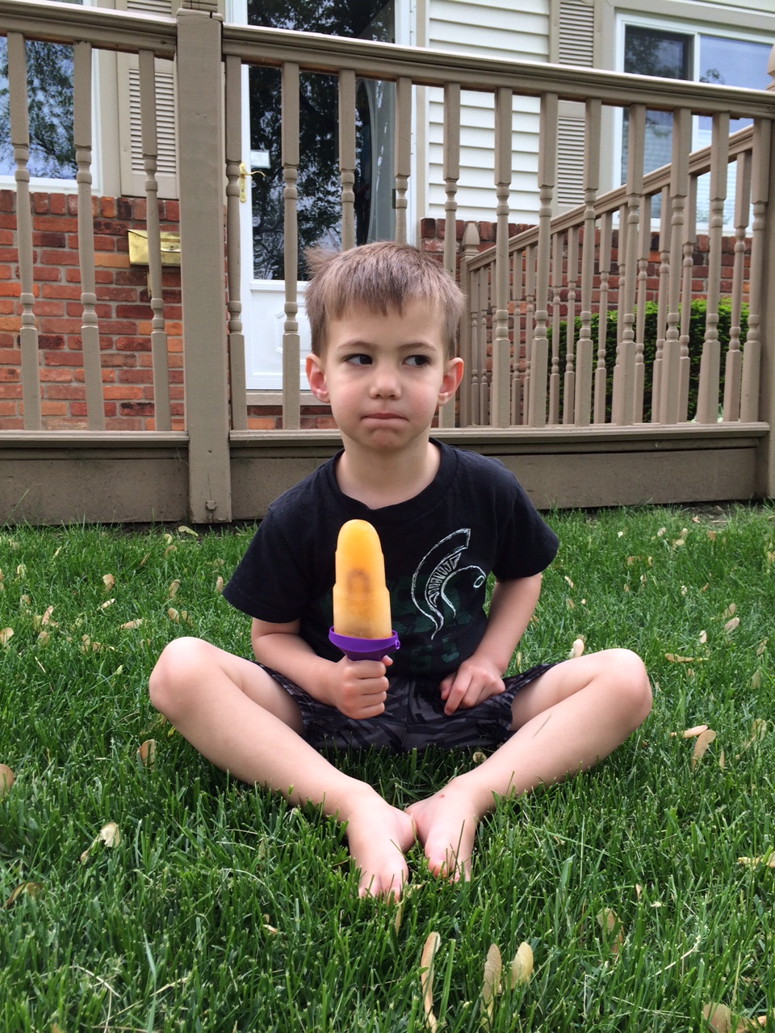
That’s nice, but how do you calculate a student’s final grade?

Slide 35
That’s nice, but how do you calculate a student’s final grade?
Average of a student’s performance in all standards on summative

Slide 36
Final Grade Principles
Final grade is proficiency on standards and THAT IS IT. Separate proficiency from behavior.

Slide 37
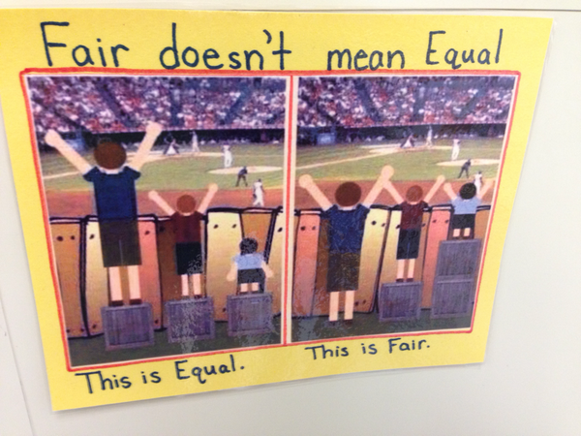
Fair Isn’t Always Equal by Rick Wormeli

Slide 38
Final Grade Principles
Final grade is proficiency on standards and THAT IS IT. Separate proficiency from behavior.
Late work, missing work, work habits, employability, participation, citizenship, etc. ARE important and deserve feedback and need to be reported…separately.

Slide 39
Citizenship district-wide should have consistency and “teeth”
“Cardinal Code” in Davison
“Creek Code” in Swartz Creek
Similar code in Grosse Ile
Armada: no code and two poor scores per marking period = ineligible (kinda)

Slide 40
Final Grade Specifics
Formatives earn students scores and feedback, but don’t count towards final grade.

Slide 41
Final Grade Specifics
Formatives earn students scores and feedback, but don’t count towards final grade.
Formative scores & feedback logged in PowerSchool, Seesaw, and on paper.

Slide 42
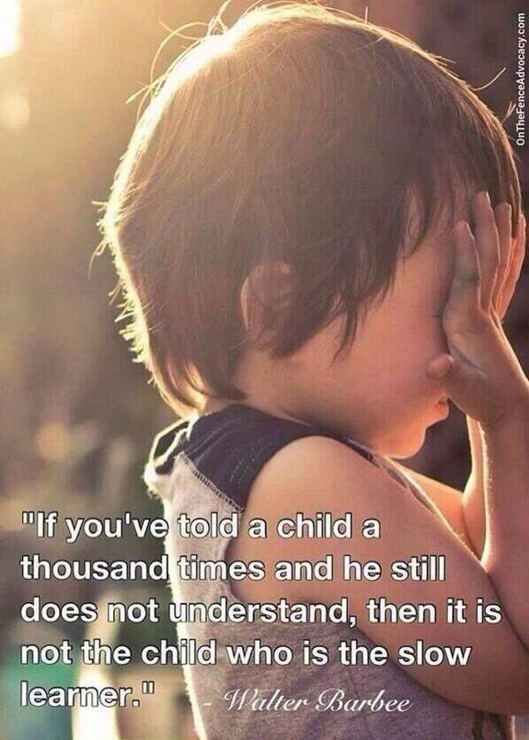

Slide 43
Final Grade Specifics
Formatives earn students scores and feedback, but don’t count towards final grade.
Formative scores & feedback logged in PowerSchool, Seesaw and on paper.
Only performance on summative counts.

Slide 44
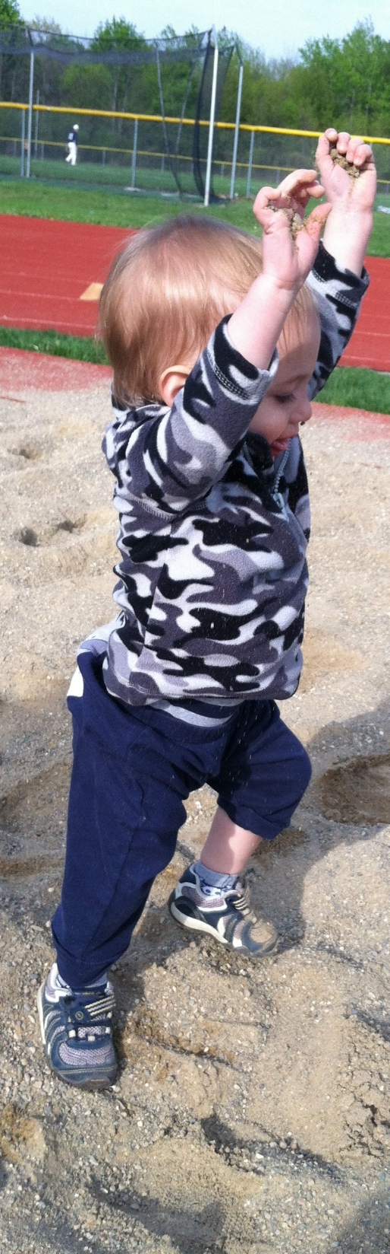
Missy O. earned
2, 3, 3, 4 in “Grammar”
Averaging
over time: 3
Final performance on summative: 4

Slide 45
Final Grade Specifics
Formatives earn students scores and feedback, but don’t count towards final grade.
Formative scores & feedback logged in PowerSchool, Seesaw and on paper.
Only performance on summative counts.
Can revise summative if not on the ICU list. ICU Formatives = “Retake Ticket”

Slide 46
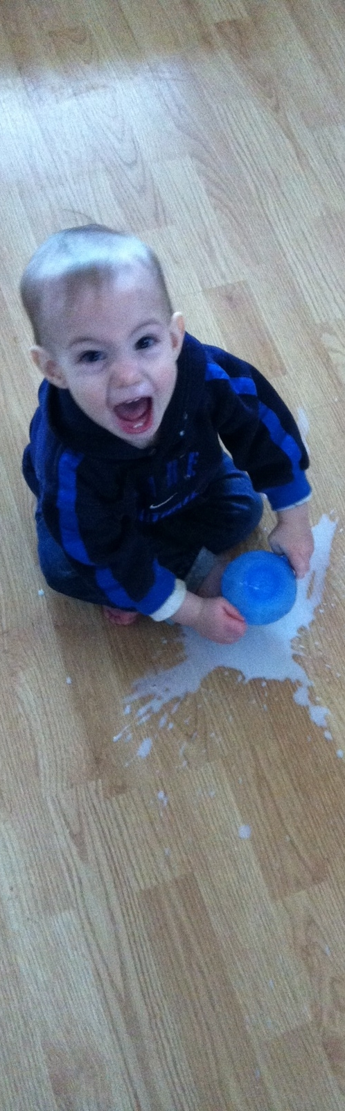
Wait…Students get zero extrinsic final grade motivation to do “homework”? They won’t do it if it’s not for points!
Oh really?
BUILD A CULTURE

Slide 47
Intensive Care Unit List = Magical Excel Spreadsheet
(page 7)

Slide 48
Intensive Care Unit List
Intensive Care and “Aggressive Compassion”

Slide 49
Intensive Care Unit List
Intensive Care and “Aggressive Compassion”
If I am convinced a task will help a student learn and grow, why would I “give up” on insisting they do it?

Slide 50
Intensive Care Unit List
Intensive Care and “Aggressive Compassion”
Never give up!
Feedback/scores are TIMELY

Slide 51
Intensive Care Unit List
Intensive Care and “Aggressive Compassion”
Never give up!
Feedback/scores are TIMELY
Proficient in all standards on a given task = off list

Slide 52
Intensive Care Unit List
Intensive Care and “Aggressive Compassion”
Never give up!
Feedback/scores are TIMELY
Proficient in all standards = off list
Stand at the door and increase consequences:
Guilt and Remind 101 EVERY DAY

Slide 53
Intensive Care Unit List
Intensive Care and “Aggressive Compassion”
Never give up!
Feedback/scores are TIMELY
Proficient in all standards = off list
Stand at the door and increase consequences:
Guilt & Remind 101 Everyday!
Work in hall until you address feedback
and revise to proficiency.
(I usually bring them back in after 10 minutes-ish)

Slide 54
Intensive Care Unit List
Intensive Care and “Aggressive Compassion”
Never give up!
Feedback/scores are TIMELY
Proficient in all standards = off list
Stand at the door and increase consequences:
Guilt & Remind 101 & Work in hall
Donate your time: before school, after, lunch with “Name on the board” ☺

Slide 55
Intensive Care Unit List
Intensive Care and “Aggressive Compassion”
Never give up!
Feedback/scores are TIMELY
Proficient in all standards = off list
Stand at the door and increase consequences:
Guilt & Remind 101 & Work in hall & Donate your time
Home contact: phone call, email,
paper letter that student writes

Slide 56
Intensive Care Unit List
Intensive Care and “Aggressive Compassion”
Never give up!
Feedback/scores are TIMELY
Proficient in all standards = off list
Stand at the door and increase consequences:
Guilt & Remind 101 & Hall & Time & Home contact
Explain how and why you are
on the ICU list to the principal

Slide 57
Intensive Care Unit List
Intensive Care and “Aggressive Compassion”
Never give up!
Feedback/scores are TIMELY
Proficient in all standards = off list
Stand at the door and increase consequences:
Guilt & Remind 101 & Hall & Time & Home & Principal
No “recess” = Dpop, auditorium, outside

Slide 58
Intensive Care Unit List
Intensive Care and “Aggressive Compassion”
Never give up!
Feedback/scores are TIMELY
Proficient in all standards = off list
Stand at the door and increase consequences:
Guilt & Remind 101 & Hall & Time & Home & Principal & Recess
www.poweroficu.com Danny Hill & Jason Nave
@PowerofICU Brickhouse Culture: Defeat Student Apathy

Slide 59
Intensive Care Unit List
Does it work?
For the past three years that I have been doing SBL, I have had about 100 Armada Juniors in four classes of English 11 per trimester. This is about 80% of all Armada Juniors.
For the past three years that I have been doing SBL, Armada’s ACT scores in English have been the highest in the history of the school, breaking its own record each year. In 2015, the AHS ACT composite score was the highest in school history.

Slide 60
Intensive Care Unit List
Does it work?
100 Armada Juniors in four classes of English 11 per trimester
300 English 11 junior final grades and
FIVE final trimester grades were E’s.
Two for lack of proficiency and
three didn’t complete summative.

Slide 61
Intensive Care Unit List
Does it work?
100 Armada Juniors in four classes of English 11 per trimester
300 English 11 junior final grades and FIVE final trimester grades were E’s.
1st trimester: 1,449 total student tasks proficient/1,550 total = 93.5%
2nd trimester: 1,460 total student tasks proficient/1,536 total = 95%
3rd trimester: 984 total student tasks proficient/1,057 total = 93.1%

Slide 62
Intensive Care Unit List
Does it work?
100 Armada Juniors in four classes of English 11 per trimester
300 English 11 junior final grades and FIVE final trimester grades were E’s.
First trimester: 1,449 total student tasks proficient/1,550 total = 93.5%
Second trimester: 1,460 total student tasks proficient/1,536 total = 95%
Third trimester: 984 total student tasks proficient/1,057 total = 93.1%
Total all year:
4,143 total student tasks on the ICU list.

Slide 63
Intensive Care Unit List
Does it work?
100 Armada Juniors in four classes of English 11 per trimester
300 English 11 junior final grades and FIVE final trimester grades were E’s.
First trimester: 1,449 total student tasks proficient/1,550 total = 93.5%
Second trimester: 1,460 total student tasks proficient/1,536 total = 95%
Third trimester: 984 total student tasks proficient/1,057 total = 93.1%
Total all year
4,143 total student tasks on the ICU list.
3,893 student tasks completed proficiently with timely, narrative, descriptive, standards-based feedback,
which is 94% completion proficiently with zero numerical contribution to their final grade. ☺
failed. All yearmeet at door to check (About 70% of students turn it in)
Give feedback & numbers. If student is proficient in all learning targets on the first try, they are off the ICU list. If not, they are given specific direction on how to revise.
1 day late: door check and disappointment. Exit reminder. Remind 101 (85%)
2 days late: door check and more disappointment. Exit reminder. Remind 101 (90%)
3 days late: door check, wait in hall and work on it until it is done. (96%)
4 days late: door check, students pick which chunk of their time they want to donate (99%)
Other methods: call home, email home, paper letter home, send student to other teachers/principal to explain ICU list and that they are on it, they can’t go to “recess” until it is done, do it in gym, etc.
@PowerofICU Brickhouse Defeating Student Apathy

Slide 64
Shameless Plug
STEM vs. “Flower” classes
are very different
Stemflower.weebly.com
@stemflowerlc
stemflowerlc@gmail.com

Slide 65
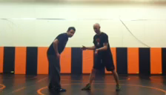
WWE Interlude

Slide 66
What if there were NO GRADES? No numbers, percentages, or indicators?
Discuss at your table and pick one “pro” and one “con” group member to share out in three minutes.

Slide 67
I realized that eventually, if kids understand growth mindset, culture of learning, and are “in,” then they don’t need numbers.

Slide 68
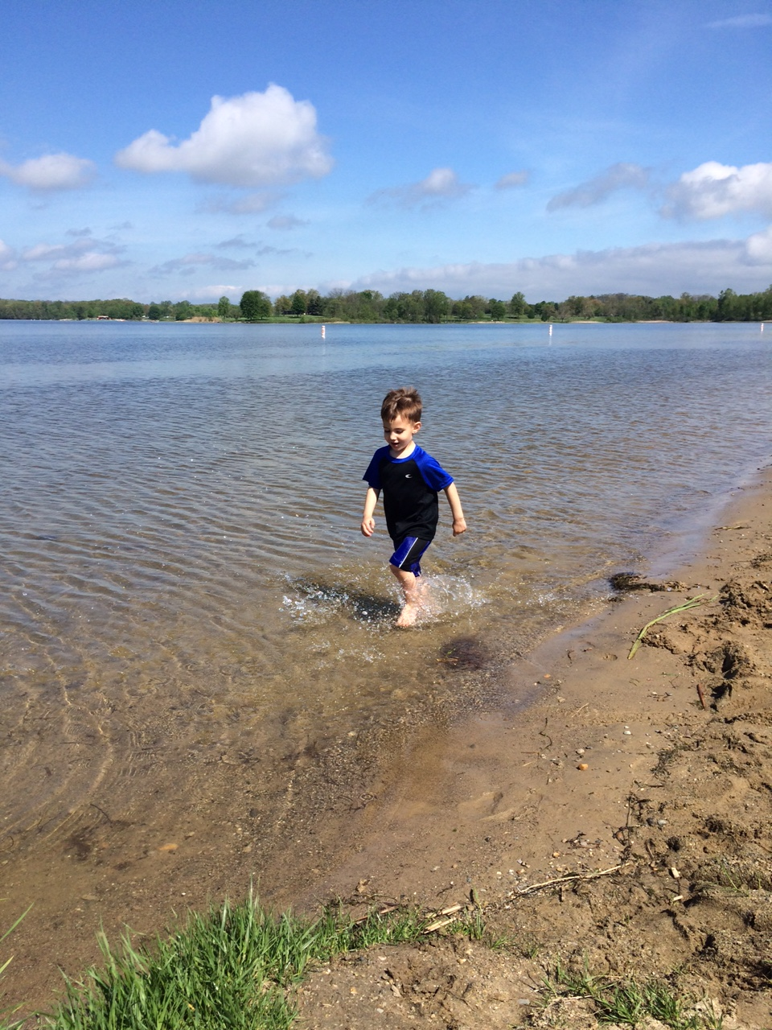
Which is the most effective feedback for mi hijito?
“Good job”
2.0 in focus
1.5 in speed
3.0 in aesthetics
2.0 in splashing
“Too slow; try again”

Slide 69
Which is the most effective feedback for mi hijito?
“I see you running. Is it challenging to run in the water? Why? What are you doing with your feet? What do you notice? I notice that the faster you run, the more you splash. Show me again. I can’t wait to see you run in the water again.”

Slide 70
#TTOG = Teachers Throwing out grades
Star Sackstein @mssackstein
Mark Barnes
@markbarnes19
Assessment 3.0: Throw out your gradebook and inspire learning

Slide 71


Slide 72
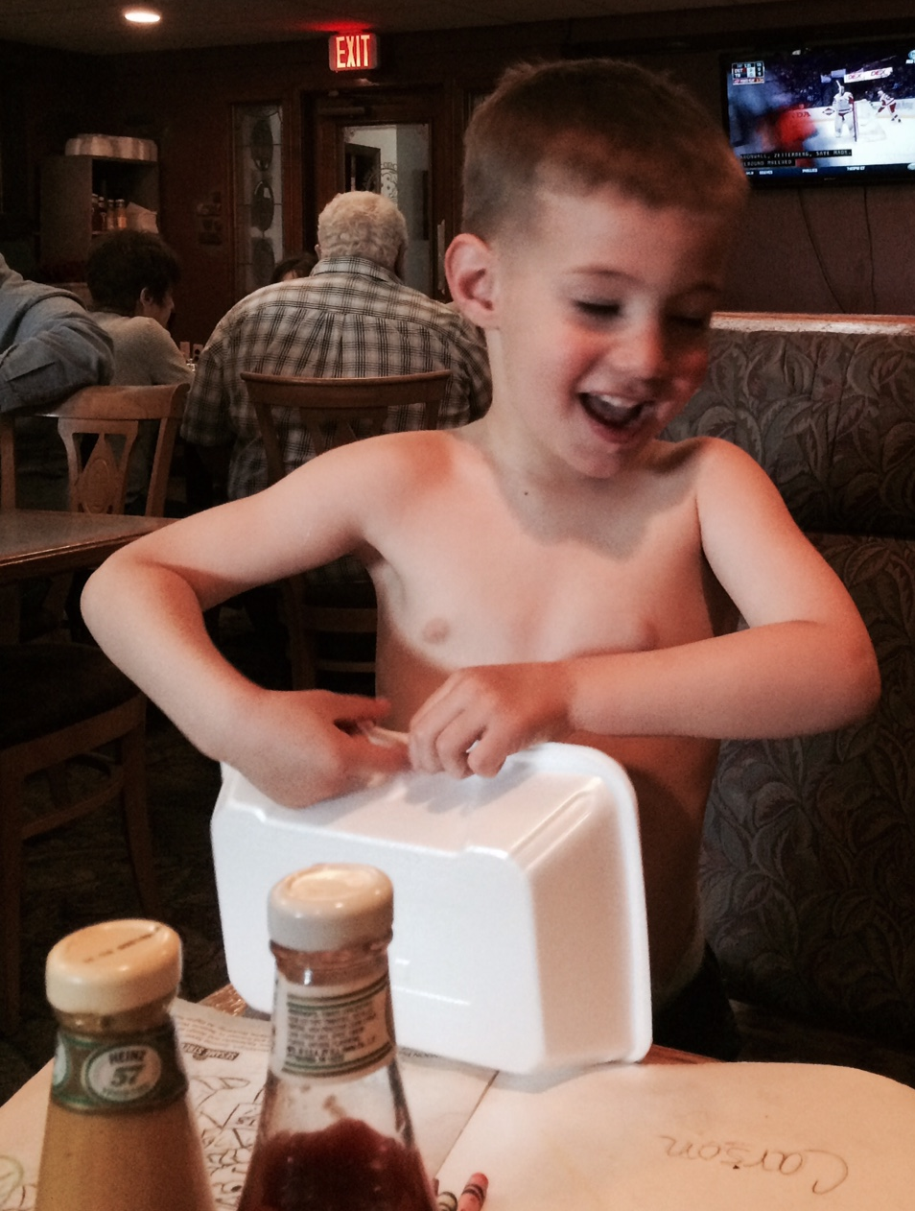
SBL ➔ TTOG
AP Lit. Seniors

Slide 73
SBL ➔ TTOG
AP Lit. Seniors
LTs: 12, 6, 0
(page 8)

Slide 74
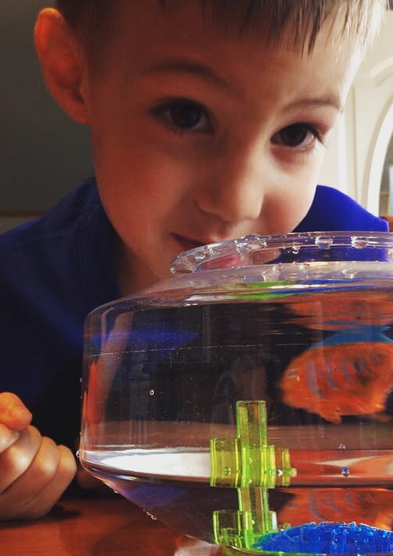
SBL ➔ TTOG
AP Lit. Seniors
LTs: 12, 6, 0
SE2R: Summarize, Explain, Redirect, Resubmit

Slide 75
SBL ➔ TTOG
AP Lit. Seniors
LTs: 12, 6, 0
SE2R
“Saw, didn’t see, how addresses specific standard, extra practice, resubmission”
(page 9)

Slide 78
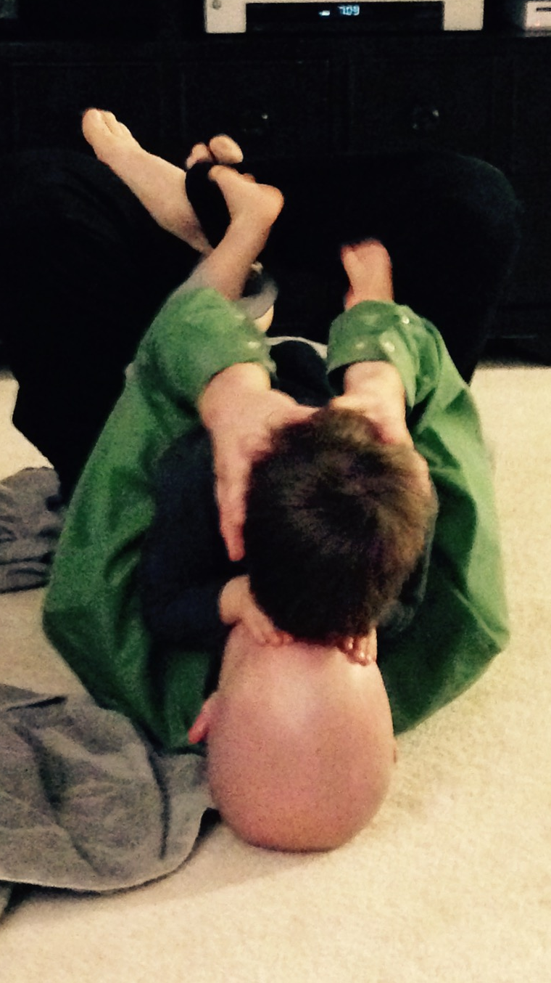
SBL ➔ TTOG
AP Lit. Seniors
LTs: 12, 6, 0
SE2R
“Saw, standards, practice, resubmit”
Abundance, not format, for evidence
Excel and graphs (5 students)

Slide 79
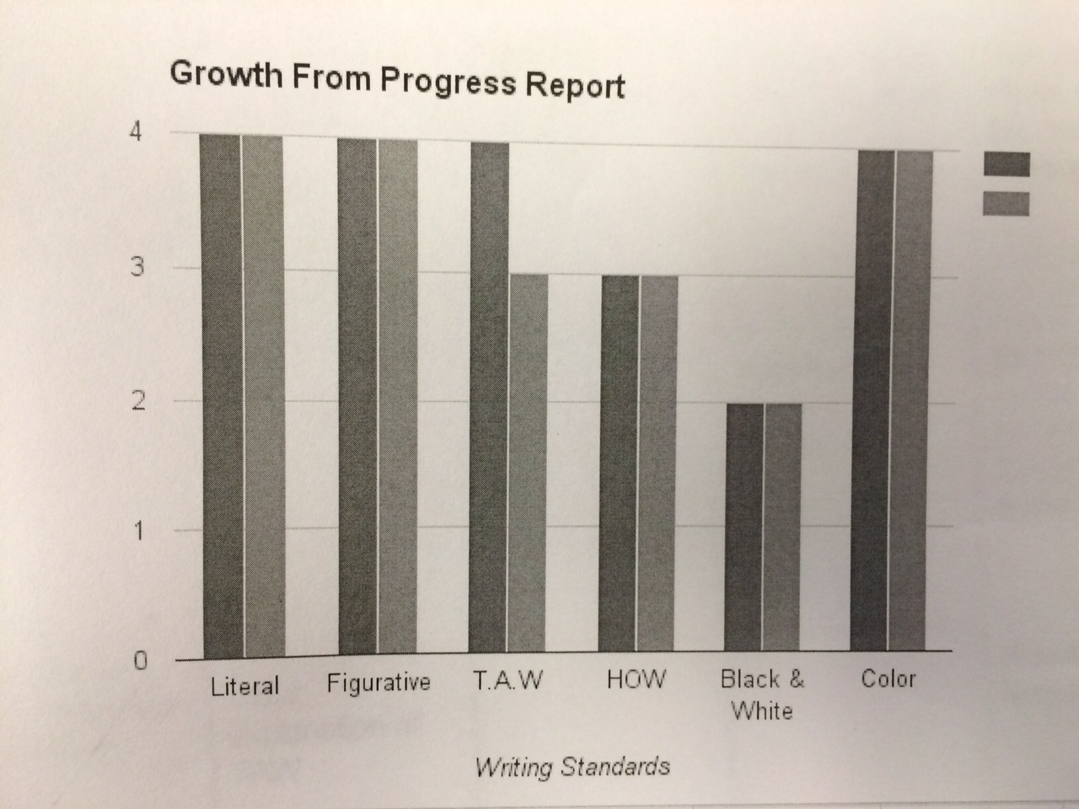

Slide 80
SBL ➔ TTOG
AP Lit. Seniors
LTs: 12, 6, 0
SE2R
“Saw, standards, practice, resubmit”
Abundance, not format, for evidence
Excel and graphs (5)
Physical Binder with dividers (11)

Slide 81
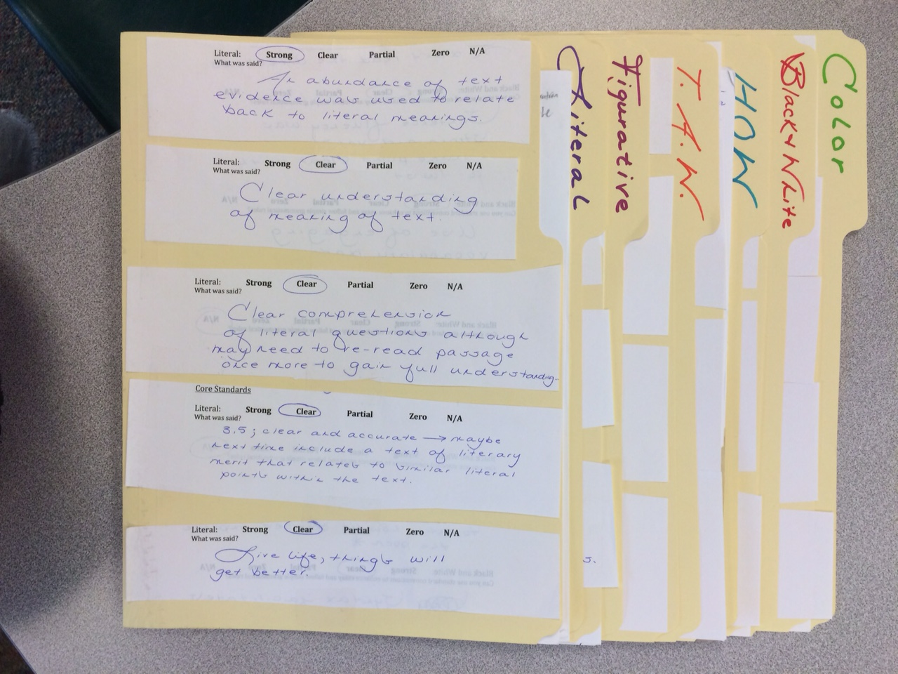

Slide 82
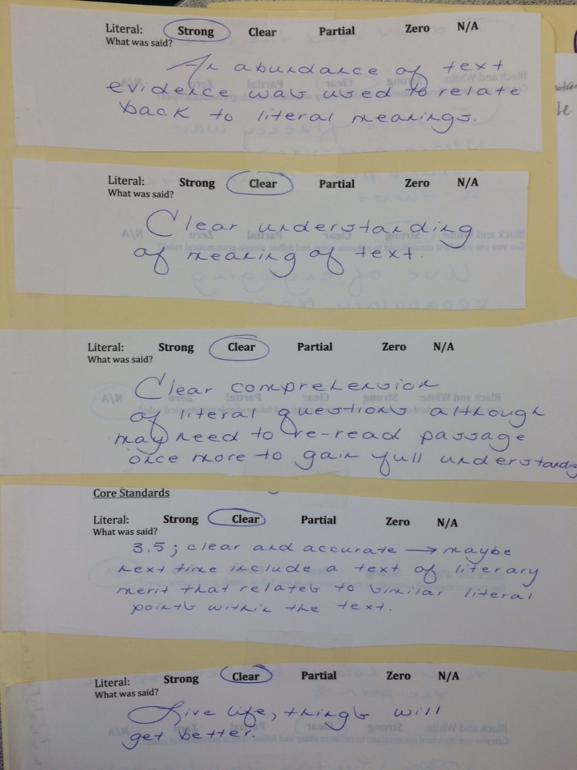

Slide 83
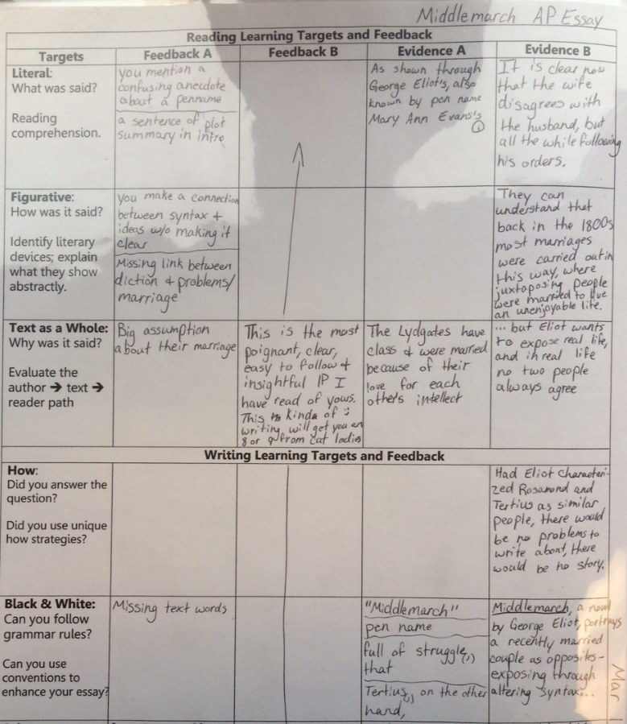

Slide 84
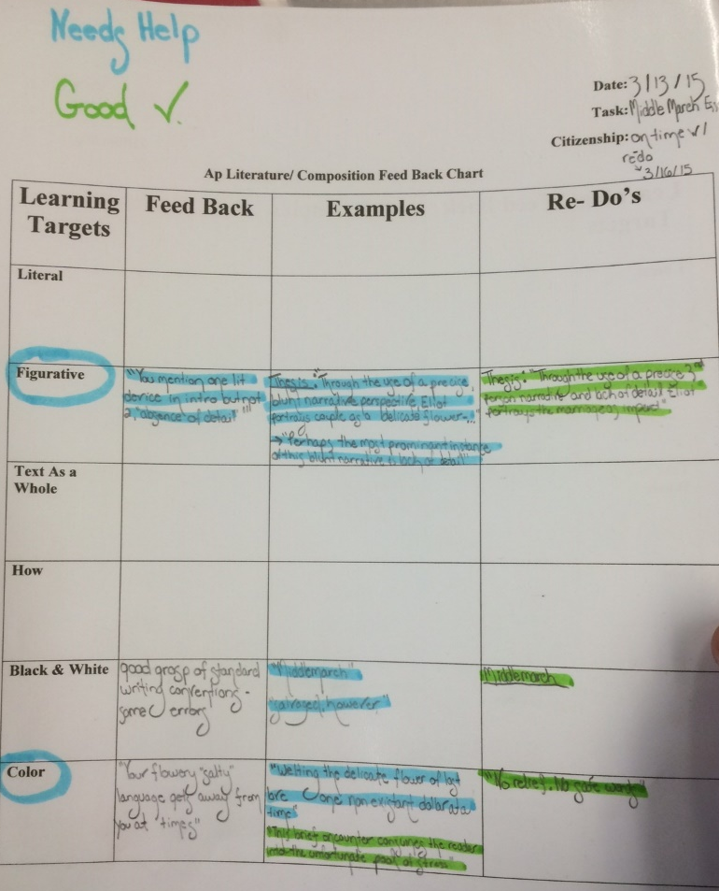

Slide 85
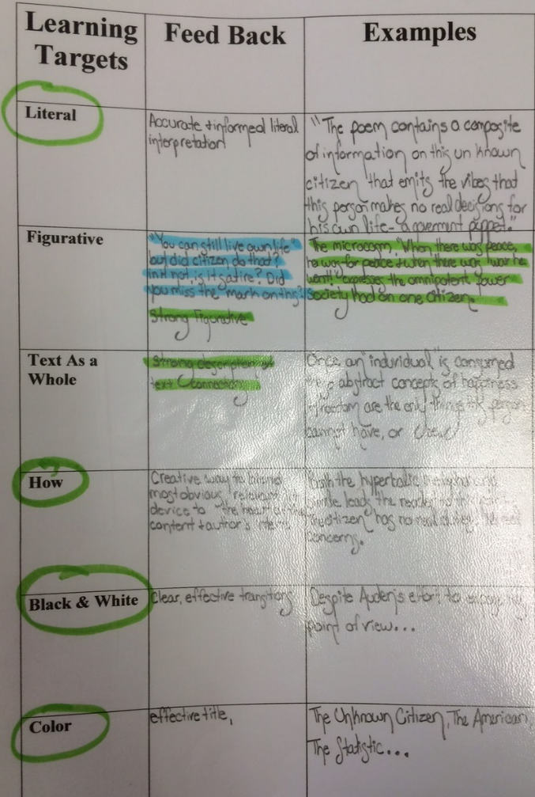

Slide 86
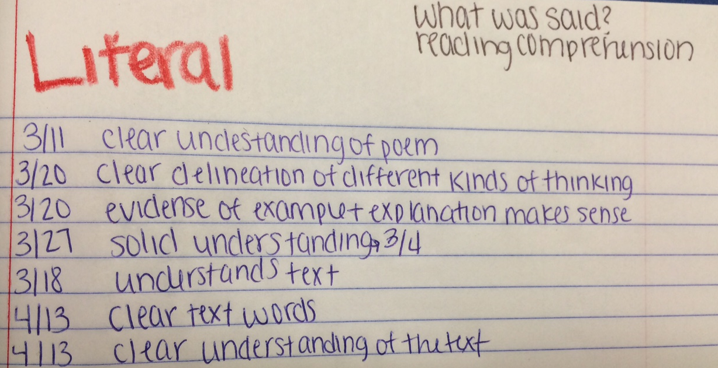

Slide 87
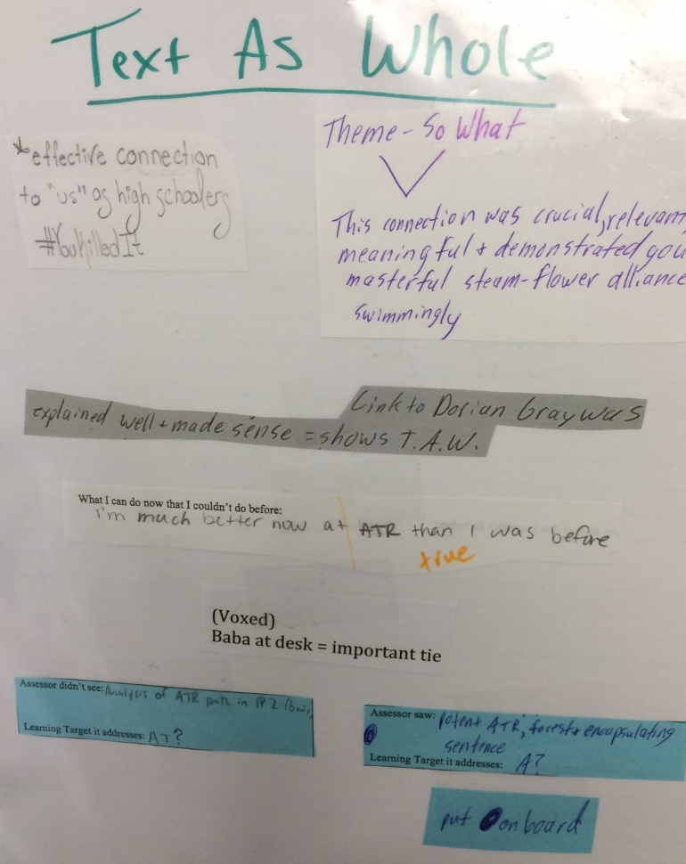

Slide 88
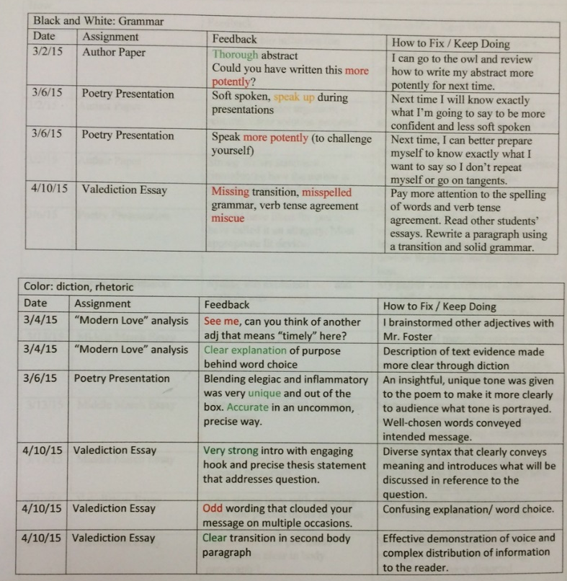

Slide 89
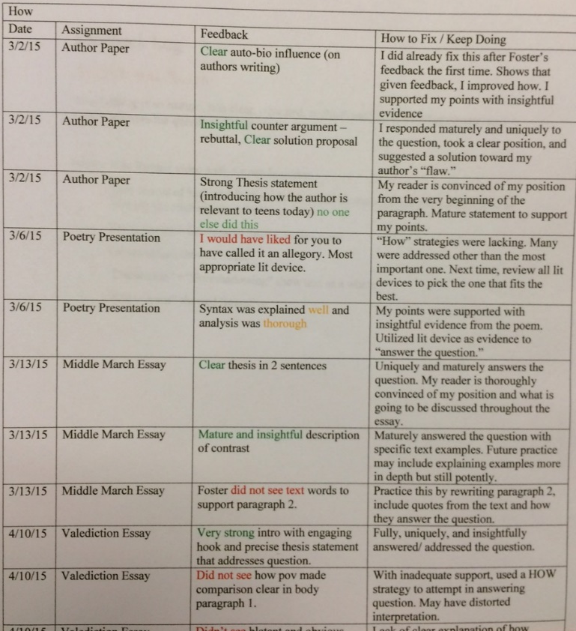

Slide 90
SBL ➔ TTOG
AP Lit. Seniors
LTs: 12, 6, 0
SE2R
“Saw, standards, practice, resubmit”
Abundance, not format, for evidence
Excel and graphs (5)
Physical Binder with dividers (11)
Blog (6)
  Apfoster.wordpress.com

Slide 91
SBL ➔ TTOG
AP Lit. Seniors
LTs: 12, 6, 0
SE2R
“Saw, standards, practice, resubmit”
Abundance, not format, for evidence
Excel graphs, binders, blogs
Weebly site (8)
  Rachelsfeedback.weebly.com

Slide 92
SBL ➔ TTOG
AP Lit. Seniors
LTs: 12, 6, 0
SE2R
“Saw, standards, practice, resubmit”
Abundance, not format, for evidence
Feedback form, whole class, Voxer, “see me”

Slide 93
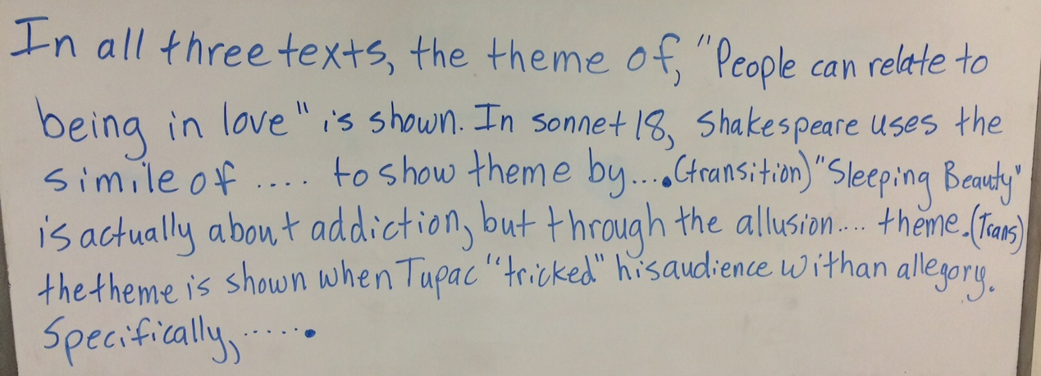
Whole Class Feedback

Slide 94
SBL ➔ TTOG
AP Lit. Seniors
LTs: 12, 6, 0
SE2R
“Saw, standards, practice, resubmit”
Abundance, not format, for evidence
Feedback form, whole class, Voxer, “see me”
Two mini-conferences, one final
(page 10-11)

Slide 95
SBL ➔ TTOG
AP Lit. Seniors
LTs: 12, 6, 0
SE2R
“Saw, standards, practice, resubmit”
Abundance, not format, for evidence
Feedback form, whole class, Voxer, “see me”
Two mini-conferences, one final
Two down, five up

Slide 96
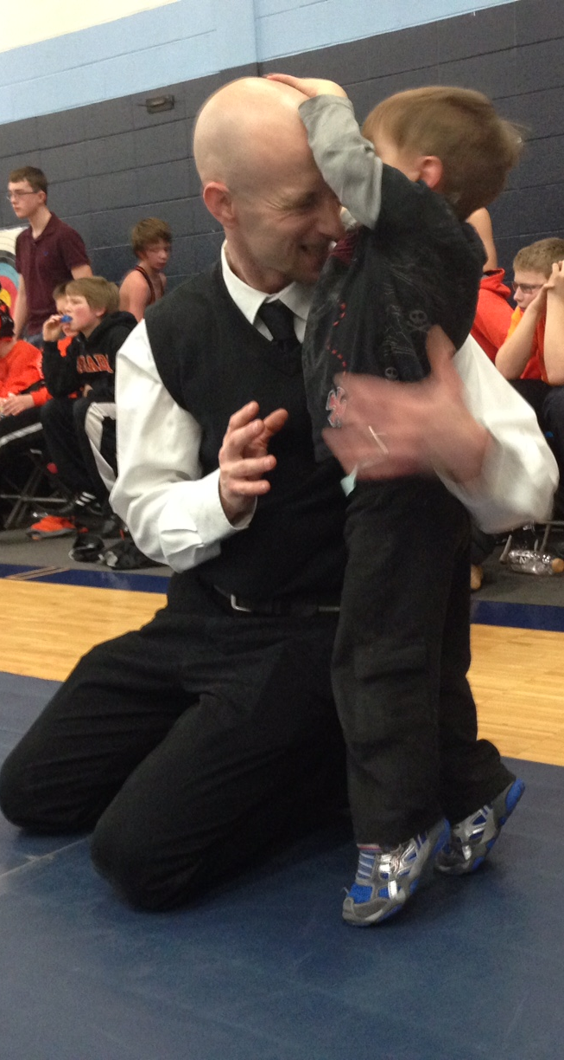
Does it work?

Slide 97
Does it work?
Zero parent, student or admin complaints

Slide 98
Does it work?
Zero parent, student or admin complaints
Kids’ positive feedback: final critique rebuttal ➔ 12, 6, 0 & could NOT do it on the 1st day
(page 12)

Slide 99
Does it work?
Zero parent, student or admin complaints
Kids’ positive feedback
Seniors felt respected, honored, & heard.

Slide 100
Does it work?
Zero parent, student or admin complaints
Kids’ positive feedback
Seniors felt respected, honored, & heard.
Same amount (if not less) work

Slide 101
Does it work?
Zero parent, student or admin complaints
Kids’ positive feedback
Seniors felt respected, honored, & heard.
Same amount (if not less) work
Strong rapport, “felt” like learning, authentic assessment

Slide 102
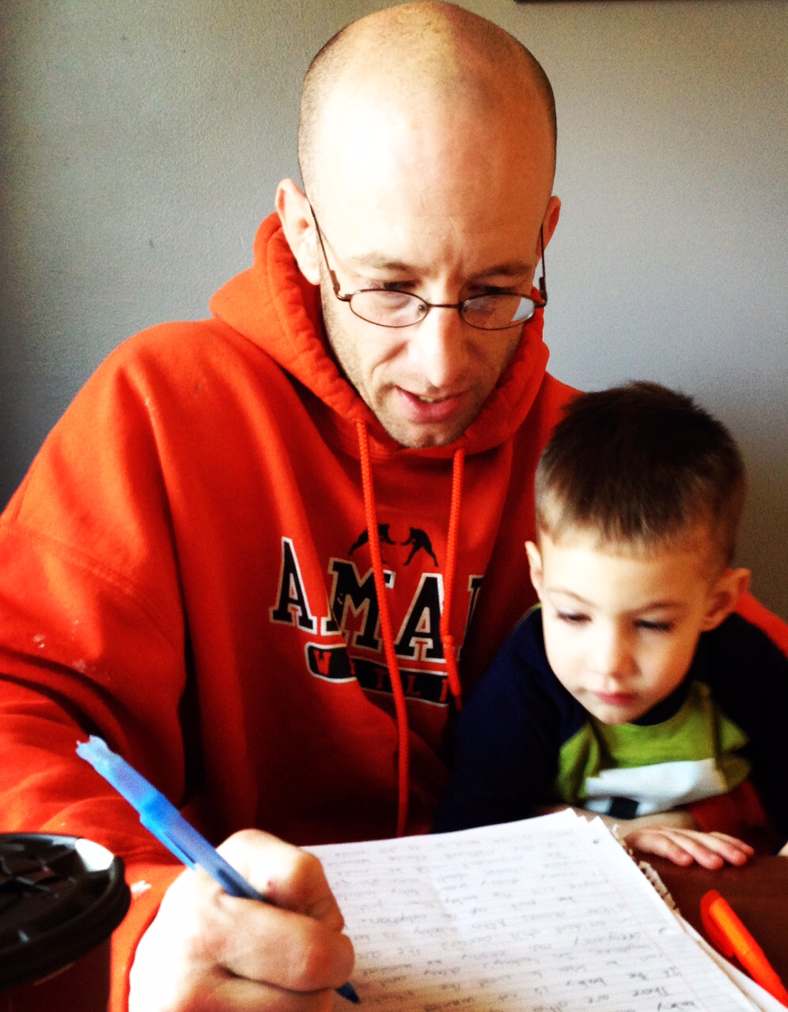
Questions?
Ask right now please
Comments?
@aricfoster2
afoster@armadaschools.org
Armadafoster.weebly.com
Complaints?
lwilson@armadaschools.org

Slide 103
Questions?
Ask right now please
Comments?
@aricfoster2
afoster@armadaschools.org
Armadafoster.weebly.com
Complaints?
jmoore@armadaschools.org

Slide 104
Welcome to your favorite part of the day
Aric Foster
afoster@armadaschools.org
armadafoster.weebly.org
@aricfoster2
The Right Side of History
One teacher’s ELA journey through the SBL process and into #ttog.

Slide 106
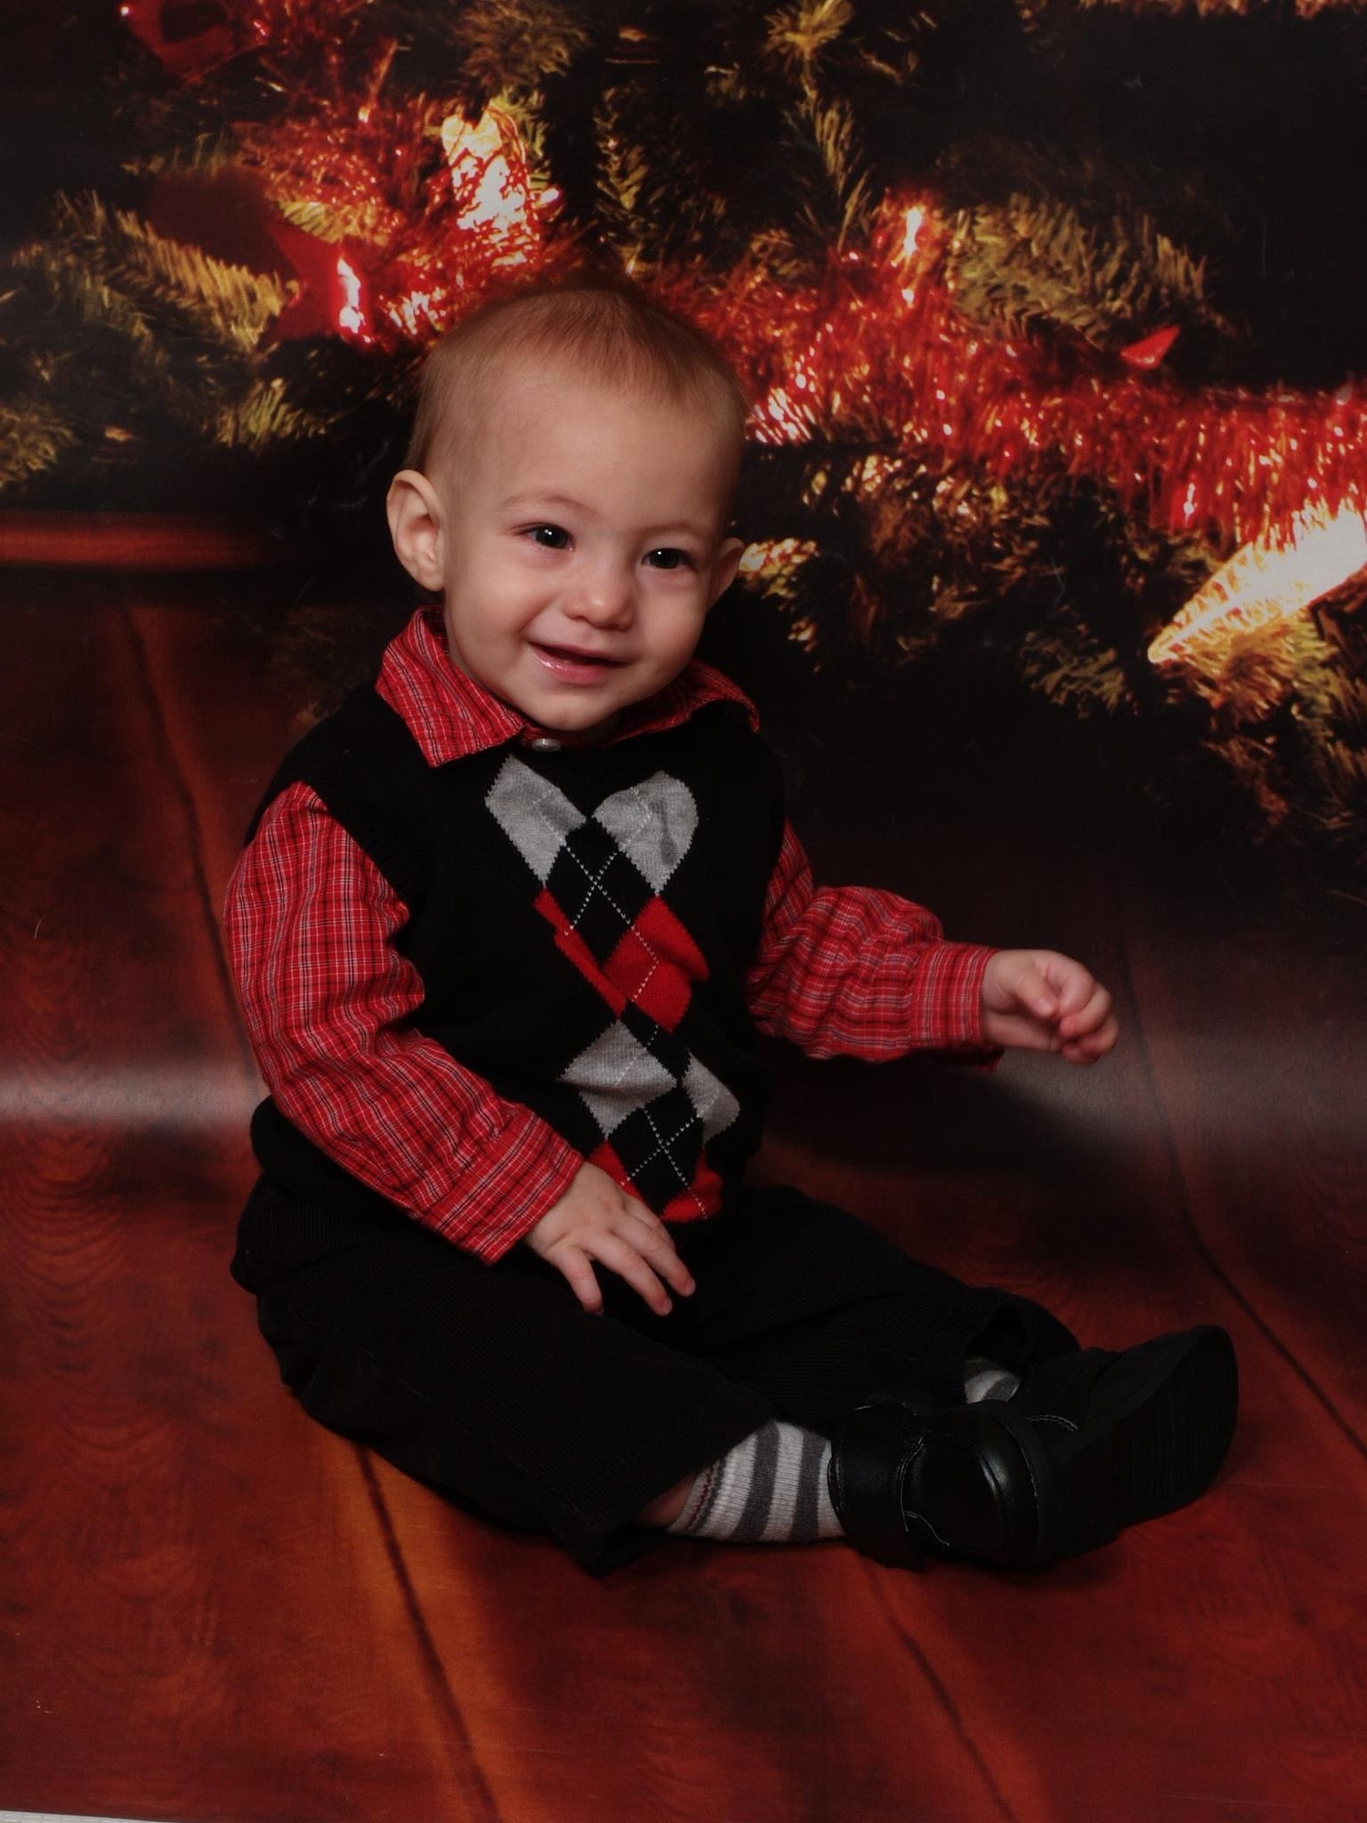
Downfalls
Front loading: 30 hours
Parents’ (mis)understanding
Grade chasers think it is unfair to get graded again if they already got a 4
Onion kids still sometimes just do nothing
Still need to include D.O.K. into activities

Slide 107
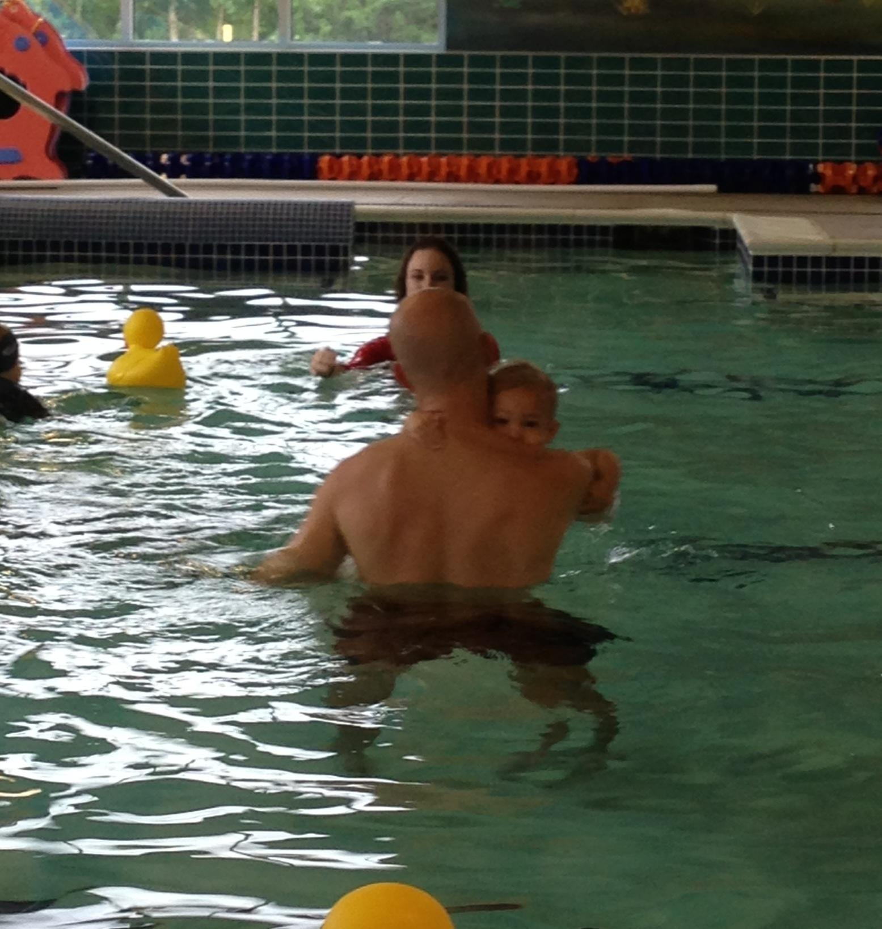
Unforeseen benefits:
Consistent, more efficient grading with appropriate, accurate feedback on the rubrics
2) Deeper student understanding of expectations
3) “B/C” students turn into “A” students
4) Old assignment flexibility: LOTF essay became “Use this to replace any skills”
5) Sub plans: “Work day to replace your skills”

Slide 108
SBG student:
Teacher: “How are those two words similar?”
Student: “The suffixes are the same – makes them the same part of speech.”
Student: “I should know what uniformity means, shouldn’t I?”
Teacher: “Maybe. What makes you think that you should know it?”
Student: “Cuz it has word parts and you will probably make me figure it out on my own.”
This shows that the kids are understanding the skills
and not just “doing a work sheet.”

Slide 109
Student reflections about SBG:
“Now our grade is only based on our skills in English”
“The only downfall is that other teachers don’t do it. We have been brainwashed to do school one way, and now I have to think differently about it in your class.”
“Grades aren’t based on just turning stuff in.”
“This kinda forces us to learn.”
“I was getting easy A’s, then your class came along, and I can’t play school anymore.”
“It’s all on us.”
“It actually shows how reliable you can be; it relates to the real world.”
“It forces you to do self-evaluation.”
“It easier to keep your grade up because you know you can always do better.”

Slide 110
Student reflections about SBG:
“How do you fail this class?”
“This is like a real job.”
“This motivates me to take your class more seriously…like a job.”
“(Citizenship) fixes the problem of waiting until the end (of the grading period) to redo (all the assignments).”
“This year was way harder than last year, but I learned more.”
“It’s easy to get caught back up.” From a student who earned a 24.4%
“If you do bad, you can redo everything.”
“It’s easy to recover.”
“You can’t fail unless you really try to.”
“The best part of this class was the (SBL) grading.”

Slide 111
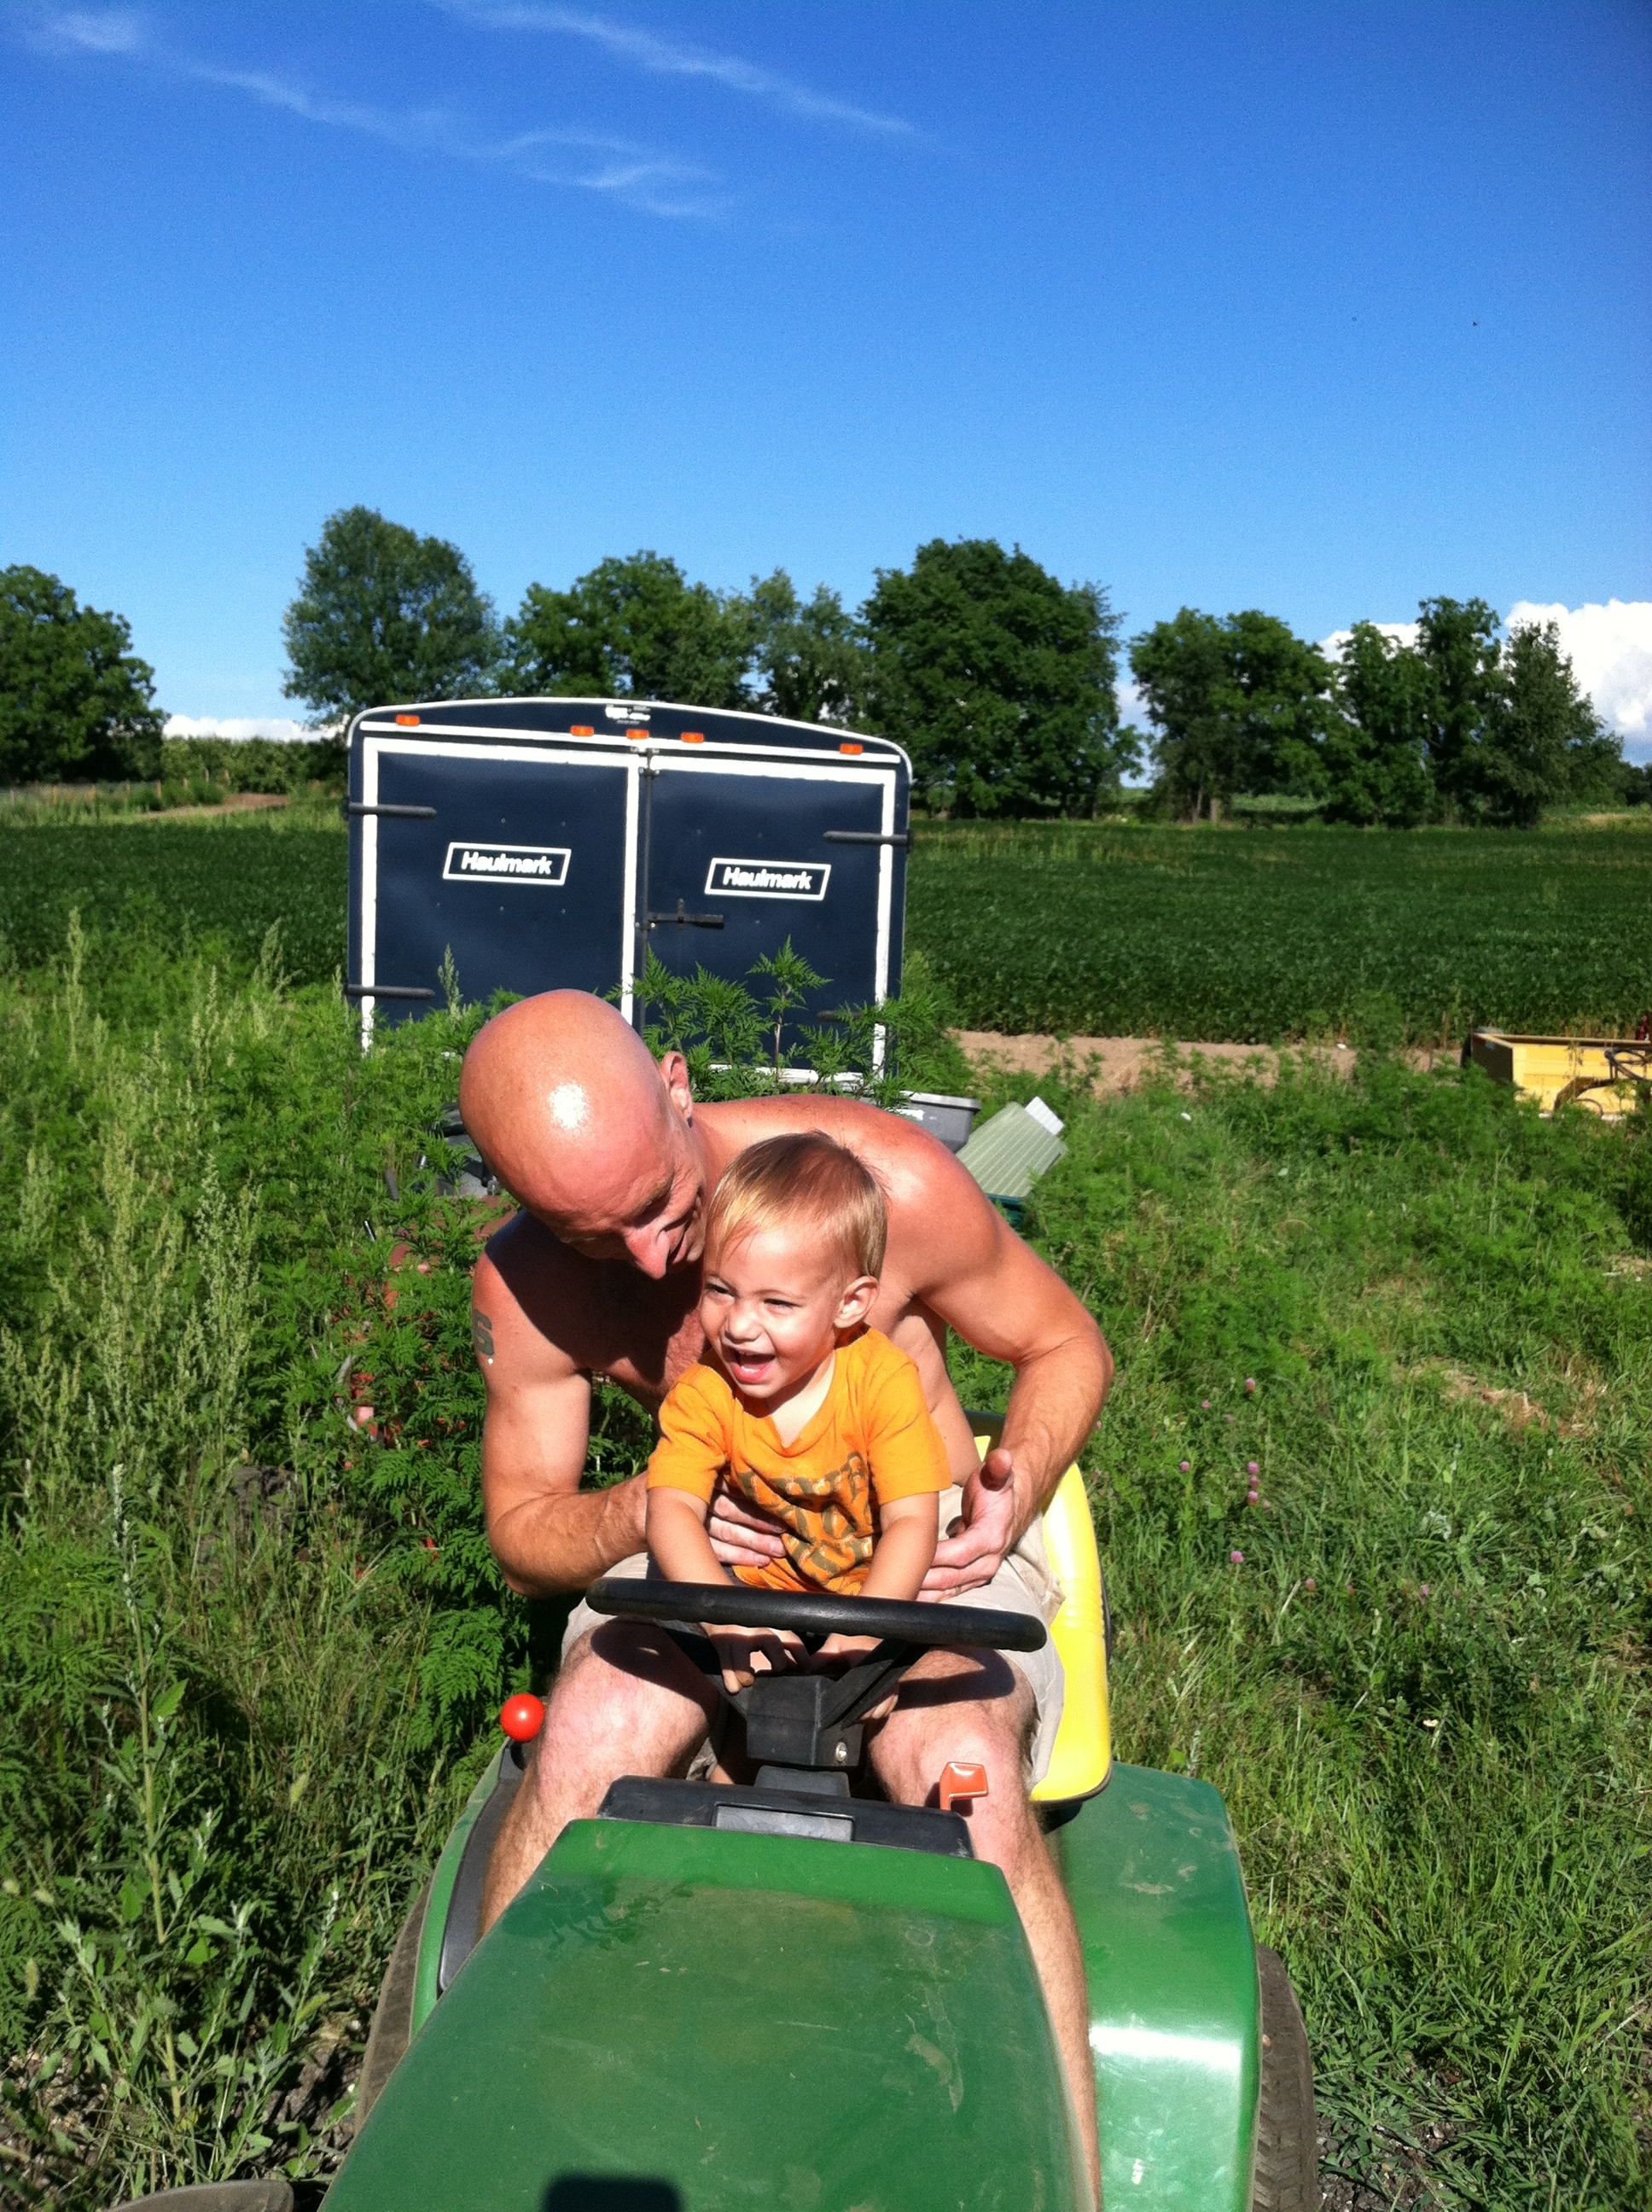
\
Questions? Concerns? Criticisms?
afoster@armadaschools.org
Armadafoster.weebly.com
Aric Foster

Slide 112
Why are you here?
To get seat time hours
Principal “insisted” on it
Truly interested in improving as a teacher
Trying to find a suitable significant other
Ironic Hypocrisy of PD:
Consultants present brilliant strategies while using ineffective strategies.
Pretest

