Slide 1
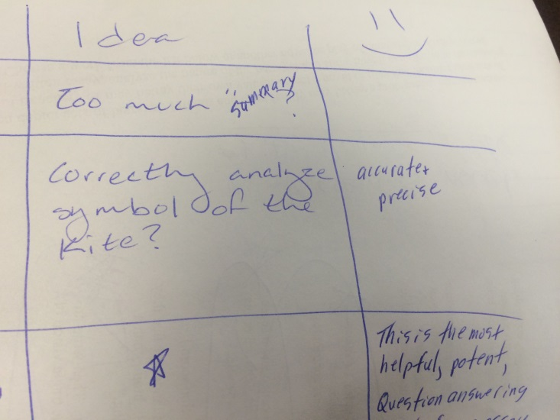
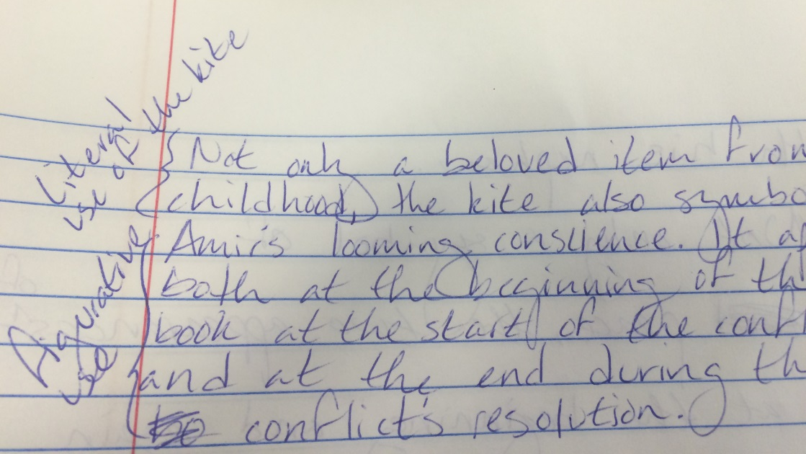
Literal

Slide 2
Figurative and Literal: Does anyone remember the eros poems?

Slide 3
Figurative

Slide 4
Text as a Whole

Slide 5
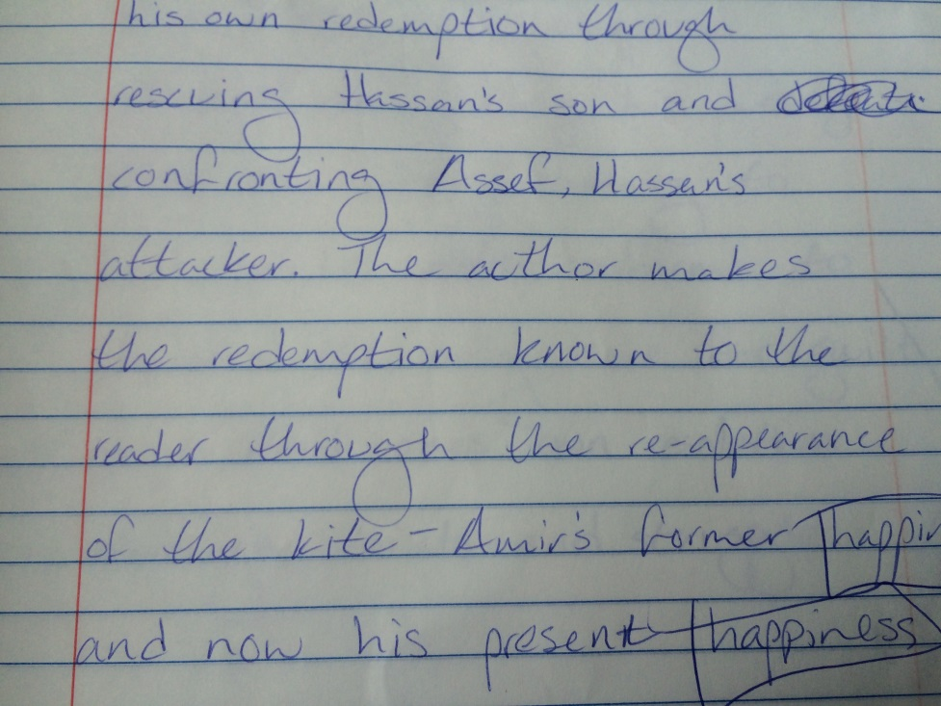
ATR Path

Slide 6
Black and White

Slide 7
Color

Slide 8
Color: Voice

Slide 9
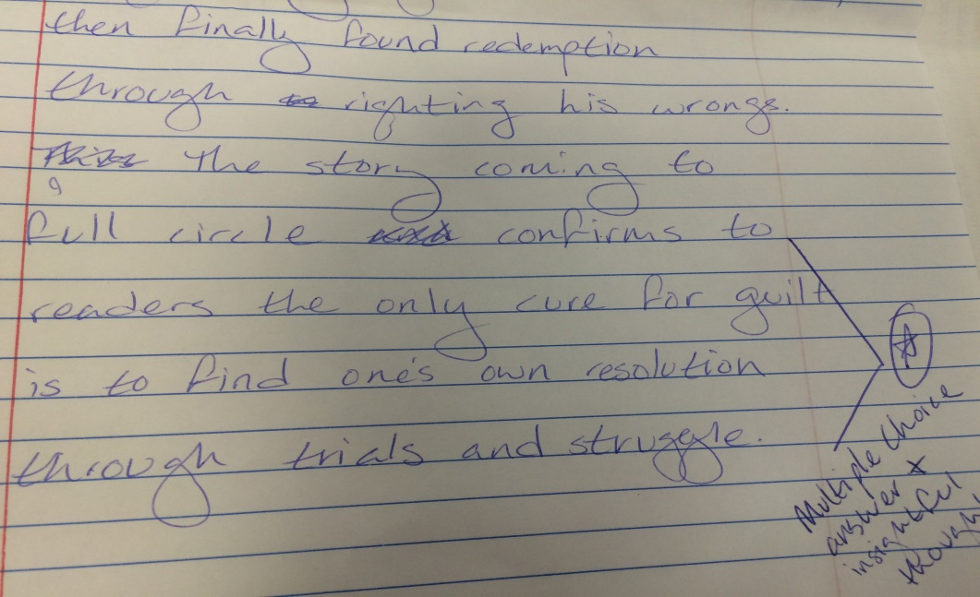
HOW/ Answering the Question

Slide 10
My Struggle Learning How

Slide 11
Based on all the feedback given and the current level my skills are at, I believe I deserve an A-.

Slide 12
A few thoughts on this year…

