Slide 1
College Prep
Senior Project

Slide 2
Components
An independent novel, weekly journals, and presentation over the novel
A research essay
Researching and using sources from MEL database
Completing an essay in APA format
A project involving the community, planning and organizing an event or activity, and/or job shadowing
An oral presentation with visual support based upon the research paper and the project
A student written self-evaluation
A static display

Slide 3
Senior project
This project will demonstrate students’ cumulative educational skills within a discipline of their choice. The focus of this project may be derived from any of the four core content areas, or the visual, performing, or applied arts. Students must consider their chosen career pathway when selecting a project focus area.
The goal of this project is also a demonstration of students’ independent research skills. This project will require a minimum of fifteen hours outside of class. Although this project will be monitored through ENGLISH, the paper and project will be completed independently and outside of regular class time. Students must also find a mentor in the subject area of their topic.

Slide 4
Evaluation of armada senior project
The evaluation for this project will have five parts:
Evaluation of weekly submission for the independent reading project and presentation
Evaluation of the written paper by the senior English teacher
Evaluation of the final presentation by a panel of evaluators/English Teacher
Evaluation of the community project, planned and organized event or activity, and/or job shadow
Evaluation of the student-written reflection of the total project by senior English teacher

Slide 5
Project must be completed to graduate
The culminating senior project components ARE the final exam for the third trimester.
NO WRITTEN PAPER = NO PRESENTATION.
NO PRESENTATION = NO FINAL EXAM.
NO FINAL EXAM = NO GRADE FOR SOME STANDARDS
NO GRADE FOR STANDARDS = DANGER OF FAILING AND NO GRADUATION

Slide 6
Timeline
Trimester 1
Topic selection
Find a mentor
Select a novel (read and complete weekly journals)
Topic and novel approval
Novel presentation (3-5) minutes
Introduction to APA formatting
Begin research
Students final exam will be composed of their weekly IRP journals and the final presentation for the novel.
Trimester 2
APA Research Essay (February 22nd).
Begin community involvement, leadership activity, and/or job shadows
Students final exam will be their APA Research Essay grade
Trimester 3
Continue with community project
Attend and present for curriculum night (static visual aid)
Self written evaluation
Community, leadership activity/event, and/or jab shadow reflection
Final presentation
Students final exam will be the presentation grade, self-written evaluation, and Community, leadership activity/event, and/or jab shadow reflection

Slide 7
Research Paper: Big Idea
Civic and personal responsibilities
Civic -- relating to the duties or activities of people in relation to their town, city, or local area.
What responsibilities do you have to yourself and the world around you

Slide 8
Research Paper: Choose a theme
Leadership takes many forms
Leadership begins with knowing and standing for what you believe in
Taking a stand requires courage
One person or group can make a difference
Citizens of America have responsibilities to be part of the world community

Slide 9
Research Paper: Choose two or three essential questions
What responsibilities do I have to society?
How can I effectively articulate my opinions and perspectives?
What leadership qualities have I developed?
What qualities define a good world citizen?
How can I create the world in which I want to live?
How can I use my talents to create new opportunities for myself and others?
How can I make an important contribution to the world?

Slide 10
Anchor text
The foundation of the senior project will include at least one anchor text. This text must be a minimum of one hundred pages in length and must be approved by the student’s mentor in the subject area of the chosen topic.
Examples of anchor texts are fiction, nonfiction, biography, poetry anthology, epic poem, drama, etc. Students must have a minimum of one anchor text.
Previously used classroom texts cannot be used as anchor texts

Slide 11
Time management
The project requires a minimum of fifteen hours outside of class
Although the research and process project may require some class instruction, the paper and process should be completed independently and outside of regular class time.
I will allow time in class whenever possible but plan on being responsible for managing your time because the project is due regardless of the time set aside for it in class.
Bring your novels to class so that when there is time you are prepared to effectively use it.

Slide 12
Research Essay
Write a formal research paper, which is supported by your anchor and linking texts (a minimum of two linking texts must be from MEL database). Also include experience involving the community, leading and activity or event, and/or completing a job shadow. The research paper follows department guidelines which include:
The paper will be 1300 – 1600 words in length
APA format with a minimum of 8 quotations, 2 appendices, and 5 sources (a minimum of two from MEL database and the anchor text)

Slide 13
Involve the community
Develop and lead community involvement connected to your Big Idea, Theme, and Essential Questions
Reflect on the overall experience and the knowledge gained throughout the experience
Explain how this experience impacted you in connection to your selected theme and essential questions
Write a one-two page reflection of this experience
Include this experience in the final presentation

Slide 14
Written reflection of your experience with the senior project
Discuss why you chose the topic
Explain what you learned through your research, and presentation of the topic
Discuss how you will apply what you learned through this experience

Slide 15
Final Presentation
Time to get ready for graduation

Slide 16
Community Piece: Get Involved
Options
Job shadow
Find somebody who you can job shadow—reach out for contacts
Create, Lead, Invent, Volunteer
Start a fundraiser
Create an event with a purpose of for a cause
Design something or create something that can impact others
Volunteer or complete community service hours in connection to your topic
Participate
Find something in the community connected to your topic that you can become a part of

Slide 17
Create, Lead, Invent, Volunteer
Health care field
Volunteer at a nursing home
Raise money for a foundation
Lead a small group talk where you invite people form the community to bring awareness to a topic
Create pamphlets that can be made available at locations to learn more about a specific topic
Take a CPR/life guarding/ASL sign language etc. class on your time

Slide 18
Create, Lead, Invent, Volunteer
Down syndrome
Raise money for a foundation
Attend events planned through the program FEDS
Volunteer at the special Olympics
Collect donations and complete a walk for the cause
Marine Biology/Veterinarian/Animal Testing/Animal therapy etc.
Volunteer at the zoo
Raise money for donations
Detroit Zoological Society Humane Youth Award application and process
4H fair
Animal Welfare Workshop (Grades 9-12)
Volunteen at the Detroit Zoo

Slide 19
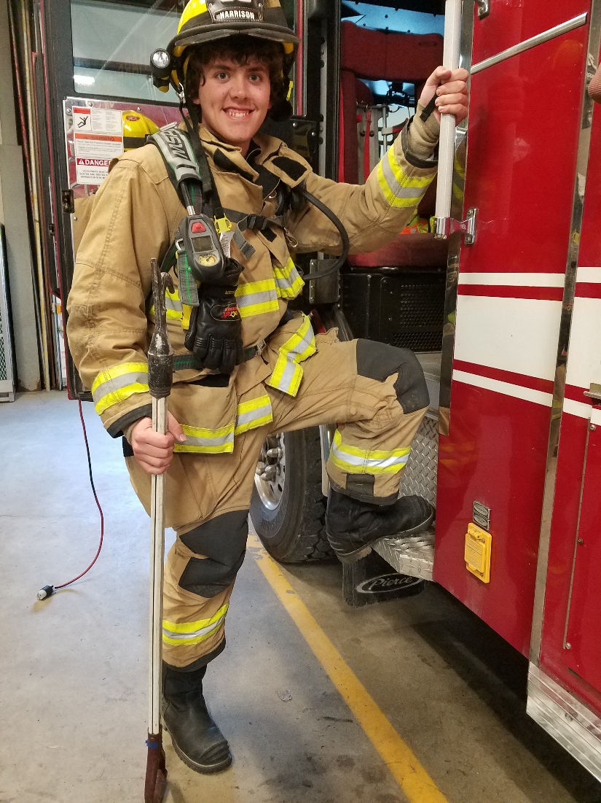
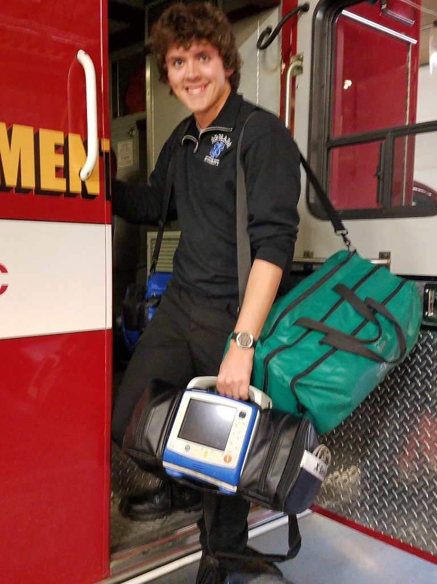
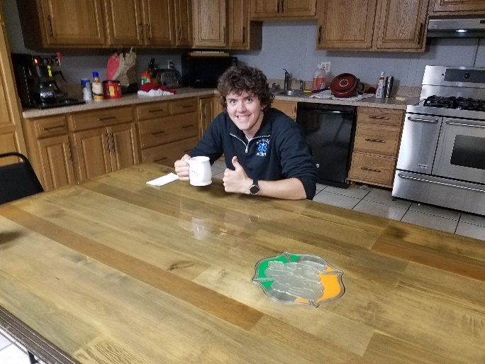
Student Examples of Community piece

Slide 20
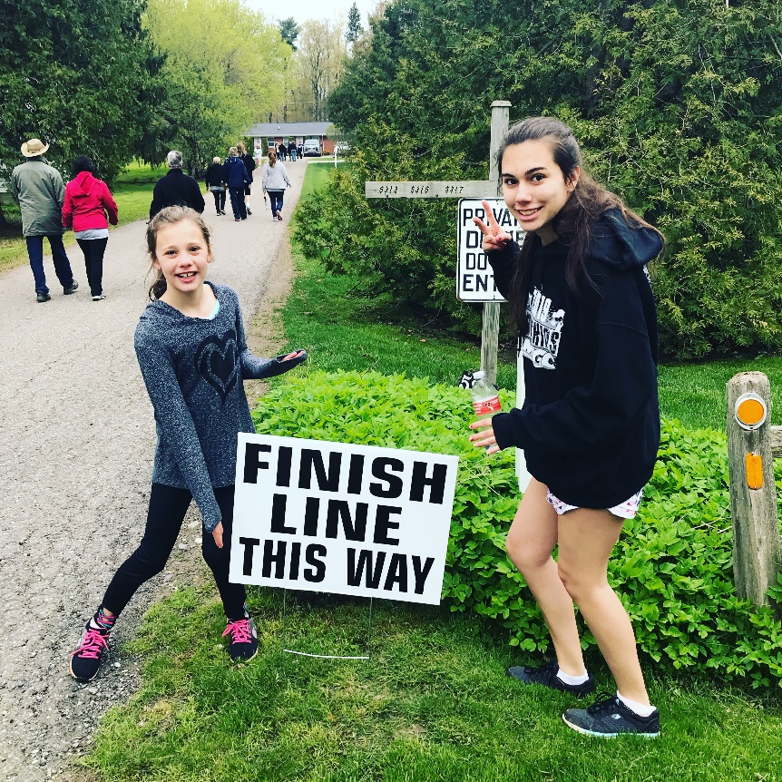
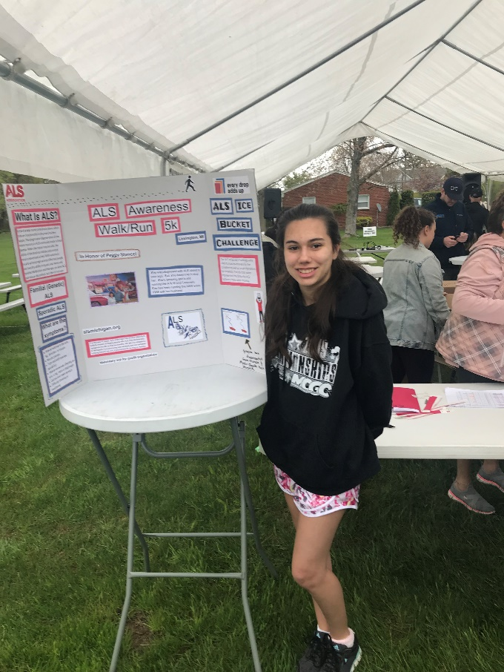
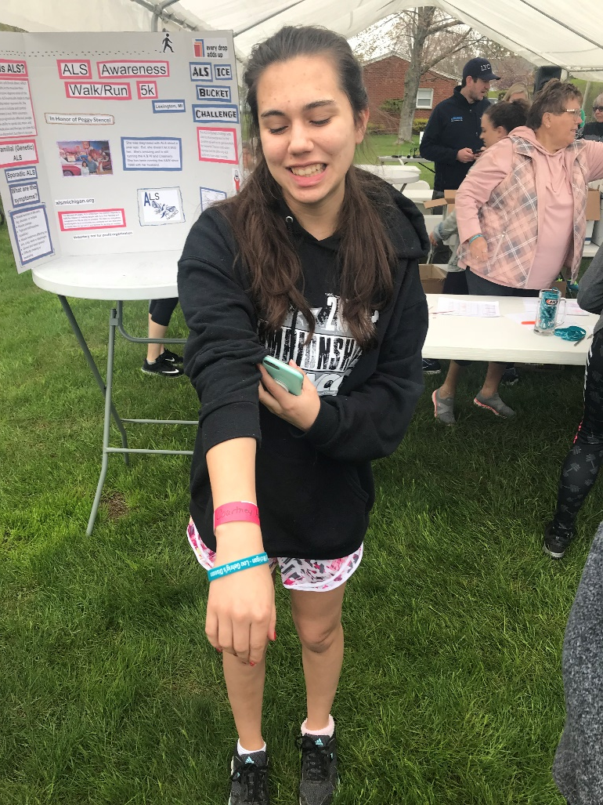
Student Examples of Community piece

Slide 21
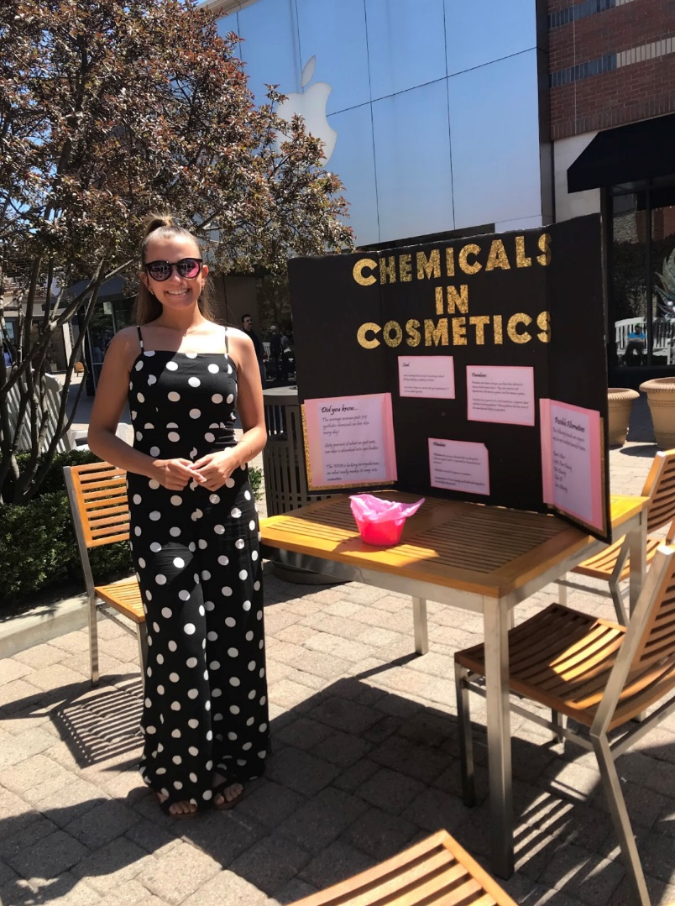
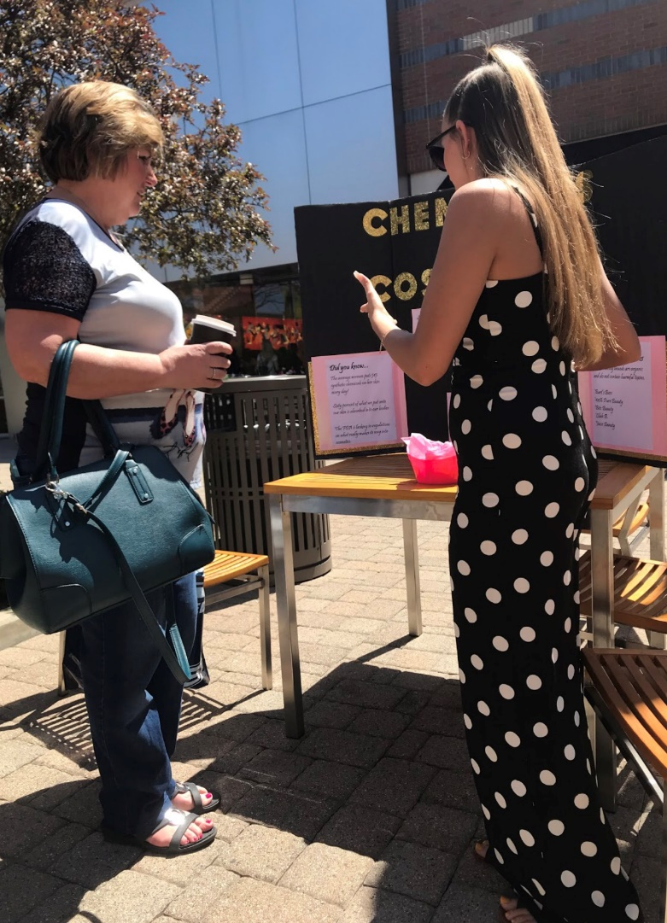
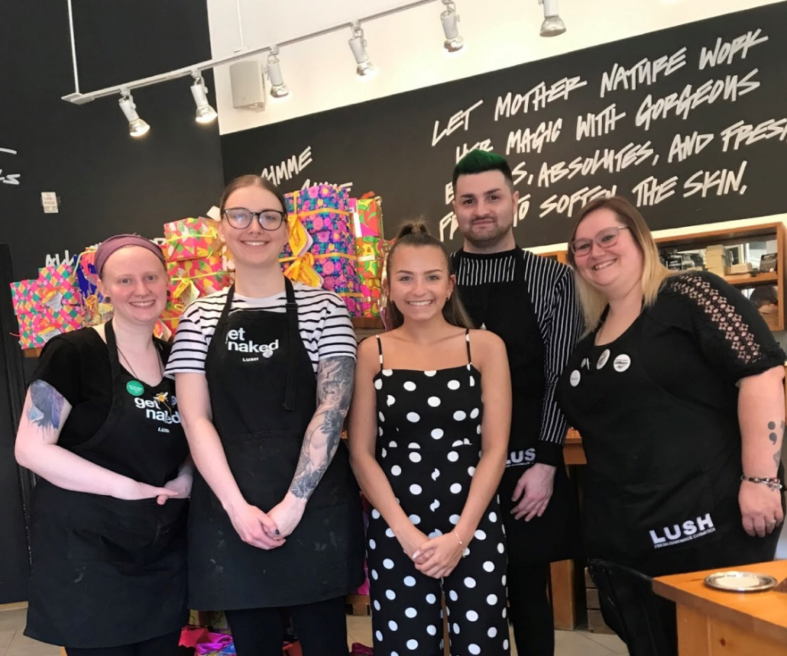
Student Examples of Community piece

Slide 22
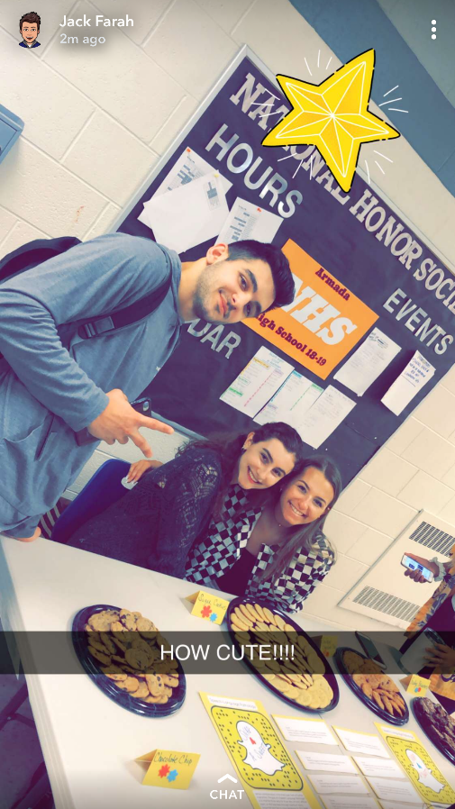
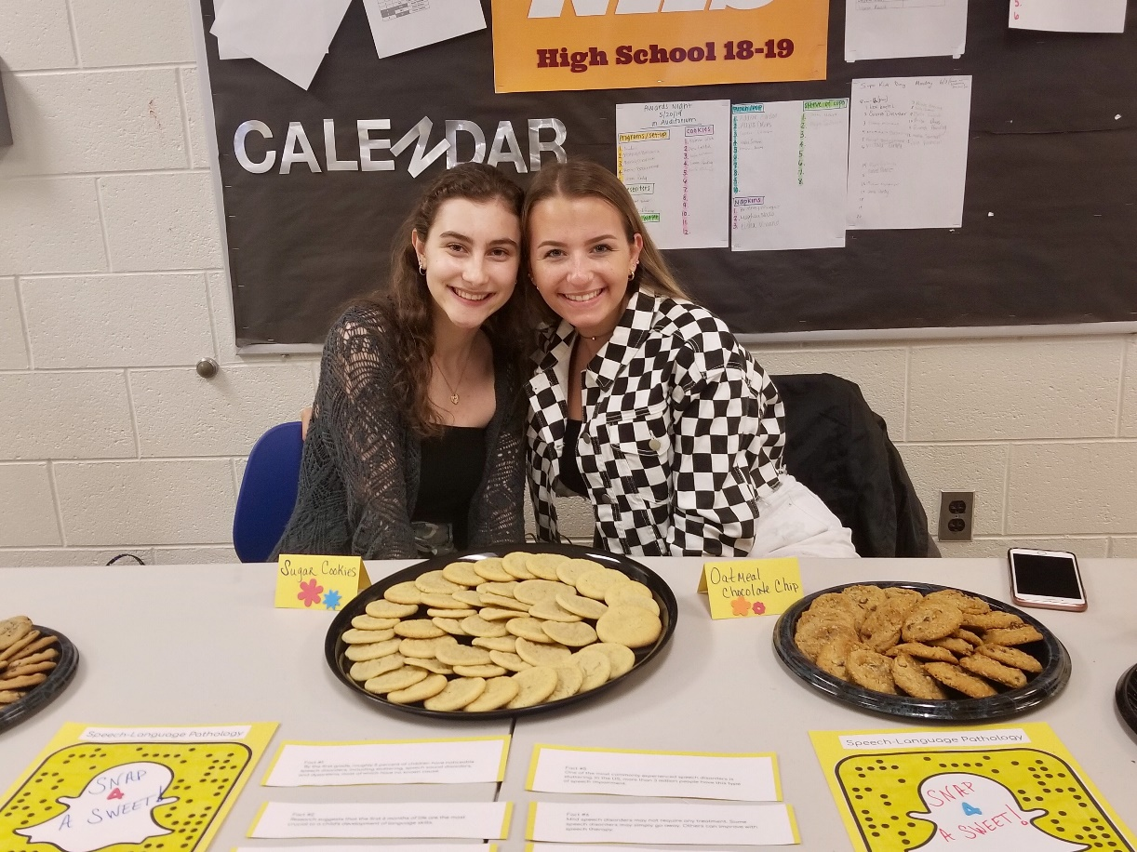
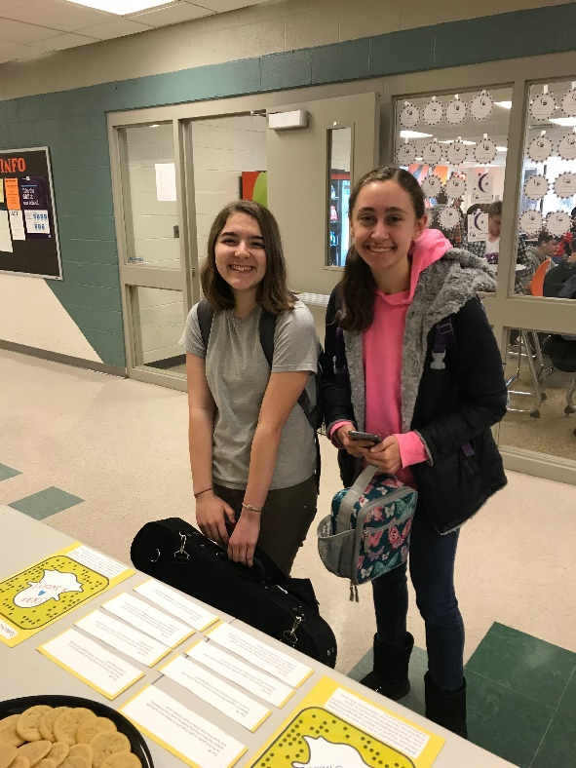
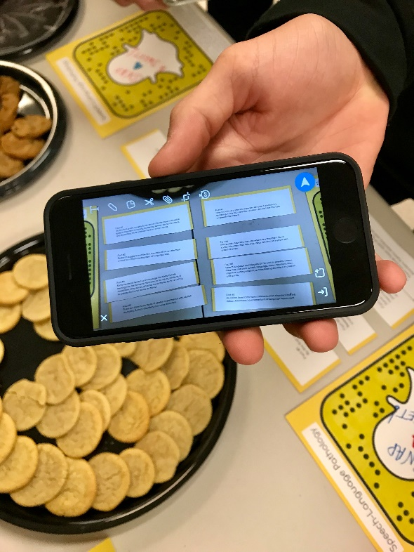
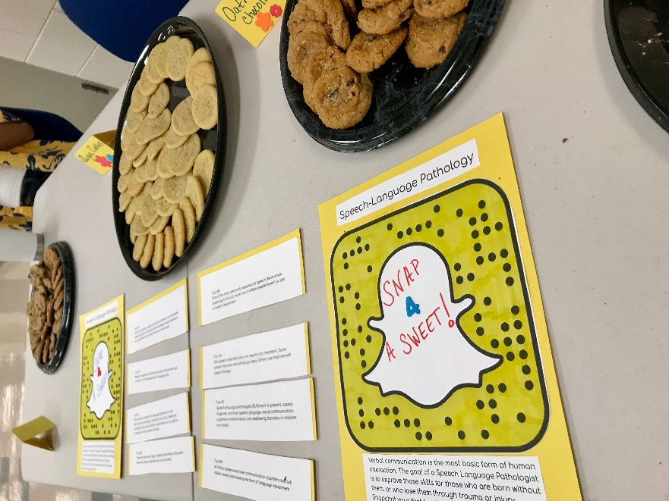
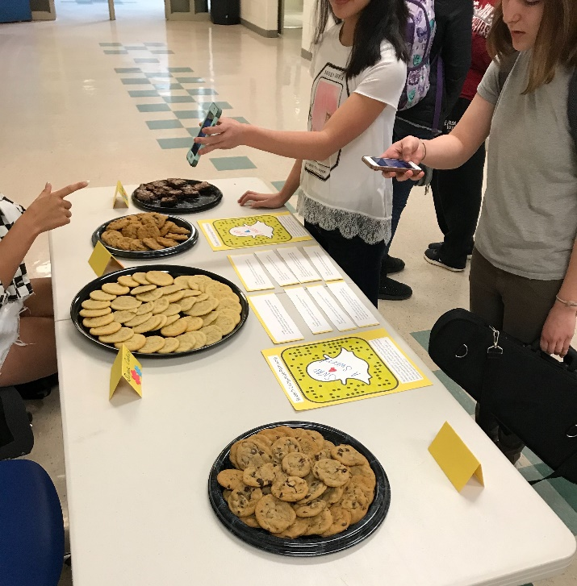
Student Examples of Community piece

Slide 23
Evaluation of senior project
A common rubric will be used to provide feedback and evaluation of the written research paper: This evaluation will be completed in the second trimester of senior English.
A common rubric for use by the panel will provide feedback and evaluation of the presentation: This evaluation will be completed in the final weeks of the third trimester.
The panel is yet to be determined but ideally it will be composed of three individuals including one language arts teacher, one non-language arts professional, and one community member.
Students will write a reflection about the experience of designing and constructing a senior p

Slide 24
Example
Topic Obesity (passionate about fighting obesity)
Book – Butter
A lonely obese boy everyone calls "Butter" is about to make history. He is going to eat himself to death-live on the Internet-and everyone is invited to watch. When he first makes the announcement online to his classmates, Butter expects pity, insults, and possibly sheer indifference. What he gets are morbid cheerleaders rallying around his deadly plan. Yet as their dark encouragement grows, it begins to feel a lot like popularity. And that feels good. But what happens when Butter reaches his suicide deadline? Can he live with the fallout if he doesn't go through with his plans? With a deft hand, E.J. Lange allows readers to identify with both the bullies and the bullied in this all-consuming look at one teen's battle with himself.
Research obesity in the nation (including problems and solutions)
Lead an exercise class (planning and/or organizing an event)
Get donations for a campaign that fights obesity (or have students buy a bracelet/bake sale/etc.)Encourage and get members of community to sign up for a physical activity (fighting pie run)
Job shadow a dietician, weight watchers employee, gym teacher etc.

Slide 25
Example
Challenges high school students face: homework, peer pressure, time management etc. (they are unprepared)
Book –
Research serious topic high school students face, why and how they can be more prepared, problems
Reality High
This is what came of it
Job shadow a youth leader, high school counselor, social worker, etc.

