Slide 1
Back to Basics: Engagement
Aric Foster
STEM & Flower Learning Consultants
stemflowerlc@gmail.com
stemflower.weebly.com
@stemflowerlc
Back to Basics
Foundations of effective teaching

Slide 2
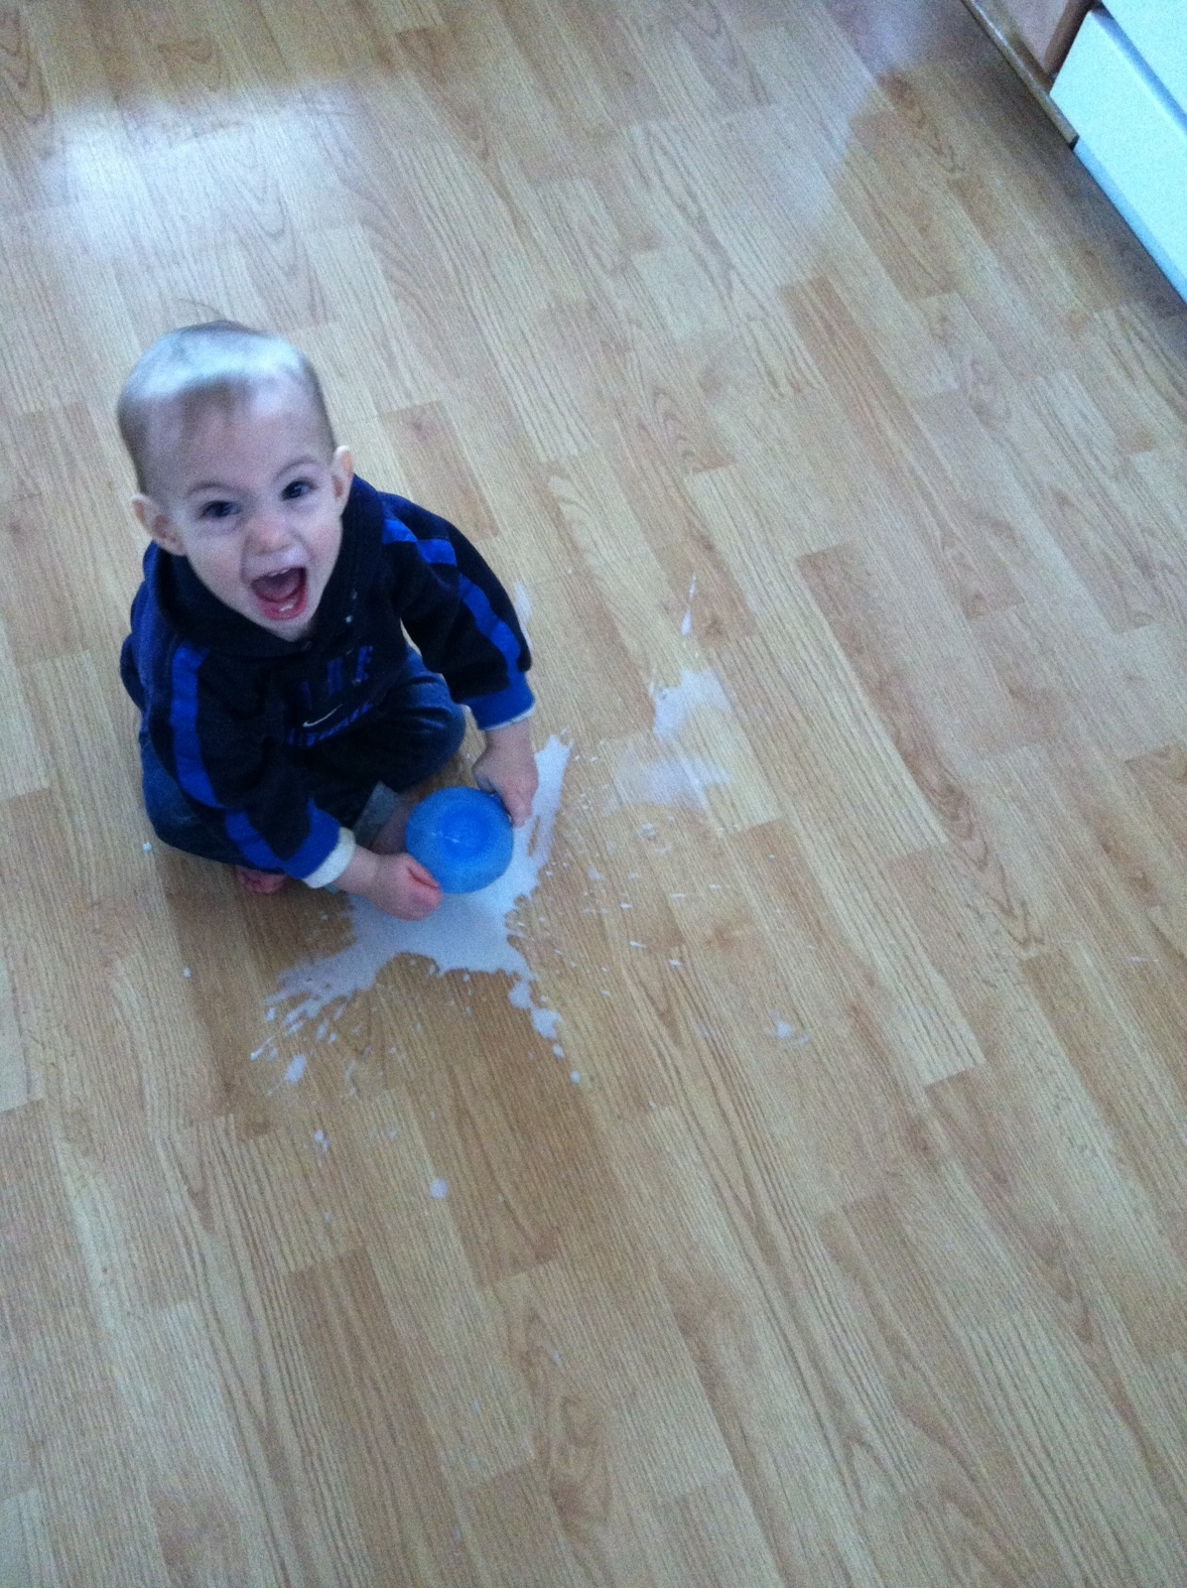
Ready to see some groovy activities?
Go to armadafoster.weebly.com
for a thorough explanation of each activity and for more activities not covered today.
All activities are vocabulary
activities and can be
modified for different content
areas and ages.
(Pages 16-20)

Slide 3
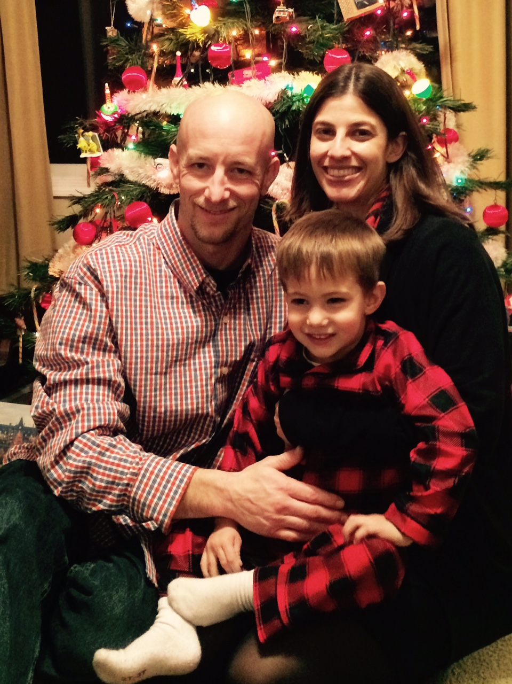
El Serpiente
Works with concepts too
Kids’ favorite
Social motivation
Day before quiz
3:00 Video example

Slide 4
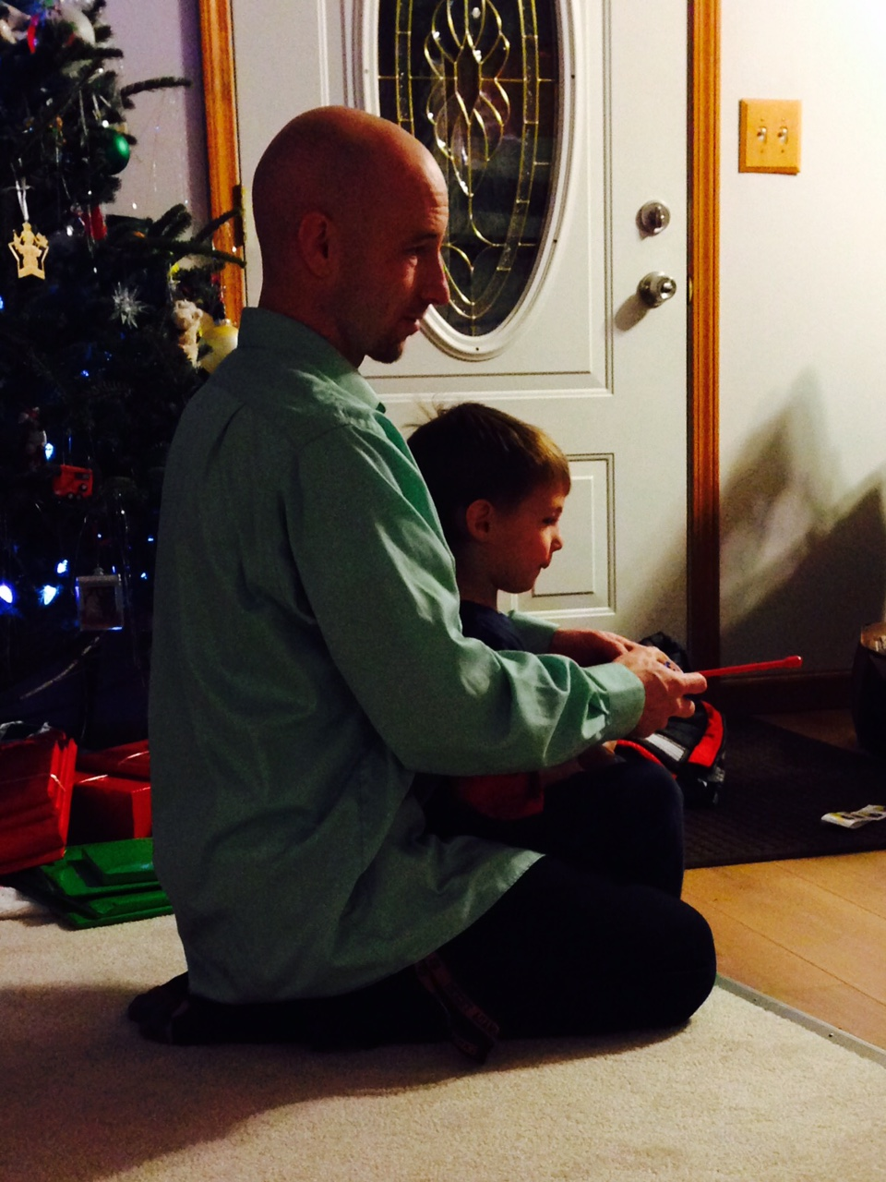
All Stars
Fly swatter (super?)

Slide 5
All Stars
Fly swatter
Dice game
2 & 3: Act it out
4 & 5: Draw it
6 & 8: Kinda not really
9 & 10: Antonym
11 & 12: Pre/suffix
7: Use it in a sentence

Slide 6
All Stars
Fly swatter
Dice game
Know/don’t
3 ☺ & 3 ☹
Same parentals
Same bf/gf
Same favorite _____
Same phone
Same # & type siblings
Video example
Video reflection

Slide 7
All Stars
Fly swatter
Dice game
Know/don’t
Polleverywhere.com
Scrolling, word art, multiple choice, bar graphs, etc.

Slide 8
All Stars
Fly swatter
Dice game
Know/don’t
Polleverywhere.com
Spectrum
Video example

Slide 9
All Stars
Fly swatter
Dice game
Know/don’t
Polleverywhere.com
Spectrum
Walking
Practice it right now with words from page 10 ☺

Slide 10
All Stars
Fly swatter
Dice game
Know/don’t
Polleverywhere.com
Spectrum
Walking
Shared conversation
Practice now with p. 10?

Slide 11
All Stars
Fly swatter
Dice game
Know/don’t
Polleverywhere.com
Spectrum
Walking
Shared conversation
You’re thinking of…
Winter Olympics, Mt. Olympus, Mountain from GOT, Game of life, cereal
Best done silently on paper in the background

Slide 12
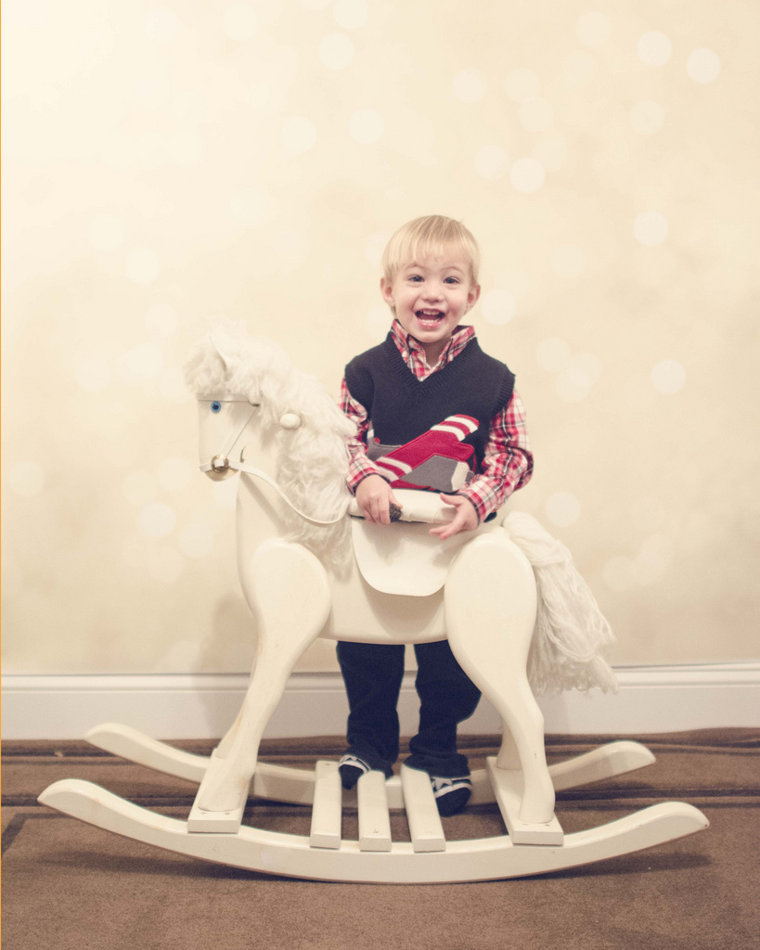
Activities with cards

Slide 13
Activities with cards
Sorting
Parts of speech
Synonyms
Antonyms
Concrete/Abs
Spectrum
Video example later with white boards

Slide 14
Activities with cards
Sorting
Tomalo
“Take it”
1-1
All on desk
Slap answer

Slide 15
Activities with cards
Sorting
Tomalo
Go Fish
“Do you have an abstract noun that means hatred?”

Slide 16
Activities with cards
Sorting
Tomalo
Go Fish
Memory
Just like the children’s game; word/P.O.S. on side & definition on other

Slide 17
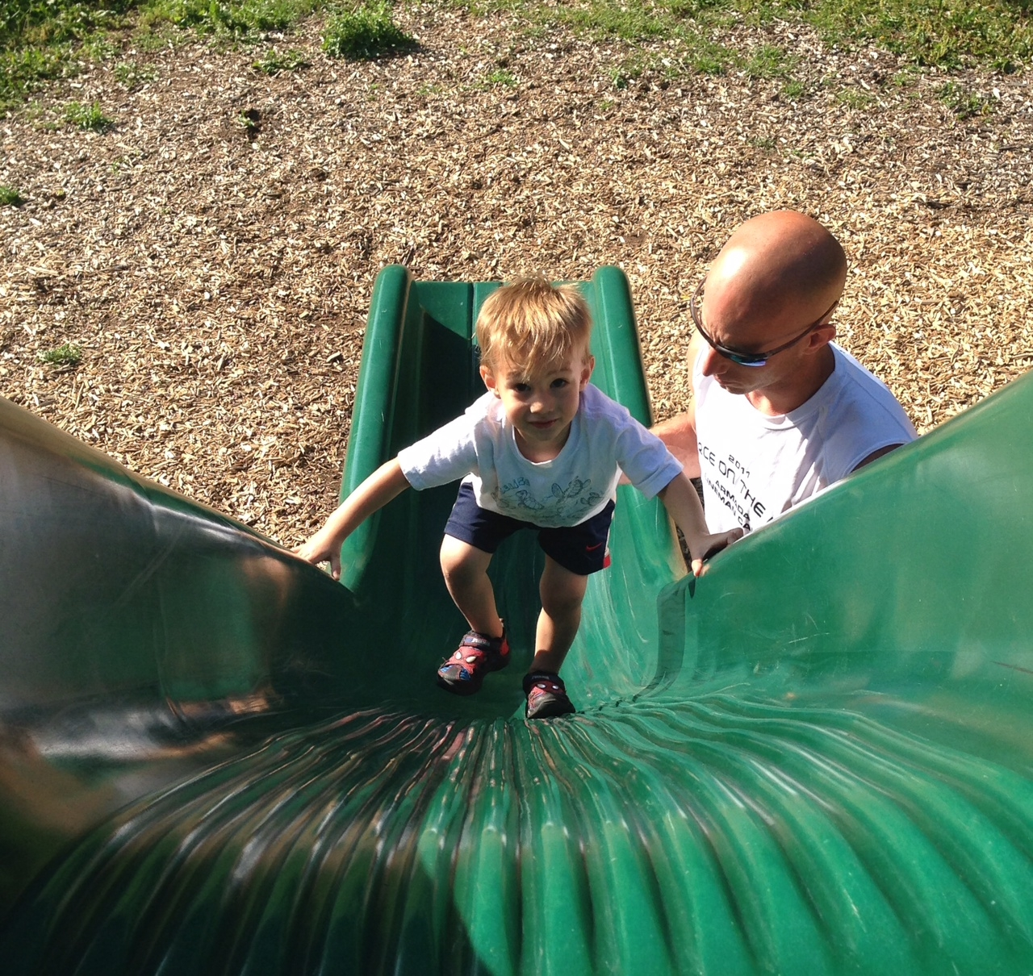
White boards: Home Depot, $35, 10 years

Slide 18
White boards: Sorting = same as with cards
Video example

Slide 19
White boards: Sorting, Four Square: pictures

Slide 20
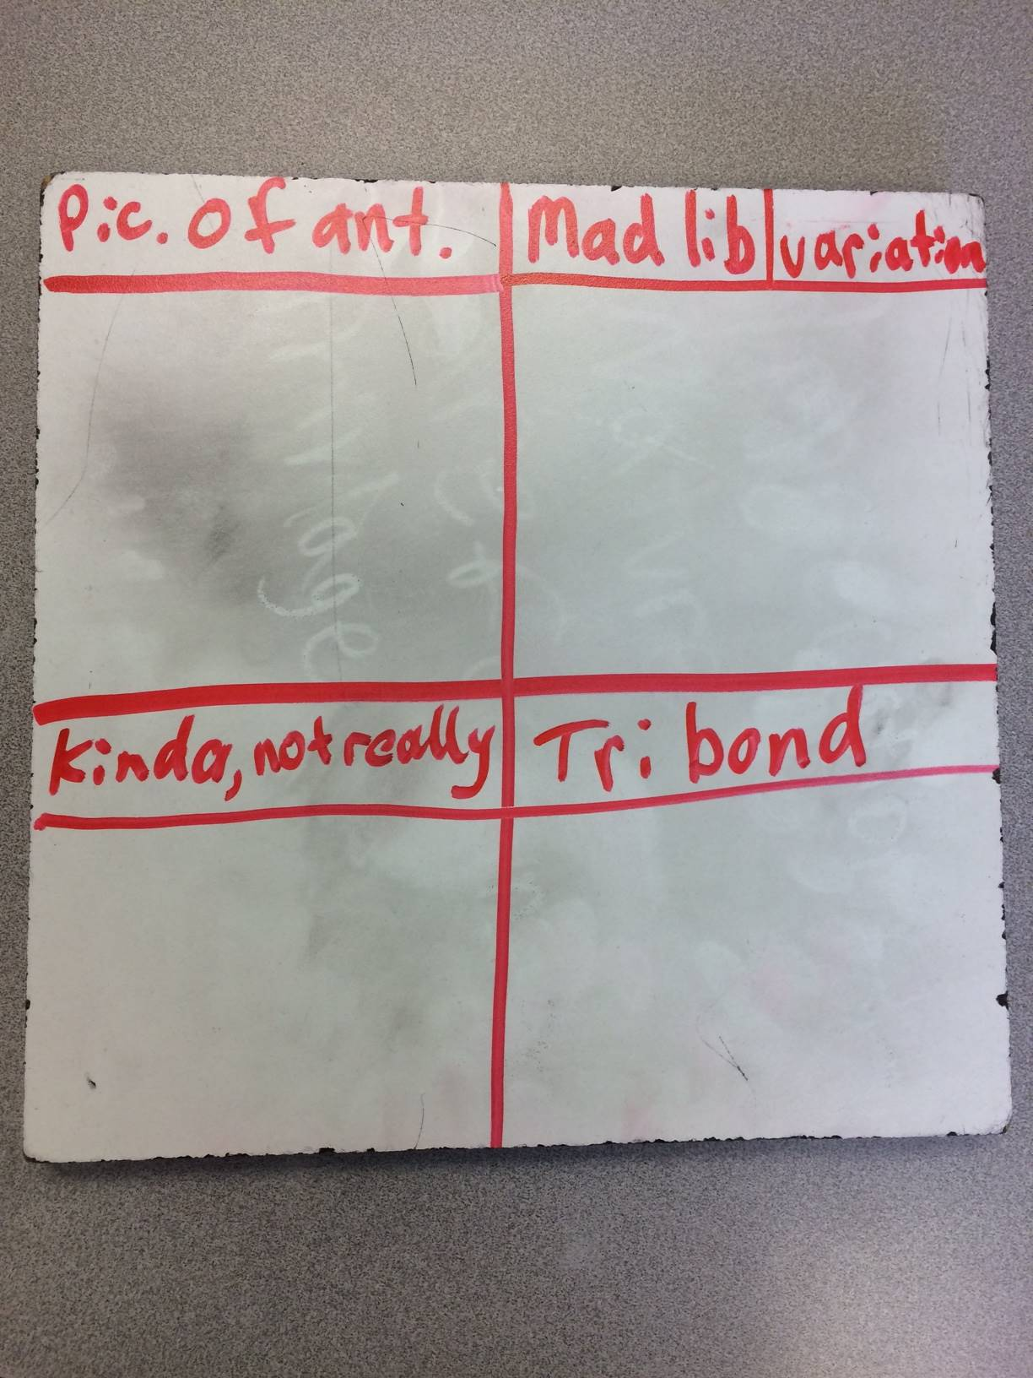

Slide 21
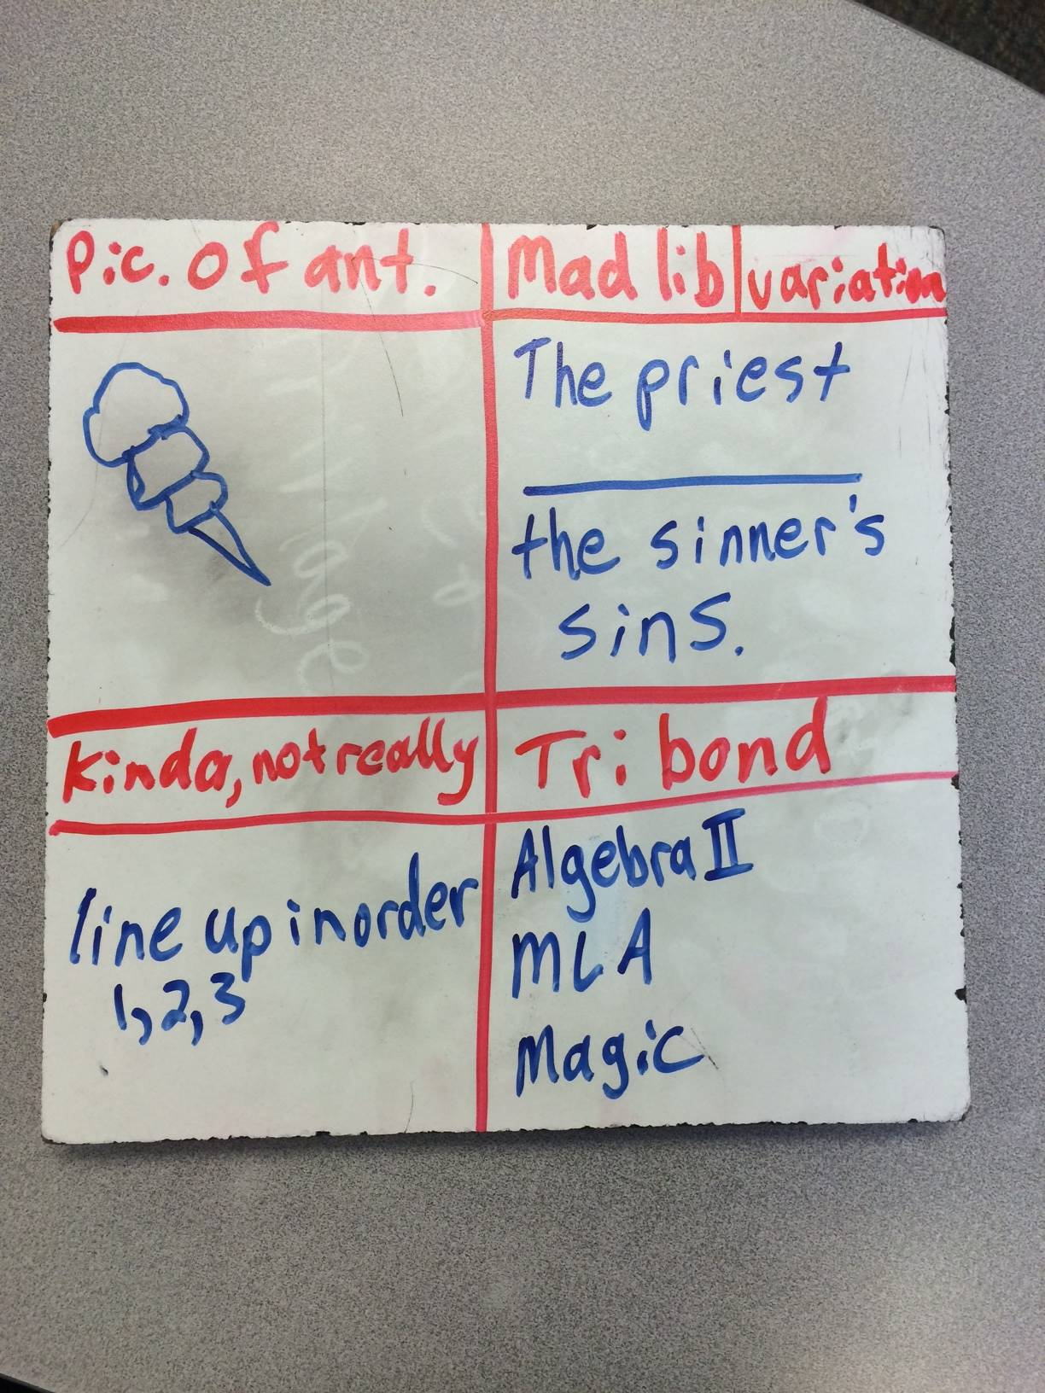

Slide 22
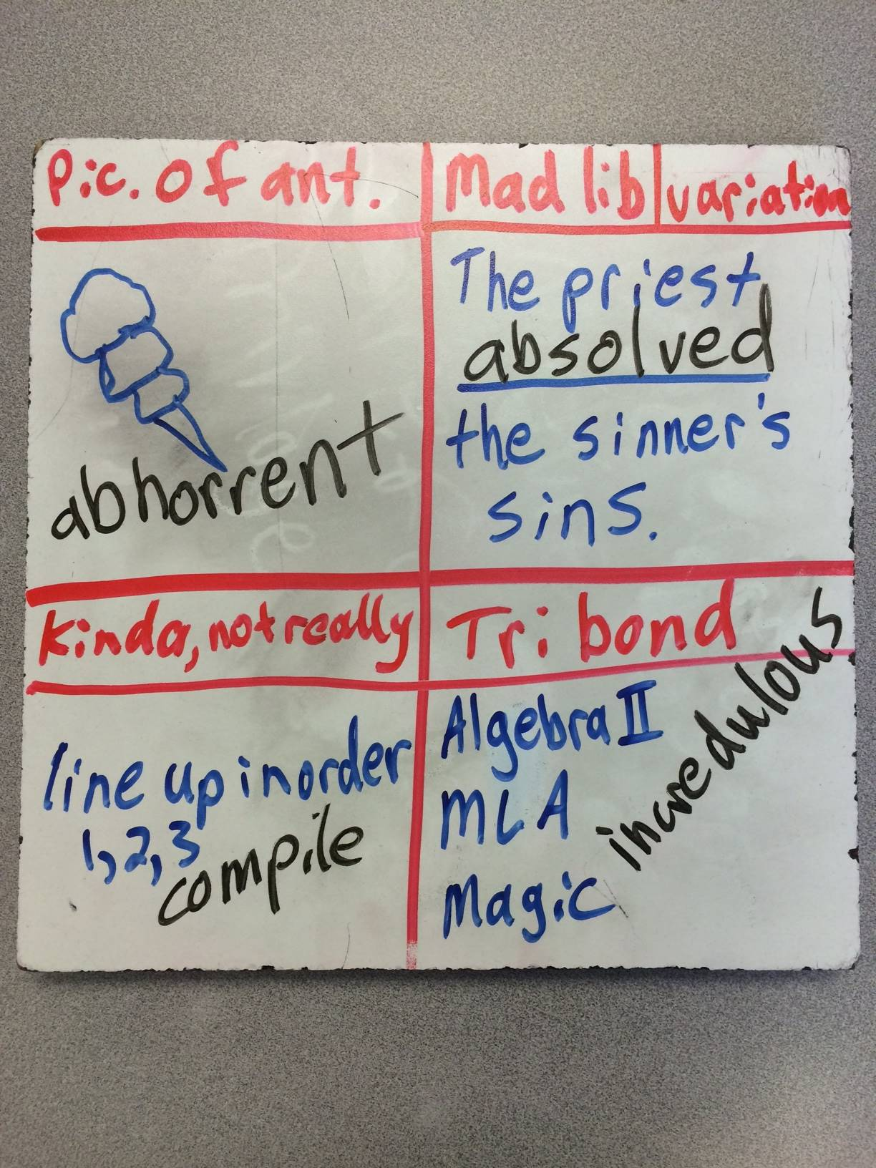

Slide 23
White boards: Sorting, Four Square, Memory
video

Slide 24
Shameless Plug
STEM vs. “Flower” classes
are very different
Stemflower.weebly.com
@stemflowerlc
stemflowerlc@gmail.com

Slide 25
Five question google form to help me grow as a professional: http://goo.gl/forms/7Ii2RcFYTR

Slide 26
El serpiente video is the next, and final, slide

