Slide 1
Back to Basics: Assessment (SBL)
Aric Foster
STEM & Flower Learning Consultants
stemflowerlc@gmail.com
stemflower.weebly.com
@stemflowerlc
Back to Basics
Foundations of Effective Teaching

Slide 2
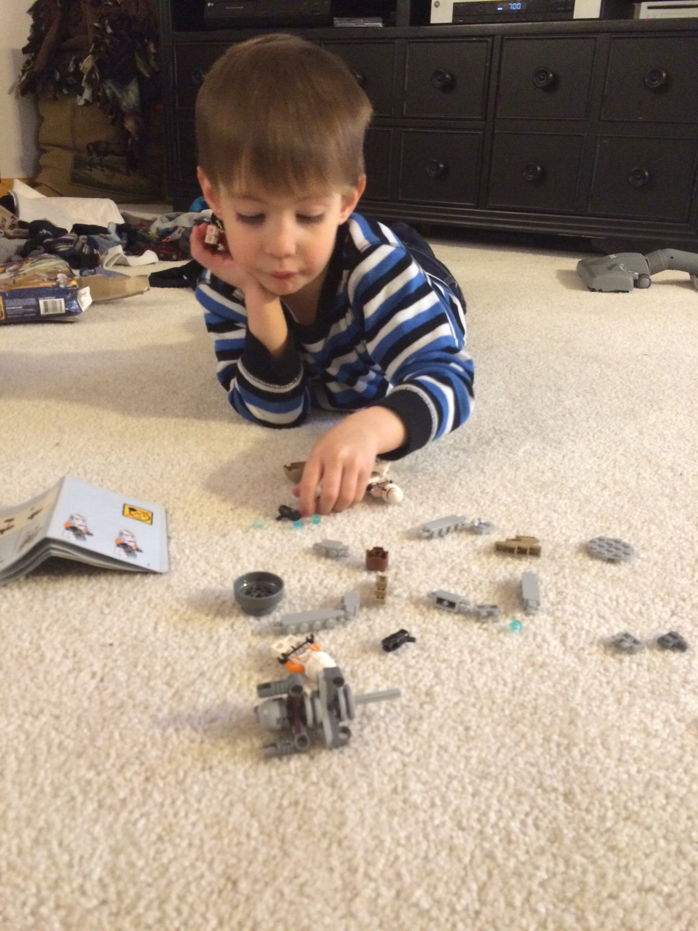
Why did I do this?
“Missy O.” & “J. Day”
“Students” vs. “Learners”
What does an 82%
mean in my class?

Slide 3
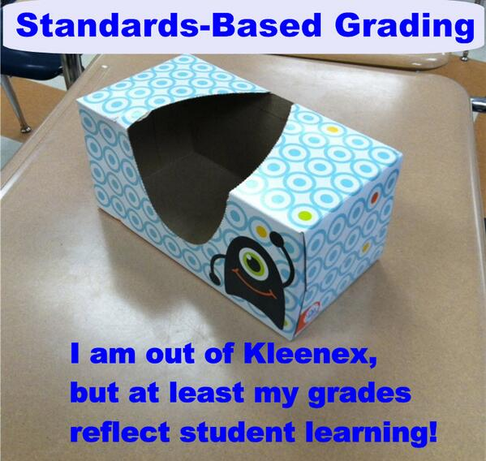

Slide 4
Creating SBL Classroom
Step #1: Create Power Standards
Lakeshore Model
Endurance: relevant in profession
Leverage: relevant in other classes
Readiness: relevant in next class
First 3 years = 15 standards = too many
E11: 10 per 12 week trimester
AP: 12, 6, 0

Slide 5

Creating SBL Classroom
Step #1: Create Power Standards
Step #2: Create Matrix
Standards Matrix
All standards with 4.0 descriptors
  4.0 = Beyond expectations in quantity and complexity and maturity, YES+
  3.0 = Proficient, “I got this” YES
  2.0 = Inconsistent, “Kinda got this” “I get the basic parts & struggle with tough parts” YES, but
  1.0 = Emerging, “I need teacher help to do this” NO

Slide 6
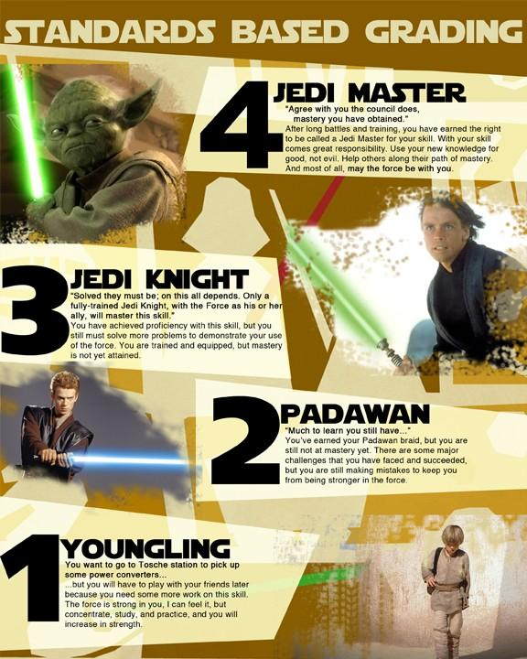

Slide 7
Creating SBL Classroom
Step #1: Create Power Standards
Step #2: Create Matrix
Standards Matrix
All standards with 4.0 descriptors
“Final exam” on first day (page 2)

Slide 8
Creating SBL Classroom
Step #1: Create Power Standards
Step #2: Create Matrix
Standards Matrix
All standards with 4.0 descriptors
“Final exam” on first day
Altered per marking period based on FA and SA performances.

Slide 9
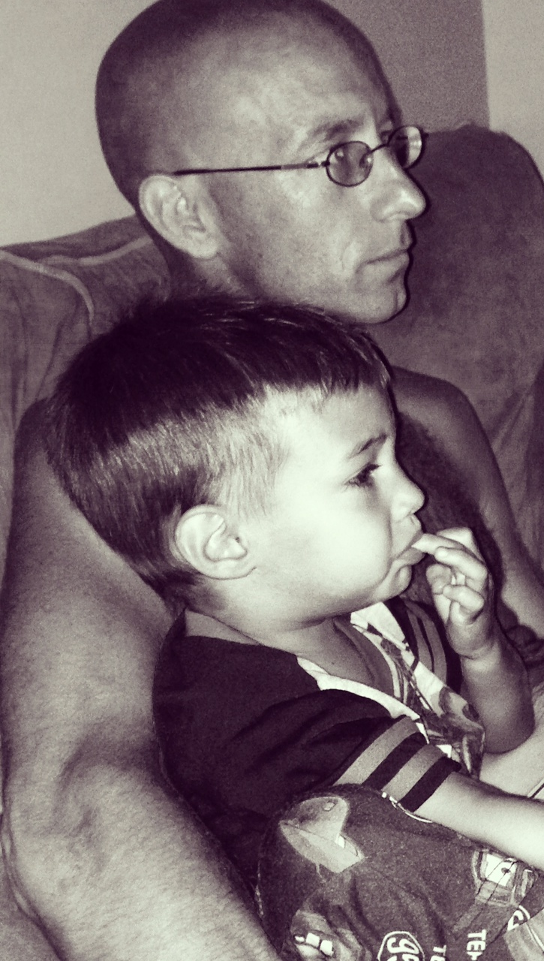
Standards Matrix Evolution
Reading & Writing
Reading: Literal, Craft, Theme
Vocab skills not words
Infer poor, switch to 1st & 2nd
Writing: Purpose, Org, Support, Mechanics, Style
Old Standards: Research, Use Technology, Follow Directions, Group Work, Present Information, Publish.

Slide 10
Creating SBL Classroom
Step #1: Create Power Standards
Step #2: Create Matrix
Standards Matrix
All standards with 4.0 descriptors
“Final exam” on first day
Altered per marking period based on FA and SA performances.
Copy/paste master document for FA’s

Slide 11
Learning Target | 4.0 | 3.0 | 2.0 | 1.0
Comprehend and explain the literal main ideas and detail of a text | I can insightfully explain the author’s “big picture” & details accurately beyond teacher’s expectations. | I can plainly explain the author’s “big picture” & details relatively accurately and consistently. | I can just mention the author’s “big picture” & details somewhat accurately and somewhat consistently. | I struggle to identify author’s “big picture” & details I have some inaccuracies and/or need teacher assistance.
Common Core Standards: | Fiction Reading: R1, R2, R3, R10 Informational Reading: R1, R2, R3, R10
Mechanics = Produce writing that follows convention: accurate grammar, punctuation, & mechanics | I can display an advanced use of Standard American English grammar, punctuation & mechanics. | I can display a sufficient control over Standard American English grammar, punctuation & mechanics. | I can only display an inconsistent or partial control over grammar, punctuation & mechanics. | I have multiple miscues in grammar, punctuation & mechanics; my errors distracted from meaning
Common Core Standards: | Writing: W1d, W2e Language: L1a, L1b, L2, L3

Slide 12
Formal Formative Assessment:
Writing choices
Three learning targets (1 reading & 2 writing), Exemplar WITH FEEDBACK
Lord of the Flies Chapter 3 Response
(pages 3-4)

Slide 13
Creating SBL Classroom
Step #1: Create Power Standards
Step #2: Create Matrix
Step #3: Create Formative Assessments
Formative Assessments
Exemplars with feedback
Kept tally so all are “covered”

Slide 14
Creating SBL Classroom
Step #1: Create Power Standards
Step #2: Create Matrix
Step #3: Create Formative Assessments
Formative Assessments
Exemplars with feedback
Kept tally so all are “covered”
All online: armadafoster.weebly.com

Slide 15
Creating SBL Classroom
Step #1: Create Power Standards
Step #2: Create Matrix
Step #3: Create Formative Assessments
Step #4: Create Summative Assessment
Summative Assessment
Covers all standards (best in chunks)

Slide 16
Creating SBL Classroom
Step #1: Create Power Standards
Step #2: Create Matrix
Step #3: Create Formative Assessments
Step #4: Create Summative Assessment
Summative Assessment
Covers all standards
Stand alone assessment with new text

Slide 17
Creating SBL Classroom
Step #1: Create Power Standards
Step #2: Create Matrix
Step #3: Create Formative Assessments
Step #4: Create Summative Assessment
Summative Assessment
Covers all standards
Stand alone assessment with new text
Differentiated instruction “show me you know it” (pages 5-6)

Slide 18
2015-16 Amendments
Amendments for new SAT
Revise Summative Assessments
Revise Formative Assessments
Keep “Summative First” mentality

Slide 19
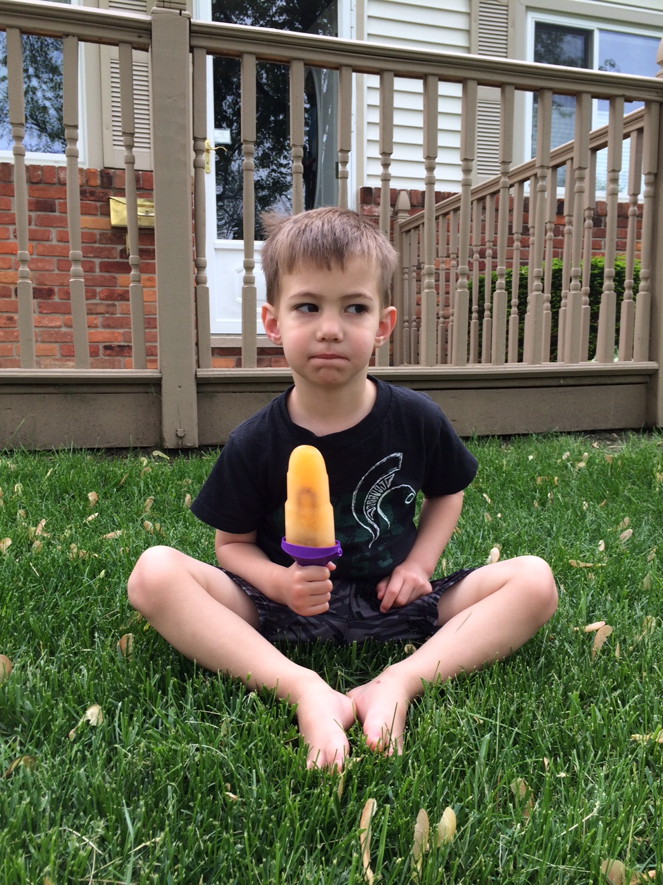
That’s nice, but how do you calculate a student’s final grade?

Slide 20
That’s nice, but how do you calculate a student’s final grade?
Average of a student’s performance in all standards on summative

Slide 21
Final Grade Principles
Final grade is proficiency on standards and THAT IS IT. Separate proficiency from behavior.

Slide 22
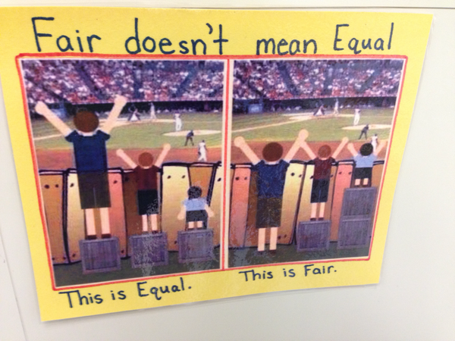
Fair Isn’t Always Equal by Rick Wormeli

Slide 23
Final Grade Principles
Final grade is proficiency on standards and THAT IS IT. Separate proficiency from behavior.
Late work, missing work, work habits, employability, participation, citizenship, etc. ARE important and deserve feedback and need to be reported…separately.

Slide 24
Citizenship district-wide should have consistency and “teeth”
“Cardinal Code” in Davison, MI
“Creek Code” in Swartz Creek, MI
Similar code in Grosse Ile, MI
Armada: no code and two poor scores per marking period = ineligible (kinda)

Slide 25
Final Grade Specifics
Formatives earn students scores and feedback, but don’t count towards final grade.

Slide 26
Final Grade Specifics
Formatives earn students scores and feedback, but don’t count towards final grade.
Formative scores & feedback logged/published/highlighted in PowerSchool, Seesaw, and/or on paper.

Slide 27
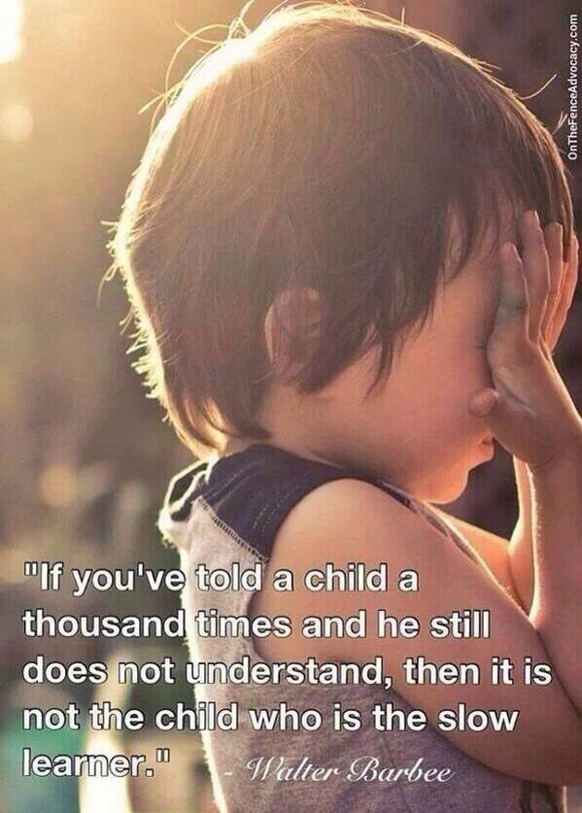

Slide 28
Final Grade Specifics
Formatives earn students scores and feedback, but don’t count towards final grade.
Formative scores & feedback logged in PowerSchool, Seesaw and on paper.
Only performance on summative counts.

Slide 29
Average of all 4.0 Learning Targets scores on summative assessments | Letter Grade
4.0-3.75 | A+
3.74-3.5 | A
3.49-3.25 | A-
3.24-3.0 | B+
2.99-2.75 | B
2.74-2.5 | B-
2.49-2.25 | C+
2.24-2.0 | C
1.99-1.75 | C-
1.74-1.5 | D+
1.49-1.25 | D
1.24-1.0 | D-
0.99-0 | E
Did not complete 100% of Summative Assessment | I (Incomplete)

Slide 30
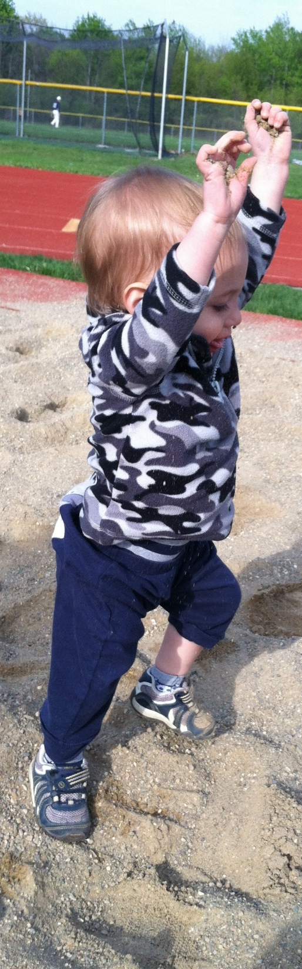
Missy O. earned
2, 3, 3, 4 in “Grammar”
Averaging
over time: 3
Final performance on summative: 4

Slide 31
Final Grade Specifics
Formatives earn students scores and feedback, but don’t count towards final grade.
Formative scores & feedback logged in PowerSchool, Seesaw and on paper.
Only performance on summative counts.
Can revise summative if all formatives are completed. Formatives = “Retake Ticket”

Slide 32
SBG student:
Teacher: “How are those two words similar?”
Student: “The suffixes are the same – makes them the same part of speech.”
Student: “I should know what uniformity means, shouldn’t I?”
Teacher: “Maybe. What makes you think that you should know it?”
Student: “Cuz it has word parts and you will probably make me figure it out on my own.”
This shows that the kids are understanding the skills
and not just “doing a work sheet.”

Slide 33
Student reflections about SBG:
“Now our grade is only based on our skills in English”
“The only downfall is that other teachers don’t do it. We have been brainwashed to do school one way, and now I have to think differently about it in your class.”
“Grades aren’t based on just turning stuff in.”
“This kinda forces us to learn.”
“I was getting easy A’s, then your class came along,
and I can’t play school anymore.”
“It easier to keep your grade up; you can always do better.”
“How do you fail this class?”
“This year was way harder than last year, but I learned more.”
“You can’t fail unless you really try to.”
“The best part of this class was the (SBL) grading.”

Slide 34
Shameless Plug
STEM vs. “Flower” classes
are very different
Stemflower.weebly.com
@stemflowerlc
stemflowerlc@gmail.com

Slide 35
Five question google form to help me grow as a professional: http://goo.gl/forms/7Ii2RcFYTR

Slide 36
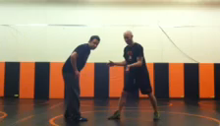
WWE Interlude

Slide 37
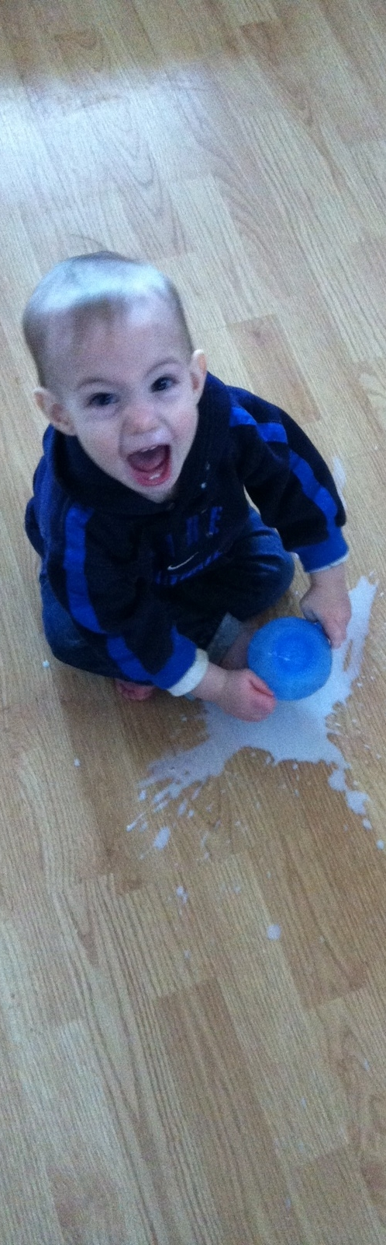
Wait…Students get zero extrinsic final grade motivation to do “homework”? They won’t do it if it’s not for points!
Oh really?
BUILD A CULTURE

Slide 38
What if there were NO GRADES? No numbers, percentages, or indicators?
Discuss at your table and pick one “pro” and one “con” group member to share out in three minutes.

Slide 39
I realized that eventually, if kids understand growth mindset, culture of learning, and are “in,” then they don’t need numbers.

Slide 40
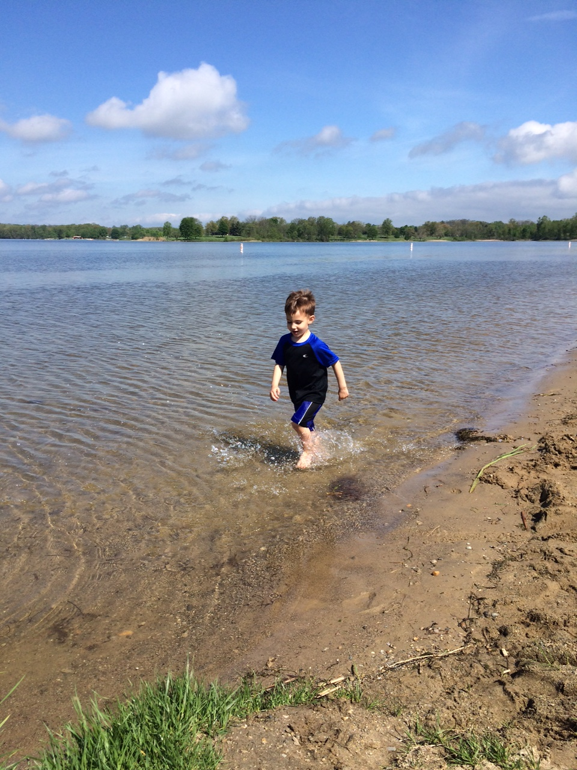
Which is the most effective feedback for mi hijito?
“Good job”
2.0 in focus
1.5 in speed
3.0 in aesthetics
2.0 in splashing
“Too slow; try again”

Slide 41
Which is the most effective feedback for mi hijito?
“I see you running. Is it challenging to run in the water? Why? What are you doing with your feet? What do you notice? I notice that the faster you run, the more you splash. Show me again. I can’t wait to see you run in the water again.”

Slide 42
#TTOG = Teachers Throwing out grades
Star Sackstein @mssackstein
Mark Barnes
@markbarnes19
Assessment 3.0: Throw out your gradebook and inspire learning

Slide 43
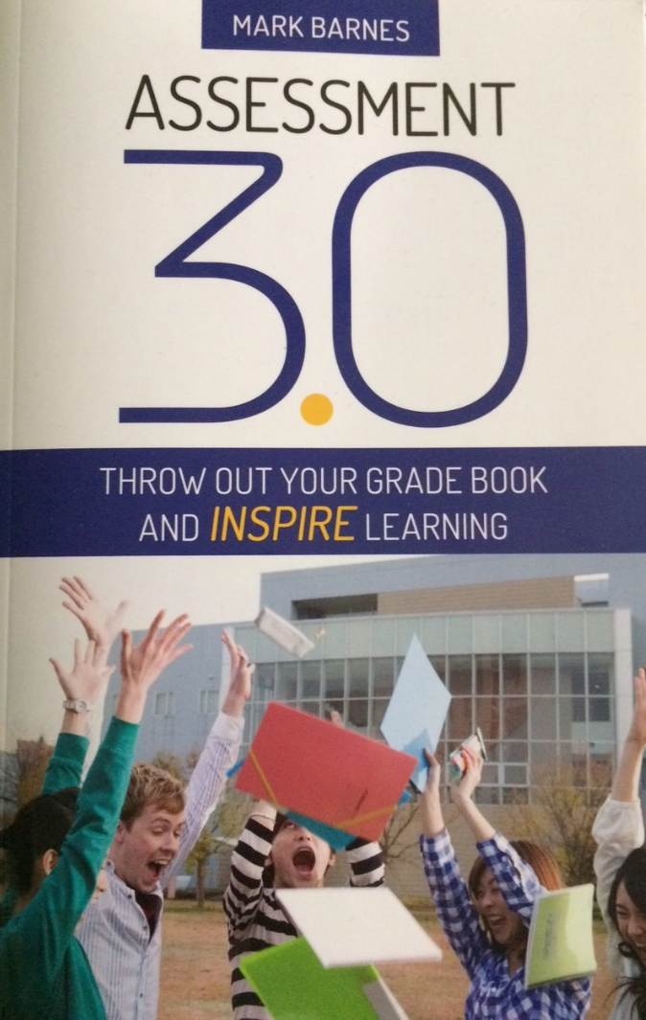

Slide 44
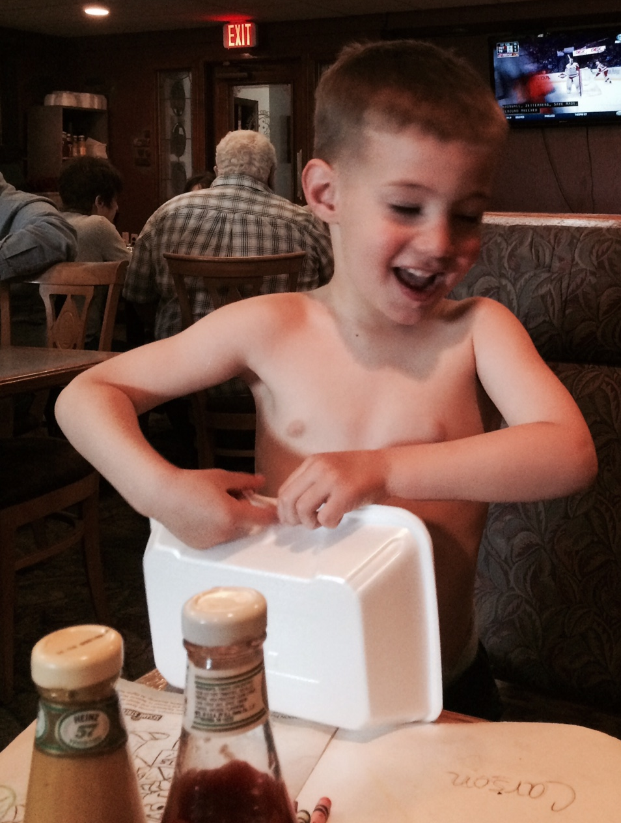
SBL ➔ TTOG
AP Lit. Seniors

Slide 45
SBL ➔ TTOG
AP Lit. Seniors
LTs: 12, 6, 0
Bold ➔ Bold
Italics ➔ Italics
Underline ➔ Underline
(page 8)

Slide 46
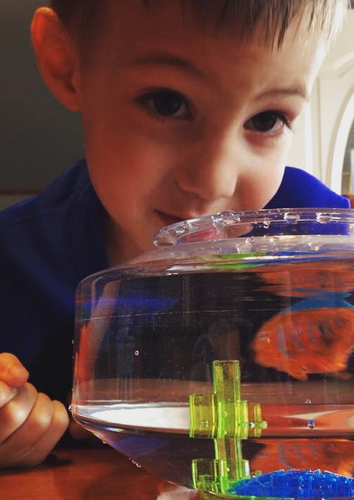
SBL ➔ TTOG
AP Lit. Seniors
LTs: 12, 6, 0
SE2R: Summarize, Explain, Redirect, Resubmit

Slide 47
SBL ➔ TTOG
AP Lit. Seniors
LTs: 12, 6, 0
SE2R
“Saw, didn’t see, how addresses specific standard, extra practice, resubmission”
(page 9)

Slide 50
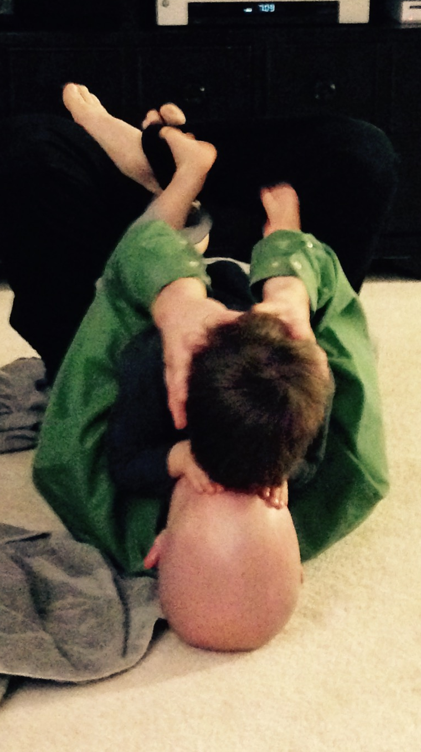
SBL ➔ TTOG
AP Lit. Seniors
LTs: 12, 6, 0
SE2R
“Saw, standards, practice, resubmit”
Abundance, not format, for evidence
Excel and graphs (5 students)

Slide 51
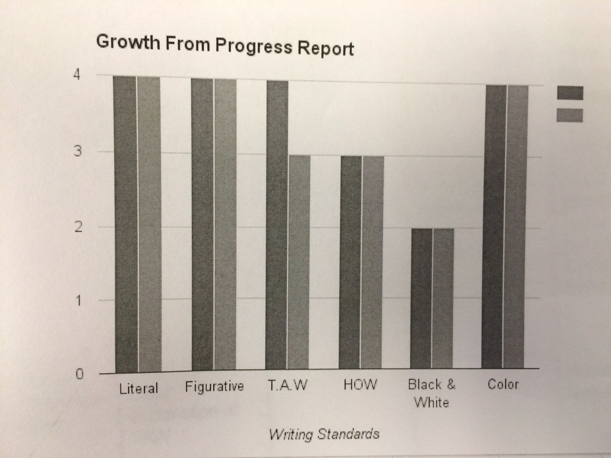

Slide 52
SBL ➔ TTOG
AP Lit. Seniors
LTs: 12, 6, 0
SE2R
“Saw, standards, practice, resubmit”
Abundance, not format, for evidence
Excel and graphs (5)
Physical Binder with dividers (11)

Slide 53
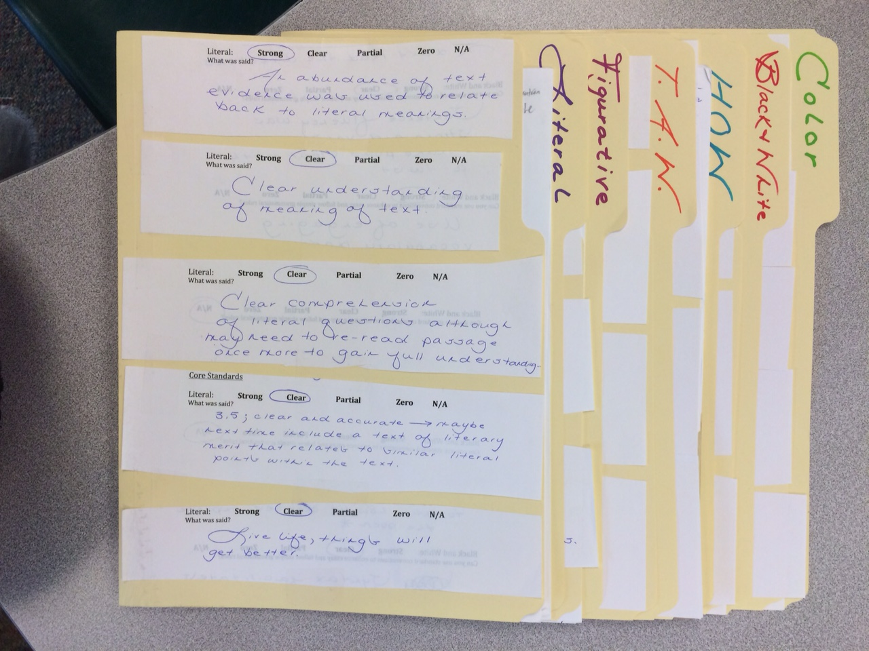

Slide 54
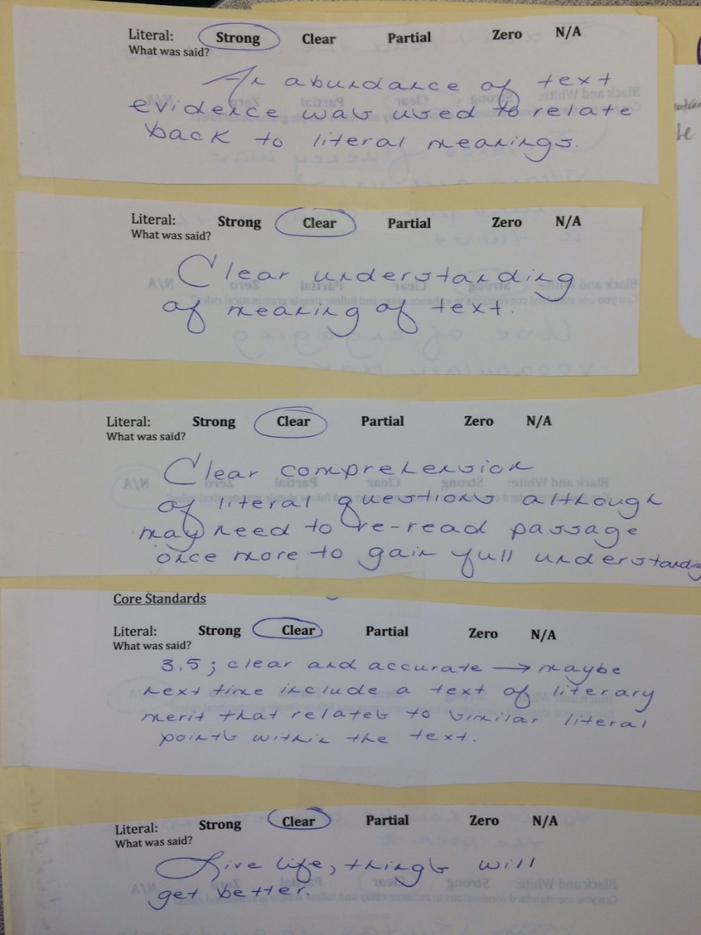

Slide 55
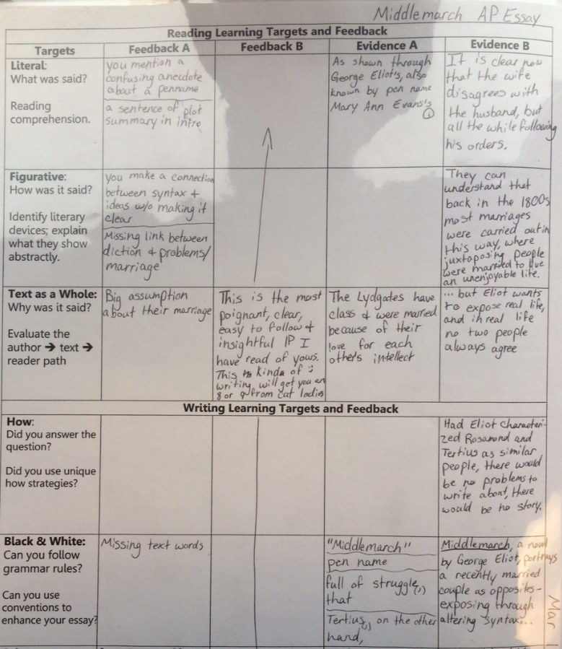

Slide 56
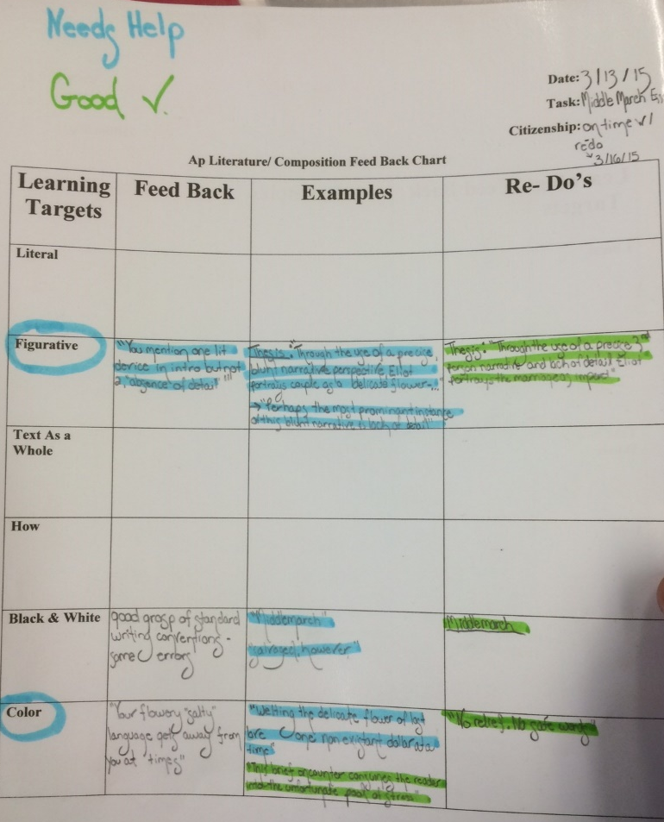

Slide 57
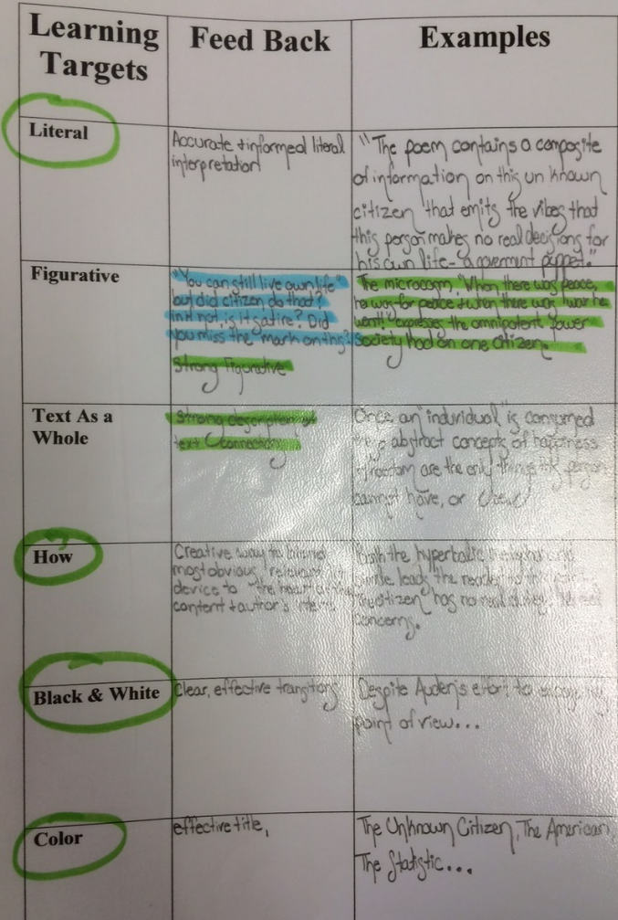

Slide 58
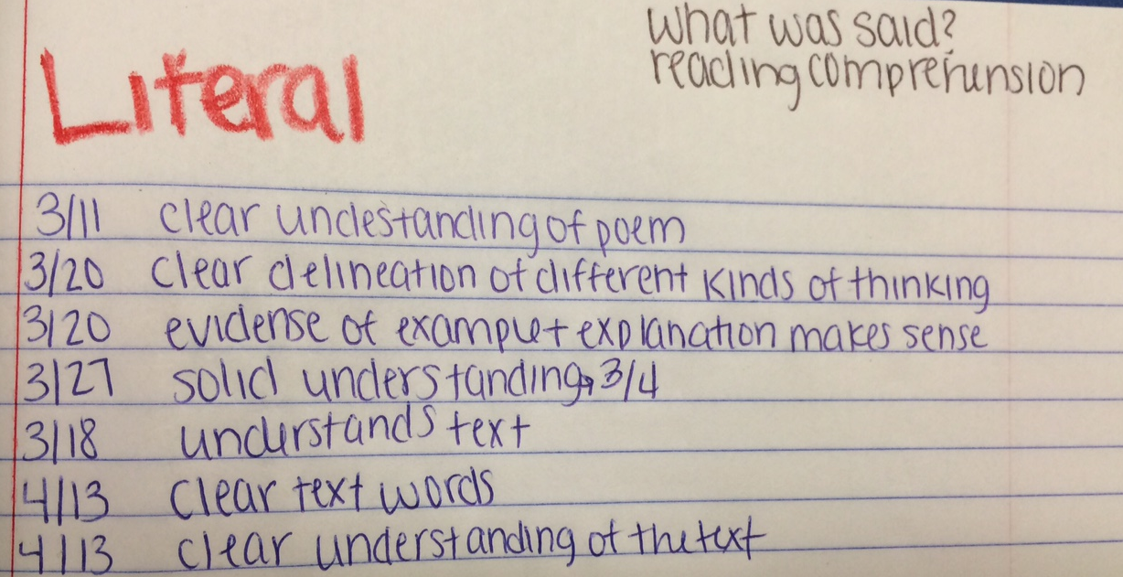

Slide 59
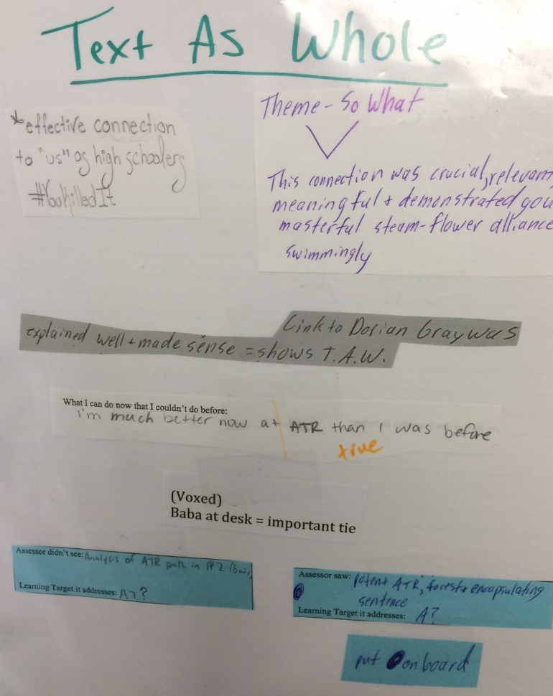

Slide 60
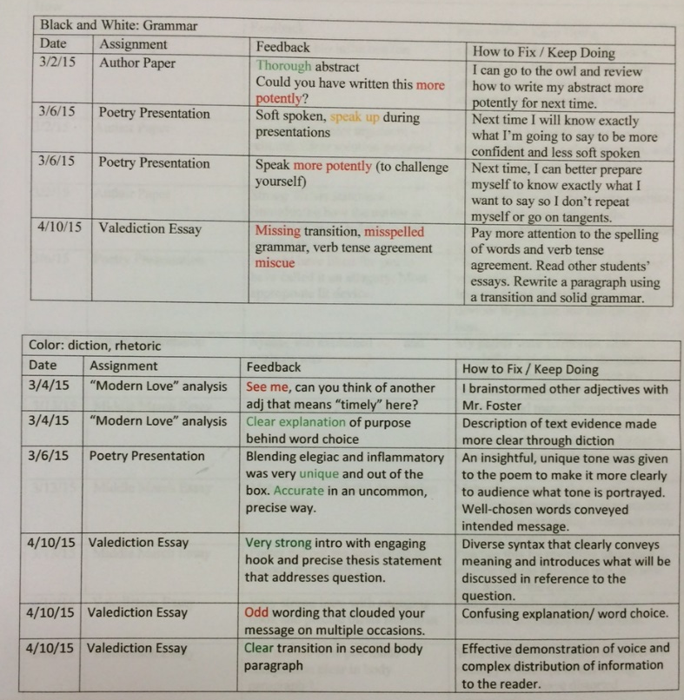

Slide 61
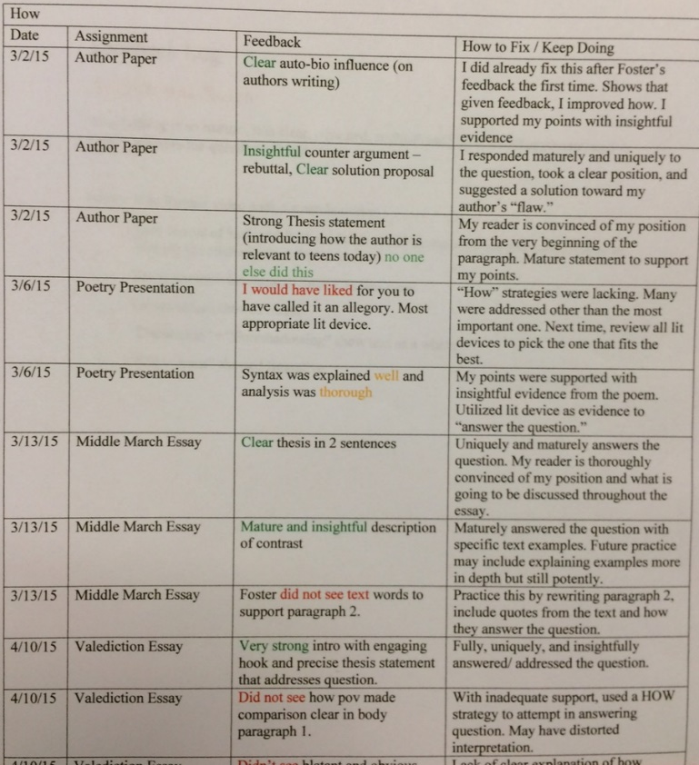

Slide 62
SBL ➔ TTOG
AP Lit. Seniors
LTs: 12, 6, 0
SE2R
“Saw, standards, practice, resubmit”
Abundance, not format, for evidence
Excel and graphs (5)
Physical Binder with dividers (11)
Blog (6)
  Apfoster.wordpress.com

Slide 63
SBL ➔ TTOG
AP Lit. Seniors
LTs: 12, 6, 0
SE2R
“Saw, standards, practice, resubmit”
Abundance, not format, for evidence
Excel graphs, binders, blogs
Weebly site (8)
  Rachelsfeedback.weebly.com

Slide 64
SBL ➔ TTOG
AP Lit. Seniors
LTs: 12, 6, 0
SE2R
“Saw, standards, practice, resubmit”
Abundance, not format, for evidence
Feedback form, whole class, Voxer, “see me”

Slide 65
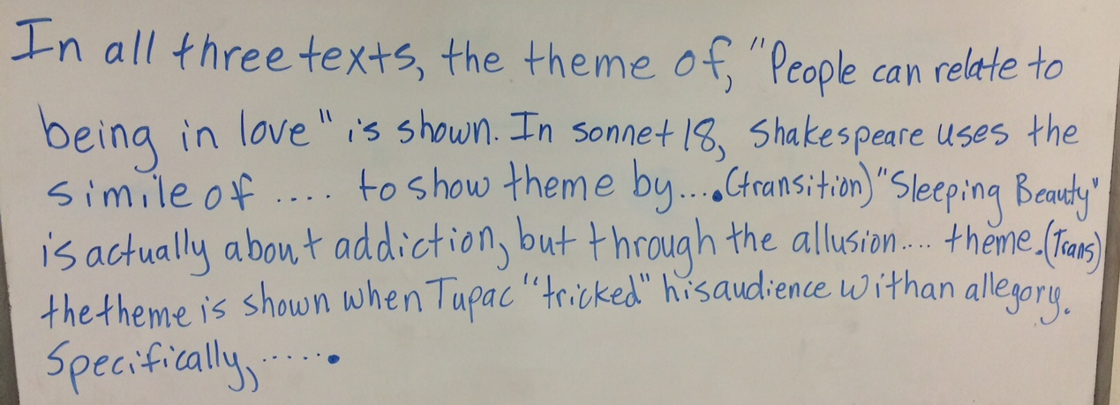
Whole Class Feedback

Slide 66
SBL ➔ TTOG
AP Lit. Seniors
LTs: 12, 6, 0
SE2R
“Saw, standards, practice, resubmit”
Abundance, not format, for evidence
Feedback form, whole class, Voxer, “see me”
Two mini-conferences, one final
(page 10-11)

Slide 67
SBL ➔ TTOG
AP Lit. Seniors
LTs: 12, 6, 0
SE2R
“Saw, standards, practice, resubmit”
Abundance, not format, for evidence
Feedback form, whole class, Voxer, “see me”
Two mini-conferences, one final
Two down, five up

Slide 68
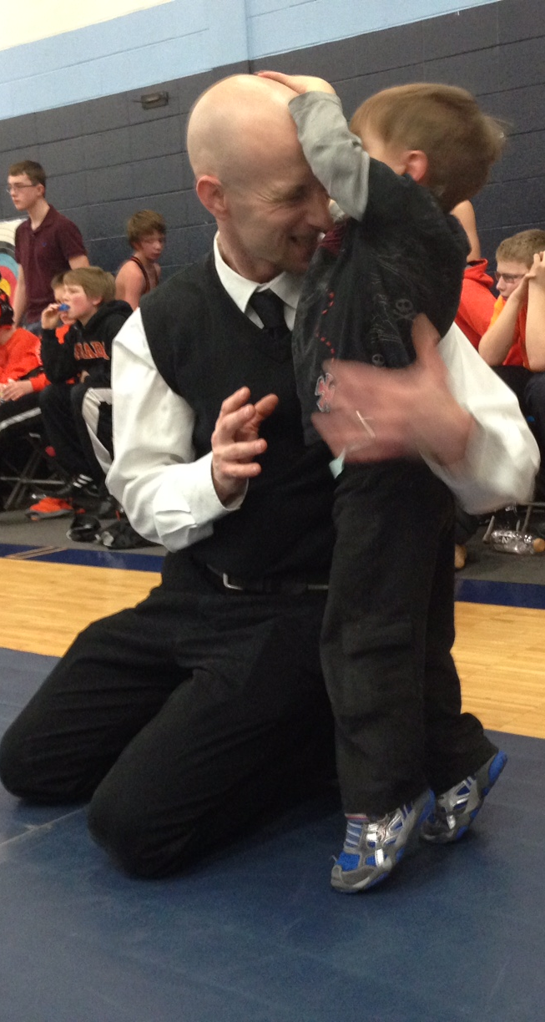
Does it work?

Slide 69
Does it work?
Zero parent, student or admin complaints

Slide 70
Does it work?
Zero parent, student or admin complaints
Kids’ positive feedback:
l. is the inspiration for the title of this presentation
(page 12)

Slide 71
Does it work?
Zero parent, student or admin complaints
Kids’ positive feedback
Seniors felt respected, honored, & heard.

Slide 72
Does it work?
Zero parent, student or admin complaints
Kids’ positive feedback
Seniors felt respected, honored, & heard.
Same amount (if not less) work

Slide 73
Does it work?
Zero parent, student or admin complaints
Kids’ positive feedback
Seniors felt respected, honored, & heard.
Same amount (if not less) work
Strong rapport, “felt” like learning, authentic assessment

