Slide 1
Back to Basics: Technology
Aric Foster
STEM & Flower Learning Consultants
stemflowerlc@gmail.com
stemflower.weebly.com
@stemflowerlc
Back to Basics
Foundations of effective teaching

Slide 2
What is the role of technology in the classroom?
Share on your favorite social media site and be ready to share aloud

Slide 3
When you used that technology to “learn,” who benefitted besides you?

Slide 4
When you used that technology to “learn,” who benefitted besides you?
Your crazy aunt with all the cats

Slide 5
When you used that technology to “learn,” who benefitted besides you?
Your crazy aunt with all the cats
Nanna and Papa

Slide 6
When you used that technology to “learn,” who benefitted besides you?
Your crazy aunt with all the cats
Nanna and Papa
Old high school friend

Slide 7
When you used that technology to “learn,” who benefitted besides you?
Your crazy aunt with all the cats
Nanna and Papa
Old high school friend
Not very many “students” like you

Slide 8
Technology is a tool, not the curriculum. It is one vehicle through which we can interact with the content, not the content itself.

Slide 9
Groovy tech tools
Twitter: class hashtag, professional account, scribe and chats

Slide 10
Groovy tech tools
Twitter: class hashtag, professional account, scribe and chats
Periscope/Meerkat: live video stream of class activity

Slide 11
Groovy tech tools
Twitter: class hashtag, professional account, scribe and chats
Periscope/Meerkat: live video stream of class activity
Padlet: simpler, cooler version of live tweeting

Slide 12
Authentic Practice
padlet.com/aricfoster2/t1cgjtuoqfa3

Slide 13
Groovy tech tools
Twitter: class hashtag, professional account, scribe and chats
Periscope/Meerkat: live video stream of class activity
Padlet: simpler, cooler version of live tweeting
Powtoon: cartoon power point creator

Slide 14
Authentic Practice
Try it at powtoon.com

Slide 15
Groovy tech tools
Twitter: class hashtag, professional account, scribe and chats
Periscope/Meerkat: live video stream of class activity
Padlet: simpler, cooler version of live tweeting
Powtoon: cartoon power point creator
Planbook.com: simply, helpful lesson plan guide

Slide 16
Groovy tech tools
Twitter: class hashtag, professional account, scribe and chats
Periscope/Meerkat: live video stream of class activity
Padlet: simpler, cooler version of live tweeting
Powtoon: cartoon power point creator
Planbook.com: simply, helpful lesson plan guide
Plickers: QR code formative assessment

Slide 17
Authentic Practice

Slide 18
Groovy tech tools
Twitter: class hashtag, professional account, scribe and chats
Periscope/Meerkat: live video stream of class activity
Padlet: simpler, cooler version of live tweeting
Powtoon: cartoon power point creator
Planbook.com: simply, helpful lesson plan guide
Plickers: QR code formative assessment
Socrative: formative assessment

Slide 19
Groovy tech tools
Twitter: class hashtag, professional account, scribe and chats
Periscope/Meerkat: live video stream of class activity
Padlet: simpler, cooler version of live tweeting
Powtoon: cartoon power point creator
Planbook.com: simply, helpful lesson plan guide
Plickers: QR code formative assessment
Socrative: formative assessment
Chirp and Remind 101: send messages to kids

Slide 20
Groovy tech tools
Twitter: class hashtag, professional account, scribe and chats
Periscope/Meerkat: live video stream of class activity
Padlet: simpler, cooler version of live tweeting
Powtoon: cartoon power point creator
Planbook.com: simply, helpful lesson plan guide
Plickers: QR code formative assessment
Socrative: formative assessment
Chirp and Remind 101: send messages to kids
Nearpod: Engaging content delivery, many examples already exist

Slide 21
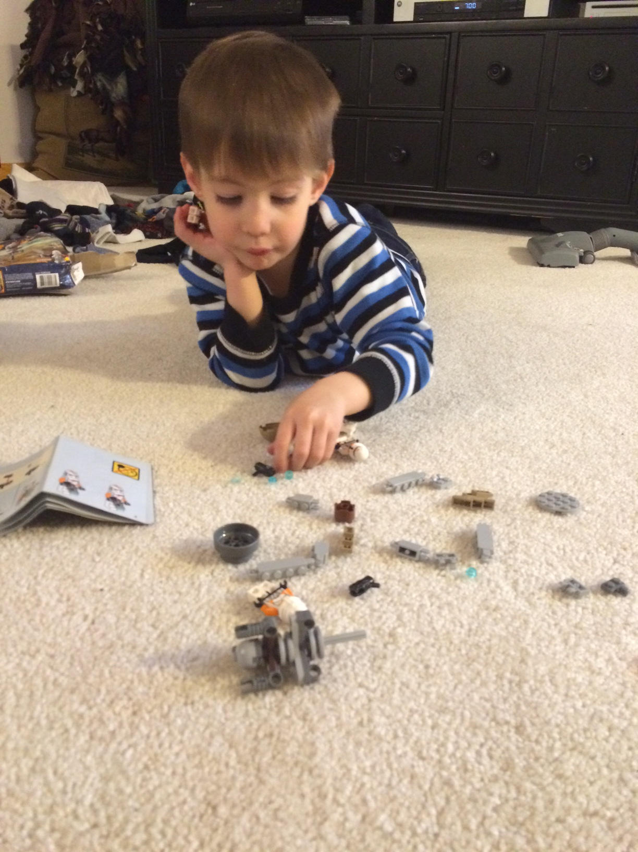
Authentic Practice
Nearpod.com

Slide 22
Groovy tech tools
Twitter: class hashtag, professional account, scribe and chats
Periscope/Meerkat: live video stream of class activity
Padlet: simpler, cooler version of live tweeting
Powtoon: cartoon power point creator
Planbook.com: simply, helpful lesson plan guide
Plickers: QR code formative assessment
Socrative: formative assessment
Chirp and Remind 101: send messages to kids
Nearpod: interact with students live and anonymously
Seesaw: log feedback like Instagram with parent access = DIST

Slide 23
Authentic Examples

Slide 24
Authentic Examples

Slide 25
Authentic Examples

Slide 26
Groovy tech tools
Twitter: class hashtag, professional account, scribe and chats
Periscope/Meerkat: live video stream of class activity
Padlet: simpler, cooler version of live tweeting
Powtoon: cartoon power point creator
Planbook.com: simply, helpful lesson plan guide
Plickers: QR code formative assessment
Socrative: formative assessment
Chirp and Remind 101: send messages to kids
Nearpod: interact with students live and anonymously
Seesaw: log feedback like Instagram with parent access = DIST
Gonoodle.com: transition breaks

Slide 27
Groovy tech tools
Twitter: class hashtag, professional account, scribe and chats
Periscope/Meerkat: live video stream of class activity
Padlet: simpler, cooler version of live tweeting
Powtoon: cartoon power point creator
Planbook.com: simply, helpful lesson plan guide
Plickers: QR code formative assessment
Socrative: formative assessment
Chirp and Remind 101: send messages to kids
Nearpod: interact with students live and anonymously
Seesaw: log feedback like Instagram with parent access = DIST
Gonoodle.com: transition breaks, quite silly and elementary
Tiki-toki.com: make timelines for stories

Slide 28
Groovy tech tools
Twitter: class hashtag, professional account, scribe and chats
Periscope/Meerkat: live video stream of class activity
Padlet: simpler, cooler version of live tweeting
Powtoon: cartoon power point creator
Planbook.com: simply, helpful lesson plan guide
Plickers: QR code formative assessment
Socrative: formative assessment
Chirp and Remind 101: send messages to kids
Nearpod: interact with students live and anonymously
Seesaw: log feedback like Instagram with parent access = DIST
Gonoodle.com: transition breaks
Tiki-toki.com: make timelines for stories
Kohoot: formative assessment

Slide 29
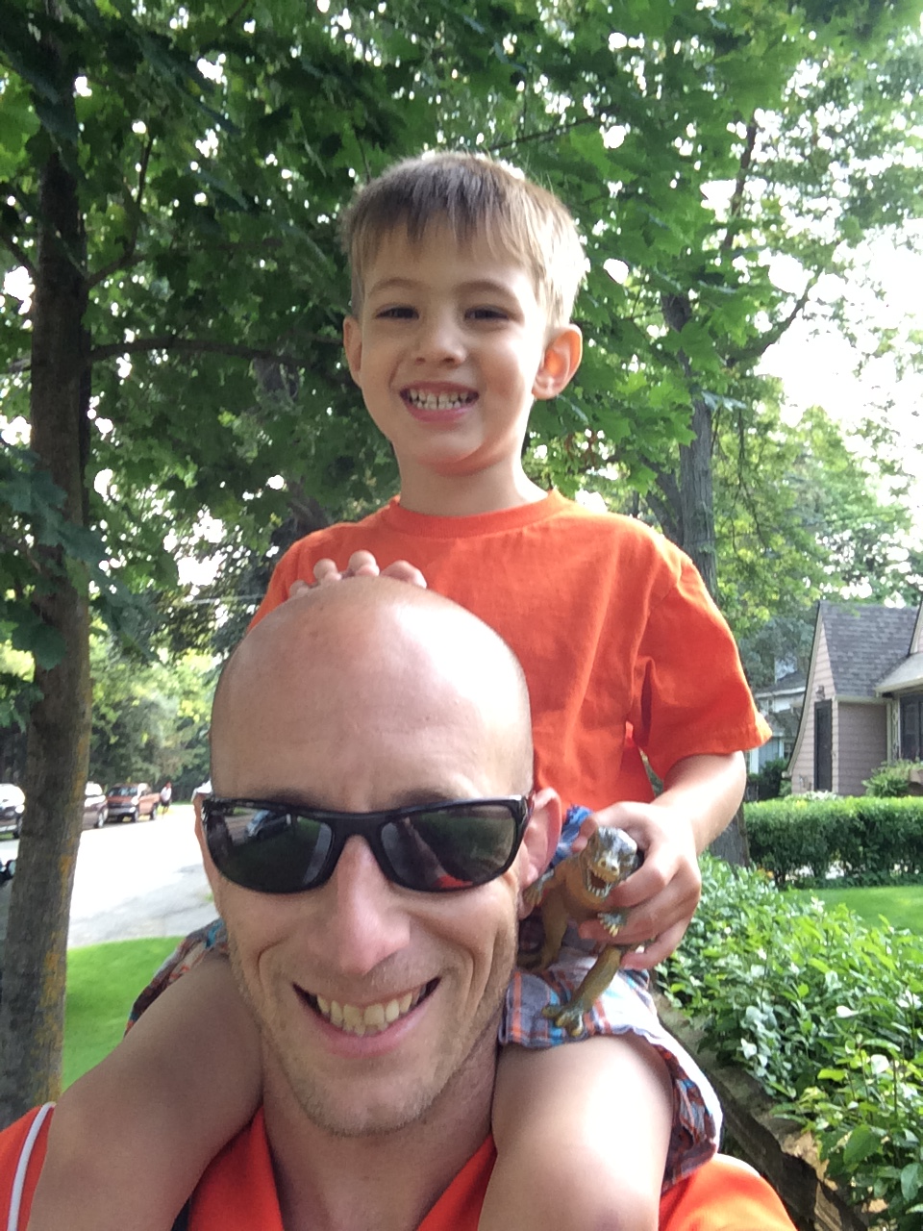
Authentic Practice
Gonoodle.com
Tiki-toki.com
Kohoot.com

Slide 30
Groovy tech tools
Twitter: class hashtag, professional account, scribe and chats
Periscope/Meerkat: live video stream of class activity
Padlet: simpler, cooler version of live tweeting
Powtoon: cartoon power point creator
Planbook.com: simply, helpful lesson plan guide
Plickers: QR code formative assessment
Socrative: formative assessment
Chirp and Remind 101: send messages to kids
Nearpod: interact with students live and anonymously
Seesaw: log feedback like Instagram with parent access = DIST
Gonoodle.com: transition breaks
Tiki-toki.com: make timelines for stories
Kohoot: formative assessment
Voxer: feedback and professional development

Slide 31
Back to Basics: Technology
Aric Foster
STEM & Flower Learning Consultants
stemflowerlc@gmail.com
stemflower.weebly.com
@stemflowerlc
Five question google form to help me grow as a professional: http://goo.gl/forms/7Ii2RcFYTR

