Slide 1
Welcome to your favorite part of the day
Aric Foster
STEM & Flower Learning Consultants
stemflowerlc@gmail.com
stemflower.weebly.com
@stemflowerlc
Back to Basics
Foundations of effective teaching

Slide 2
Why are you here?
To get seat time hours

Slide 3
Why are you here?
To get seat time hours
Principal “insisted” on it

Slide 4
Why are you here?
To get seat time hours
Principal “insisted” on it
Truly interested in improving as a teacher

Slide 5
Why are you here?
To get seat time hours
Principal “insisted” on it
Truly interested in improving as a teacher
Trying to find a suitable significant other

Slide 6
Why are you here?
To get seat time hours
Principal “insisted” on it
Truly interested in improving as a teacher
Trying to find a suitable significant other
Ironic Hypocrisy of PD:
Consultants present brilliant strategies while using ineffective strategies.

Slide 7
Why are you here?
To get seat time hours
Principal “insisted” on it
Truly interested in improving as a teacher
Trying to find a suitable significant other
Ironic Hypocrisy of PD:
Consultants present brilliant strategies while using ineffective strategies.
Pretest

Slide 8
Question #1:
How many years have I been teaching?

Slide 9
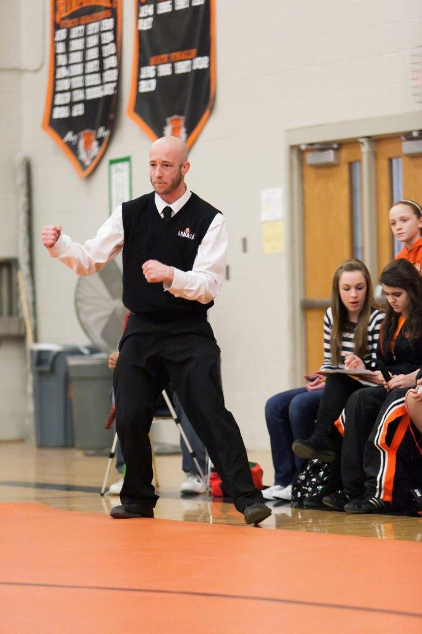
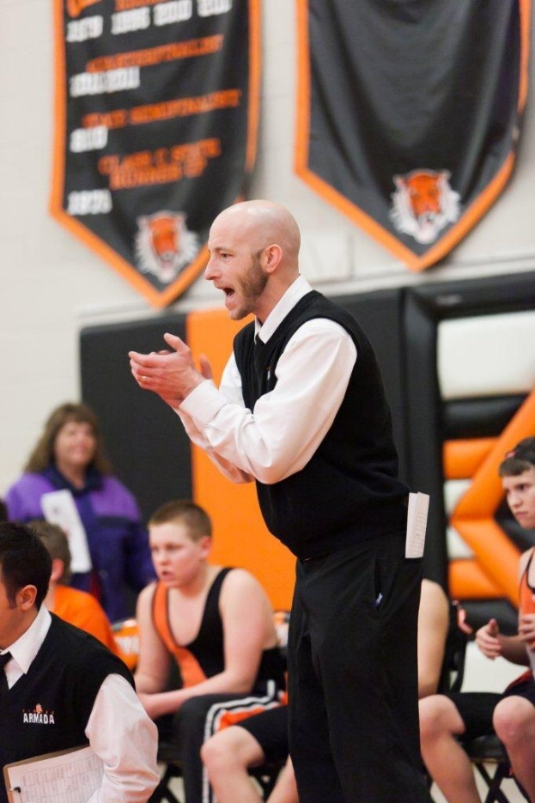
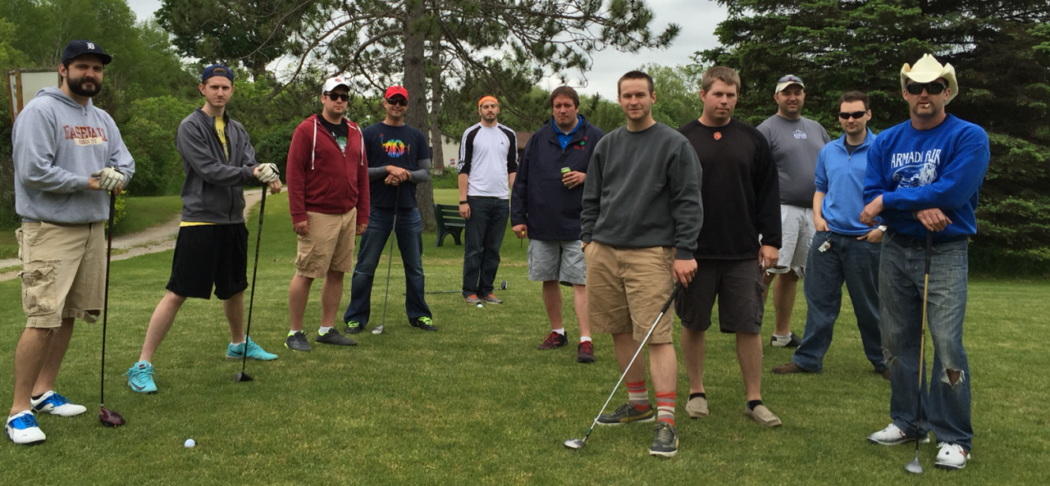
Starting year
15 in Armada
English 11,
AP Lit/Comp,
Coaching:
wrestling, track

Slide 10
Question #2:
What university
did I attend?

Slide 11
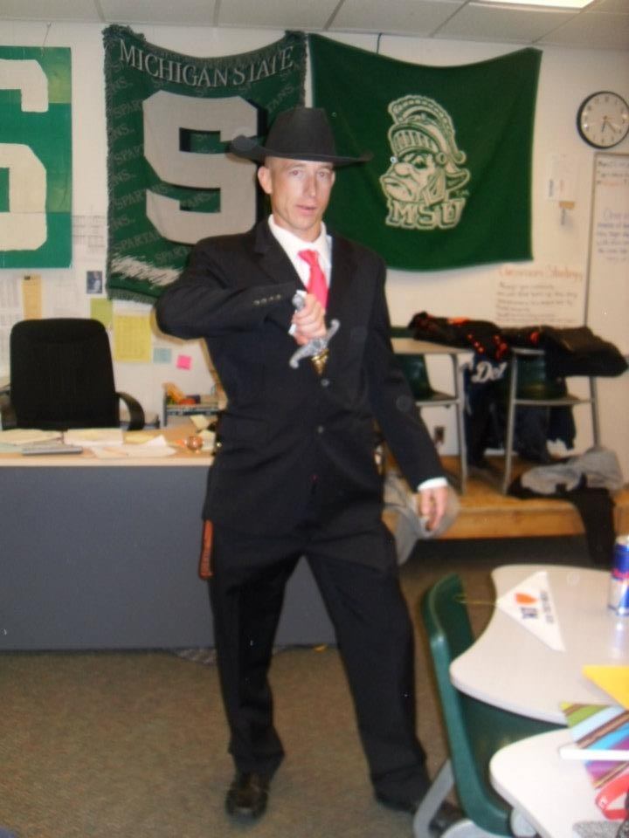
Answer #2:
Michigan
State
University
Bachelor: English
Master: Teaching & Curriculum

Slide 12
Question #3:
How many children do I have?

Slide 13
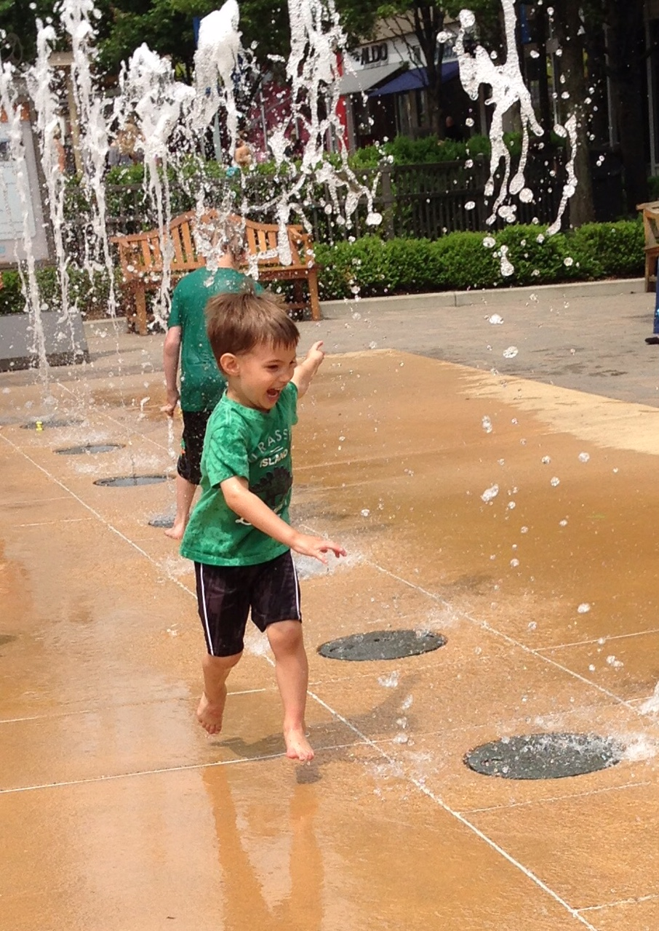
Answer #3:
One perfect child:
Aric Victor
3 years old

Slide 14
What do we want to get out of today? #sflearn @stemflowerlc
Partner share same phone
Partner share same S.O. status
Partner share same height
Partner share same favorite color
Partner share opposite fear

Slide 15
What did I do so far as the “teacher”?
Established rapport: my bio, student bios

Slide 16
What did I do so far as the “teacher”?
Established rapport: my bio, student bios
Assessment with zero academic reward

Slide 17
What did I do so far as the “teacher”?
Established rapport: my bio, student bios
Assessment with zero academic reward
Engaged the “students” through talking, moving and choice

Slide 18
What did I do so far as the “teacher”?
Established rapport: my bio, student bios
Assessment with zero academic reward
Engaged the “students” through talking, moving and choice
Integrated technology into learning

Slide 19
What did I do so far as the “teacher”?
Established rapport: my bio, student bios
Assessment with zero academic reward
Engaged the “students” through talking, moving and choice
Integrated technology into learning
In which order should we discuss these?

Slide 20
Shameless Plug
STEM vs. “Flower” classes
are very different
Stemflower.weebly.com
@stemflowerlc
stemflowerlc@gmail.com

Slide 21
Five question google form to help me grow as a professional: http://goo.gl/forms/7Ii2RcFYTR

