Slide 1
Foundations of Education
Aric Foster
STEM & Flower Learning Consultants
Stemandflowerlearning.com
stemflowerlc@gmail.com
@stemflowerlc
Standards and Assessment
How do we really know what our kids know?

Slide 2
Nature vs. Nurture: Is teaching innate or learned?

Slide 3
Nature vs. Nurture: Is teaching innate or learned?
Spectrum: access student prior knowledge

Slide 4
Nature vs. Nurture: Is teaching innate or learned?
Spectrum: access student prior knowledge
Nurture:
You are taking this class

Slide 5
Nature vs. Nurture: Is teaching innate or learned?
Spectrum: access student prior knowledge
Nurture:
You are taking this class
Constant PD is required

Slide 6
Nature vs. Nurture: Is teaching innate or learned?
Spectrum: access student prior knowledge
Nurture:
You are taking this class
Constant PD is required
Twittershpere: #edchat #COLchat #sblchat #miched

Slide 7
Nature vs. Nurture: Is teaching innate or learned?
Spectrum: access student prior knowledge
Nurture:
You are taking this class
Constant PD is required
Twittershpere: #edchat #COLchat #sblchat #miched
Nature:
Why did you get into this? Taekwondo

Slide 8
Nature vs. Nurture: Is teaching innate or learned?
Spectrum: access student prior knowledge
Nurture:
You are taking this class
Constant PD is required
Twittershpere: #edchat #COLchat #sblchat #miched
Nature:
Why did you get into this? Taekwondo
Do you “go to work” or “go to school”?

Slide 9
Nature vs. Nurture: Is teaching innate or learned?
Spectrum: access student prior knowledge
Nurture:
You are taking this class
Constant PD is required
Twittershpere#edchat #COLchat #sblchat #miched
Nature:
Why did you get into this? Taekwondo
Do you “go to work” or “go to school”?
What do you talk about in your free time?

Slide 10
Nature vs. Nurture: Is teaching innate or learned?
Spectrum: access student prior knowledge
Nurture:
You are taking this class
Constant PD is required
Twittershpere: #edchat #COLchat #sblchat #miched
Nature:
Why did you get into this? Taekwondo
Do you “go to work” or “go to school”?
What do you talk about in your free time?
Passion pays for itself

Slide 11
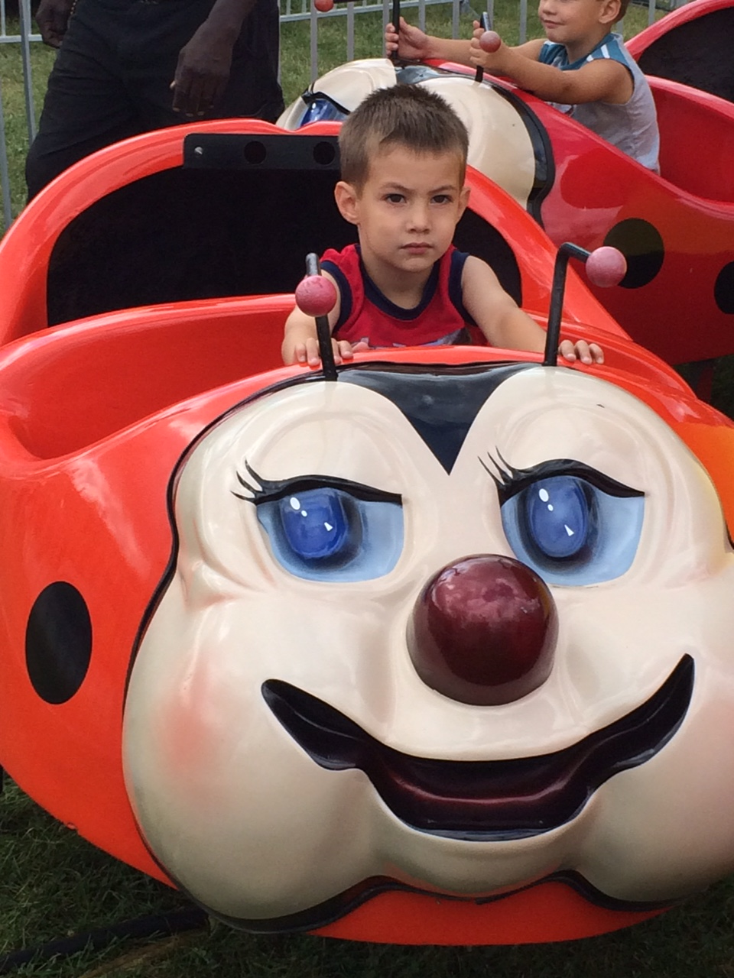

Slide 12
How do we really know what our kids know?

Slide 13
How do we really know what our kids know?
TEACH THE PATH

Slide 14
How do we really know what our kids know?
Standards, Objectives, Learning Targets, etc.

Slide 15
How do we really know what our kids know?
Standards, Objectives, Learning Targets, etc.
Activities: texts, questions, productions, formative assessments (both formal and informal), etc.

Slide 16
How do we really know what our kids know?
Standards, Objectives, Learning Targets, etc.
Activities: texts, questions, productions, formative assessments (both formal and informal), etc.
Assessment: projects, summative assessments, unit tests, etc.

Slide 17
How do we really know what our kids know?
Standards, Objectives, Learning Targets, etc.
Activities: texts, questions, productions, formative assessments (both formal and informal), etc.
Assessment: projects, summative assessments, unit tests, etc.
The path MUST be clear, transparent, consistent.

Slide 18
How do we really know what our kids know?
Standards, Objectives, Learning Targets, etc.
Activities: texts, questions, productions, formative assessments (both formal and informal), etc.
Assessment: projects, summative assessments, unit tests, etc.
The path MUST be clear, transparent, consistent.
Standardized tests? Whole different can of worms that we can discuss later if time

Slide 20
How do we really know what our kids know?
Teaching 101 Path:
Standards ➔ Activities ➔ Assessment

Slide 21
How do we really know what our kids know?
Teaching 101 Path:
Standards ➔ Activities ➔ Assessment
Teaching 2.0 Path:
Standards ➔ Assessment ➔ Activities

Slide 22
Teaching 2.0 Path: Standards ➔

Slide 23
Teaching 2.0 Path: Standards ➔
Standards need to be aligned per department/grade level

Slide 24
Teaching 2.0 Path: Standards ➔
Standards need to be aligned per department/grade level
“Synthesize” them in your school/district.

Slide 25
Teaching 2.0 Path: Standards ➔
Standards need to be aligned per department/grade level
“Synthesize” them in your school/district.
CCSS is a guide, but too voluminous ⇒ “Power Standards”

Slide 26
Teaching 2.0 Path: Standards ➔
Standards need to be aligned per department/grade level
“Synthesize” them in your school/district.
CCSS is a guide, but too voluminous ⇒ “Power Standards”
Standardized tests are certainly a factor, such as ACT’s “infer” focus in ELA

Slide 27
Teaching 2.0 Path: Standards ➔
Standards need to be aligned per department/grade level
“Synthesize” them in your school/district.
CCSS is a guide, but too voluminous ⇒ “Power Standards”
Standardized tests are certainly a factor, such as ACT’s “infer” focus in ELA
STEM and Flower classes are different: sequential vs. recursive, respectively

Slide 28
Teaching 2.0 Path: Standards ➔
What Aric did:
Highlighted CCSS for Endurance (job), Leverage (other classes) and Readiness (next level)

Slide 29
Teaching 2.0 Path: Standards ➔
What Aric did:
Highlighted CCSS for Endurance (job), Leverage (other classes) and Readiness (next level)
Synthesized 10ish standards per trimester

Slide 30
Teaching 2.0 Path: Standards ➔
What Aric did:
Highlighted CCSS for Endurance (job), Leverage (other classes) and Readiness (next level)
Synthesized 10ish standards per trimester
Revised each grading period based on proficiency
Main ideas + details = Comprehension
No infer third trimester
Put diction in first trimester

Slide 31
How do we really know what our kids know?
Teaching 2.0 Path:
Standards ➔ Assessment ➔ Activities
Look at page one and write your own standard for your subject major.

Slide 32
How do we really know what our kids know?
Teaching 101 Path:
Standards ➔ Activities ➔ Assessment
Teaching 2.0 Path:
Standards ➔ Assessment ➔ Activities

Slide 34
Teaching 2.0 Path: Standards ➔ Assessment

Slide 35
Teaching 2.0 Path: Standards ➔ Assessment
Summative: start with the end in mind

Slide 36
Teaching 2.0 Path: Standards ➔ Assessment
Summative: start with the end in mind
Summative assessments to measure standards

Slide 37
Teaching 2.0 Path: Standards ➔ Assessment
Summative: start with the end in mind
Summative assessments to measure standards
STEM = 3 per unit; Flower = 10 per six weeks

Slide 38
Teaching 2.0 Path: Standards ➔ Assessment
Summative: start with the end in mind
Summative assessments to measure standards
STEM = 3 per unit; Flower = 10 per six weeks
Final grade calculation is 100% summative

Slide 39
Teaching 2.0 Path: Standards ➔ Assessment
Summative: start with the end in mind
Summative assessments to measure standards
STEM = 3 per unit; Flower = 10 per six weeks
Final grade calculation is 100% summative
Not a “test” but a performance based task

Slide 40
Teaching 2.0 Path: Standards ➔ Assessment
Summative: start with the end in mind
Summative assessments to measure standards
STEM = 3 per unit; Flower = 10 per six weeks
Final grade calculation is 100% summative
Not a “test” but a performance based task
Can be “performed” in parts or one sitting

Slide 41
Teaching 2.0 Path: Standards ➔ Assessment
What Aric did:
Made standards in June & summative in July

Slide 42
Teaching 2.0 Path: Standards ➔ Assessment
What Aric did:
Made standards in June & summative in July
Summative performance task measuring all 10 standards. See pages 3-10

Slide 43
Teaching 2.0 Path: Standards ➔ Assessment
What Aric did:
Made standards in June & summative in July
Summative performance task measuring all 10 standards. See pages 3-4
Two days in library and a weekend

Slide 44
Teaching 2.0 Path: Standards ➔ Assessment
What Aric did:
Made standards in June & summative in July
Summative performance task measuring all 10 standards. See pages 3-4
Two days in library and a weekend
“Repeat offenders” = show me all 10

Slide 45
Teaching 2.0 Path: Standards ➔ Assessment
What Aric did:
Made standards in June & summative in July
Summative performance task measuring all 10 standards. See pages 3-4
Two days in library and a weekend
“Repeat offenders” = show me all 10
Feedback: timely, narrative, descriptive, standards referenced and action-oriented

Slide 46
Teaching 2.0 Path: Standards ➔ Assessment
What Aric did:
Made standards in June & summative in July
Summative performance task measuring all 10 standards. See pages 3-4
Two days in library and a weekend
“Repeat offenders” = show me all 10
Feedback: timely, narrative, descriptive, standards referenced and action-oriented
Revisions = see me to explain aloud or Voxer

Slide 47
How do we really know what our kids know?
Teaching 2.0 Path:
Standards ➔ Assessment ➔ Activities
Look at pages 3-4. How would you assess the standard you wrote?

Slide 48
How do we really know what our kids know?
Teaching 101 Path:
Standards ➔ Activities ➔ Assessment
Teaching 2.0 Path:
Standards ➔ Assessment ➔ Activities

Slide 50
Teaching 2.0 Path: Standards ➔ Assessment ➔ Activities
Formative: “back-filling” learning

Slide 51
Teaching 2.0 Path: Standards ➔ Assessment ➔ Activities
Formative: “back-filling” learning
If it doesn’t practice what and how kids need to perform on “game day,” don’t do it.

Slide 52
Teaching 2.0 Path: Standards ➔ Assessment ➔ Activities
Formative: “back-filling” learning
If it doesn’t practice what and how kids need to perform on “game day,” don’t do it.
But this activity is really fun…

Slide 53
Teaching 2.0 Path: Standards ➔ Assessment ➔ Activities
Formative: “back-filling” learning
If it doesn’t practice what and how kids need to perform on “game day,” don’t do it.
But this activity is really fun…
Teach the standards, not the content

Slide 54
Teaching 2.0 Path: Standards ➔ Assessment ➔ Activities
Formative: “back-filling” learning
If it doesn’t practice what and how kids need to perform on “game day,” don’t do it.
But this activity is really fun…
Teach the standards, not the content
What if I don’t “cover” everything?

Slide 55
Teaching 2.0 Path: Standards ➔ Assessment ➔ Activities
What Aric did:
Reviewed old tasks and modified them to address standards

Slide 56
Teaching 2.0 Path: Standards ➔ Assessment ➔ Activities
What Aric did:
Reviewed old tasks and modified them to address standards
Graphed which standards got addressed in a unit

Slide 57
Teaching 2.0 Path: Standards ➔ Assessment ➔ Activities
What Aric did:
Reviewed old tasks and modified them to address standards
Graphed which standards got addressed in a unit
Amended tasks for equal practice of all 10 standards

Slide 58
Teaching 2.0 Path: Standards ➔ Assessment ➔ Activities
What Aric did:
Reviewed old tasks and modified them to address standards
Graphed which standards got addressed in a unit
Amended tasks for equal practice of all 10 standards
Deleted “Beowulf monomyth” task ☹

Slide 59
How do we really know what our kids know?
Teaching 2.0 Path:
Standards ➔ Assessment ➔ Activities
Look at page 5. How would you practice the standard you wrote so learners would be prepared for summative assessment day?

Slide 60
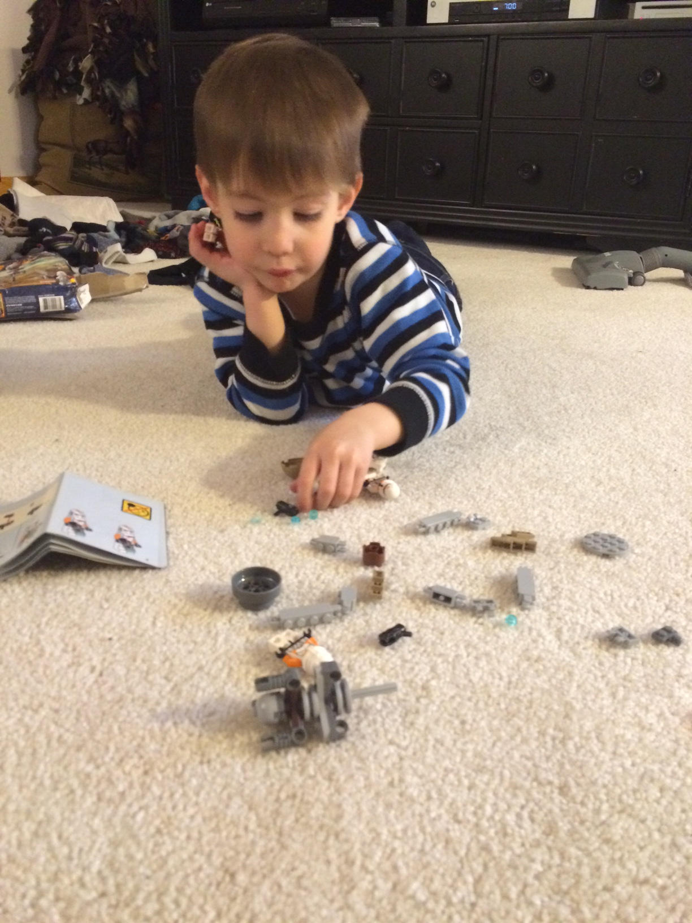
Discussion
What does an 82%
mean in my class?

Slide 61
Do our grades match learners’ proficiency?
“Missy O.” & “J. Day”
“Students” vs. “Learners”
Standards Based Learning

Slide 62
Student reflections about SBG:
“Now our grade is only based on our skills in English”
“The only downfall is that other teachers don’t do it. We have been brainwashed to do school one way, and now I have to think differently about it in your class.”
“Grades aren’t based on just turning stuff in.”
“This kinda forces us to learn.”
“I was getting easy A’s, then your class came along,
and I can’t play school anymore.”
“It easier to keep your grade up; you can always do better.”
“How do you fail this class?”
“This year was way harder than last year, but I learned more.”
“You can’t fail unless you really try to.”
“The best part of this class was the (SBL) grading.”

Slide 65
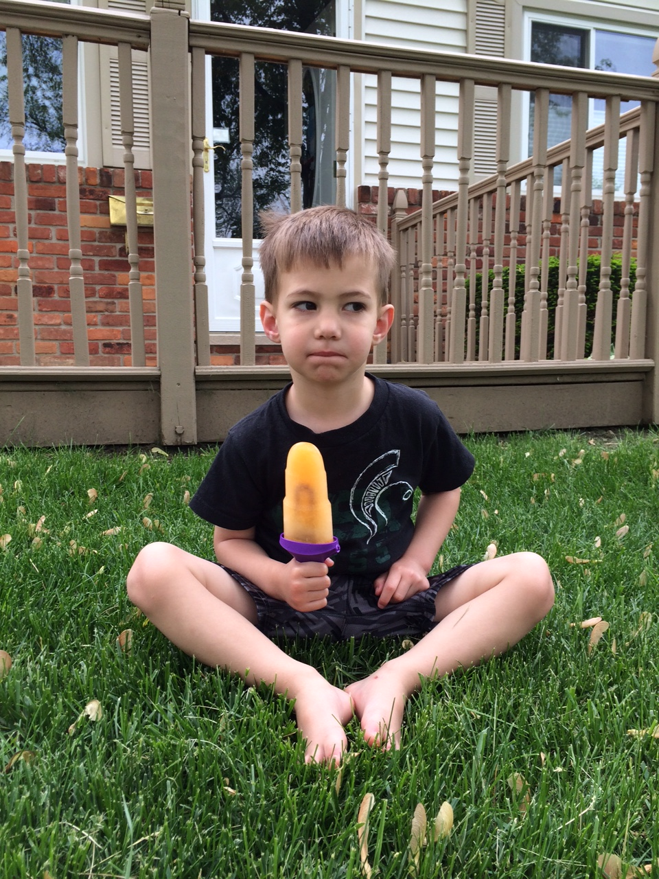
That’s nice, but how do we cultivate a culture of learning in class?

Slide 66
That’s nice, but how do you calculate a student’s final grade?
Feedback: timely, narrative, descriptive, standards-based and action-oriented

Slide 67
Review the example on page 6. It is given to learners before they attempt the task.
Be ready to share what you notice about the feedback.

Slide 68
That’s nice, but how do you calculate a student’s final grade?
ICU list: Defeating student apathy one task at a time

Slide 69
Intensive Care Unit List
Intensive Care and “Aggressive Compassion”
Never give up!
Feedback/scores are TIMELY
Proficient in all standards = off list
Stand at the door and increase consequences:
Guilt & Remind 101 & Hall & Time & Home & Principal & Recess
www.poweroficu.com
Danny Hill & Jason Nave
@PowerofICU
Brickhouse Culture: Defeat Student Apathy

Slide 70
Intensive Care Unit List
Does it work?
100 Armada Juniors in four classes of English 11 per trimester
300 English 11 junior final grades and FIVE final trimester grades were E’s.
First trimester: 1,449 total student tasks proficient/1,550 total = 93.5%
Second trimester: 1,460 total student tasks proficient/1,536 total = 95%
Third trimester: 984 total student tasks proficient/1,057 total = 93.1%
Total all year
4,143 total student tasks on the ICU list.
3,893 student tasks completed proficiently with timely, narrative, descriptive, standards-based feedback,
which is 94% completion proficiently with zero numerical contribution to their final grade. ☺
failed. All yearmeet at door to check (About 70% of students turn it in)
Give feedback & numbers. If student is proficient in all learning targets on the first try, they are off the ICU list. If not, they are given specific direction on how to revise.
1 day late: door check and disappointment. Exit reminder. Remind 101 (85%)
2 days late: door check and more disappointment. Exit reminder. Remind 101 (90%)
3 days late: door check, wait in hall and work on it until it is done. (96%)
4 days late: door check, students pick which chunk of their time they want to donate (99%)
Other methods: call home, email home, paper letter home, send student to other teachers/principal to explain ICU list and that they are on it, they can’t go to “recess” until it is done, do it in gym, etc.
@PowerofICU Brickhouse Defeating Student Apathy

Slide 71
Questions? Comments? Criticisms?

Slide 72
Questions? Comments? Criticisms?
“Sounds great, but it is a lot of time/effort.”

Slide 73
Questions? Comments? Criticisms?
“Sounds great, but it is a lot of time/effort.”
“Sounds great, but it is new and challenging.”

Slide 74
Questions? Comments? Criticisms?
“Sounds great, but it is a lot of time/effort.”
“Sounds great, but it is new and challenging.”
“Sounds great, but what if my principal won’t let me do this?”

Slide 75
Questions? Comments? Criticisms?
“Sounds great, but it is a lot of time/effort.”
“Sounds great, but it is new and challenging.”
“Sounds great, but what if my principal won’t let me do this?”
“Sounds great, but where do I turn for questions?”

Slide 76
Foundations of Education
Aric Foster
STEM & Flower Learning Consultants
Stemandflowerlearning.com
stemflowerlc@gmail.com
@stemflowerlc
Standards and Assessment
How do we really know what our kids know?

Slide 77
Five question google form to help me grow as a professional: http://goo.gl/forms/7Ii2RcFYTR

Slide 78
Final Grade Principles
Final grade is proficiency on standards and THAT IS IT. Separate proficiency from behavior.

Slide 79
Final Grade Principles
Final grade is proficiency on standards and THAT IS IT. Separate proficiency from behavior.
Late work, missing work, work habits, employability, participation, citizenship, etc. ARE important and deserve feedback and need to be reported…separately.

Slide 80
Citizenship district-wide should have consistency and “teeth”
“Cardinal Code” in Davison, MI
“Creek Code” in Swartz Creek, MI
Similar code in Grosse Ile, MI
Armada: no district code and two poor scores per grading period = ineligible (kinda)

Slide 81
Final Grade Specifics
Formatives earn students scores and feedback, but don’t count towards final grade.

Slide 82
Final Grade Specifics
Formatives earn students scores and feedback, but don’t count towards final grade.
Formative scores & feedback logged/published/highlighted in PowerSchool, Seesaw, Goggle forms, and/or on paper.

Slide 83
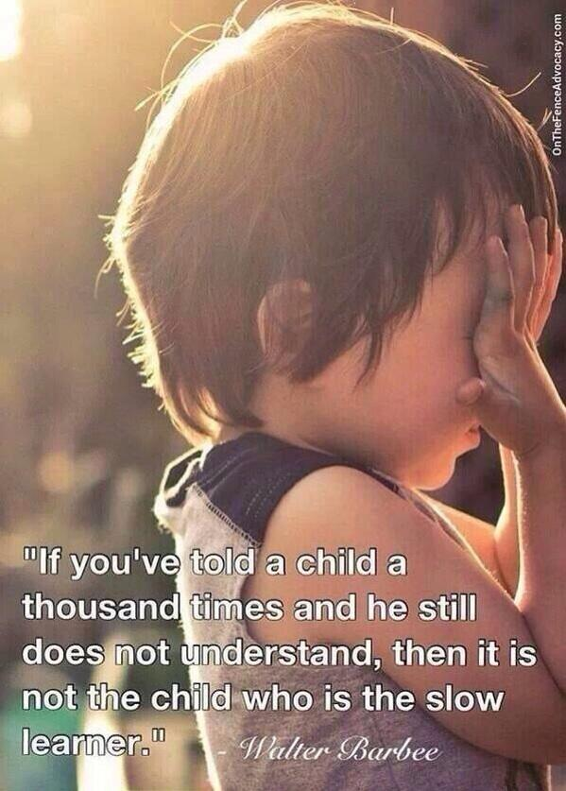

Slide 84
Final Grade Specifics
Formatives earn students scores and feedback, but don’t count towards final grade.
Formative scores & feedback logged in PowerSchool, Seesaw and on paper.
Only performance on summative counts.

Slide 85
Average of all 4.0 Learning Targets scores on summative assessments | Letter Grade
4.0-3.6 | A
3.59-3.3 | A-
3.29-3.0 | B+
2.99-2.7 | B
2.69-2.4 | B-
2.39-2.1 | C+
2.09-1.8 | C
1.79-1.5 | C-
Why no “D”? D is a “poor man’s E.” Are you comfortable that a learner is prepared for the next level with a D?
Did not complete 100% of Summative Assessment | I (Incomplete)
Earning less than a 1.5 overall does NOT earn credit for the class.

Slide 86
Missy O. earned
2, 3, 3, 4 in “Grammar”
Averaging
over time: 3
Final performance on summative: 4

Slide 87
Final Grade Specifics
Formatives earn students scores and feedback, but don’t count towards final grade.
Formative scores & feedback logged in PowerSchool, Seesaw and on paper.
Only performance on summative counts.
Can revise summative if all formatives are completed. Formatives = “Retake Ticket”

Slide 88
Standards Based Learning
Does it work?
For the past three years that I have been doing SBL, I have had about 100 Armada Juniors in four classes of English 11 per trimester. This is about 80% of all Armada Juniors.
For the past three years that I have been doing SBL, Armada’s ACT scores in English have been the highest in the history of the school, breaking its own record each year. In 2015, the AHS ACT composite score was the highest in school history.

Slide 89
Standards Based Learning
Does it work?
100 Armada Juniors in four classes of English 11 per trimester
300 English 11 junior final grades and
FIVE final trimester grades were E’s.
Two for lack of proficiency and
three didn’t complete summative.

Slide 90
Wait…Students get zero extrinsic final grade motivation to do “homework”? They won’t do it if it’s not for points!
Oh really?
BUILD A CULTURE

Slide 91
I realized that eventually, if kids understand growth mindset, culture of learning, and are “in,” then they don’t need numbers.

Slide 92
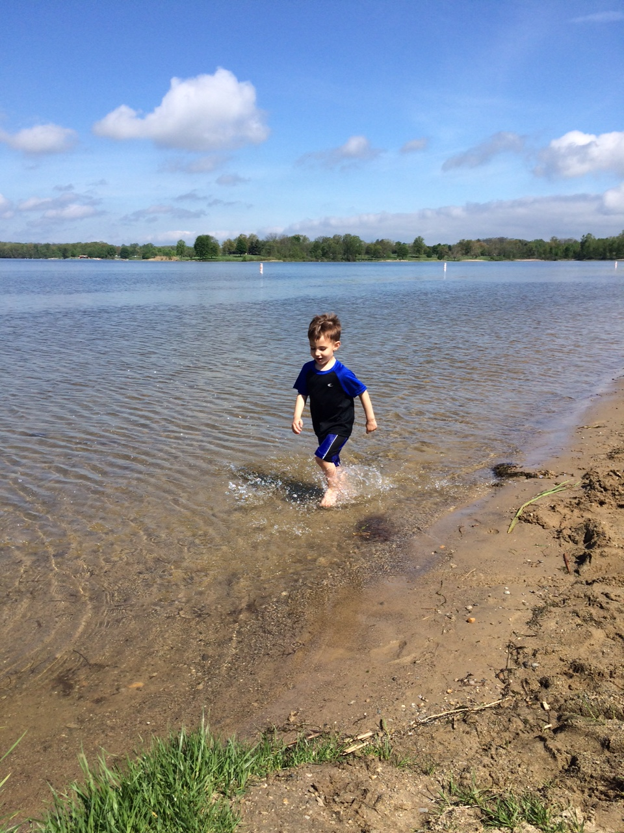
Which is the most effective feedback for mi hijito?
“Good job”
2.0 in focus
1.5 in speed
3.0 in aesthetics
2.0 in splashing
“Too slow; try again”

Slide 93
Which is the most effective feedback for mi hijito?
“I see you running. Is it challenging to run in the water? Why? What are you doing with your feet? What do you notice? I notice that the faster you run, the more you splash. Show me.” again. I can’t wait to see you run in the water again.”

Slide 94
Intensive Care Unit List = Magical Excel Spreadsheet
(page 7)

Slide 95
Intensive Care Unit List
Intensive Care and “Aggressive Compassion”

Slide 96
Intensive Care Unit List
Intensive Care and “Aggressive Compassion”
If I am convinced a task will help a student learn and grow, why would I “give up” on insisting they do it?

Slide 97
Intensive Care Unit List
Intensive Care and “Aggressive Compassion”
Never give up!
Feedback/scores are TIMELY

Slide 98
Intensive Care Unit List
Intensive Care and “Aggressive Compassion”
Never give up!
Feedback/scores are TIMELY
Proficient in all standards on a given task = off list

Slide 99
Intensive Care Unit List
Intensive Care and “Aggressive Compassion”
Never give up!
Feedback/scores are TIMELY
Proficient in all standards = off list
Stand at the door and increase consequences:
Guilt and Remind 101 EVERY DAY

Slide 100
Intensive Care Unit List
Intensive Care and “Aggressive Compassion”
Never give up!
Feedback/scores are TIMELY
Proficient in all standards = off list
Stand at the door and increase consequences:
Guilt & Remind 101 Everyday!
Work in hall until you address feedback
and revise to proficiency.
(I usually bring them back in after 10 minutes-ish)

Slide 101
Intensive Care Unit List
Intensive Care and “Aggressive Compassion”
Never give up!
Feedback/scores are TIMELY
Proficient in all standards = off list
Stand at the door and increase consequences:
Guilt & Remind 101 & Work in hall
Donate your time: before school, after, lunch with “Name on the board” ☺

Slide 102
Intensive Care Unit List
Intensive Care and “Aggressive Compassion”
Never give up!
Feedback/scores are TIMELY
Proficient in all standards = off list
Stand at the door and increase consequences:
Guilt & Remind 101 & Work in hall & Donate your time
Home contact: phone call, email,
paper letter that student writes

Slide 103
Intensive Care Unit List
Intensive Care and “Aggressive Compassion”
Never give up!
Feedback/scores are TIMELY
Proficient in all standards = off list
Stand at the door and increase consequences:
Guilt & Remind 101 & Hall & Time & Home contact
Explain how and why you are
on the ICU list to the principal

Slide 104
Intensive Care Unit List
Intensive Care and “Aggressive Compassion”
Never give up!
Feedback/scores are TIMELY
Proficient in all standards = off list
Stand at the door and increase consequences:
Guilt & Remind 101 & Hall & Time & Home & Principal
No “recess” = Dpop, auditorium, outside

Slide 105
Intensive Care Unit List
Intensive Care and “Aggressive Compassion”
Never give up!
Feedback/scores are TIMELY
Proficient in all standards = off list
Stand at the door and increase consequences:
Guilt & Remind 101 & Hall & Time & Home & Principal & Recess
www.poweroficu.com
Danny Hill & Jason Nave
@PowerofICU
Brickhouse Culture: Defeat Student Apathy

Slide 106
Intensive Care Unit List
Does it work?
100 Armada Juniors in four classes of English 11 per trimester
300 English 11 junior final grades and FIVE final trimester grades were E’s.
First trimester: 1,449 total student tasks proficient/1,550 total = 93.5%
Second trimester: 1,460 total student tasks proficient/1,536 total = 95%
Third trimester: 984 total student tasks proficient/1,057 total = 93.1%
Total all year
4,143 total student tasks on the ICU list.
3,893 student tasks completed proficiently with timely, narrative, descriptive, standards-based feedback,
which is 94% completion proficiently with zero numerical contribution to their final grade. ☺
failed. All yearmeet at door to check (About 70% of students turn it in)
Give feedback & numbers. If student is proficient in all learning targets on the first try, they are off the ICU list. If not, they are given specific direction on how to revise.
1 day late: door check and disappointment. Exit reminder. Remind 101 (85%)
2 days late: door check and more disappointment. Exit reminder. Remind 101 (90%)
3 days late: door check, wait in hall and work on it until it is done. (96%)
4 days late: door check, students pick which chunk of their time they want to donate (99%)
Other methods: call home, email home, paper letter home, send student to other teachers/principal to explain ICU list and that they are on it, they can’t go to “recess” until it is done, do it in gym, etc.
@PowerofICU Brickhouse Defeating Student Apathy

Slide 107
Let me share more
STEM vs. “Flower” classes
are very different
Stemandflowerlearning.com
@stemflowerlc
stemflowerlc@gmail.com

