Slide 1
My final grade should be an A.
Here’s why….

Slide 2
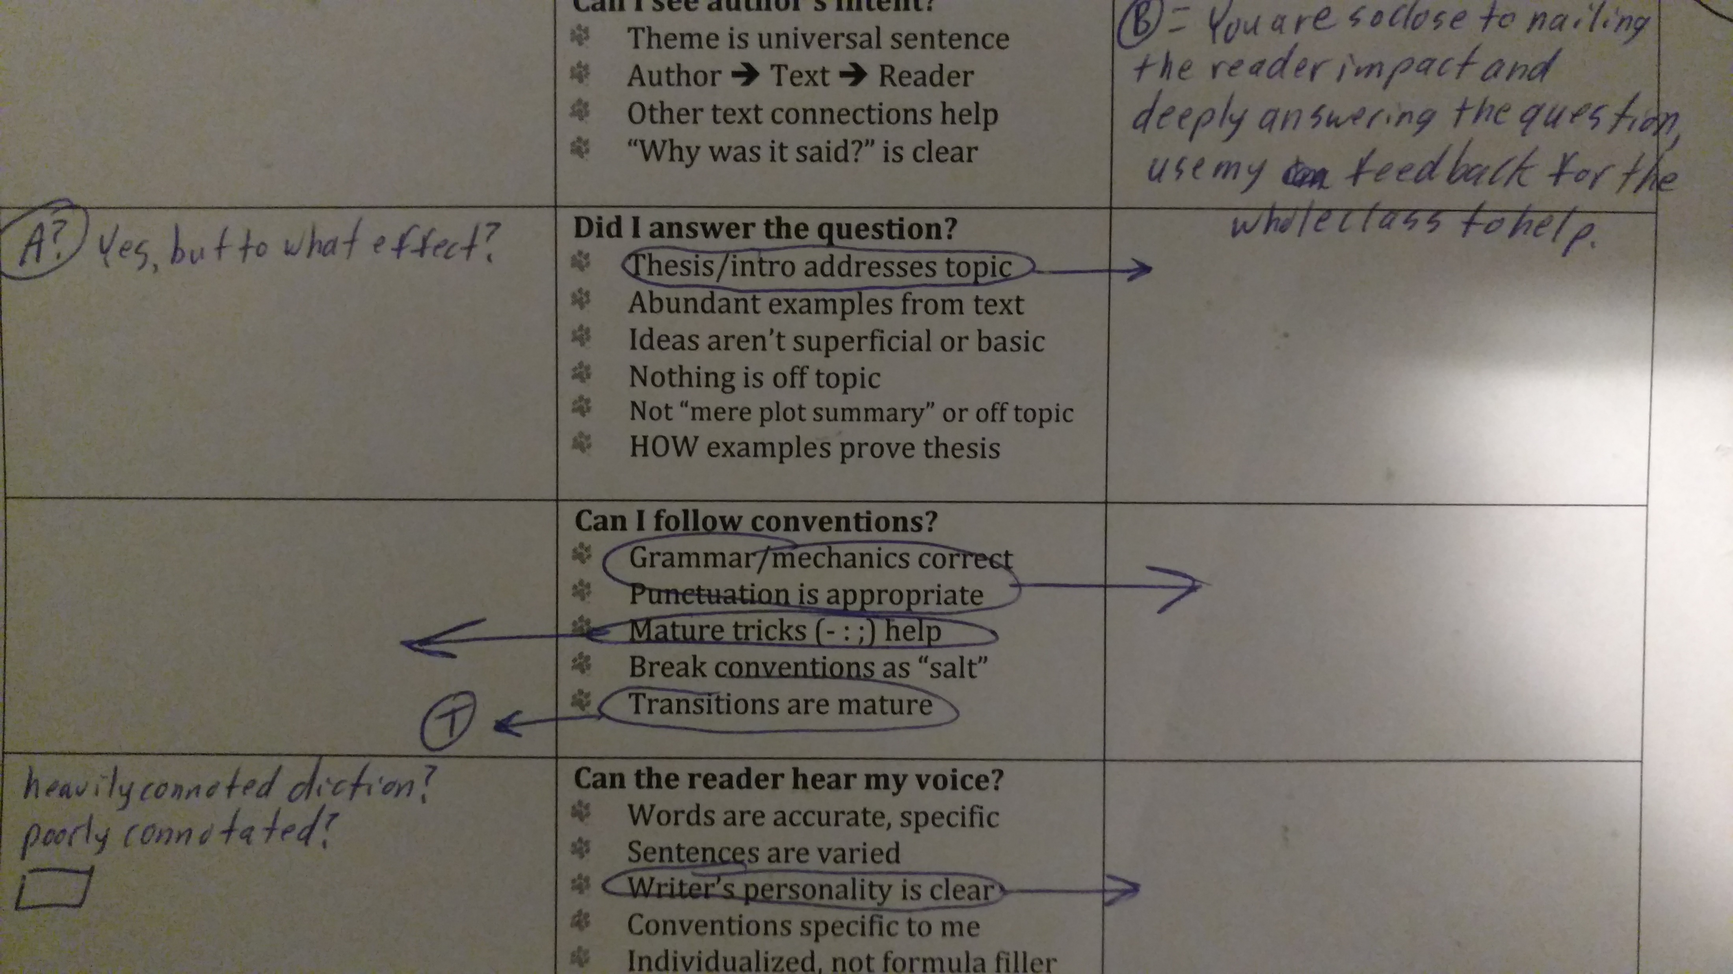
Tri 1

Slide 3
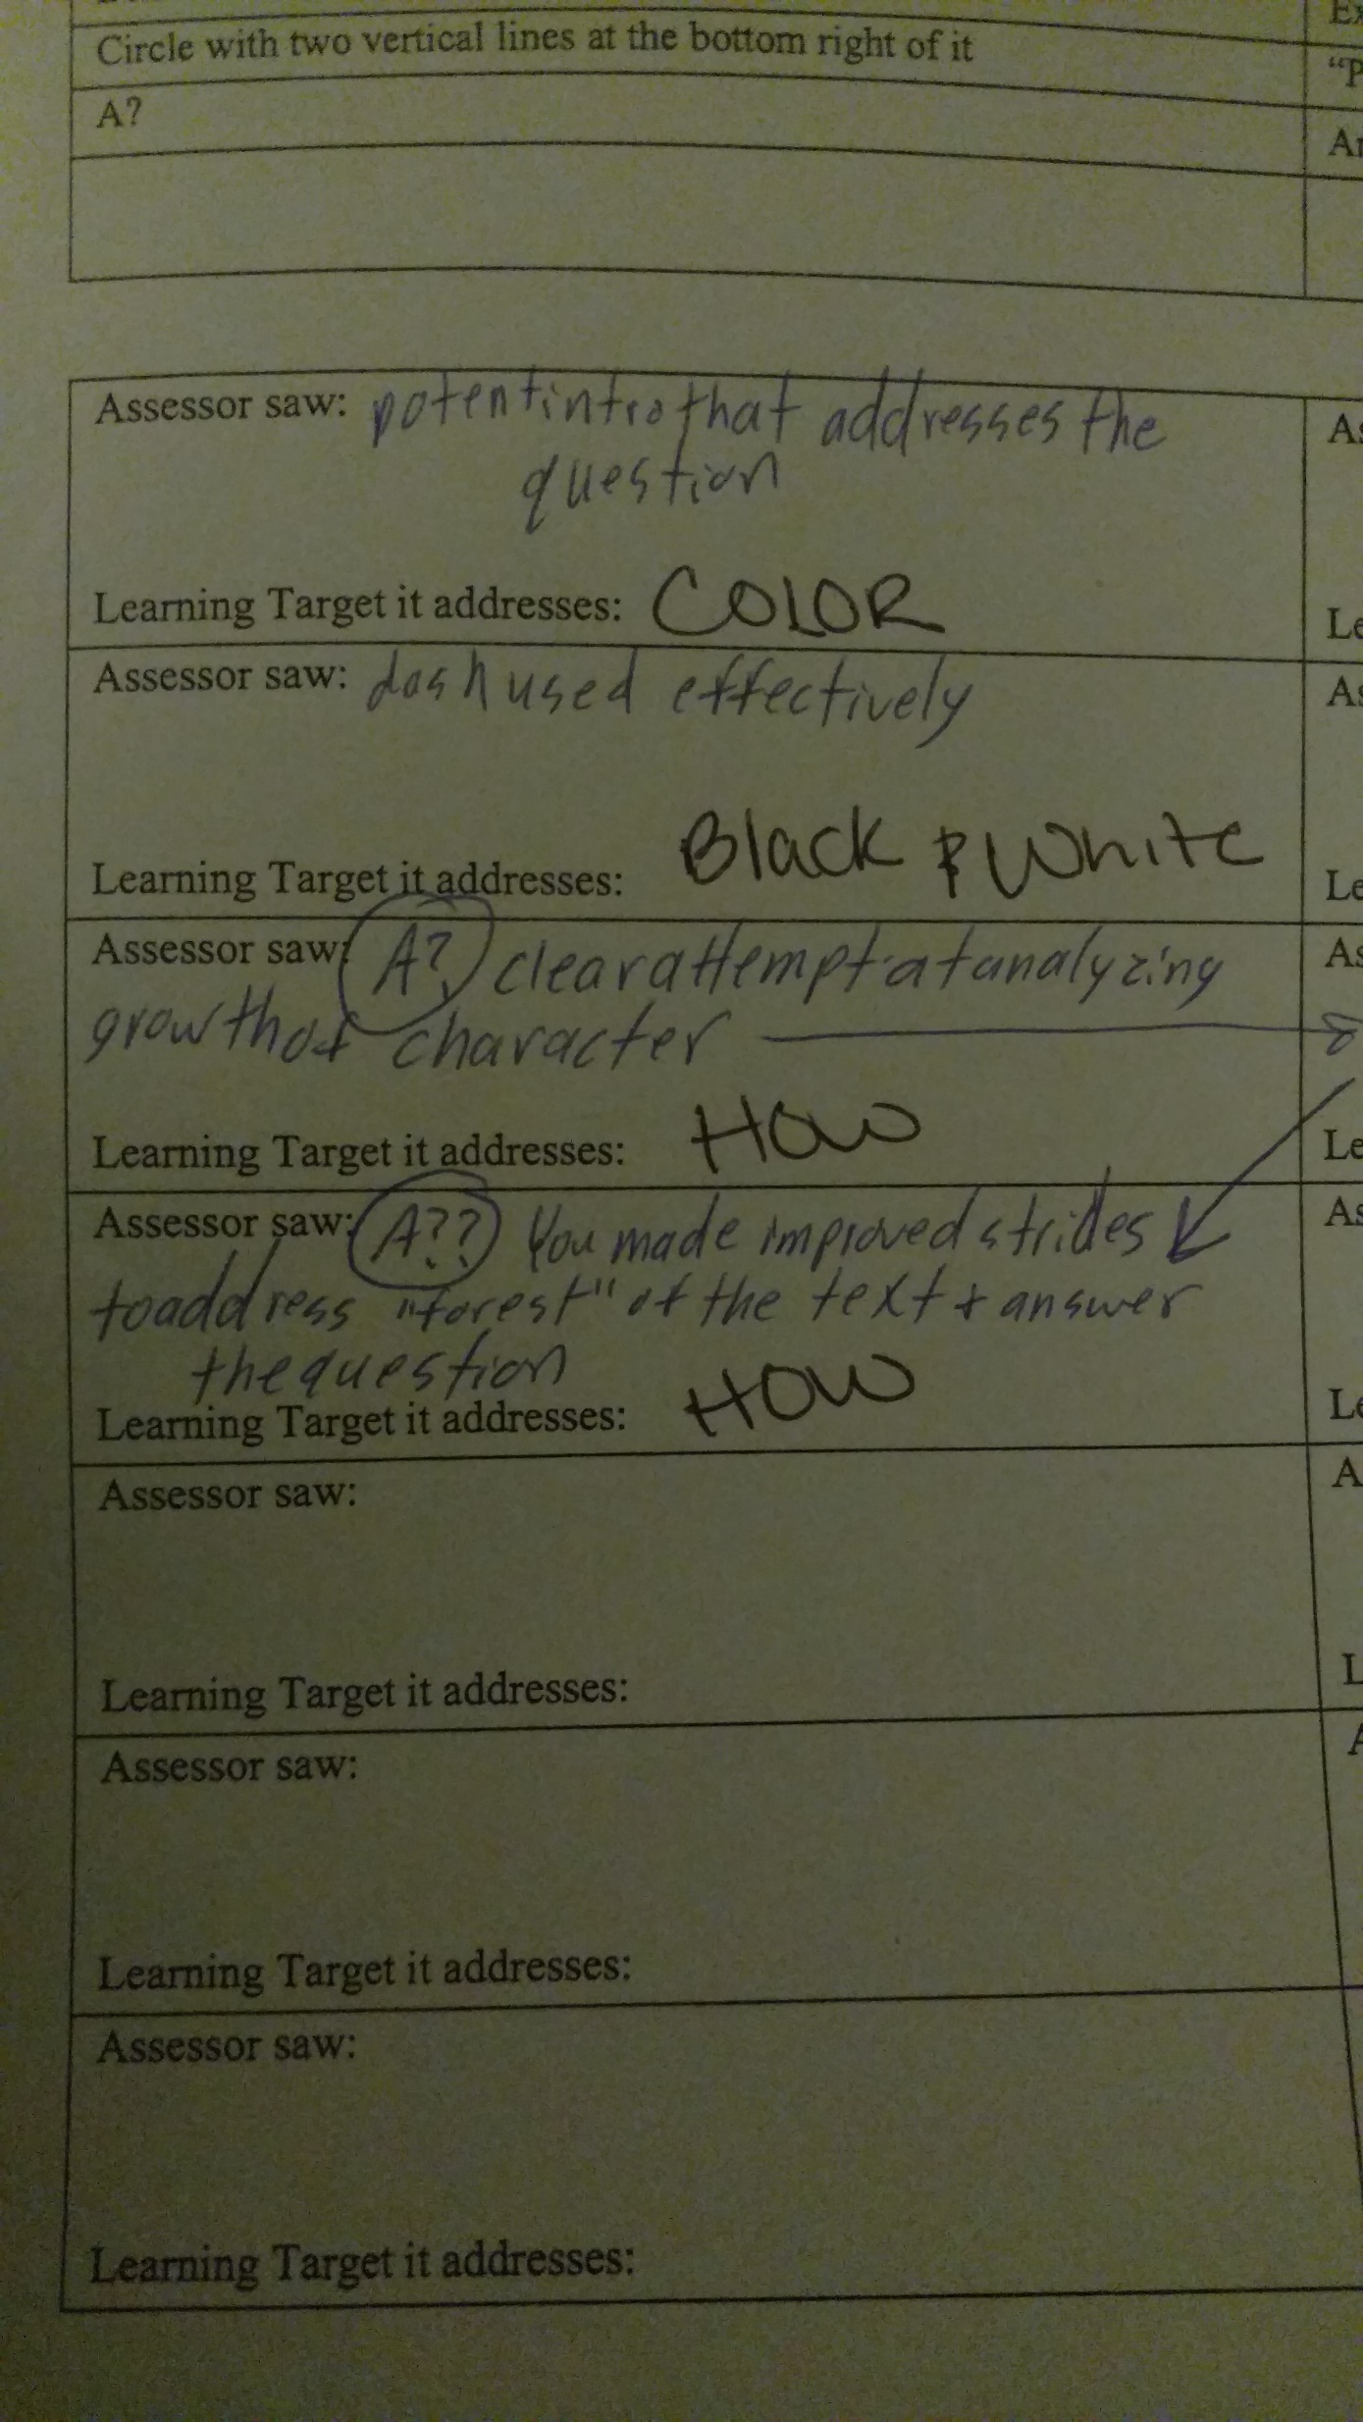
Tri 1

Slide 4
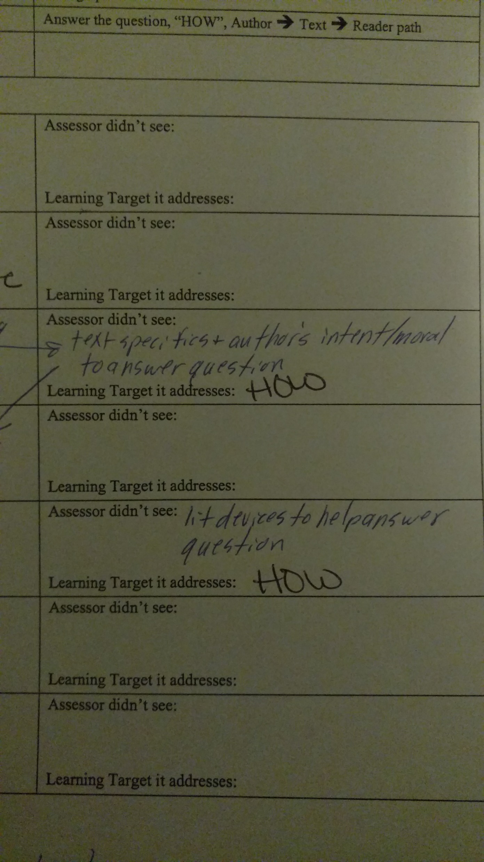
Tri 1

Slide 5
So, I’d improved a little, yet I was still quite lacking in “HOW”.

Slide 6
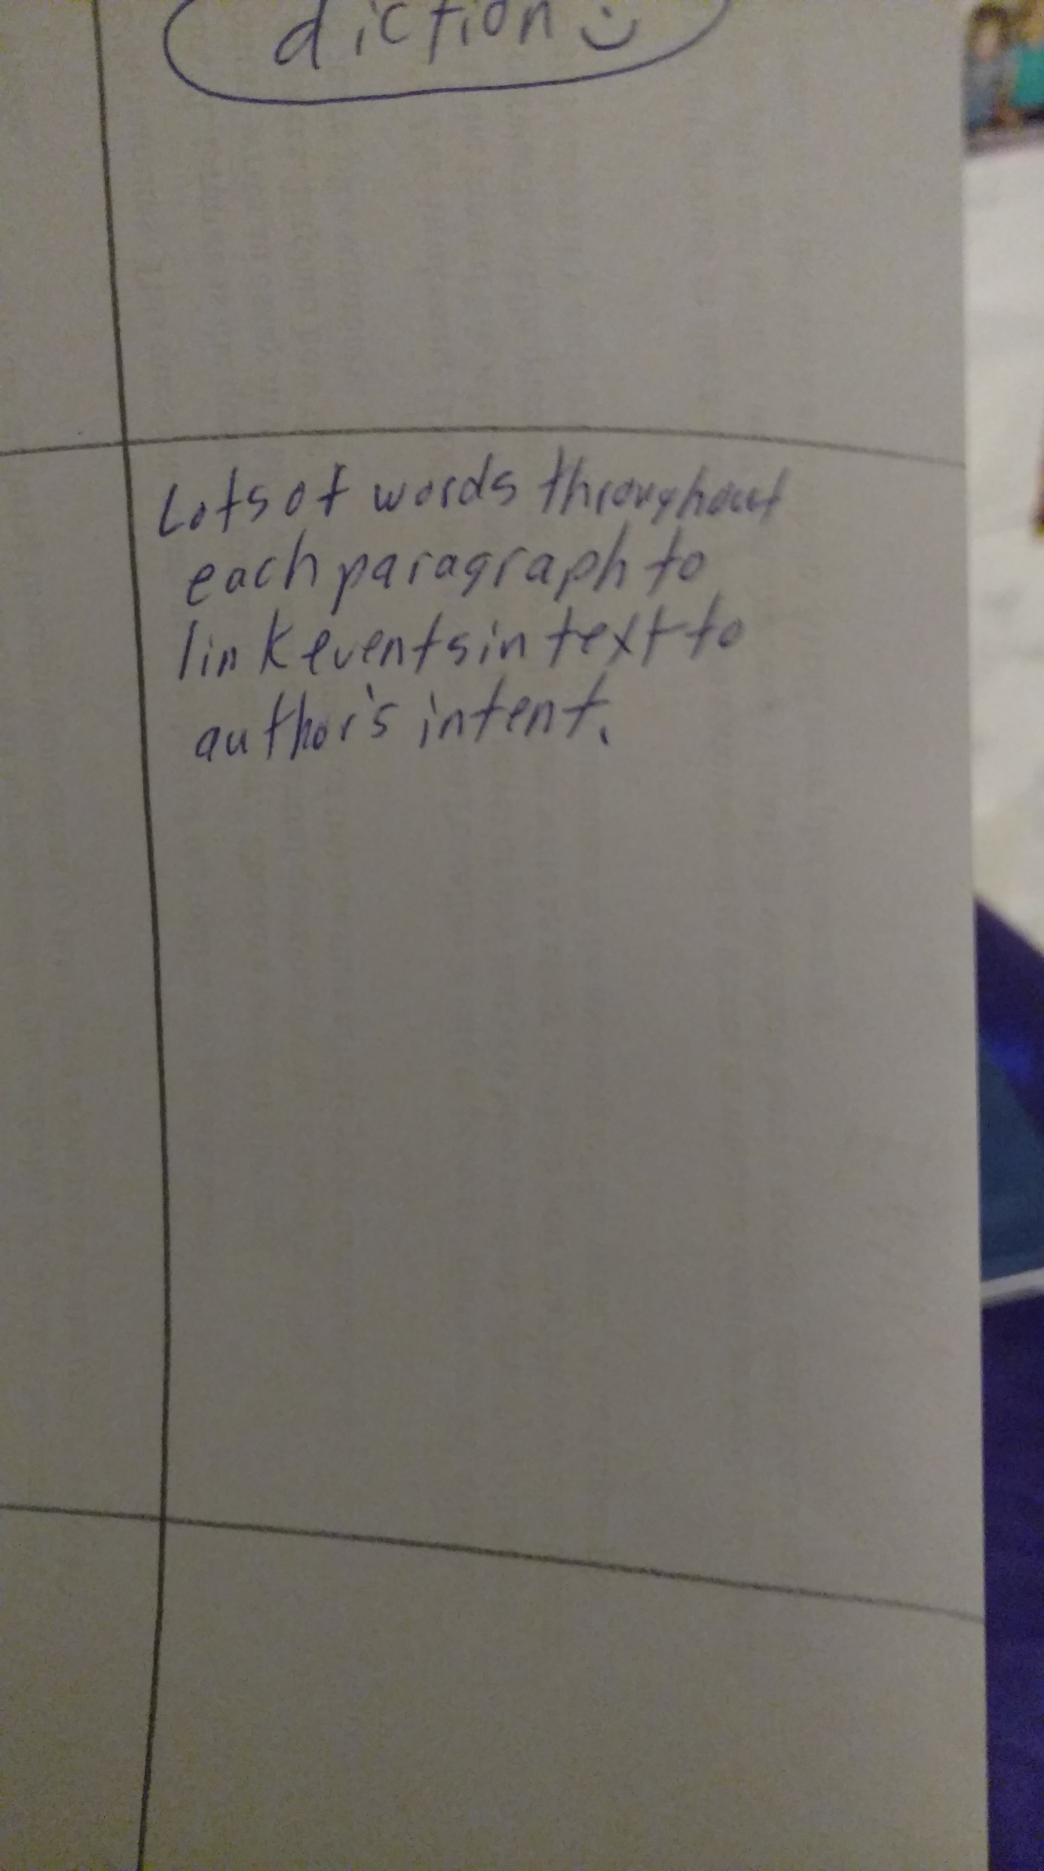
End of Tri 1

Slide 7
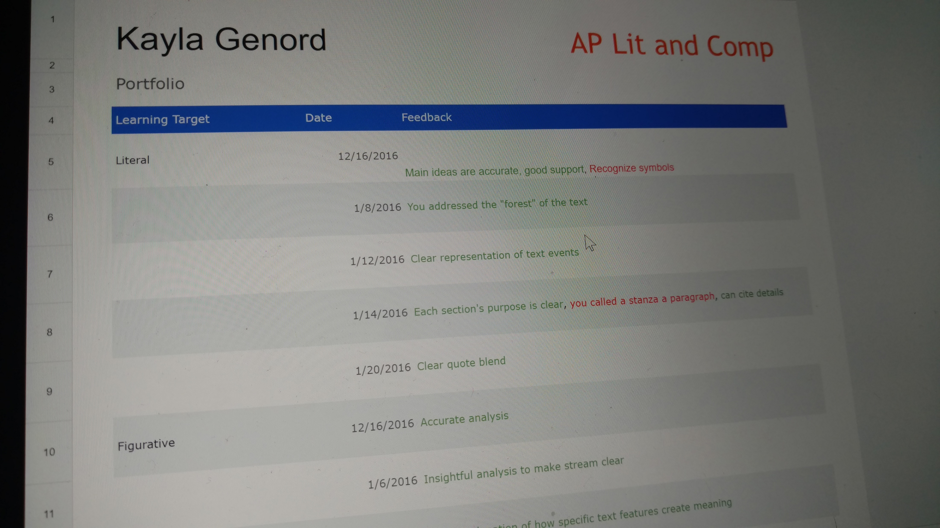
Tri 2

Slide 8
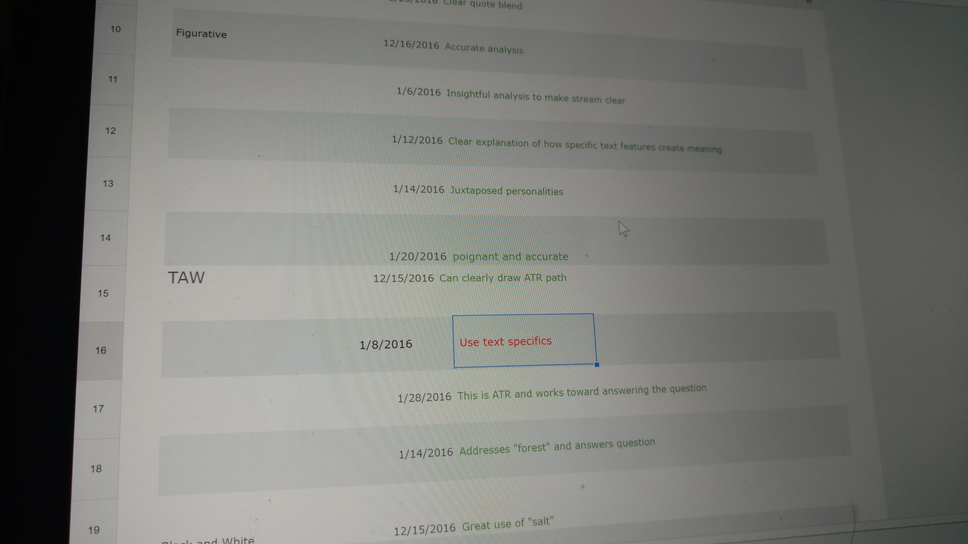
Tri 2

Slide 9
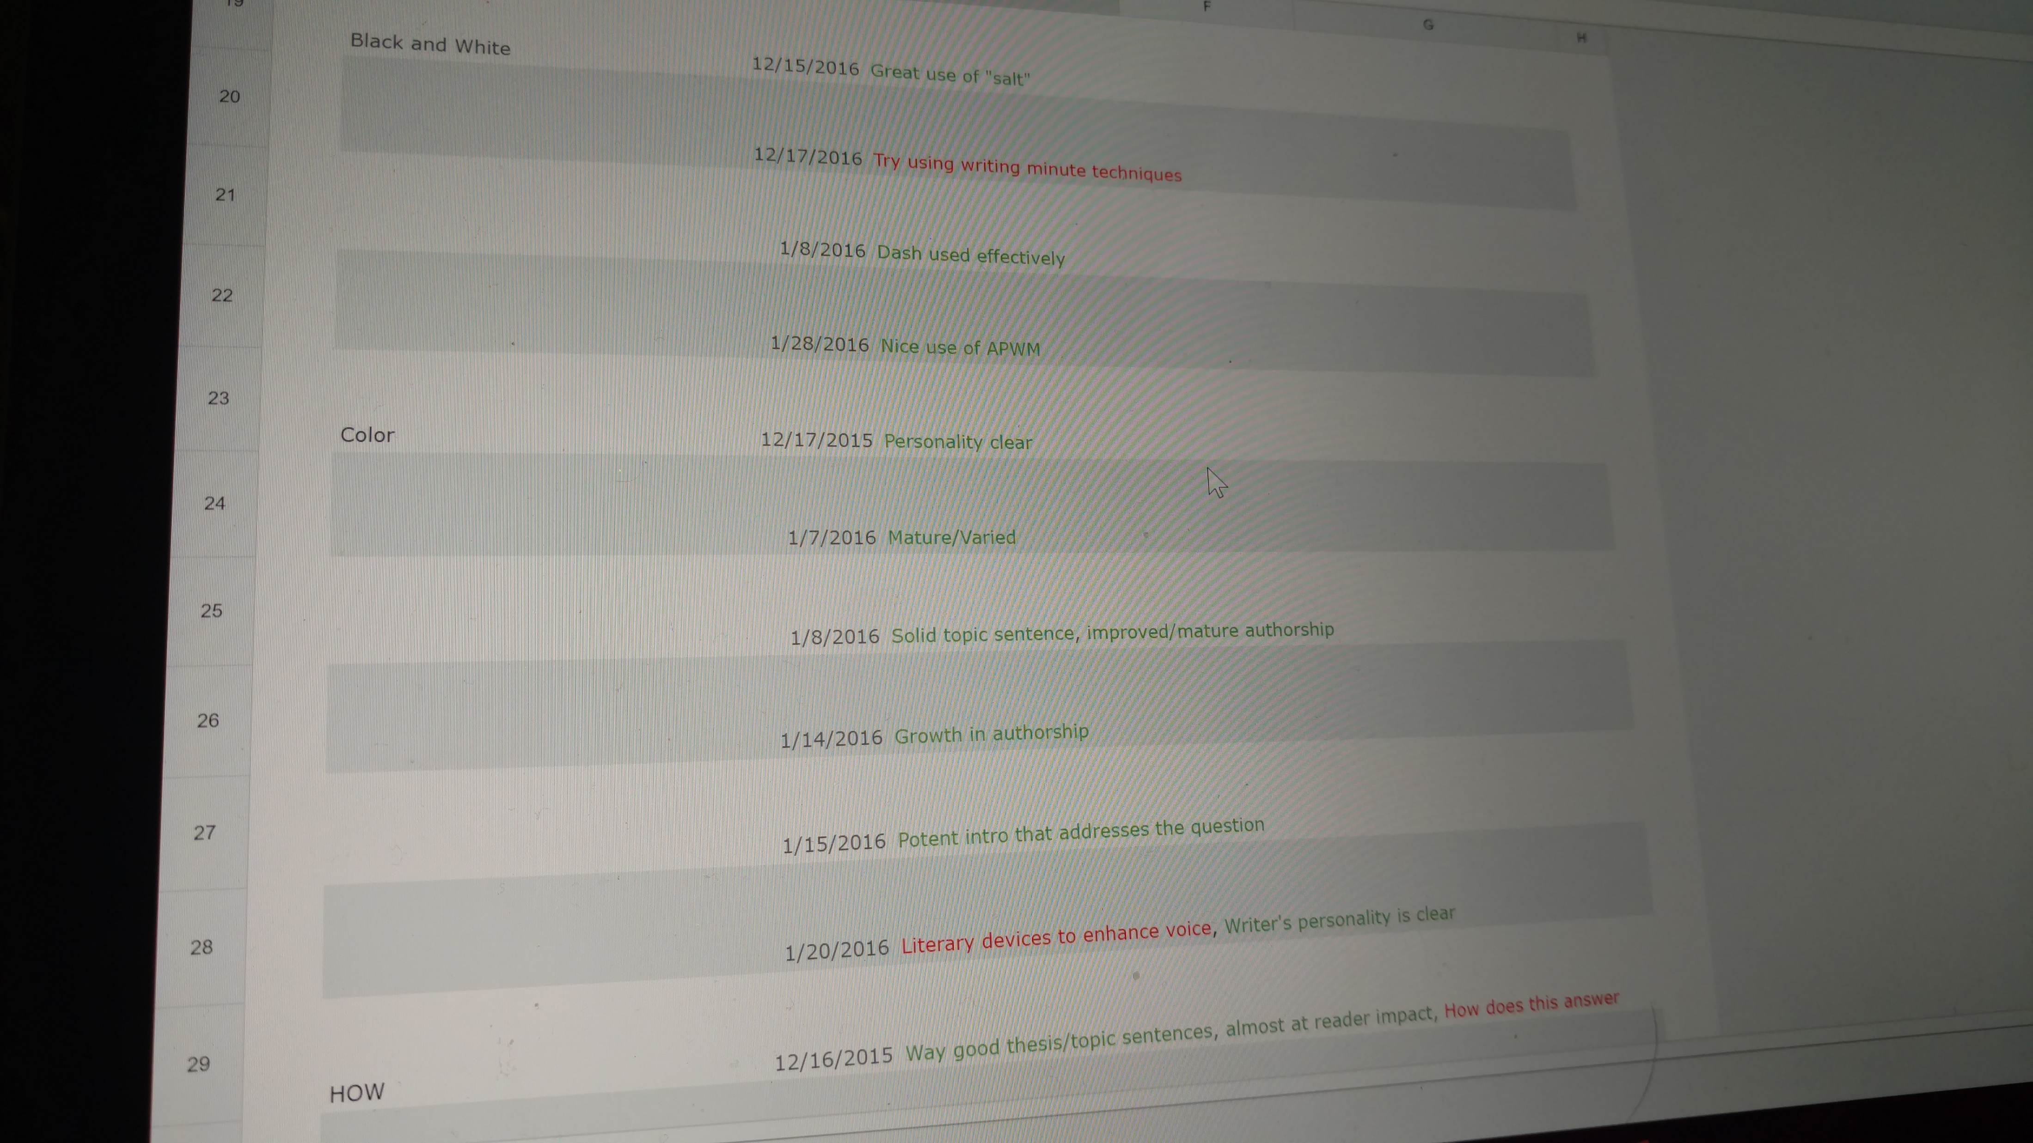
Tri 2

Slide 10
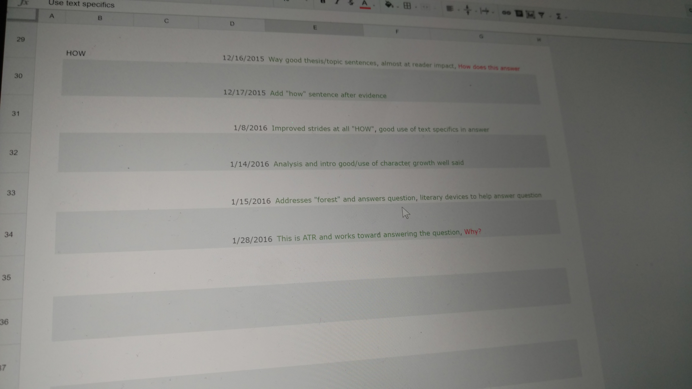
Tri 2

Slide 11
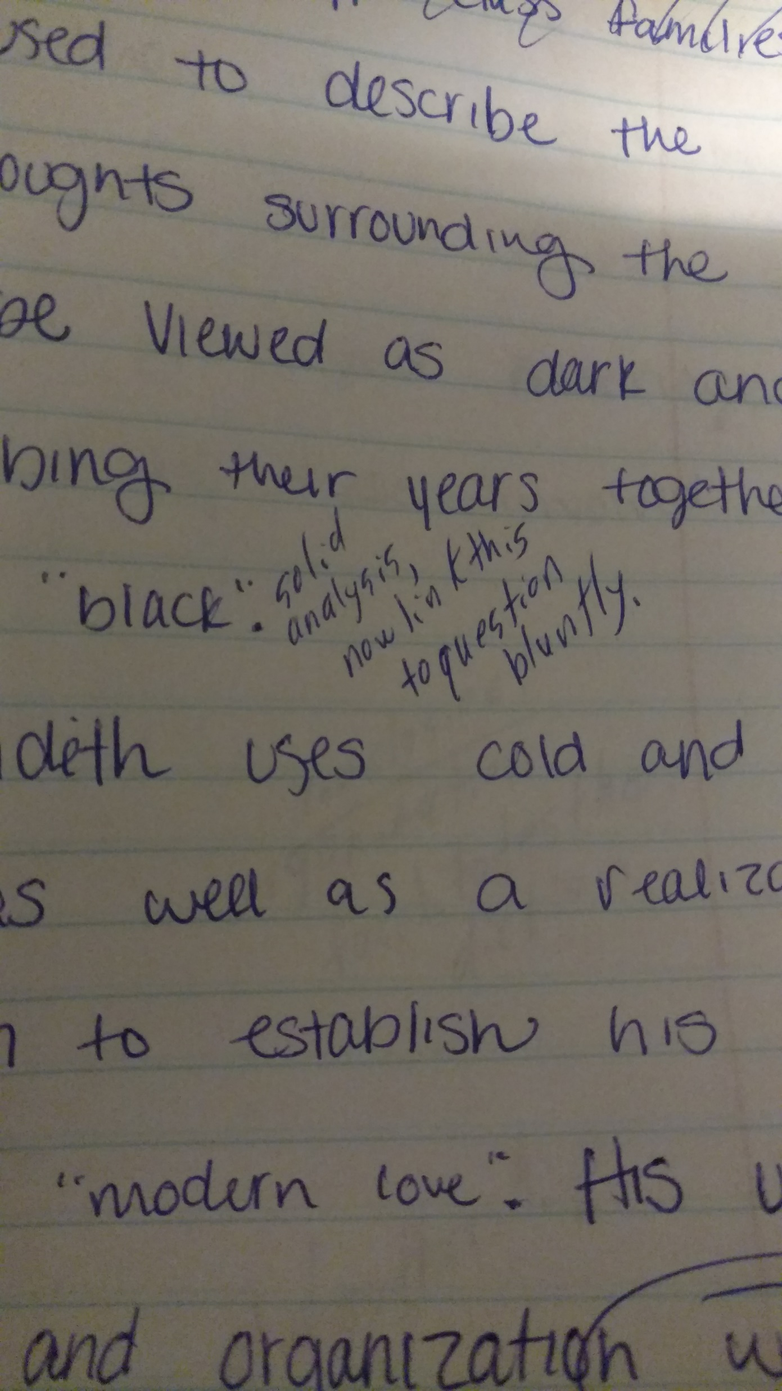
End of Tri 2

Slide 12
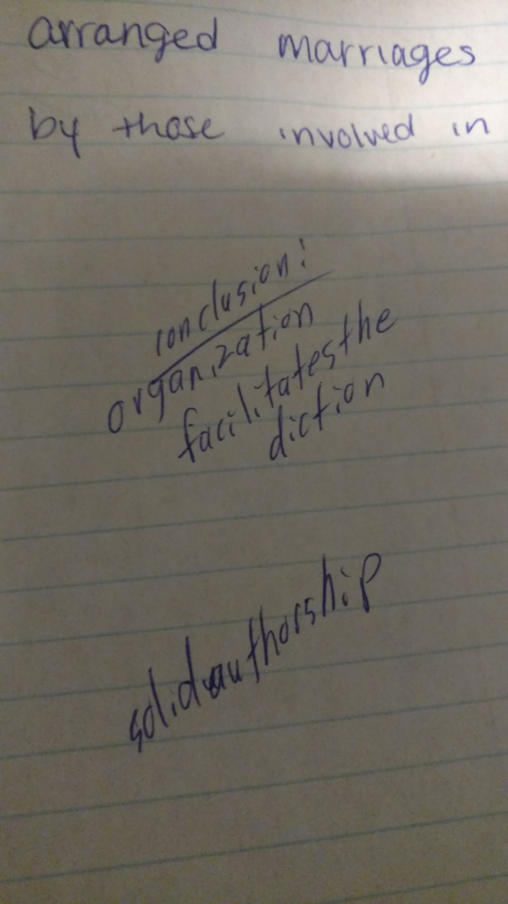
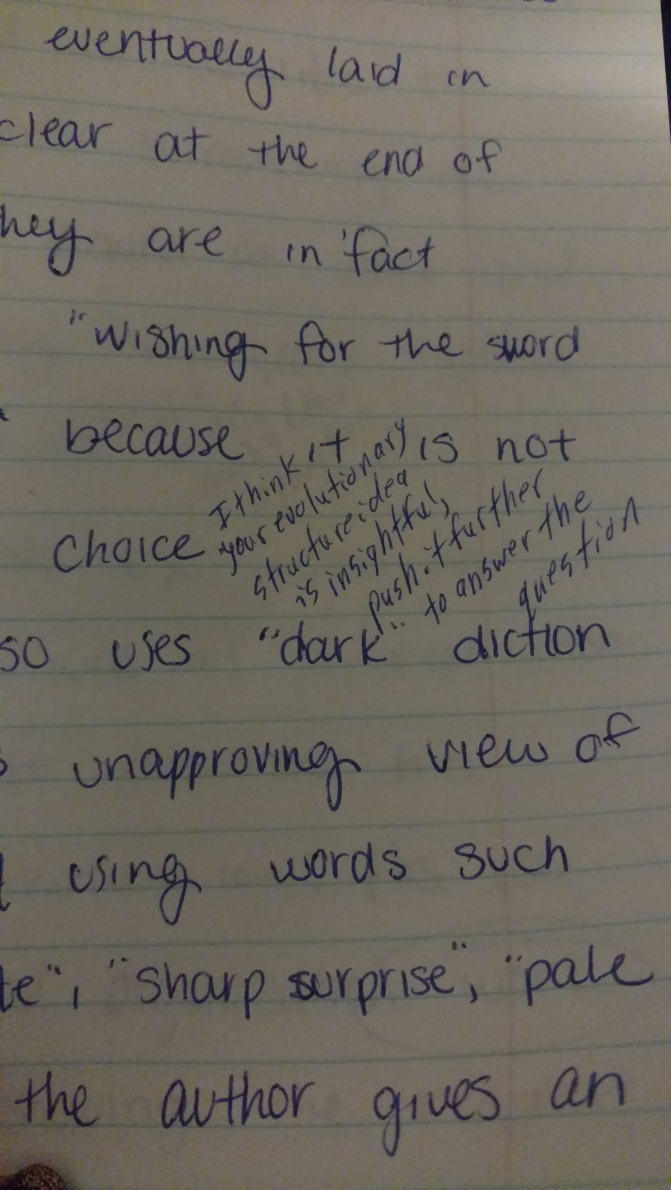
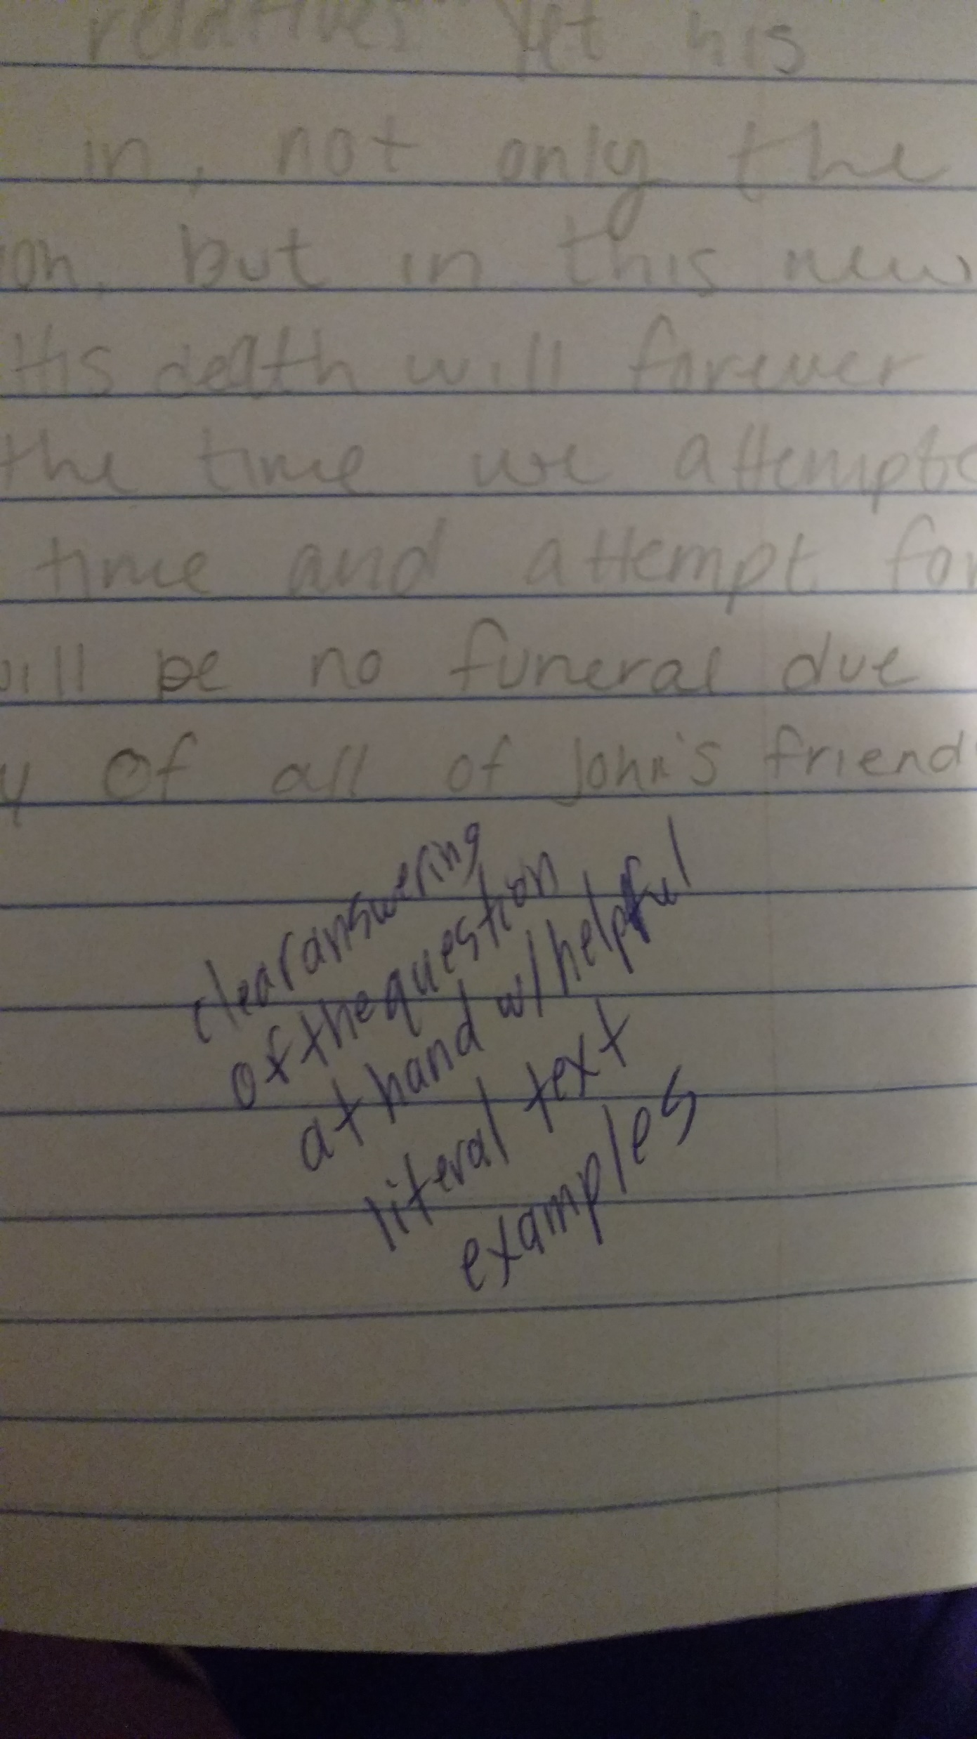
Tri 3

