Slide 1
Pechakucha
A year of Feedback and Growth
By: Emily Andrews

Slide 2
- Literal Compression - Figurative analysis - Understanding text as a whole - Answering the question - Black and white - color
Presentation Layout:

Slide 3
Literal Comprehension:
Trimester 2: Lit Circle Sheet
Trimester 2 (later): Echo Essay
-Lack of details to details
- But not ties to TAW

Slide 4
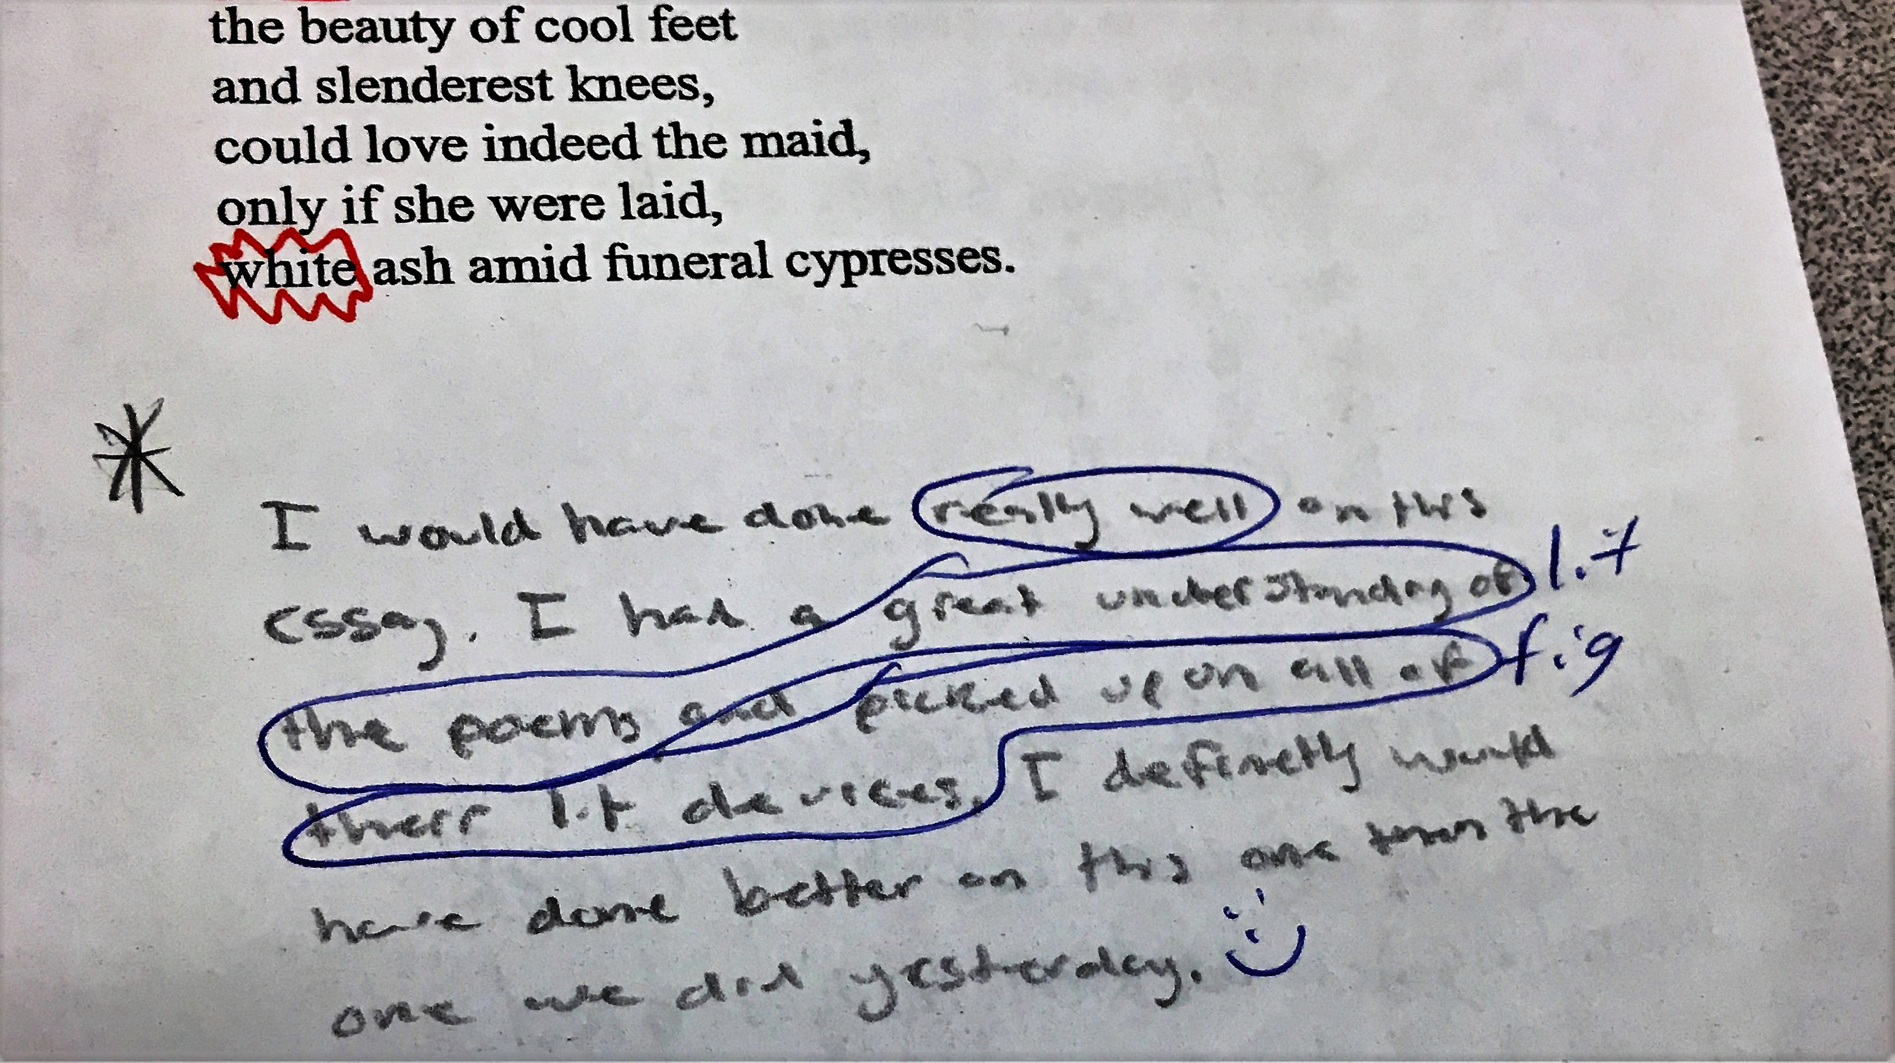
Literal Continued…
-Basic understanding
- “I know literally what’s happening”
-Understanding used to embody TAW
Trimester 2: Helen poem Analysis
Trimester 3: Sonnet

Slide 5
Figurative
I can see the bigger picture
Uses understanding to show TAW
Can analyze devices
Can explain importance to TAW
Trimester 2 (early): Lit Circle
Trimester 2: Author Paper 3

Slide 6
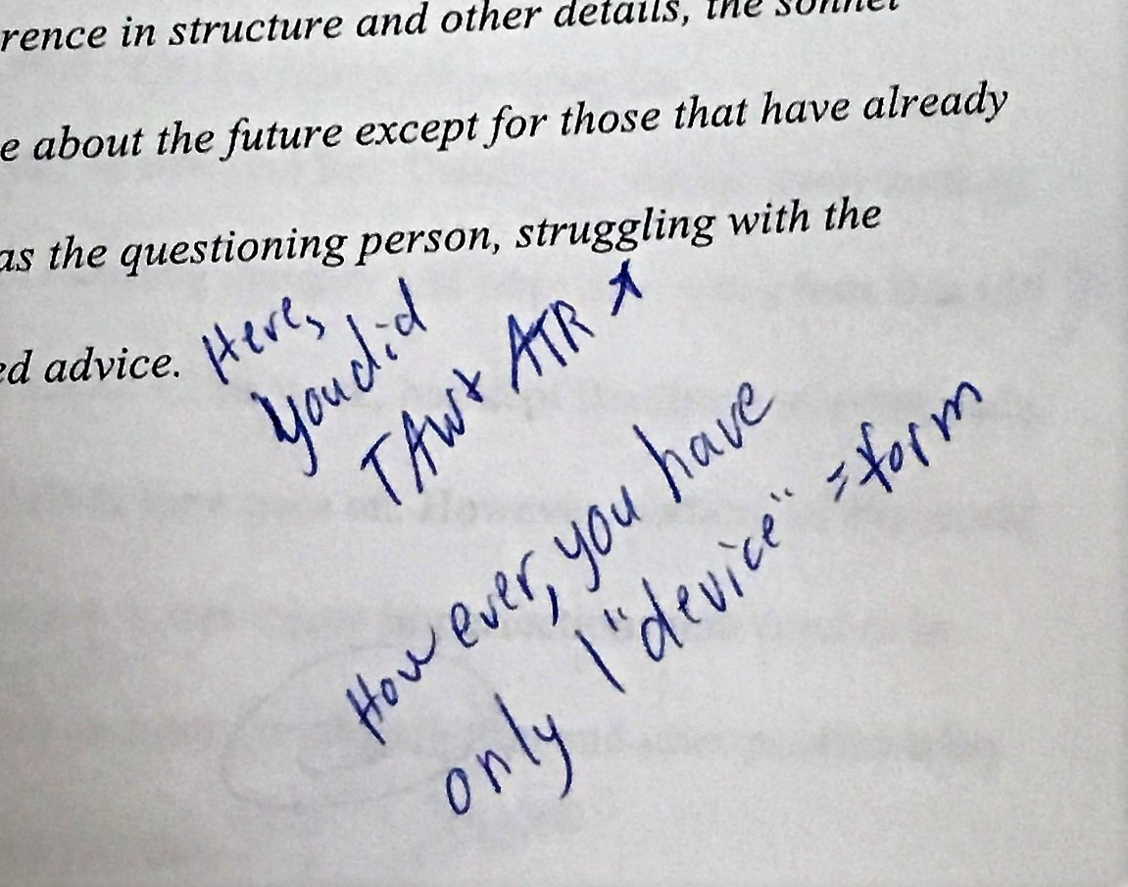
Understanding Text as a Whole
-Always close
-But not quite
-Ask the how/ what/ why three times
Trimester 2: Author paper 3
Trimester 3: Our town summative
TRIMESTER 2: ECHO ESSAY

Slide 7
Answering the Question
To much fluff
Distraction of ideas
Stay on task
What is the question asking?
Trimester 2: Author paper 5
Trimester 2: Estrella Essay

Slide 8
Answering the question continued…
Trimester 3: 5 sentence essay body
Trimester 3: Estrella Essay corrections

Slide 9
Black and white
Not enough focus on the basics
Simple errors
Easy fix
Trimester 2: author paper 5
Trimester 2: compare contrast essay

Slide 10
Color
Needed to step out of comfort zone
Different tricks
Lead of average understanding (3)
Trimester 2 (early): Irp project
Trimester 2: Bless me ultima poem

Slide 11
Color continued…
Added different tricks
Tricks to prove a point
They embody TAW
Trimester 3: epilogues
Trimester 3: our town summative

Slide 12
Overall…
How did it go?
Feedback process
Substantial growth
All tasks were completed
-Final Letter Grade
=A

