Slide 1
Standards Based Learning
Does it work?
Let’s ask the students.

Slide 2
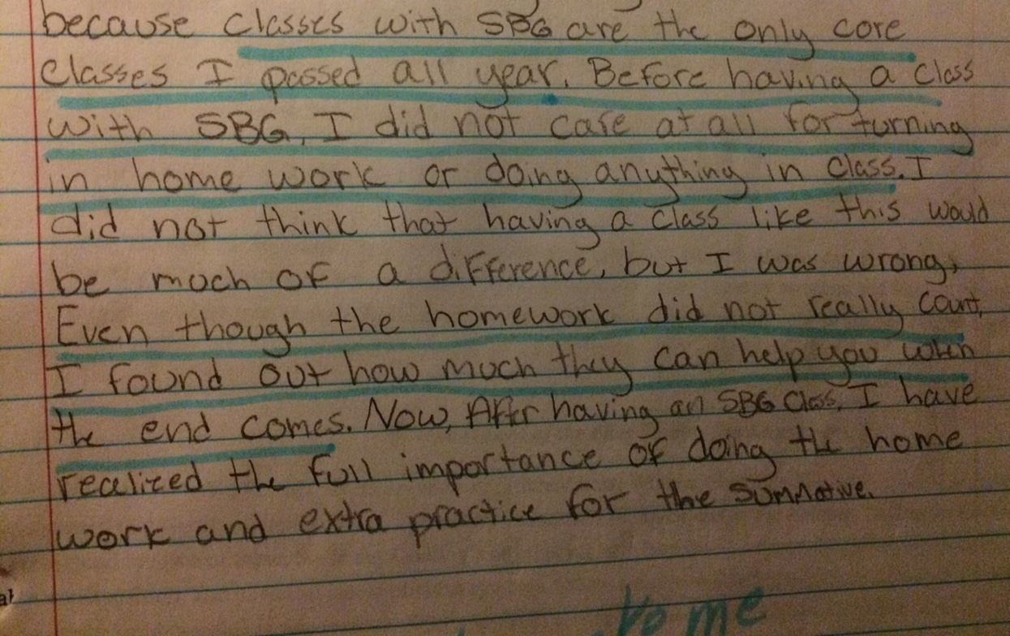

Slide 3
http://www.npr.org/2013/08/28/209559002/taking-a-closer-look-at-milgrams-shocking-obedience-study

